Slide 1
THE DEFENSIVE HOOP

Slide 2
THE DEFENSIVE HOOP
With the ongoing urbanisation a lot of women prefer to work in Tier I-II cities for better wages but their security is a major concern. They face trouble like harassment, kidnapping, molestation or even rape. To provide them security and safeguard their dignity we have come up with a user-friendly idea.
The idea suggests using technology in their daily fashion entities like rings, pendants(not necessarily gold or silver) which can be reliable and easily concealed .The ring and pendant are provided with microchips with specified codes which are connected to a server and is activated through smartphones. User can select a group of people whom can be sent SOS call at time of need and the server will inform the police. The ring is provided with a button on the bottom part which when pressed twice gets activated , turns on the GPS and sends location and SOS call continuously. The pendant on the other hand contains a microcamera which captures pictures of the culprit and sends to the server. It is also activated upon pressing a button. The ring and the pendant are provided with button cell.
For additional security the ring is also provided with a mild electric shock which gets activated on keeping the button pressed for 5 seconds. The users will be provided with a user manual.
The issue that may be faced while electrocuting is that the user should not get electrical shock and should be provided with insulator in the ring and pendant itself.

Slide 3
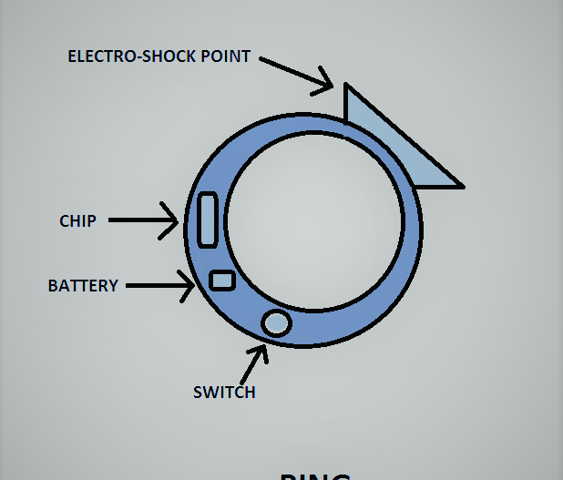
SAFETY RING

Slide 4
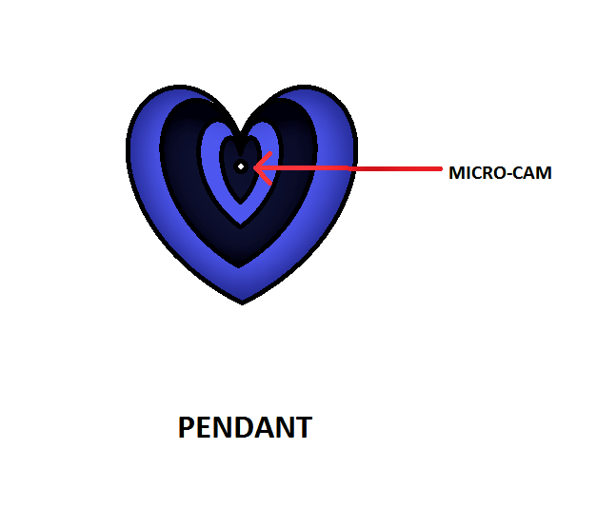

Slide 5
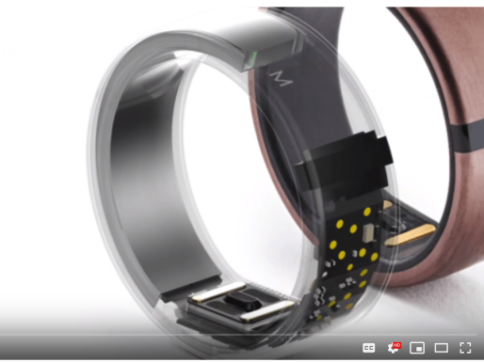
SAFETY RING
Fashion has become an indispensible part of life. Using a ring with technological aid to provide security to user is essential.
The ring comes with an inbuilt nano-chip which is programmed that is GPS,SOS alarm enabled and providing electric shock when required.
CONSTRUCTION
The ring is made of either alloys or Carbon Polymer in order to provide insulation to the user.
The ring comes in various sizes.
It is advisable to wear the ring in the strong finger i.e the middle finger instead of the traditional ring finger.
The chip is installed inside it within carbon polymer along with the GPS and all the wiring remain inside the case.
The usb2.0 is provided which can be slided out in order to charge.
The switch is present on the exterior.
The backbone of every smart ring is Bluetooth technology. Bluetooth is a close-range wireless technology that allows any two Bluetooth-enabled devices to communicate with each other as far away as 328 feet (100 meters) . You've probably seen hands-free Bluetooth headsets that let you make cell phone calls without actually holding the phone. Like those headsets, the ring and the pendant contain a Bluetooth chip, which is really a small radio that can transmit signals to the mobile application.
Bluetooth is considered a low-power technology,thus it needs very less battery.

Slide 6
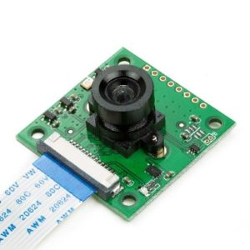
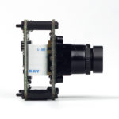
Pendant
The pendant is the other part of the safety system.
It comes with a microcam that is almost concealable is placed at the centre.
Inside of it there exists a microchip that controls the functioning of the microcam.
It has to be worn just as a normal pendant with the camera facing the front enabling to capture pictures.
It starts when the switch is pressed and starts clicking pictures.
Similar to the ring, the device is connected to the server via mobile data on smart phones.
The device is connected to the smart phones via Bluetooth.
In order to recharge an usb is provided on the side which can be slided in and out.
It is provided with an insulated casing like fibreglass, polystrene which will prevent the user frem getting any electric shock.

Slide 7
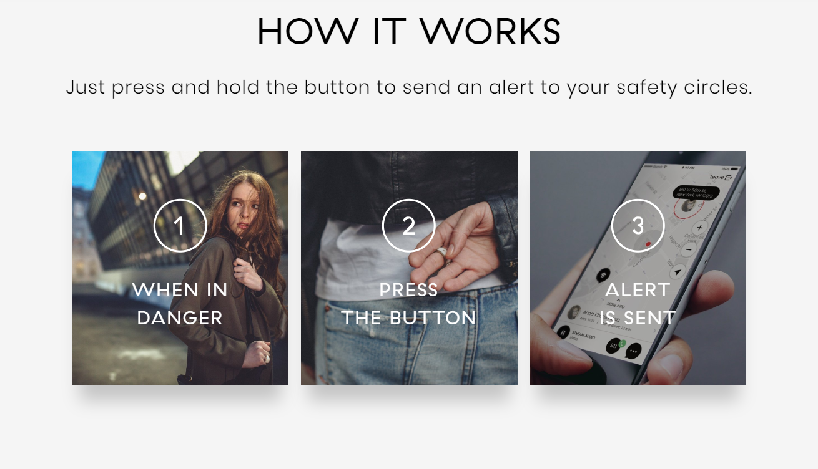

Slide 8
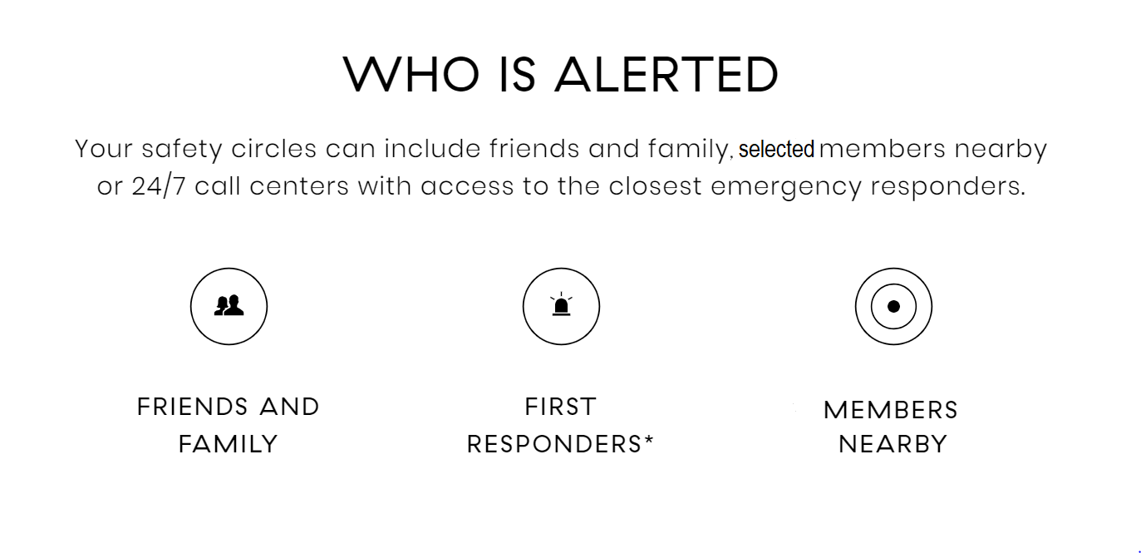

Slide 9
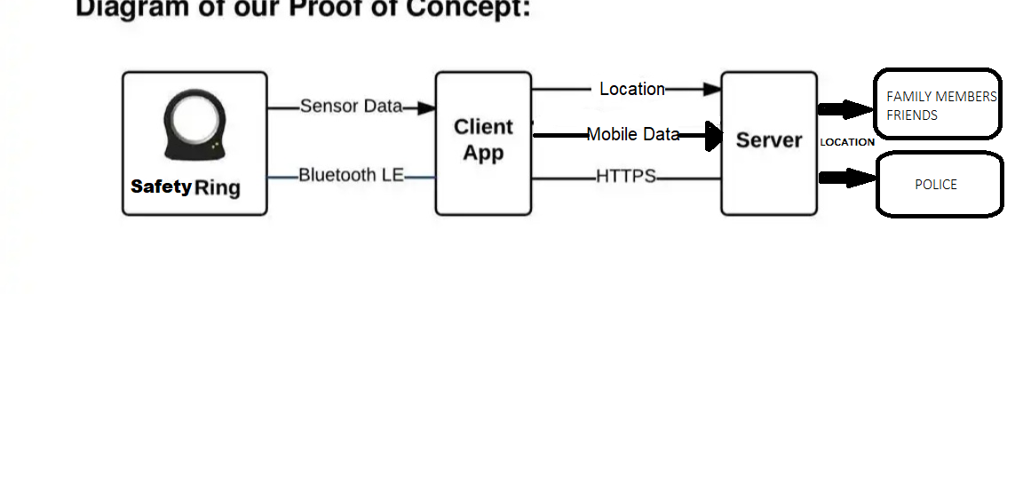

Slide 10
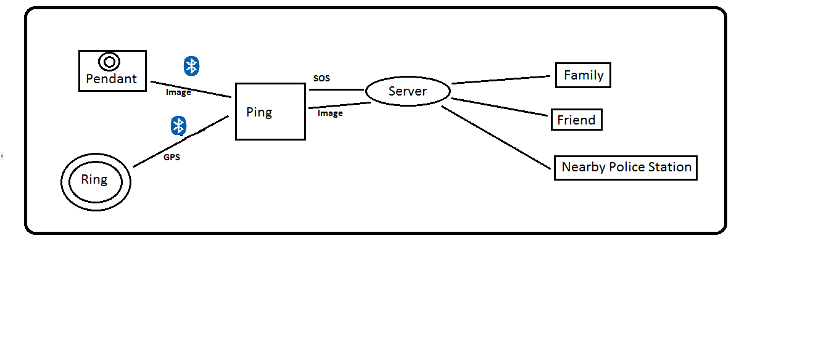
FLOWCHART

Slide 11
MICROPROCESSOR
1. A microprocessor is a computer processor that incorporates the functions of a central processing unit on a single integrated circuit (IC),[1] or at most a few integrated circuits.
2.The microprocessor is a multipurpose, clock driven, register based, digital integrated circuit that accepts binary data as input, processes it according to instructions stored in its memory, and provides results as output.
3.Microprocessors contain both combinational logic and sequential digital logic. They operate on numbers and symbols represented in the binary number system.
4.The integration of a whole CPU onto a single chip or on a few chips greatly reduced the cost of processing power, increasing efficiency.
5. Integrated circuit processors are produced in large numbers by highly automated processes, resulting in a low per-unit cost. Single-chip processors increase reliability because there are many fewer electrical connections that could fail.
The microprocessor is coded via arduino.cc IDE.

Slide 12
APP DEVELOPMENT
The application is the connecting link between the safety devices and the server.
The devices are connected to the application via Bluetooth.
The devices are given distinct codes in order to provide individuality.
By registering the codes on the application on mobile platform,the devices get activated and are ready to use.
The application used for this purpose is built on various programminng languages namely C,C++,Python,Java etc.
The app stores user information and data , receives the signal and sends the predefined message to the selected members when SOS call is given.
Also the images captured by microcam placed in the pendant to the selected contacts and police.

Slide 13
SERVER DEVELOPMENT
The server performs one of the most crucial task.
Server receives data from chip embedded in ring via mobile data on smartphones.
The server acts as the connecting link between the user and the preselected members and the emergency services i.e the Police.
It tracks the user through GPS via the tracker and keeps record of its track from the moment the chip is activated.

Slide 14
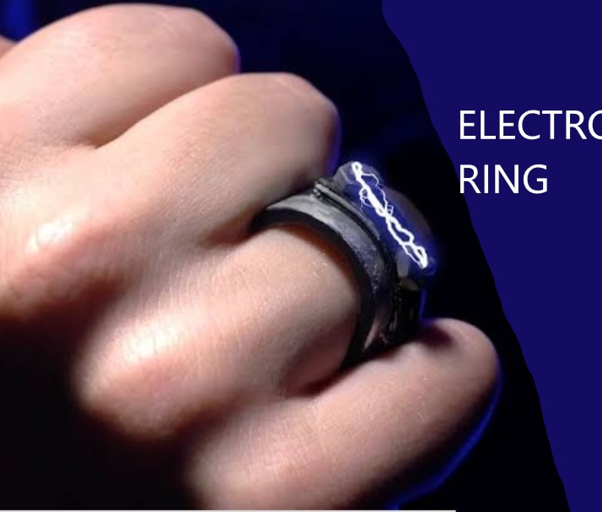
Electric shock giver: the major part
The major part of our project is the electric shock giver ,which will be fitted in the ring.
The SHOCKGIVER gets activated when the button of the ring is pressed for more than 4 seconds.
the shock giver shall only give shock to the culprit , means the user shall be fully electrically insulated and during surprise attack to the culprit,will give time to the user to run away from his sight and hide.
For insulation purpose,we cover the entire device with carbon fibre.
When the button is pressed for 5secs it accumulates charge and releases it as electic shock.

Slide 15


Slide 16


