Slide 1
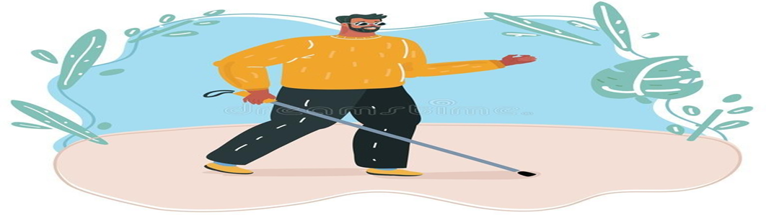
Project Title: Arduino based smart blind stick using ultrasonic sensor
Group: 2
Sec: A
Course Instructor: NADIA NOWSHIN

Slide 2
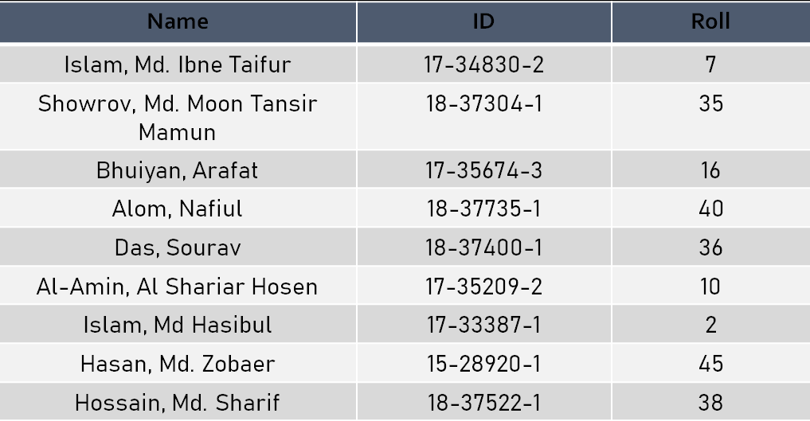
Group No_02

Slide 3
Content
Introduction
Components
Ultrasonic Sensor
Visual Design
Schematic Capture
Applications
Advantages
Disadvantages
Future Scope

Slide 4
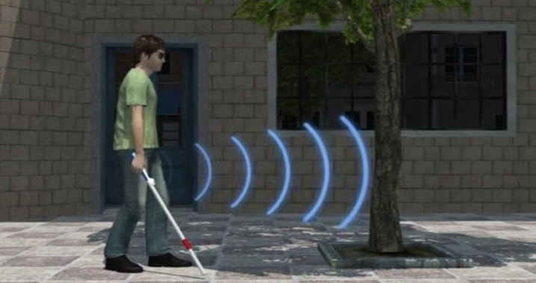
Introduction
Blindness is one of the major disabilities that entire human kind is suffering from all across the world.
In Bangladesh, 750,000 people are suffering from blindness and this number is increasing day by day
with the increasing population. With the rapid advancement of science and technology and our
enormous dependency on technological aspects, we are trying to find a solution of this major problem
for the visually impaired people. Our proposed project called “Arduino based smart blind stick
using ultrasonic sensor” will an effective solution which incorporates latest technology of modern
science with sole purpose of solving the global problem which visually impaired people are
continuously facing in their daily routine.

Slide 5
Components
Grove Ultrasonic Ranger Module
Arduino Buzzer
Arduino Servo
Grove 128x64 OLED display Module

Slide 6
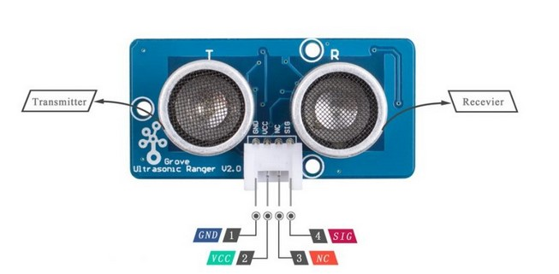
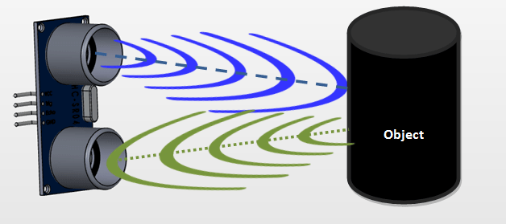
Ultrasonic Sensor
What is Ultrasonic sensor ?
Grove Ultrasonic Ranger.
Grove Ultrasonic ranger features.

Slide 7
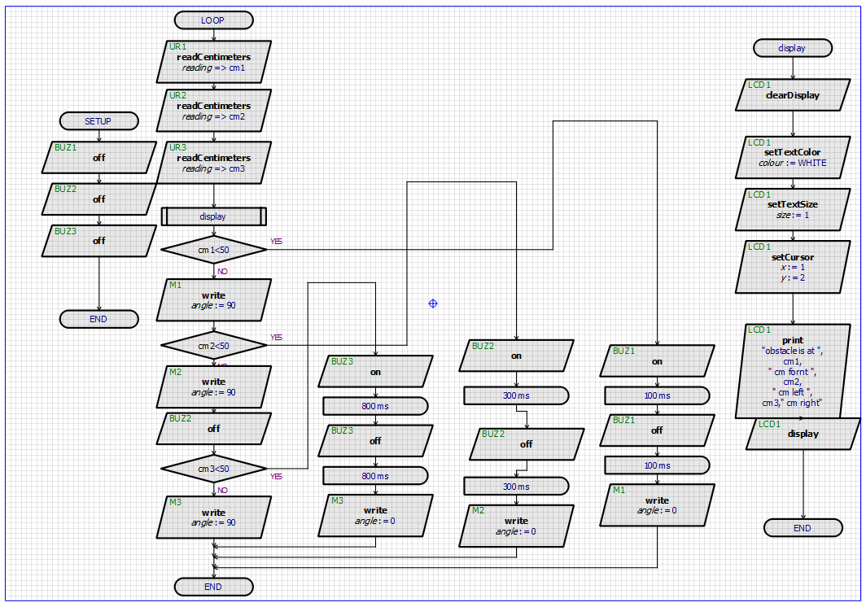
Visual Design

Slide 8
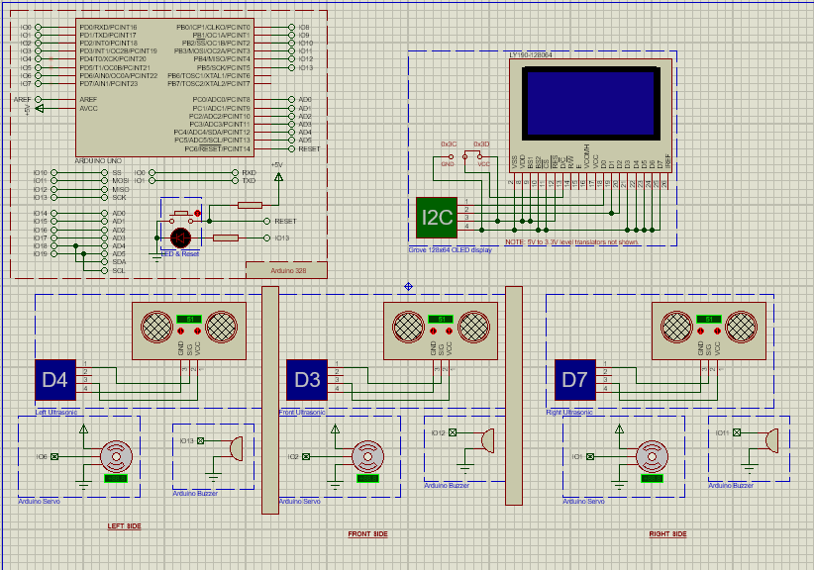
Schematic Capture

Slide 9
Applications
Help people to easily walk to destination
Help blind people to obstacle detection
Alert blind people about dig

Slide 10
Advantages
The system enables the blind people to move with the same ease confidence as sighted people
Since the system is linked with the GSM module it can provide the direction information.
Having feature to left and right turn alarm signal.
Obstacle detection with indication support.
Dig information with indication alarm.
Auto alarming system.
Simple to use.
Less accident will accrued from the blind people.

Slide 11
Disadvantages
Limited & fixed route to follow daily routine.
Till now, GPS can’t attach in it due to 40 meter to change coordinate as to follow the path/ new path.
Little sensor support in these fields
Requires charging of the battery
If charging is not done stick can’t work.
Ultrasonic sensor doesn’t work most of the time.

Slide 12
Future Scope
The smart stick can be further enhanced by using VLSI technology to design the PCB unit. This will makes the system further more compact.
A wall following function can also be added so that the user can walk straight along a corridor in an indoor environment.
GPS can help blind peoples to source & destination route information.
GPS also can help to find the shortest & best path as accordingly to Google/Bing map based on real-time coordinates.
The system can be supplemented with actual GPS MODULE used in cars and we can provide a vibrator for the partially deaf person.

Slide 13
Thank You ☺

