Slide 1
American International University-Bangladesh
TOPIC : Driving system of the lift
Presenter Serial | Name | ID
1 | SADIQ MD IJAJ | 18-37466-1
2 | DAS,SOURAV | 18-37400-1
3 | KUASHA BOSU AKA | 18-37397-1
4 | SUMAITA AFNAN HOSSAIN | 18-37515-1
5 | MD. SHAHADOT HOSSAIN SHANTO | 18-37529-1
Sec: B
Group: 5
SUBMITTED TO :
MEHEDI AZAD SHAWON

Slide 2
Outline of this presentation:
Project Problem
Objective 1
Objective 2
Block Diagram
Flowchart
Simulink Circuit
Output Graph 1
Output Graph 2
Conclusion

Slide 3

Project problem :
A lift is mounted in a 5-story industrial building that can hold N numbers of cartoons in both upward and downward directions.
60 kg is known to be the weight of each cartoon.
A single load resistance, RL = 10 linked to the variable voltage supply
To simulate deriving system of this lift first we need to compare number of cartoons with the voltage output .
Secondly we need to Design a model which can detect the temperature within the lift driving system.

Slide 4
Objective 1:
To simulate a counting system for the lift we need to take the input from step signal.
Then add the values from the step signal.
Calculate total weight by multiplying them with 6o .
Calculating strain on the resistance through equation block.
𝑆 = [1 + 𝑒 (𝑊⁄100) ] × 10−4
At the last we got voltage output according to the weight included.
Lookup table

Slide 5

Objective 2 :
Calcolation of cupper loss
To calculate copperloss calculate current
Formula to convert cupper loss into temperature
Convert tempetayure into kelvin
Thermocouple sencor circuit
Lookup table

Slide 6
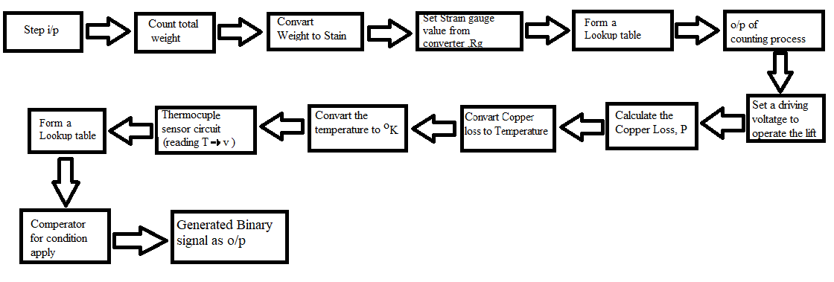
Block Diagram :
Objective 1 Block Diagram:
Objective 2 Block Diagram:

Slide 7
Flow chart:
Start
Flowchart starting
Step Input
According to Floor , No. of cartoons and Weight
Strain Gauge
I/p of stain gauge given by PS converter
W. bridge & Diff amp
Wheatstone Bridge and differential amplifier
O/p volt
Temp. reading
Calculating Voltage output and determining temperature
Given i/p to thermocouple
Thermocouple
Voltage detection
Detecting voltage from Thermocouple
Yes No
Scope
High 1
Temp > 35
Low 0
End

Slide 8

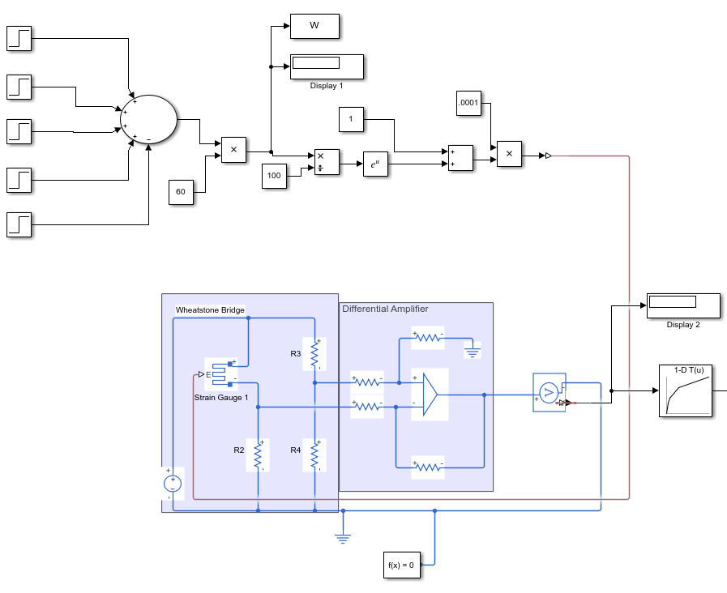


Design of objective 1:

Slide 9
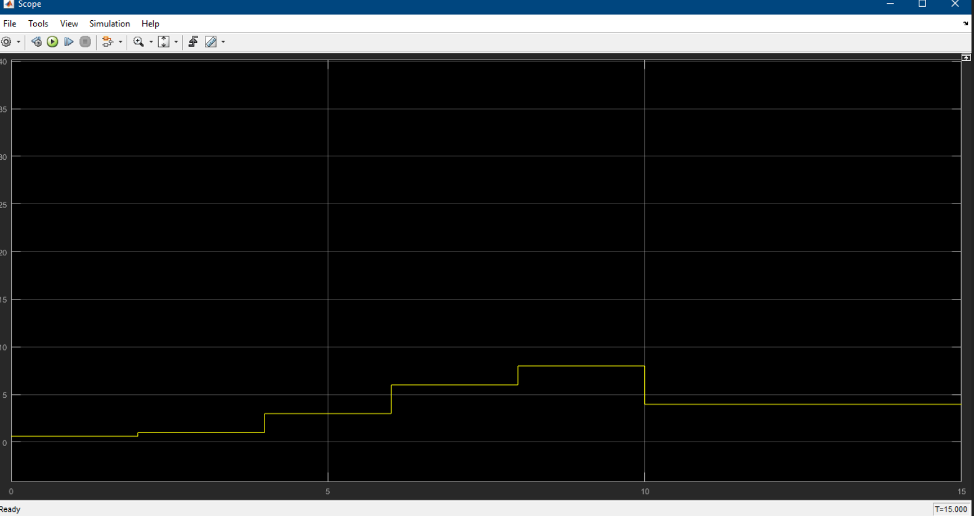
Output graph 1 :

Slide 10
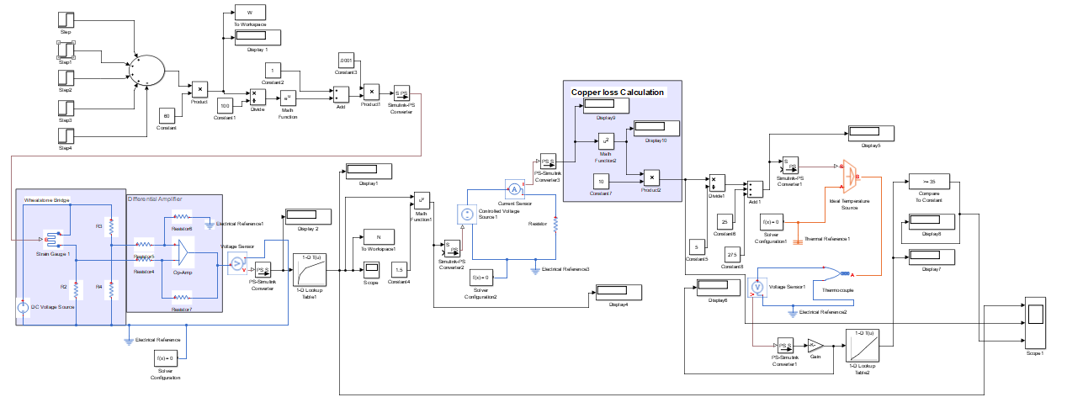
Design of objective 2 :

Slide 11
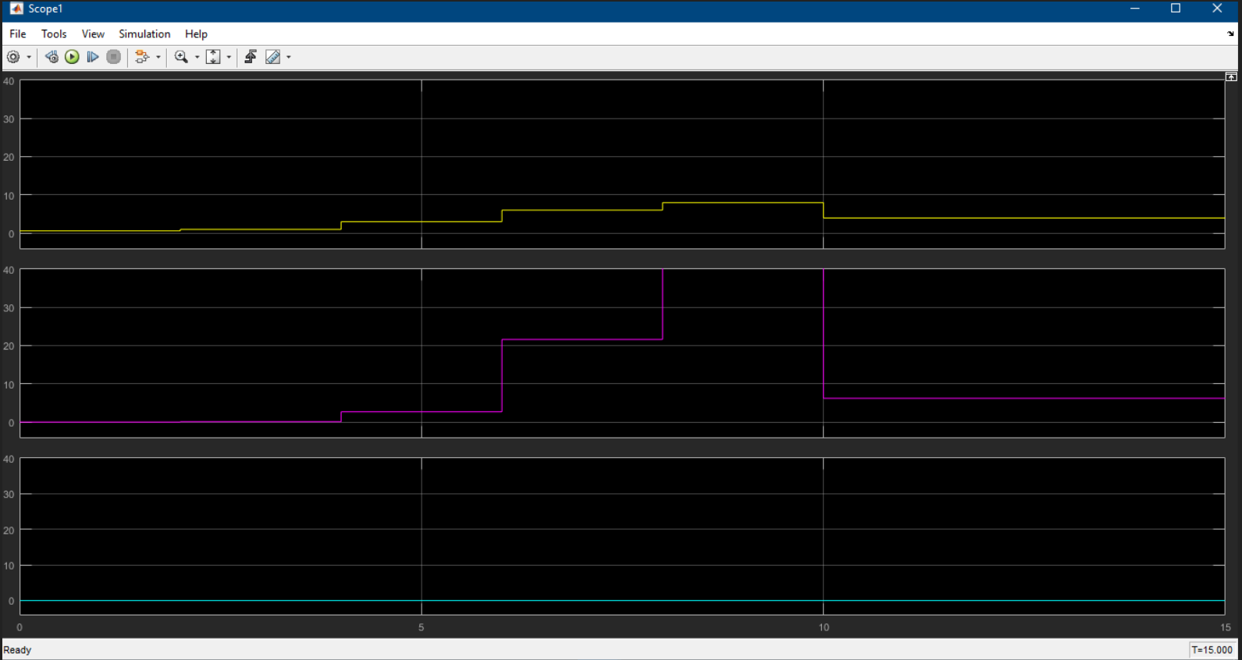
Output graph 2:

Slide 12
Conclussion :
first objective is mainly counting process.
Then the total weight of cartoons placed on the lift floor, there will be a strain on the resistance strain gauge.
systematically added math function, divide, product, and convertor. Then we found cartoon counting system, N (Y-axis) vs Weight (X-axis) on the lift at different times.
The second object is detecting the temperature within the lift driving system.
The two-instrument used for we found out , if the temperature of driving system exceed 35°Cthe output will be 1 (high) otherwise 0 (low) and determine copper loss & binary output signal.

Slide 13

THANK YOU

