Slide 1
American International University-Bangladesh (AIUB)
POWER SYSTEM PROTECTION
Section: D

Slide 2
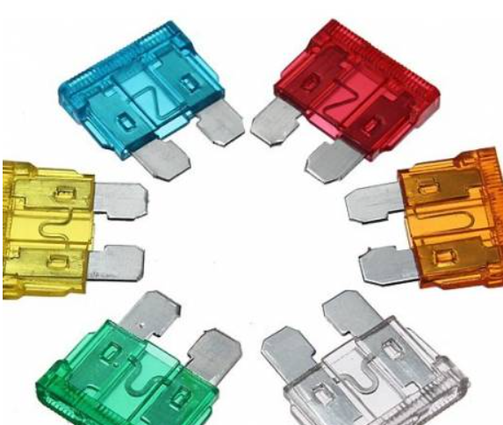
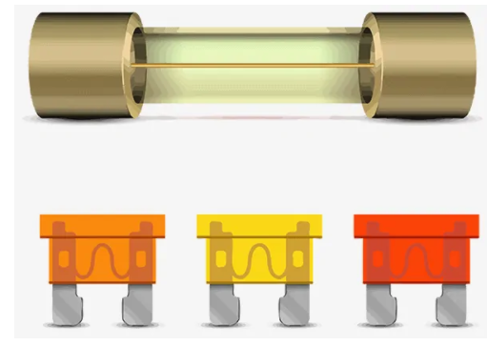
FUSE
Course Instructor: MEHEDI AZAD SHAWON
Group-07
Name | Student ID
Shahadot Hossain Shanto | 18-37397-1
Das, Sourav | 18-37400-1
Ashik Ahamed | 18-37291-1
Moon Md Omur Faruk | 18-37425-1
Shompod Abdullah Al Noman | 18-37416-1

Slide 3
Content
Introduction
Construction
Working Principle
Classification
Comparison between different types of fuse
Application of fuse
Advantage of fuse
Disadvantage of fuse
Conclusion

Slide 4
Introduction
Fuse is an electrical safety device that operates to provide overcurrent protection of an electrical circuit.
It is a sacrificial device; once a fuse has operated it is an open circuit, and it must be replaced or rewired, depending on type.
There are thousands of different fuse designs which have specific current and voltage ratings, breaking capacity and response times, depending on the application.

Slide 5
Construction
A fuse consists of a metal strip or wire fuse element, of small cross-section compared to the circuit conductors, mounted between a pair of electrical terminals, and enclosed by a non-combustible housing.
The fuse is arranged in series to carry all the current passing through the protected circuit.
The resistance of the element generates heat due to the current flow.

Slide 6
Working Principle

Slide 7
Classification

Slide 8
Comparison between different types of fuse
Mainly there are two type of fuse:
DC fuse
AC fuse
AC Fuse
High voltage Fuse
Expulsion Type HRC Fuse
Liquide Type HRC Fuse
Low voltage Fuse
Cartridge Type LV Fuse
Drop-Out Fuse
Switch Type Fuse
Striker Type Fuse
Rewireable Fuse
Cartrdge Fuse
Link Type Fuse
D-Type Fuse
Blade Type Fuse
Bolted Type Fuse

Slide 9
Application of fuse
Motors , Transformers & different distribution lines
Air-conditions
Home distribution boards
General electrical appliances and devices
Laptops
Cell phones
Game systems
Printers
Digital cameras
DVD players
Portable Electronics
LCD monitors
Battery packs
Power convertors

Slide 10
Advantage of fuse
Fuse is cheapest type of protection in an electrical circuit.
Fuse needs zero maintenance.
Operation of fuse is simple and no complexity is involved.
Fuse has the ability to interrupt enormous short circuit current without producing noise, flame, gas or smoke.
The operation time of fuse can be made much smaller than operation of circuit breaker. It is the primary protection device against short circuits.
It affords current limiting effect under short-circuit conditions.
Fuse inverse time current characteristic has the ability to use for over-load protection.

Slide 11
Disadvantage of fuse
During short circuit or overload once fuse blows off replacing of fuse takes time. During this period the circuit lost power.
When fuses are connected in series it is difficult to discriminate the fuse unless the fuse has significant size difference.
The protection of fuse is not reliable.
Low breaking capacity.
Fuse has not protected the circuit against under-voltage.

Slide 12
Conclusion

Slide 13
Reference
https://www.electricaltechnology.org/2014/11/fuse-types-of-fuses.html

