Slide 1

Energy Storage
Renewable Energy Technology

Slide 2
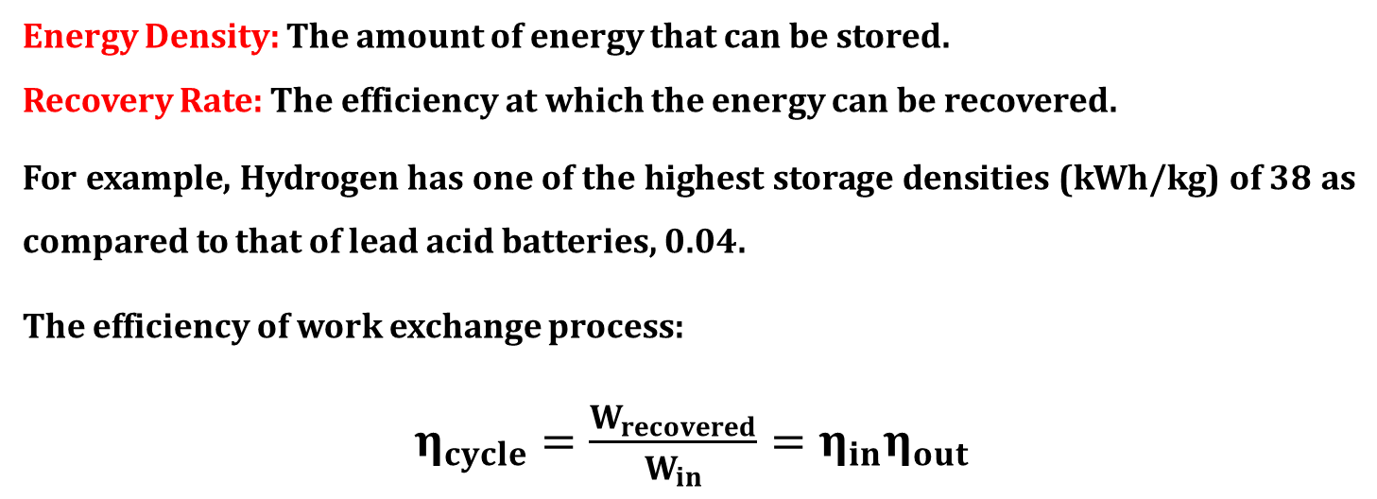
Energy Storage
Storage modes are determined by the particular end-use applications.
Main Parameter:
Energy Density: The amount of energy that can be stored.
Recovery Rate: The efficiency at which the energy can be recovered.
For example, Hydrogen has one of the highest storage densities (kWh/kg) of 38 as compared to that of lead acid batteries, 0.04.
The efficiency of work exchange process:
$η_{cycle}=\frac{W_{recovered}}{W_{in}}=η_{in}η_{out}$

Slide 3
Generic Energy Storage Systems
Electrochemical Systems: Batteries and flow cells
Mechanical Systems: Fly-wheels and compressed air energy storage (CAES)
Electrical Systems: Super-capacitors and super-conducting magnetic energy storage (SMES)
Chemical Systems: Hydrogen cycle (Electrolysis -> Storage -> Power conversion)
Thermal Systems: Sensible heat (storage heaters) and phase change

Slide 4
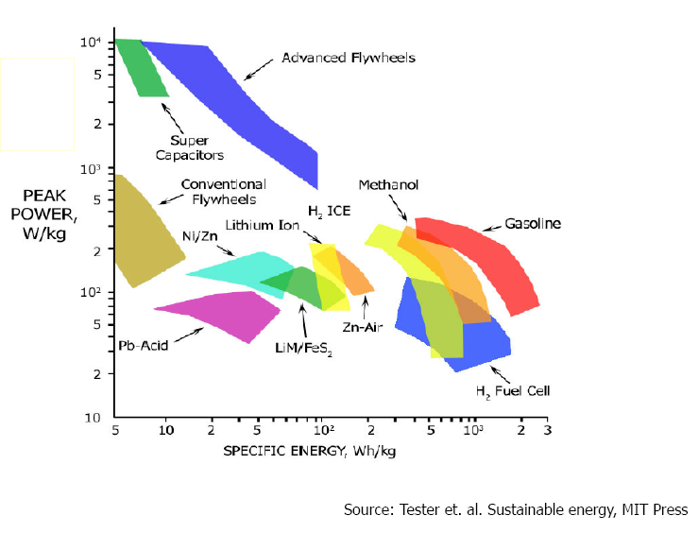
Ragone Plot

Slide 5
Specific Energy
Method | kWh/kg
Gasoline | 14
Lead Acid Batteries | 0.04
Hydro storage | 0.3/m³
Flywheel, Steel | 0.05
Flywheel, Carbon Fiber | 0.2
Flywheel, Fused Silica | 0.9
Hydrogen | 38
Compressed Air | 2/m³

Slide 6
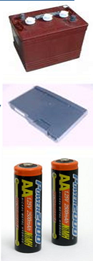
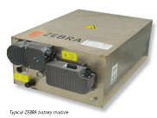
Battery Storage
Conventional Batteries (stationary electrolyte)
• Lead Acid cells – Standard car battery.
• Lithium Ion – Mobile Phone, very good energy density
• Nickel Cadmium – less common, memory problem, toxic content
• Nickel Metal Hydride – good characteristics
• Reusable Alkaline – Less common
• ZEBRA Battery – high temperature sodium/nickel -very robust, good characteristics
Photovoltaic systems
High energy density

Slide 7
Battery Storage
Definitions
Specific Power = power to weight ratio = Watts / Kilogram
Specific Energy = energy capacity to weight ratio = Watt-Hours / Kilogram
Power Density = power to volume ratio = Watts / liter
Energy Density = energy to capacity to volume ratio = Watt-Hours /liter
Example:
1 module with 3,840 W peak power, 1,208 Wh actual energy,
15.8 kg, 260 x 173 x 225 mm = 10.1 liters
Specific Power = 3,840 W / 15.8 kg = 243 W/kg
Specific Energy = 1,208 Wh / 15.8 kg = 76 Wh/kg
Power Density = 3,840 W / 10.1 l = 380 W/l
Energy Density = 1,208 Wh / 10.1 l = 119 Wh/l
Nominal voltage
It is a multiple of cell voltage.
1.2 [V] in Ni-Cd ; 2.0 [V] in Pb
This voltage drops when a load is connected
Capacity
Current intensity the battery is capable to provide during one hour before reaching the discharge voltage.

Slide 8
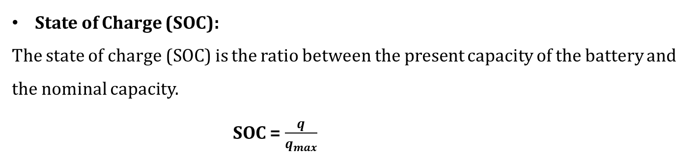
Battery Storage
Definitions
State of Charge (SOC):
The state of charge (SOC) is the ratio between the present capacity of the battery and the nominal capacity.
SOC = $\frac{q}{q_{max}}$
If SOC = 1, then the battery is fully charged; and
if SOC = 0, then the battery is totally discharged.

Slide 9
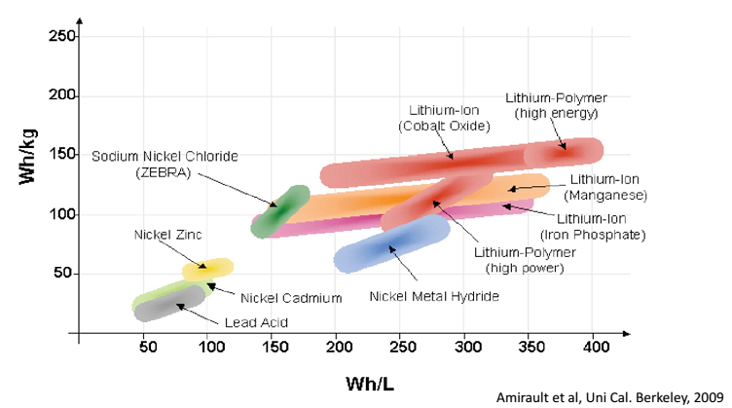
Battery Storage
Comparison of battery types:

Slide 10
Battery Storage
Memory Effect
Also known as battery effect, lazy battery effect or battery memory describes one very specific situation in which certain batteries gradually lose their maximum energy capacity if they are repeatedly recharged after being only partially discharged. The battery appears to "remember" the smaller capacity.
This is an effect observed in certain NICKEL CADMIUM
rechargeable batteries that causes them to hold less charge
Voltage
Voltage
Charge
Charge
Similar phenomena have been reported with Ni-MH batteries.
Li-ion batteries do not suffer from memory effect.

Slide 11
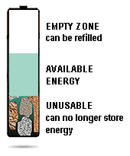
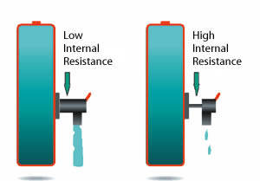
Battery Storage
Declining capacity
The amount of charge a battery can hold gradually decreases due to usage, aging and, with some chemistries, lack of maintenance. Specified to deliver about 100 percent capacity when new, the battery eventually requires replacement when the capacity drops to the 70 or 60 percent level
Internal resistance
A battery with low impedance provides unrestricted current flow and delivers all available energy. A battery with high impedance cannot deliver high-energy bursts due to a restricted path, and equipment may cut off prematurely

Slide 12
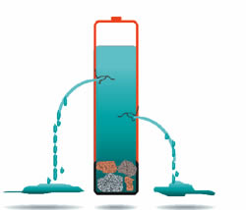

Battery Storage
Self-discharge
A battery may gradually self-discharge as a result of high temperature, high cycle count and age. In older batteries, stored energy may be lost during the course of the day through self-discharge rather than actual use.
Premature voltage cut-off
Some portable devices do not utilize all available battery power and leave precious energy behind.

Slide 13
Battery Storage
Designed for load leveling
Large number of batteries charged during low demand periods
Batteries require environmentally damaging chemicals
Typical installation: Southern California Edison
8000 lead acid battery modules to deliver up to 10 MW of power for four hours of continuous discharge
Performance Factors
Life time (Maximum Number of charge and discharge cycles)
Overall cycle efficiency
Depth of discharge per cycle (deep cycle – less instant energy but longer term energy delivery, e.g. Golf cart battery)
Cost of unit of power or energy stored.

Slide 14
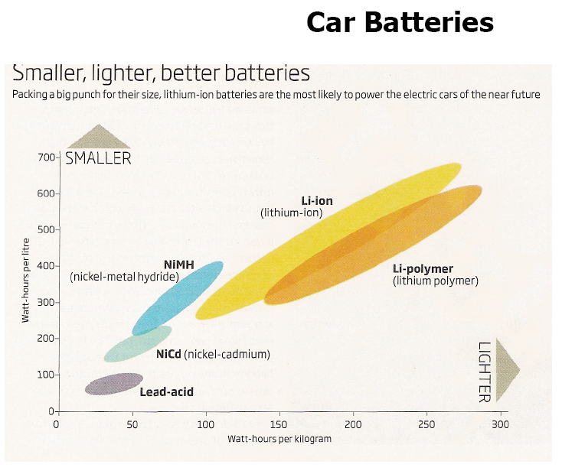
Battery Storage

Slide 15
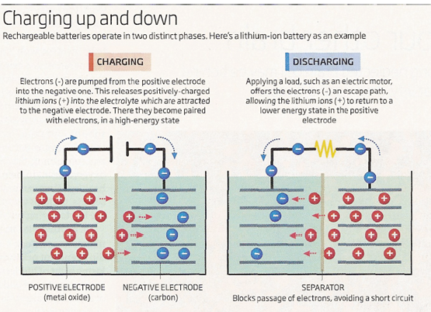
Battery Storage
Li-ion Battery Operation
In many Li-ion batteries, the cathode is made from lithium cobalt oxide.
Replacing cobalt with another metal, Chromium, for example has up to six active electrons compared with cobalt’s maximum of three. This may result in 500 watt-hours per kg.

Slide 16
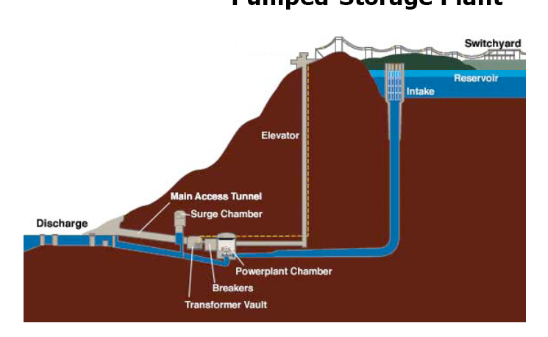
Potential Energy Storage
Pumped Hydropower:
Use excess energy to pump water uphill from a lower reservoir to higher reservoir.
Energy recovery depends on total volume of water and its height above the turbine location.
The efficiency of pumping : 80%
Net efficiency : 0.8 X 0.8 = 0.64
The typical coal power plant efficiency ~ 40%

Slide 17
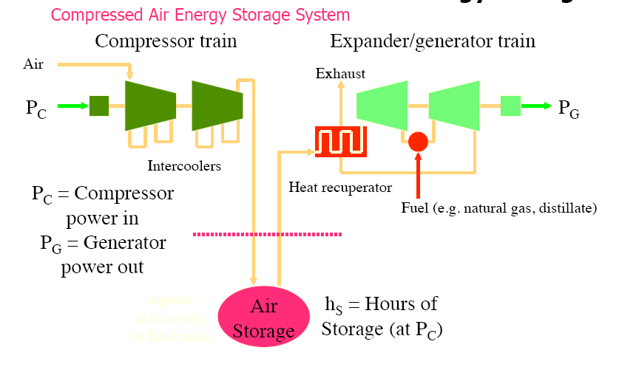
Compressed Air Energy Storage (CAES) System

Slide 18
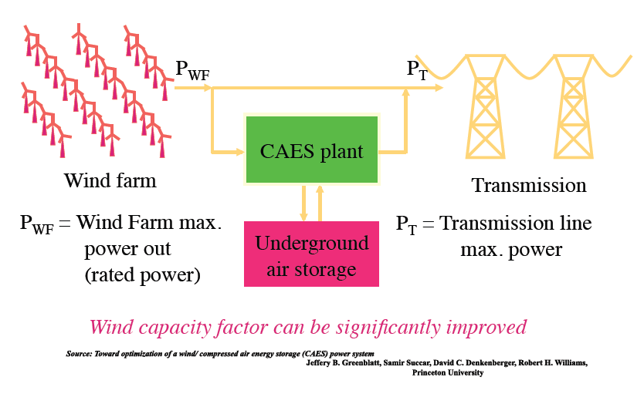
Compressed Air Energy Storage (CAES) System

Slide 19
Flywheels
A flywheel is a mechanical battery storing energy mechanically in the form of kinetic energy.
It uses a electric motor to accelerate the rotor up to a high speed and return the electrical energy by using the same motor as a generator.
The rotational energy is delivered until friction overcomes it.
Flywheel has a higher energy density over chemical energy storage.
The rate at which energy can be exchanged into or out of the flywheel is limited only by the motor-generator design.
Flywheel purchase costs: $ 100 /kW - $300/kW
Installation cost: $20 /kW - $40 /kW

Slide 20

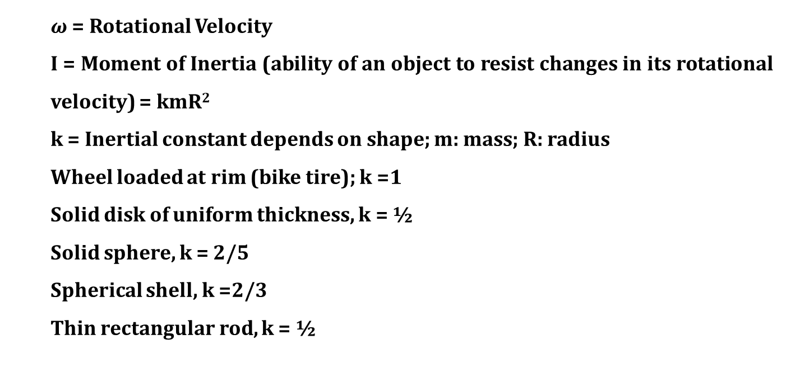
Flywheels
Stored Energy:
$$KE=\frac{1}{2}Iω^{2}=\frac{1}{2}kmR^{2}ω^{2}$$
$ω$ = Rotational Velocity
I = Moment of Inertia (ability of an object to resist changes in its rotational velocity) = kmR²
k = Inertial constant depends on shape; m: mass; R: radius
Wheel loaded at rim (bike tire); k =1
Solid disk of uniform thickness, k = ½
Solid sphere, k = 2/5
Spherical shell, k =2/3
Thin rectangular rod, k = ½

Slide 21
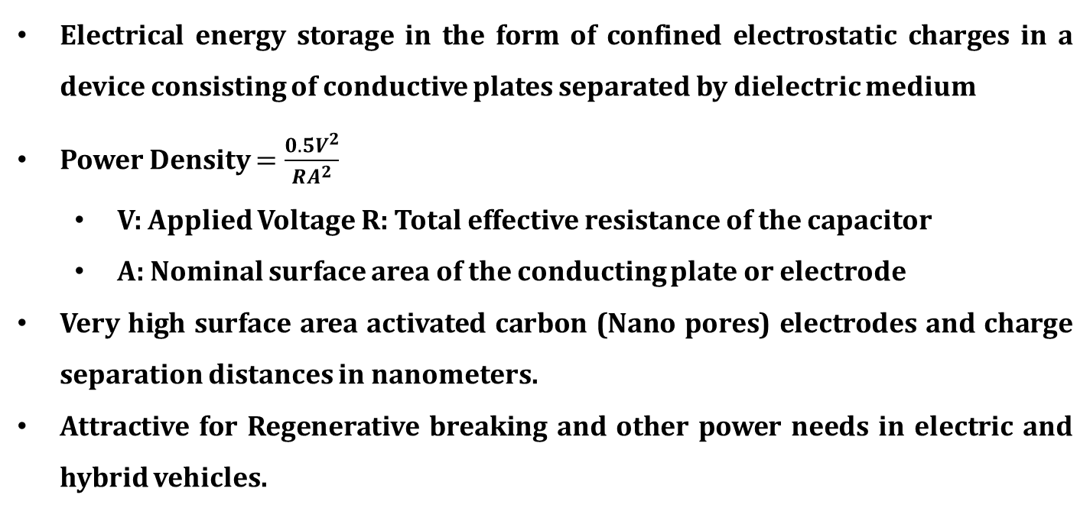
Supercapacitors
Electrical energy storage in the form of confined electrostatic charges in a device consisting of conductive plates separated by dielectric medium
Power Density $=\frac{0.5V^{2}}{RA^{2}}$
V: Applied Voltage R: Total effective resistance of the capacitor
A: Nominal surface area of the conducting plate or electrode
Very high surface area activated carbon (Nano pores) electrodes and charge separation distances in nanometers.
Attractive for Regenerative breaking and other power needs in electric and hybrid vehicles.

Slide 22
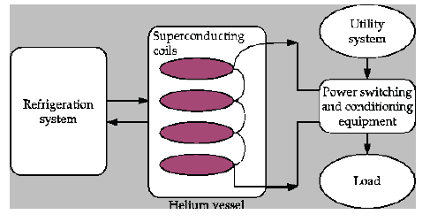
Superconducting Magnetic Energy Storage (SMES)

Slide 23
Superconducting Magnetic Energy Storage (SMES)
A device for storing and instantaneously discharging large quantities of power.
It stores energy in the magnetic field created by the flow of DC in a coil of superconducting material that has been cryogenically cooled.
The SMES recharges within minutes and can repeat the charge/discharge sequence thousands of times without any degradation of the magnet.
Recharge time can be accelerated to meet specific requirements, depending on system capacity.
In low-temperature superconducting materials, electric currents almost no resistance.

