Slide 1

Renewable Energy Technology

Slide 2
Maximum Power Point Tracking (MPPT) of PV Panel

Slide 3
What is MPPT?
MPPT or Maximum Power Point Tracking is algorithm that included in charge controllers used for extracting maximum available power from PV module under certain conditions.
The voltage at which PV module can produce maximum power is called maximum power point (or peak power voltage). Maximum power varies with solar radiation, ambient temperature and solar cell temperature.

Slide 4
How MPPT works?
The major principle of MPPT is to extract the maximum available power from PV module by making them operate at the most efficient voltage (maximum power point).
MPPT is most effective under these conditions:
 | Cold weather, cloudy or hazy days: Normally, PV module works better at cold temperatures and MPPT is utilized to extract maximum power available from them.
 | When battery is deeply discharged: MPPT can extract more current and charge the battery if the state of charge in the battery is lowers.

Slide 5
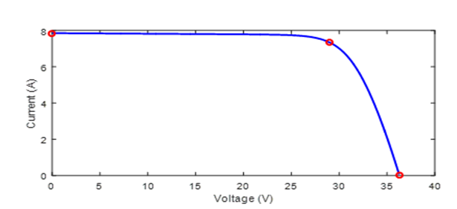
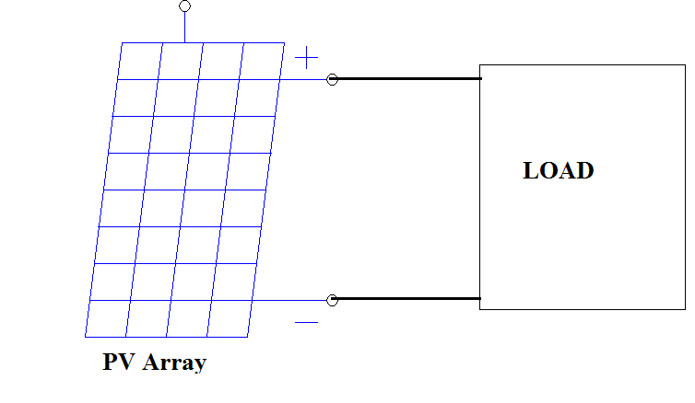
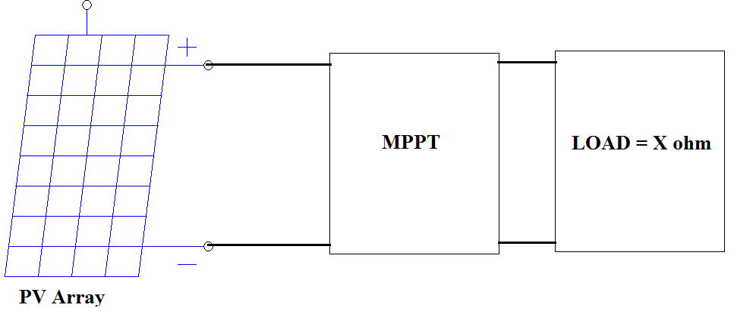

Why do we need MPPT?
B
D
A
P_{max}
We will loose this amount of power
P_{max}
Dr. Md. Rifat Hazari

Slide 6
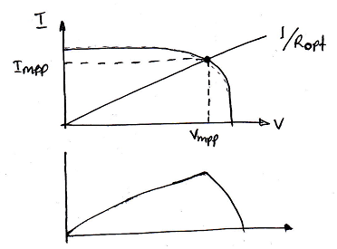

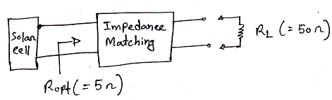

MPPT
$$R_{opt}=\frac{V_{mpp}}{I_{mpp}}$$
According to maximum power transfer theorem,
Let, R_{th} = 5 Ω
Two ways to do this,
Impedance Matching Transformer (Not possible, as solar cell produce DC)
DC-DC converter

Slide 7
MPPT
Examples of DC to DC converter are
MPPT algorithm can be applied to both of them depending on system design. Normally, for battery system voltage is equal or less than 48 V, buck converter is useful. On the other hand, if battery system voltage is greater than 48 V, boost converter should be chosen.
 | Boost converter is power converter which DC input voltage is less than DC output voltage. That means PV input voltage is less than the battery voltage in system.
 | Buck converter is power converter which DC input voltage is greater than DC output voltage. That means PV input voltage is greater than the battery voltage in system.

Slide 8
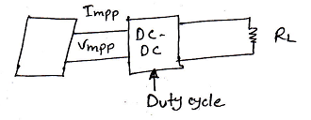
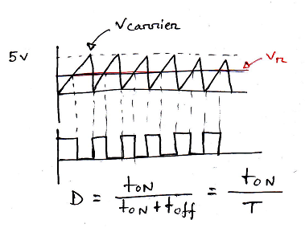

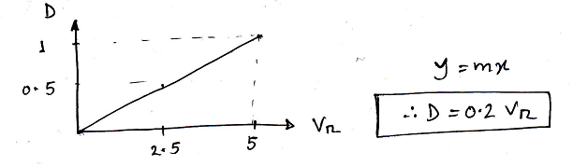
MPPT
DC-DC Converter:
How to vary Duty Cycle:
Equation Relating V_{r} and D:

Slide 9
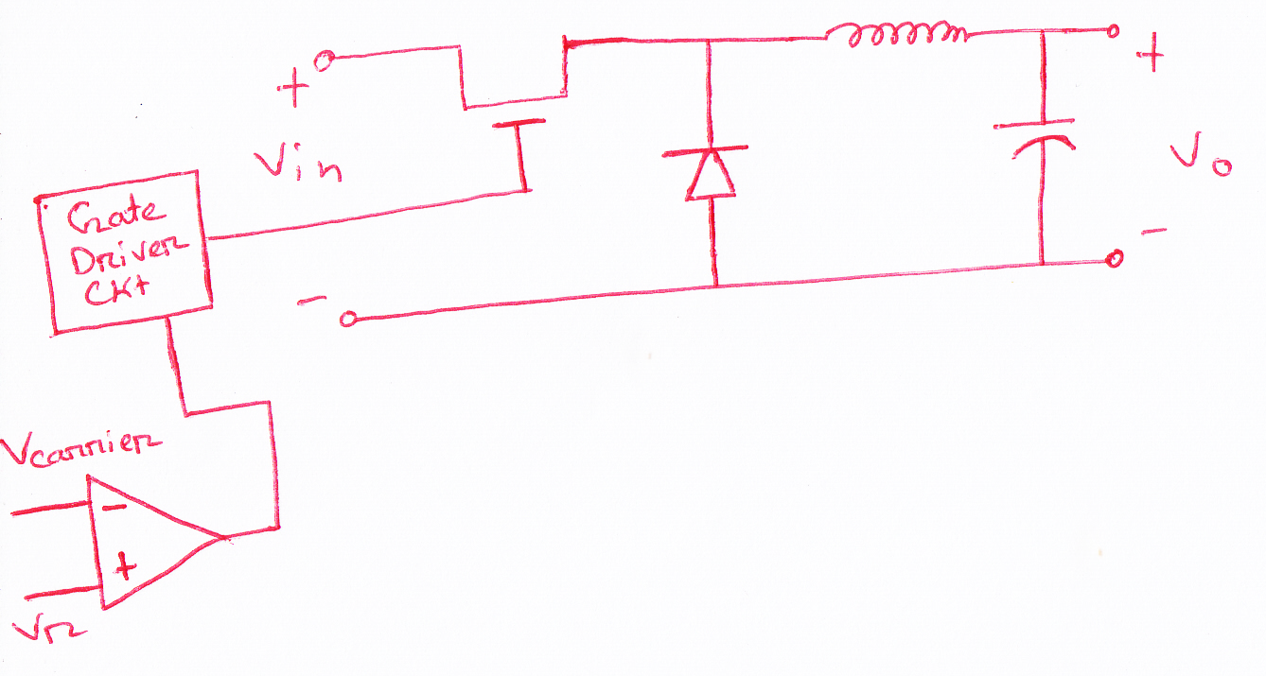
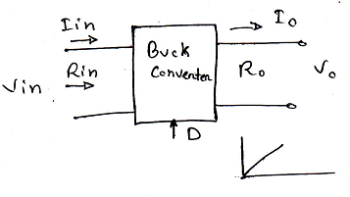



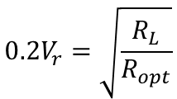

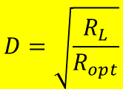





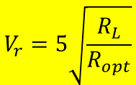
MPPT
Buck Converter:
$$P_{0}=P_{in}$$
$$V_{0}\frac{V_{0}}{R_{0}}=V_{in}\frac{V_{in}}{R_{in}}$$
$$\frac{V_{0}^{2}}{R_{0}}=\frac{V_{in}^{2}}{R_{in}}$$
$$V_{0}I_{0}=V_{in}I_{in}$$
$$\frac{{D^{2}V}_{in}^{2}}{R_{0}}=\frac{V_{in}^{2}}{R_{in}}$$
$$D^{2}=\frac{R_{0}}{R_{in}}=\frac{R_{L}}{R_{opt}}$$
$$V_{0}=DV_{in}$$
$$D=\sqrt{\frac{R_{L}}{R_{opt}}}$$
$$0.2V_{r}=\sqrt{\frac{R_{L}}{R_{opt}}}$$
$$\left[As D=0.2V_{r}\right]$$
$$V_{r}=5\sqrt{\frac{R_{L}}{R_{opt}}}$$
Valid only for,
$$R_{L}≤R_{opt}$$

Slide 10
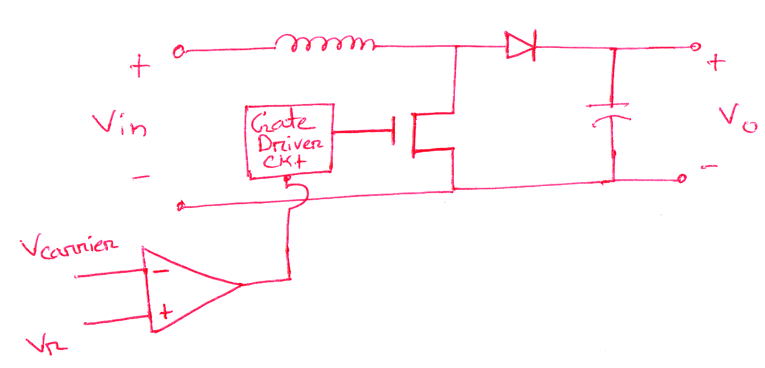


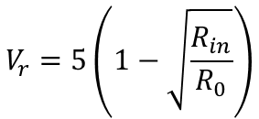
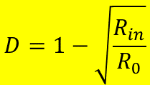


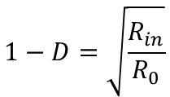

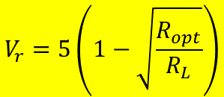



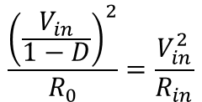
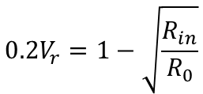


MPPT
Boost Converter:
$$V_{0}=\frac{1}{1−D}V_{in}$$
$$P_{0}=P_{in}$$
$$V_{0}\frac{V_{0}}{R_{0}}=V_{in}\frac{V_{in}}{R_{in}}$$
$$\frac{V_{0}^{2}}{R_{0}}=\frac{V_{in}^{2}}{R_{in}}$$
$$V_{0}I_{0}=V_{in}I_{in}$$
$$\frac{{\left(\frac{V_{in}}{1−D}\right)}^{2}}{R_{0}}=\frac{V_{in}^{2}}{R_{in}}$$
$${\left(\frac{1}{1−D}\right)}^{2}=\frac{R_{0}}{R_{in}}$$
$${\left(1−D\right)}^{2}=\frac{R_{in}}{R_{0}}$$
$$1−D=\sqrt{\frac{R_{in}}{R_{0}}}$$
$$D=1−\sqrt{\frac{R_{in}}{R_{0}}}$$
$$0.2V_{r}=1−\sqrt{\frac{R_{in}}{R_{0}}}$$
$$\left[As D=0.2V_{r}\right]$$
$$V_{r}=5\left(1−\sqrt{\frac{R_{in}}{R_{0}}}\right)$$
$$V_{r}=5\left(1−\sqrt{\frac{R_{opt}}{R_{L}}}\right)$$
Valid only for,
$$R_{L}≥R_{opt}$$

Slide 11
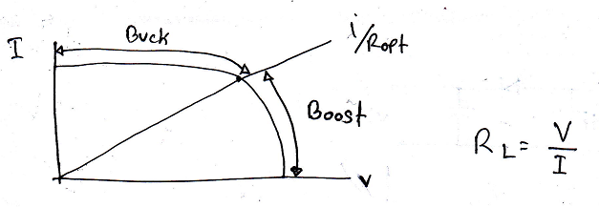
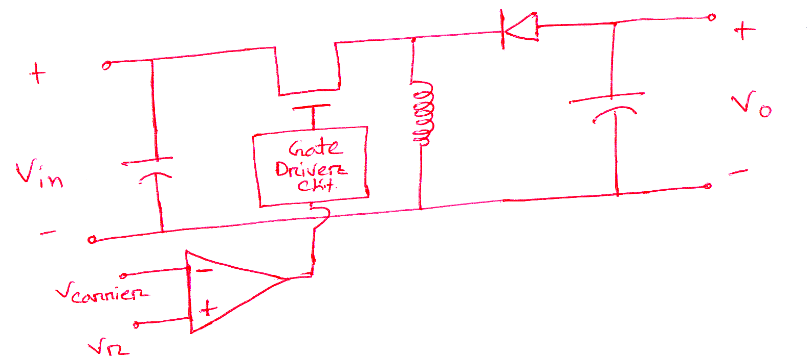

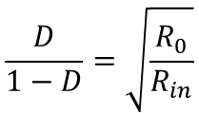
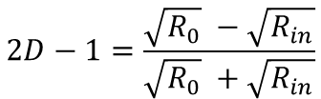


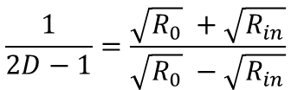
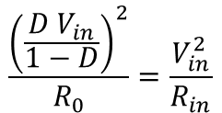
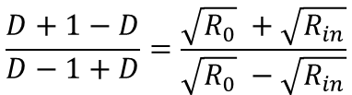


MPPT
Buck-Boost Converter:
$$V_{0}=\frac{D}{1−D}V_{in}$$
D < 0.5 Buck
D > 0.5 Boost
D = 0.5 V₀ = V_{in}
$$P_{0}=P_{in}$$
$$\frac{{\left(\frac{D V_{in}}{1−D}\right)}^{2}}{R_{0}}=\frac{V_{in}^{2}}{R_{in}}$$
$$\frac{D}{1−D}=\sqrt{\frac{R_{0}}{R_{in}}}$$
$$\frac{V_{0}^{2}}{R_{0}}=\frac{V_{in}^{2}}{R_{in}}$$
$${\left(\frac{D}{1−D}\right)}^{2}=\frac{R_{0}}{R_{in}}$$
$$\frac{D+1−D}{D−1+D}=\frac{\sqrt{R_{0}} +\sqrt{R_{in}}}{\sqrt{R_{0}} −\sqrt{R_{in}}}$$
$$\frac{1}{2D−1}=\frac{\sqrt{R_{0}} +\sqrt{R_{in}}}{\sqrt{R_{0}} −\sqrt{R_{in}}}$$
$$2D−1=\frac{\sqrt{R_{0}} −\sqrt{R_{in}}}{\sqrt{R_{0}} +\sqrt{R_{in}}}$$

Slide 12
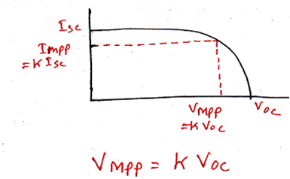


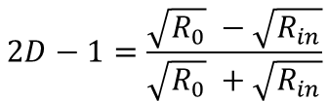

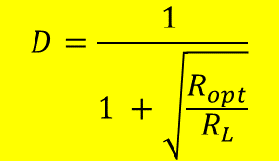

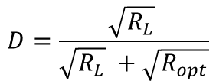
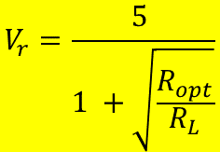
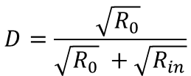
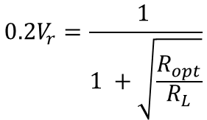
MPPT
Buck-Boost Converter (Contd.):
$$2D−1=\frac{\sqrt{R_{0}} −\sqrt{R_{in}}}{\sqrt{R_{0}} +\sqrt{R_{in}}}$$
$$D=\frac{\sqrt{R_{0}} }{\sqrt{R_{0}} +\sqrt{R_{in}}}$$
$$D=\frac{\sqrt{R_{L}} }{\sqrt{R_{L}} +\sqrt{R_{opt}}}$$
$$D=\frac{1 }{1 +\sqrt{\frac{R_{opt}}{R_{L}}}}$$
$$0.2V_{r}=\frac{1 }{1 +\sqrt{\frac{R_{opt}}{R_{L}}}}$$
$$\left[As D=0.2V_{r}\right]$$
$$V_{r}=\frac{5 }{1 +\sqrt{\frac{R_{opt}}{R_{L}}}}$$
$$R_{L}≥R_{opt}$$
Boost Converter
$$R_{L}≤R_{opt}$$
Buck Converter

Slide 13
MPPT
There are many well established MPPT algorithm. Such as:
Constant Voltage Based Maximum Power Point Tracking
Perturb & Observe
Incremental Conductance etc.

Slide 14
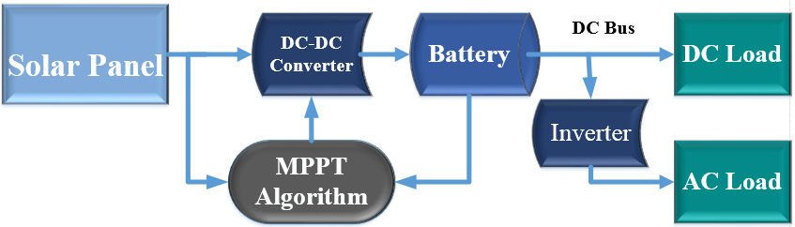
MPPT
General Block Diagram of MPPT with PV system:

Slide 15
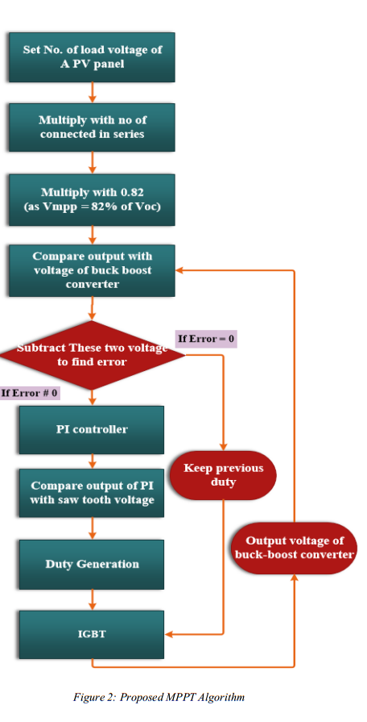
MPPT
Constant Voltage Based MPPT: Algorithm
V_{MPP}=0.82V_{oc}

Slide 16
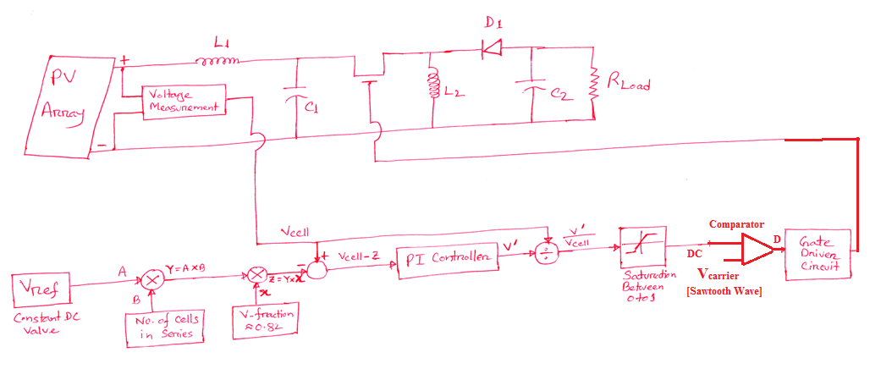
MPPT
Constant Voltage Based MPPT Control Strategy:

Slide 17
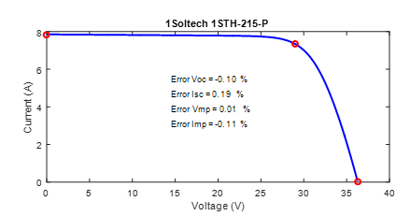
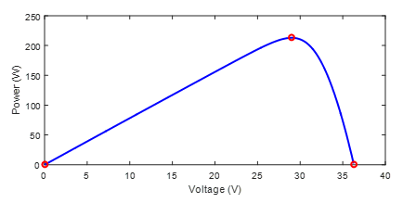
Simulation & Results
I_{mpp}
V_{mpp}
Fig: Rated Output voltage and Power Curve of used PV panel

Slide 18
Simulation & Results
From Fig. : V_{mpp} = 28 Volt, I_{mpp} =7.6 A
As we have used two PV panels in series,
V_{mpp_array} = (28+28)= 56 Volt , I_{mpp_array} =7.6 A
P_{MPP_arry} = (56 X 7.6) = 425.6 W
If the proposed algorithm works then we should get around 425.6 W at the output (for any value of connected load) at rated solar irradiance (1000 W/m²) and temperature (25⁰C)

Slide 19
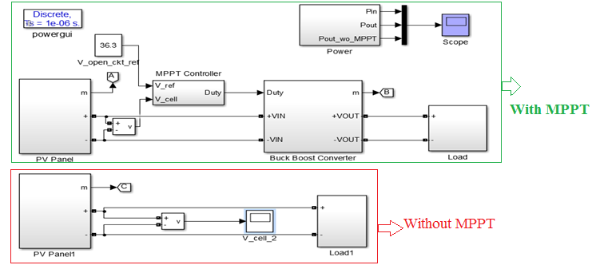
Simulation & Results
Fig: MATLAB Simulink ® Simulation Circuit (Top Level)

Slide 20
Simulation & Results
Fig: Output Power of PV arrays with and without using proposed MPPT algorithm (Solar Irradiance 1000 W/m² and Temp. 25⁰C, Load = 60Ω)
398 W
Output Power Using Proposed MPPT
30W
Output Power without MPPT

Slide 21
Reference
Kalogirou, Soteris A. “Solar energy engineering: processes and systems”, Academic Press, 2009.
Boyle, Godfrey. Renewable energy. OXFORD University press, 2004.
Jain, Sachin, and Vivek Agarwal. "A single-stage grid connected inverter topology for solar PV systems with maximum power point tracking." Power Electronics, IEEE Transactions on 22.5 (2007): 1928-1940.
Reddy, P. Jayarama. Science technology of photovoltaics. BS publications, 2010.
Energy Technology, B.B.Parulekar, S.Rao, Khanna Publishers, India.
J. F. Manwell, Jon G. McGowan, Anthony L. Rogers, “Wind Energy Explained: Theory, Design and Application”, Wiley

