Slide 1
Bioenergy
American International University, Bangladesh
Name: DAS, Sourav
Department: Faculty of engineering
ID:18-37400-1
Subject: renewable energy technology
Sec: A

Slide 2
OUTLINE:
Classification and source of Bio energy
Advantage and Disadvantage
Biodiesel
Biogas
Biomass
Biomass power plant
Conclusion

Slide 3
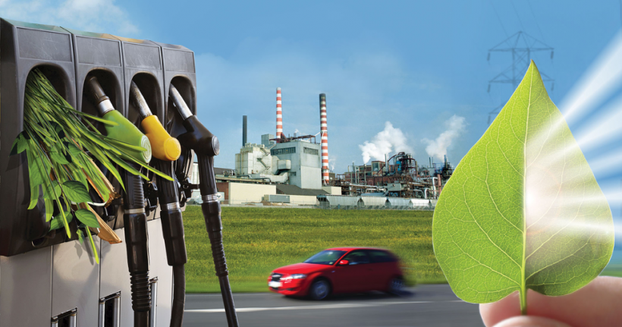
Classification and source of Bio energy:
Biomass is defined as living matter or its residues and is a renewable source of energy .Which energy is generated from biomass is called Bioenergy
Example :
Agricultural and forest residues
Carbonaceous waste
Biodegradable organic affluent from industries

Slide 4
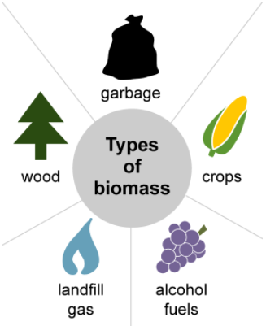
Source of Bio energy:
Wood and wood processing waste
Agricultural crops and waste materials
Biogenic materials in municipal solid waste
Animal manure and human sewage
LFC

Slide 5
Advantage of Bioenergy:
Biomass is always and widely available as a renewable source of energy
It is carbon neutral
It reduces the overreliance of fossil fuels
It is less expensive than fossil fuels
Biomass production adds a revenue source for manufacturers
Less garbage in landfills

Slide 6
Disadvantage of Bioenergy:
Biomass energy is not as efficient as fossil fuels
It is not entirely clean
It can lead to deforestation
Biomass plants require a lot of space

Slide 7
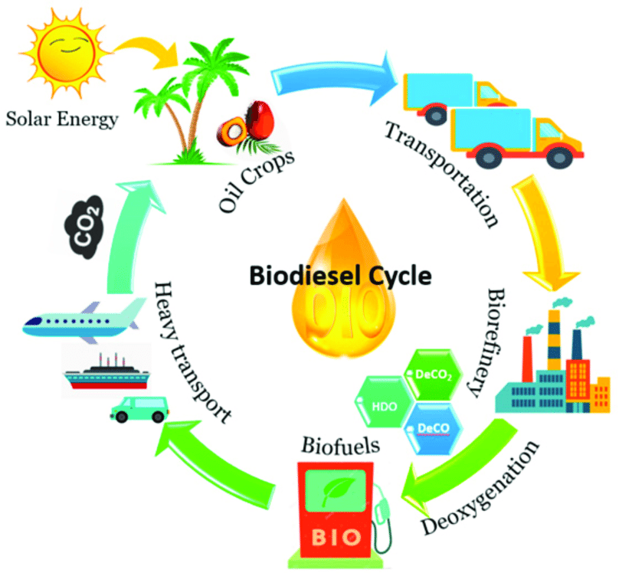
Biodiesel:
Biodiesel is a form of diesel fuel derived from plants or animals and consisting of long-chain fatty acid esters

Slide 8
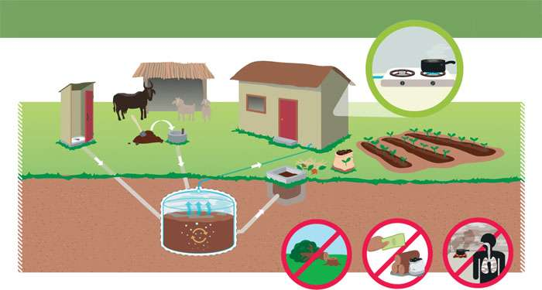
Biogas:
Biogas is the mixture of gases produced by the breakdown of organic matter in the absence of oxygen, primarily consisting of methane and carbon dioxide

Slide 9
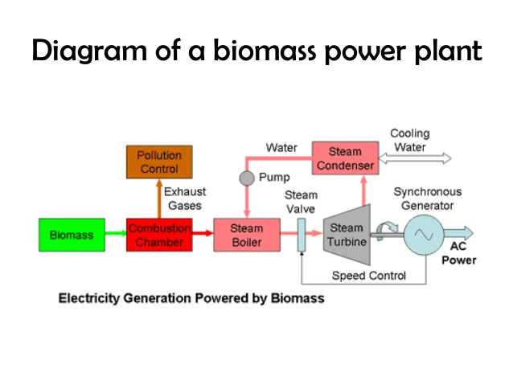
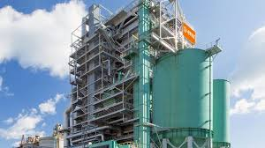
Biomass power plant:
Diagram of Biomass power plant
300MW Biomass power plant in japan

Slide 10
Conclusion:
Clean source of green energy
Eco friendly
Cost efficient

Slide 11
That’s all. Thank you so much

