Slide 1
Tracking Phase, Chemical and Morphological Changes in Co-Fe Oxides for Redox-Based Thermal Storage
Presenter – Chirag Saharan

Slide 2
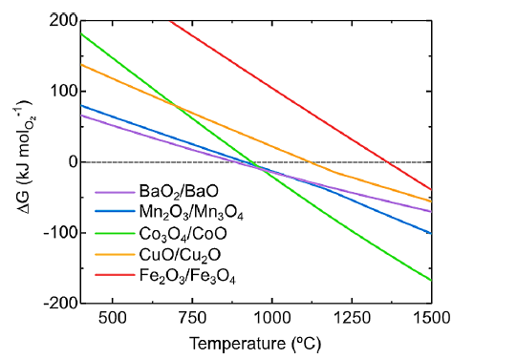
Current Project
Current
Pure Co oxides
Pure CuO
Mixtures –
Co-Cu Oxides
Co-Fe Oxides
Ellingham plot
Ref - Carrillo et al., Chem. Rev., 2019, 119, 4777–4816.

Slide 3
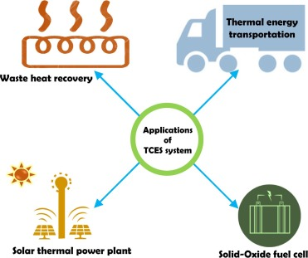
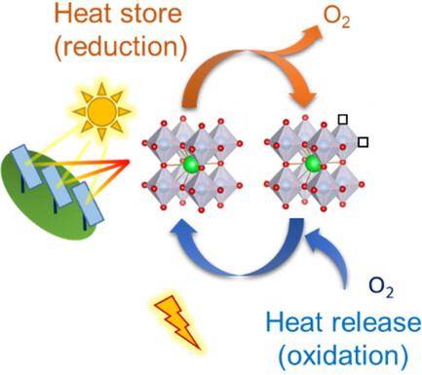
Applications of TCM

Slide 4
Overview of current system
TGA – to have an idea about the reduction/oxidation temperatures and time of the reaction so that we can plan the beamtime accordingly.
ISS – focused on in situ reactions of Co-Fe oxides.
FXI – focused on in situ 2D XANES imaging and Tomography for Co-Fe oxides to get insights on chemicals heterogeneity.
XPD – focused on in situ ramping/cooling and get insights the LT and HT phases.

Slide 5
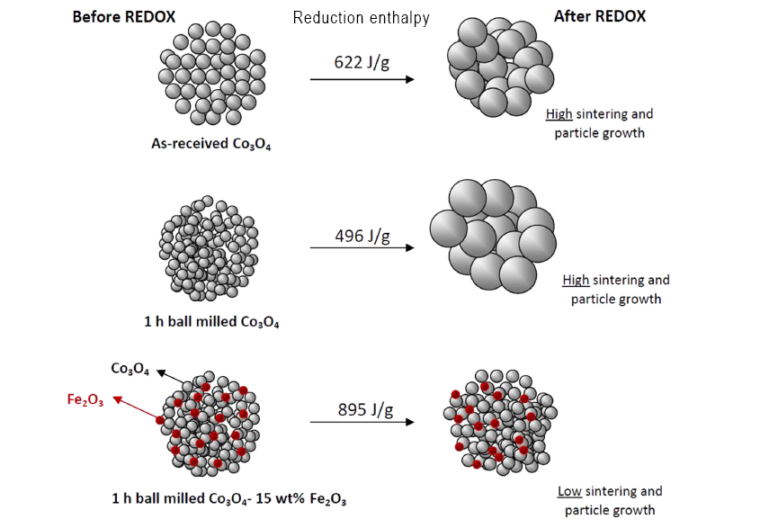
Introduction
Advantages by Fe incorporation –
Cycling stability.
Addresses issues like slow reaction kinetics.
Lower cost than pure Co oxides.
Keeps the energy density almost same.
Reaction reversibility.
Previous Challenges –
Slow reaction kinetics.
Loss of capacity over cycles.
Sintering issues.
Ref. - Block, T., Knoblauch, N., & Schmücker, M. (2014)

Slide 6
Why 10%?
Higher reduction/oxidation reversibility while retaining a high enthalpy of reaction,
10% - minimum % required to make sure Iron is participating,
>10% would reduce the enthalpy content.
Scientific Challenges –
Incomplete conversion of the spinel phase at high Fe contents
The formation of non-stoichiometric monoxide phases, which reduce oxygen storage capacity.
How to improve kinetics? Like mass transfer limitations.
Ref. - Block, T., Knoblauch, N., & Schmücker, M. (2014)

Slide 7
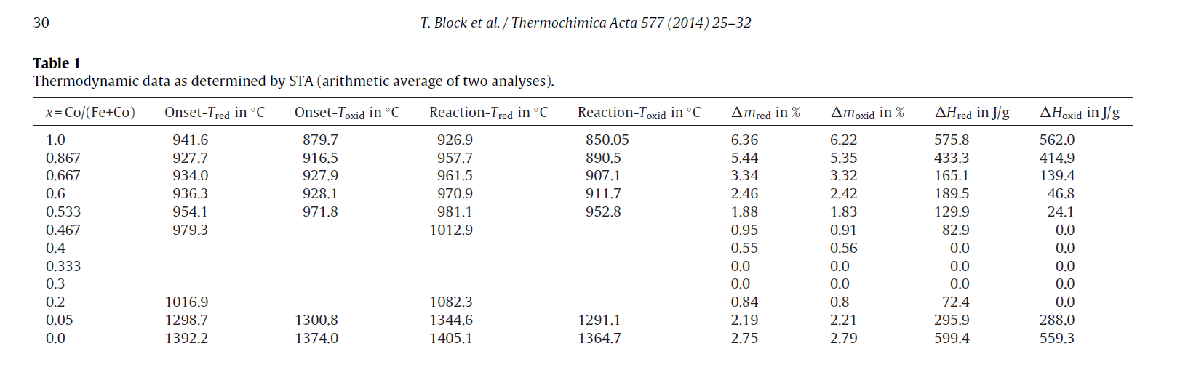
Phase diagram & Reduction/Oxidation Temp.
Ref. - Block, T., Knoblauch, N., & Schmücker, M. (2014)

Slide 8
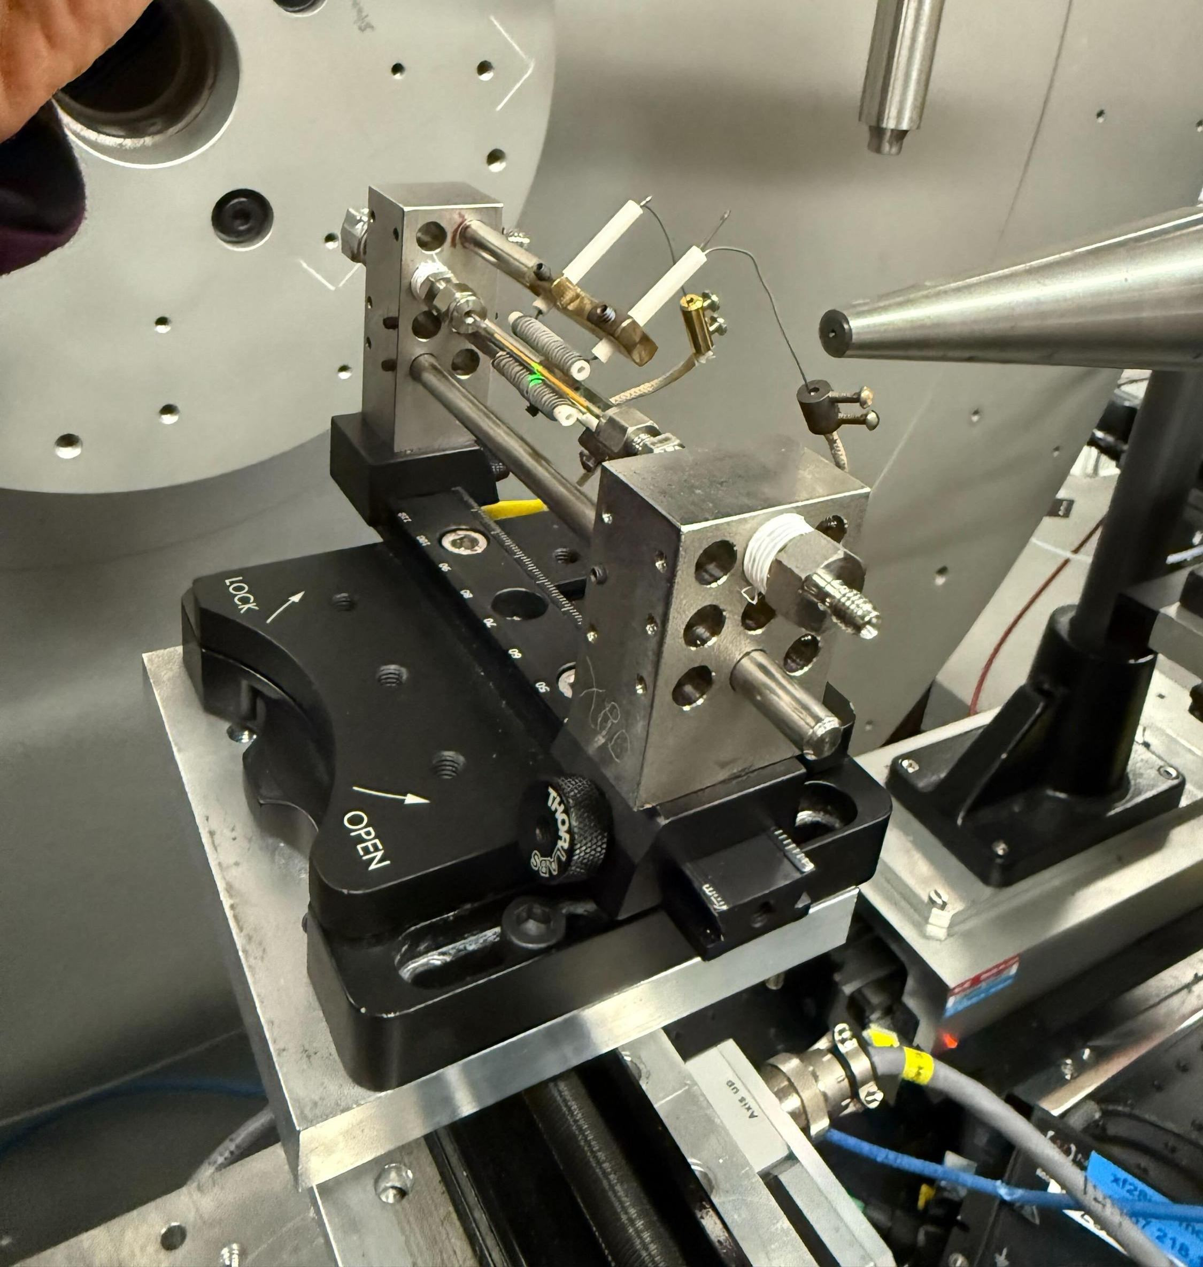
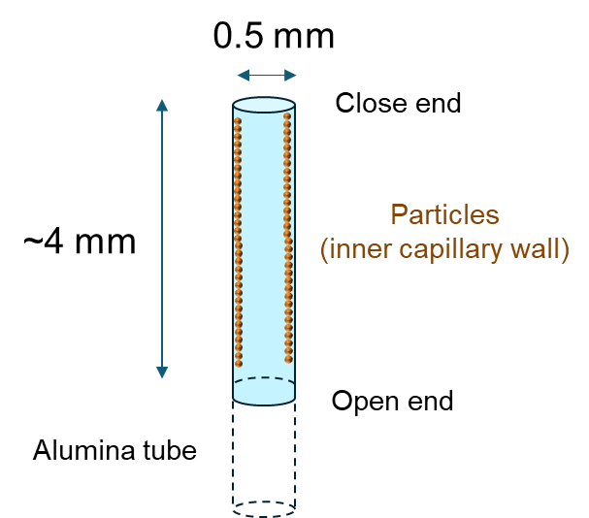
XPD sample preparation
XPD Beamtime in Feb 2025.
Furnace
Sample
(Horizontal capillary)
Beam

Slide 9
Workflow -
1.Import the needed libraries – numpy, pandas…
2. Load the XRD file using pandas
3.Extract the x,y axis value and find the peak(tallest) to be fitted.
4.Select region near the peak (+-0.2°) for the fitting – Gaussian
5.Define Gaussian fit and an intital guess for the fitting
6.Do the fitting
7.Compute the R2 value
8.Then use Debye-Scherror’s formula to find the crystallite size.

Slide 10
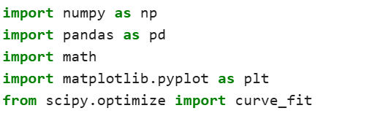
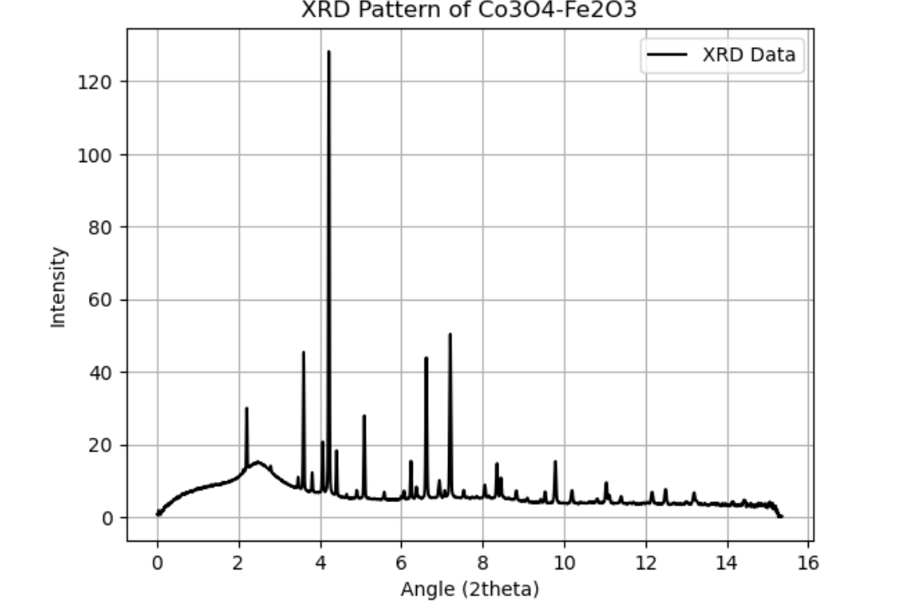
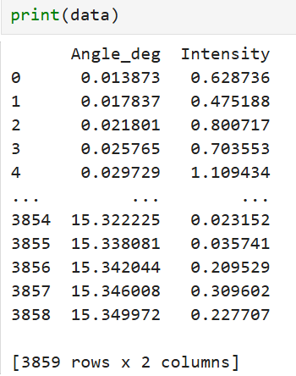
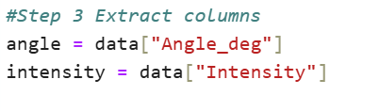
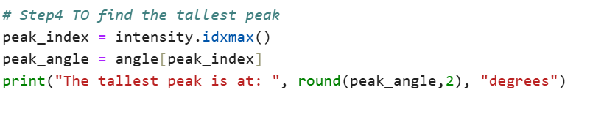

Slide 11
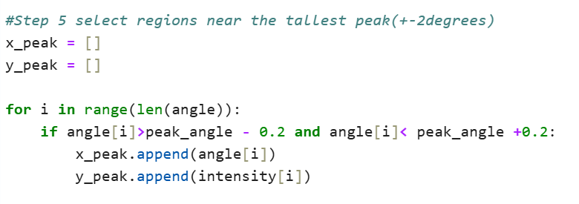
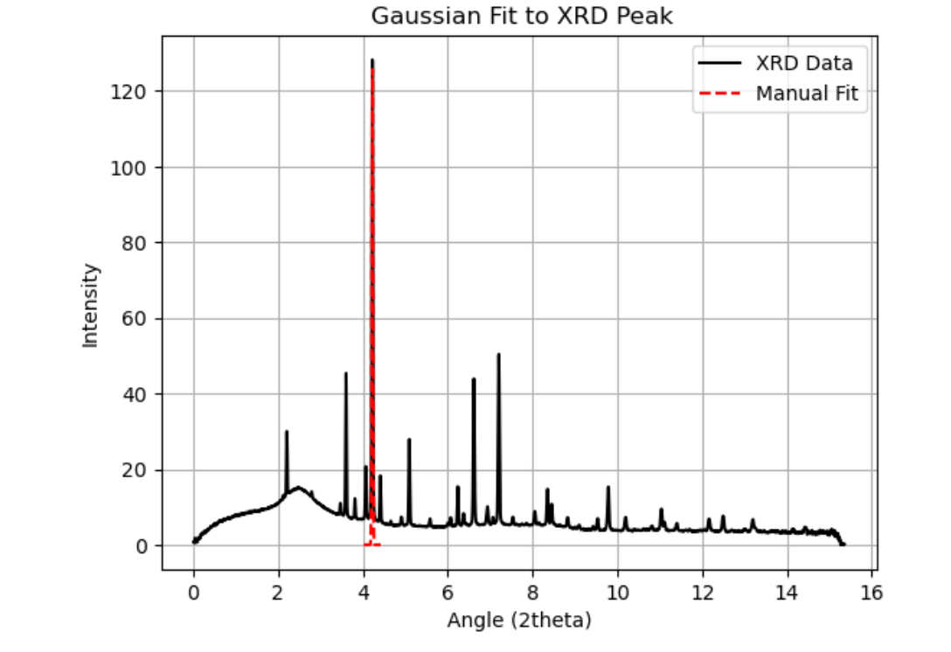
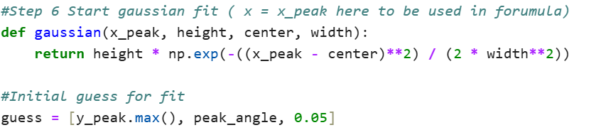


Slide 12
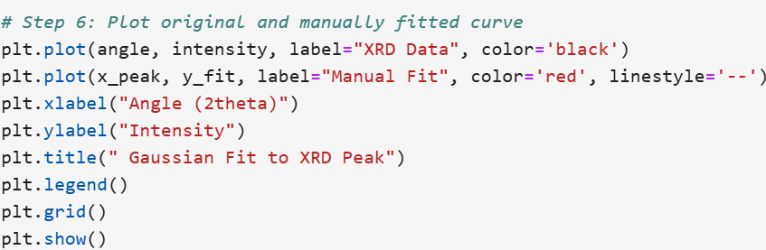
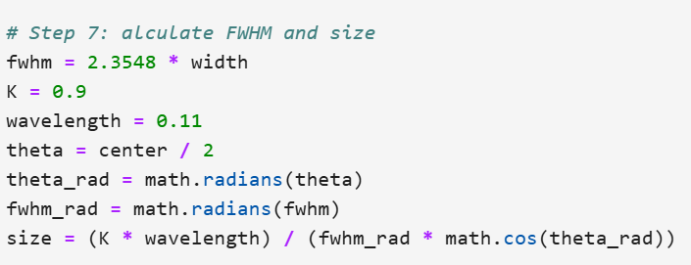
XRD parameters
The tallest peak is at: 4.22 degrees.
FWHM: 0.0306°
Crystallite Size: 185.85 nm
R² value of the fit: 0.8787

Slide 13
Future Work
Plot more in-situ data for XRD.
Plot the time stamping data
Compare the heating and cooling along with the time stamping.
Do the fitting.
See if ISS data can also be plotted and fitted – Spline fitting.

Slide 14
Thanks

