Slide 1


Investigation of Propane + CO2 Gas as Hydrate Clathrate Co-promoters
Christopher Noe
Spring 2025

Slide 2
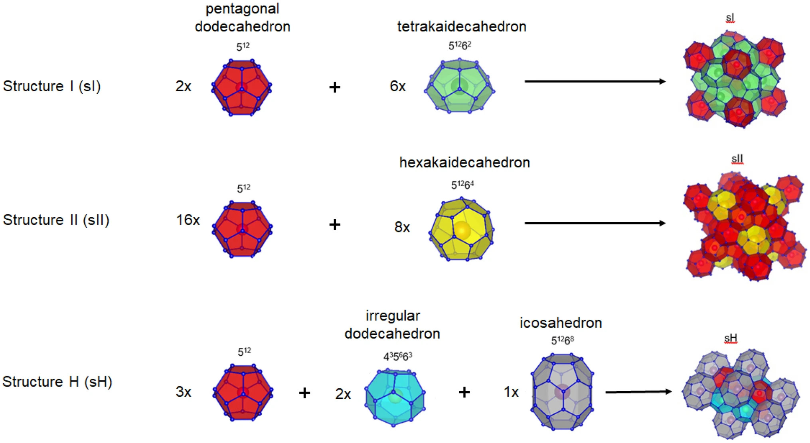
Background (Hydrate Clathrates)

Slide 3
Methane, Propane, CO2 Hydrates
All three gases are known to form stable hydrate phases under sufficient pressures
On their own, CO2 and Methane are known to form sI hydrates, while propane forms sII hydrates
A promoting effect has been observed between methane and propane
Methane has a much smaller size, fitting into the smaller cages and stabilizing the sII hydrate
Propane and methane for a double hydrate with sII structure

Slide 4
Project Goals
Investigate CO2 + propane hydrate interactions and confirm/deny a promoting effect
Investigate physical mechanisms and rate-limiting steps
Tune process for optimal hydrate formation
Energy usage
Gas usage
Water usage
Procedure
Reactors

Slide 5
Program Goals
Search database of experiments: Pressure/Temperature vs Time
Combine data from multiple experiments
Sort experiments by conditions
Sort experiments by procedure
Readily accept experiment repeats
Calculate and display the rate of gas consumption
Plot experimental data for visualization purposes
Plot the experimental phase boundary condition

Slide 6
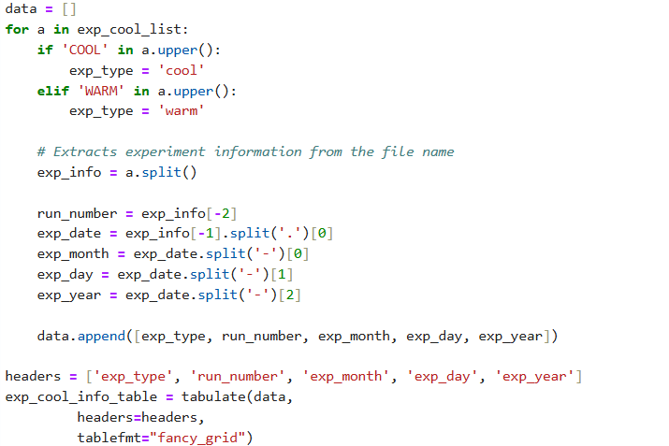

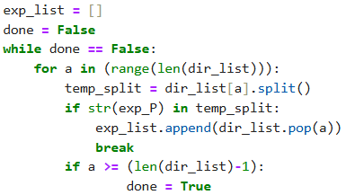
1. Search Database

Slide 7
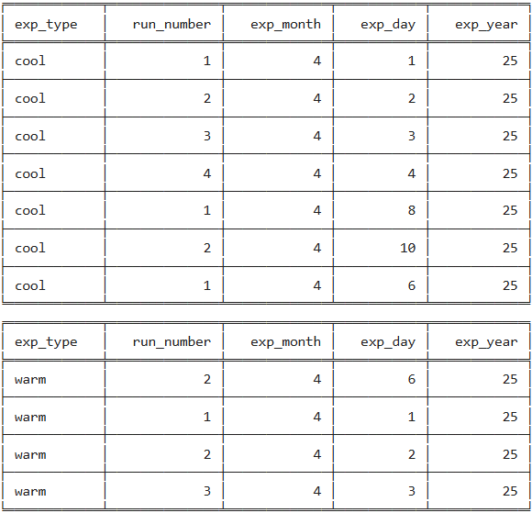
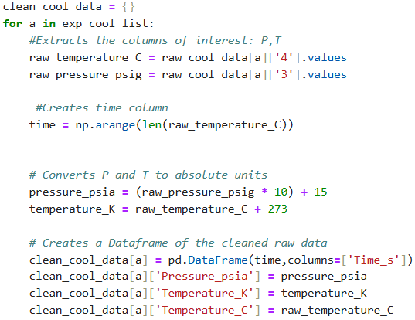
1. Display Database

Slide 8
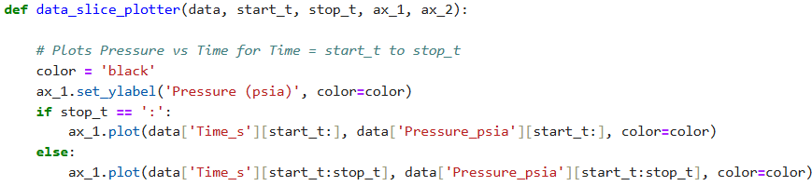
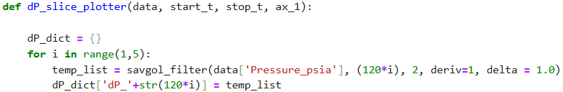
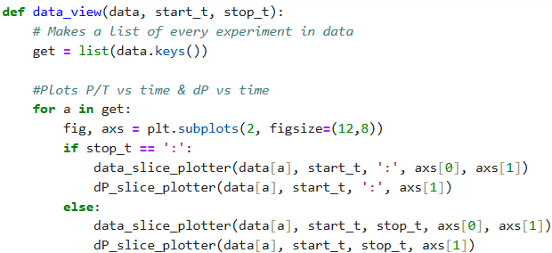
2. Rate of gas consumption

Slide 9
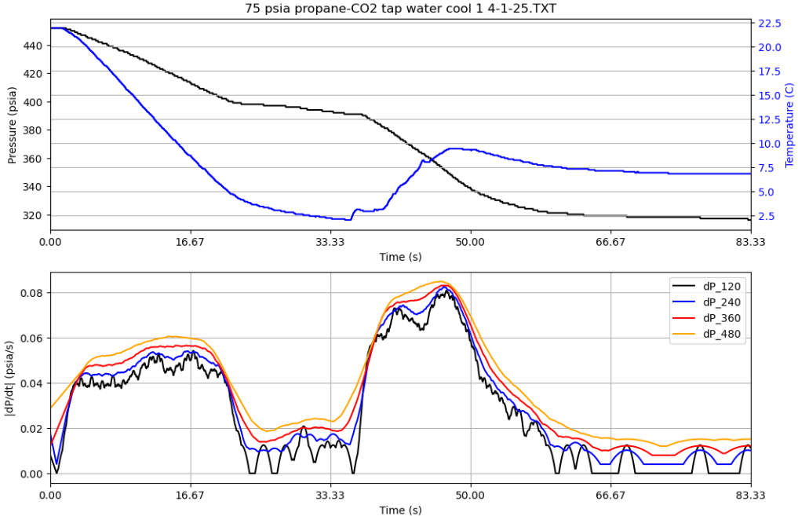
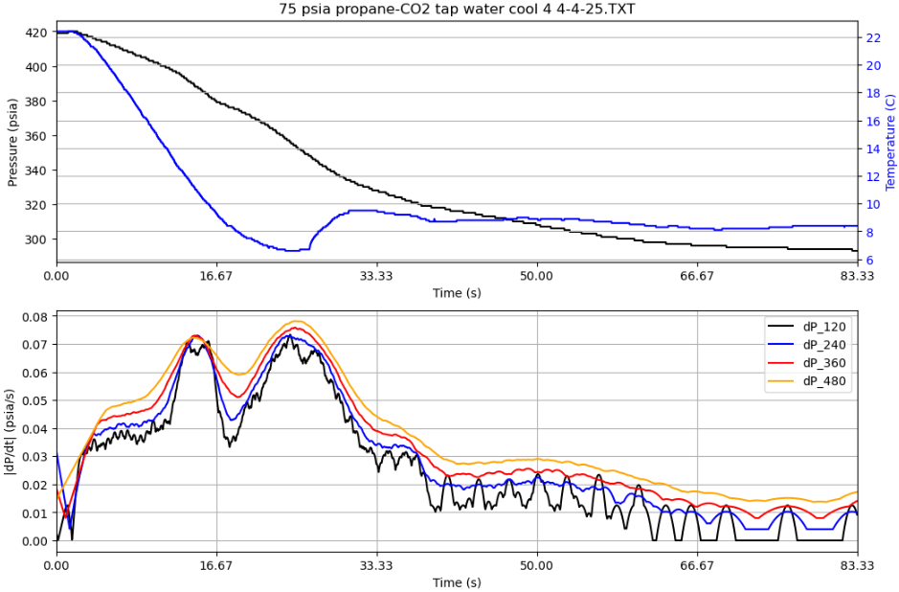
3. Rate of Gas Consumption

Slide 10
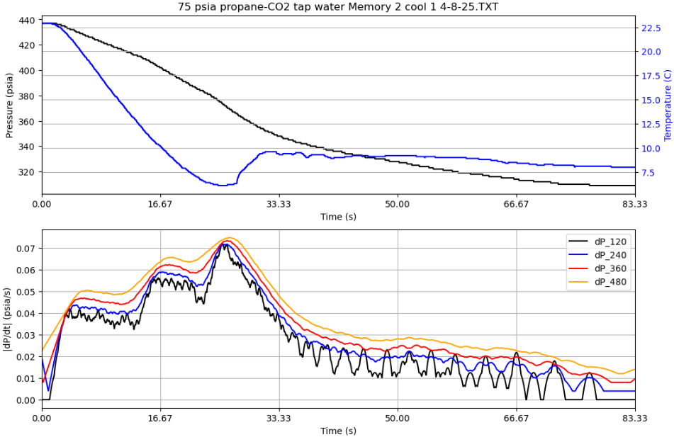
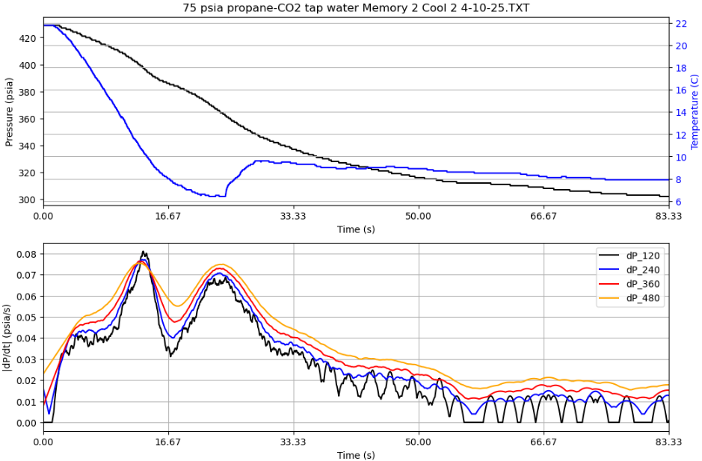
3. Rate of Gas Consumption

Slide 11
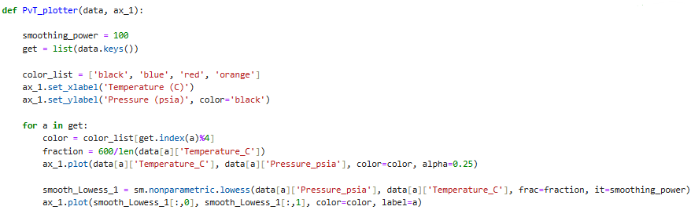
4. Phase Boundary Plots

Slide 12
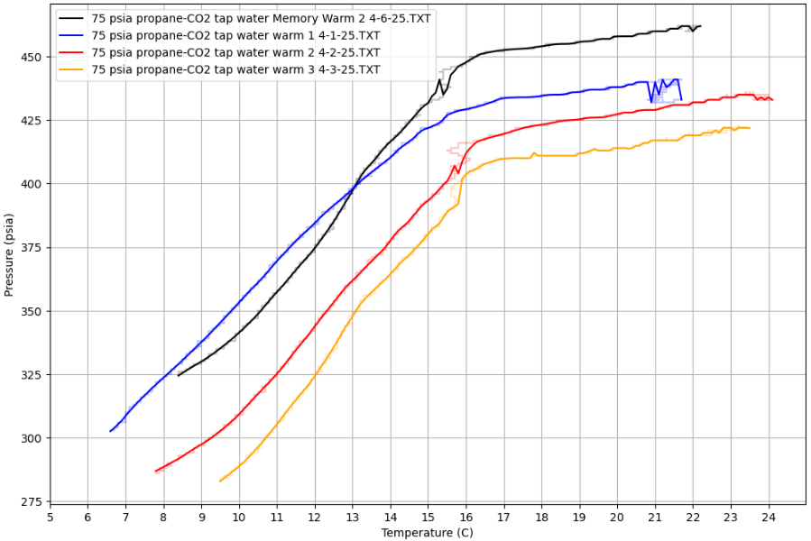
4. Phase Boundary Plots

Slide 13
Conclusions and Future Work
Python is quite useful for streamlining work.
User functions make it much easier to analyze the same data in slightly different ways.
Smoothing and curve fitting can be powerful tools for visualizing data
Future work
Follow up experiments will be varying more parameters, so this program will be updated to include sorting by those.
Data will also be analyzed to look for patterns across these new parameters.
Output will be tuned to export as a summary file.

Slide 14
Questions?

Slide 15
References
(1) Scale Unstirred Reactor: Quantification of the Promoting Effect Due to the Addition of Propane to the Gas Mixture. Energies 2024, 17 (5), 1104. https://doi.org/10.3390/en17051104.
(2) Ma, Z. W.; Zhang, P.; Bao, H. S.; Deng, S. Review of Fundamental Properties of CO2 Hydrates and CO2 Capture and Separation Using Hydration Method. Renewable and Sustainable Energy Reviews 2016, 53, 1273–1302. https://doi.org/10.1016/j.rser.2015.09.076.
(3) Nasrifar, K.; Javanmardi, J.; Rasoolzadeh, A.; Shoushtari, A. Experimental and Modeling of Methane + Propane Double Hydrates. J. Chem. Eng. Data 2022, 67 (9), 2760–2766. https://doi.org/10.1021/acs.jced.2c00243.
(4) Schicks, J. M. Gas Hydrates in Nature and in the Laboratory: Necessary Requirements for Formation and Properties of the Resulting Hydrate Phase. ChemTexts 2022, 8 (2), 1–10. https://doi.org/10.1007/s40828-022-00164-3.

