Slide 1
Modeling Polymer Chain Growth and Cluster Formation Using Brownian Motion
By, Alex D’Acunto Student ID: 113134942
Date: 4/29/25 CME 502-Prof. Nav Nidhi Rajput

Slide 2
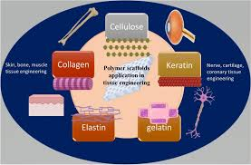
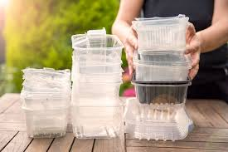
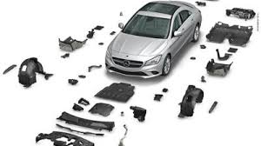
Background
[1]
Polymers are instrumental in modern science due to the broad range of applications they possess.
Medical, Packaging, Automotive, Textiles, etc.
Improving Polymers:
Analytical techniques, characterization, developing new materials
Another important way to develop our understanding of polymers is through computer modeling.
Improve speed at which polymers can be evaluated
Study polymer properties
Study polymer structures
[2]
[3]

Slide 3
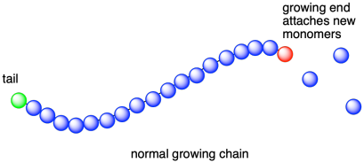
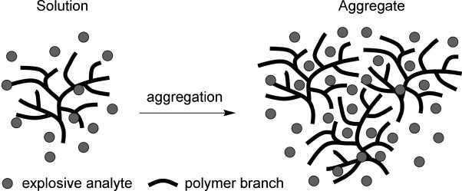
Background
[4]
My focus will be on the growth and aggregation of polymer chains.
Polymer chains grow via step growth
Throughout the course of many polymer chain growths, the polymers tend to aggregate together to form clusters.
These clusters tend to grow in a fractal pattern similar to that of a snowflake
By improving our understanding of polymer growth, we can further optimize their properties to create more effective polymers.
[5]

Slide 4
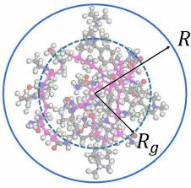
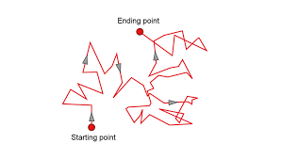
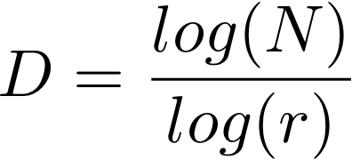
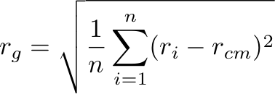
Goals
Develop a code that simulates polymer chain growth via Brownian Motion.
Iterate through many polymer chain growths and record each iteration.
Have these individual polymer chains stick together when the random walks collide.
Plot the resulting diffusion-limited aggregate (DLA).
Find the Radius of Gyration (Rg)
Find the Mean Squared End-to-End Distance (MSD)
Find the Fractal Dimension (FD)
[6]
[7]
[8]
[9]

Slide 5
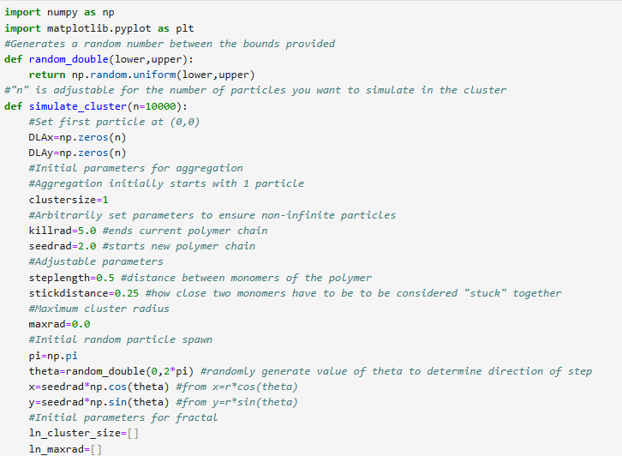
Results
Initialization
First function is purely for generating a random number.
Second function is main function where all computations occur.
Value for “n” is customizable based on how many polymer chain growths you want to simulate.
DLAx and DLAy track positional values for the polymer chains.
Generating a random number allows for the first polymer chain spawn randomly:
x=rcos(Θ) and y=rsin(Θ)
Randomly selecting Θ between 0 and 2𝜋 allows for initial x and y coordinates for generation to be truly randomized.

Slide 6
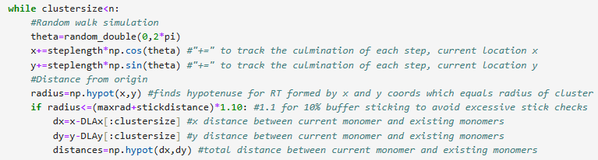
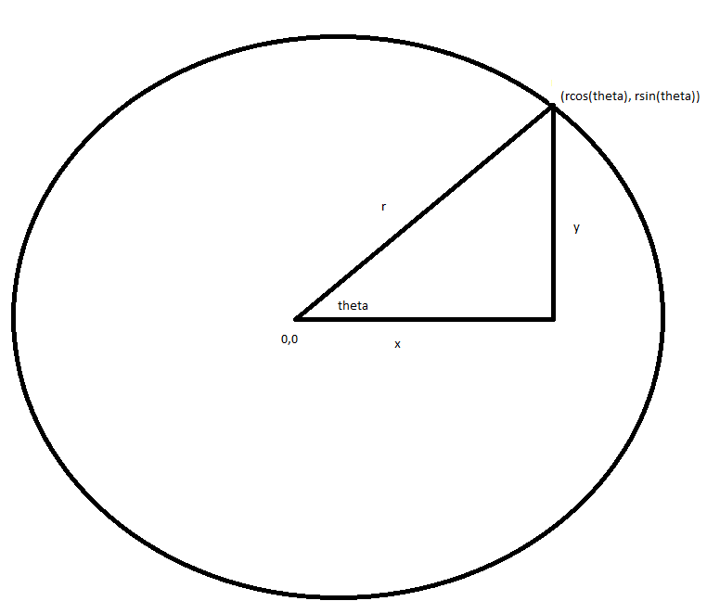
Results
Brownian Motion Chain Growth
While loop to continue the main functions procedure until the specified number of polymer chains have been simulated.
Random theta here is generated to determine direction of the step the polymer chain grows in.
“np.hypot” is a compact form of the distance formula r=(x²+y²)^{½}.
If statement to check distance between currently generating polymer and existing polymer.
R
Y
X
[10]

Slide 7
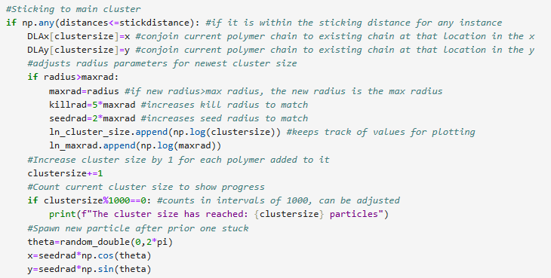

Results
Forming Aggregate and Resetting
If statement that if the monomer of current chain is too close to the monomer of another, they conjoin and kill the growth of that monomer.
Checks to see if the radius has been pushed outwards, updates max/kill/seed radii.
Increases cluster count variable and spawns new polymer chain growth.
Another If statement to account for if polymer chain extends past “kill” radius.

Slide 8
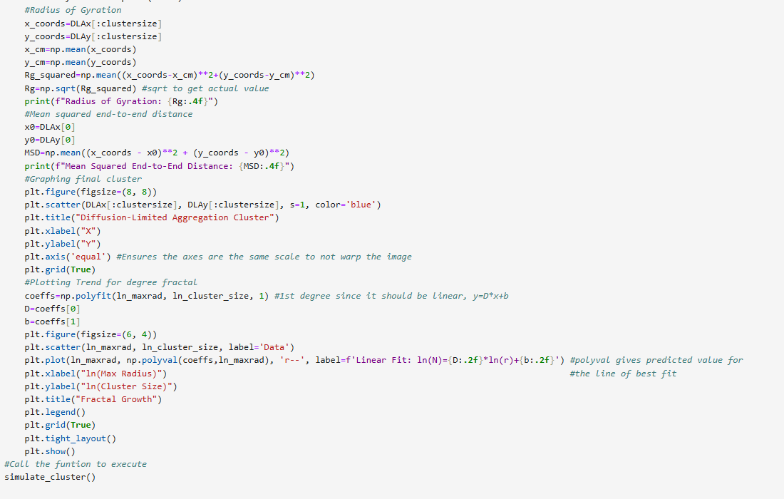
Results
Graphing and Calculations
Equations used to calculate Rg.
Equation used to calculate MSD.
Scatter plot used to picture the overall aggregate of polymer chains.
np.polyfit and np.polyval to generate the parameters for plotting the line of best fit for fractal dimension with scatter plot of actual data for comparison.
Finally call the main function to execute!

Slide 9
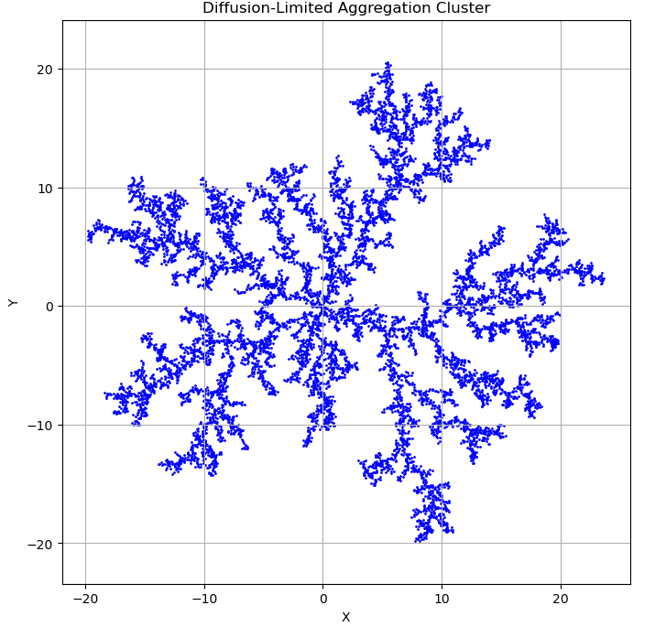
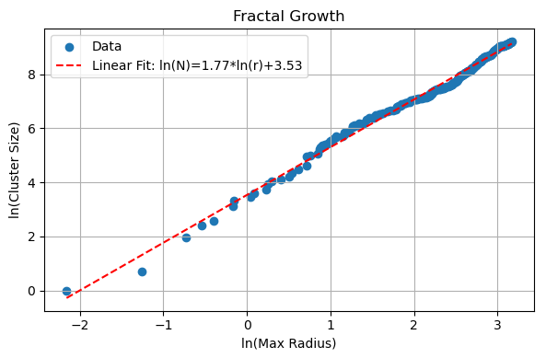
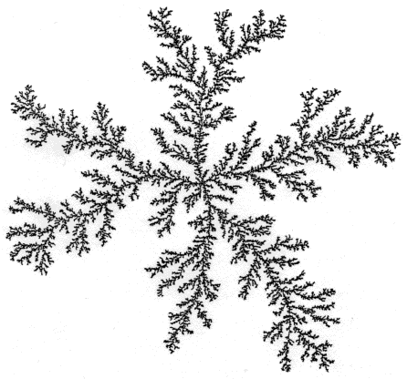
Conclusion
DLA Imaging and FD Trend
Great fractal imaging, can see individual polymer chain growths combining into one DLA.
Plotting ln(R) vs ln(N) gives the fractal dimension D as the slope.
D=1.77 in this case, high degree of fractalization.
[11]

Slide 10
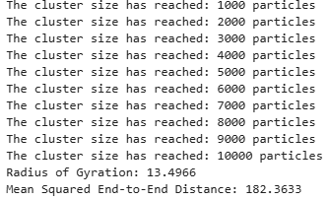
Conclusion
Rg and MSD Values
Counting for cluster size working properly, can observe it slowing down as the polymer generation gets more and more complex.
Rg=13.4966 which is lower than the actual radius as we expected.
MSD=182.36, seems accurate considering the size of the DLA.
Overall, all goals have been met.
Some improvements to the code can be made in terms of optimization, method of polymer chain generation (at low numbers it does not work well), make it polymer specific.

Slide 11
References
[1] Chouhan, Dheeraj, and Bhupender S. Rajput. "Polymer Scaffolds in Tissue Engineering: Recent Trends and Progress." ResearchGate, 2021, doi:10.1016/j.matpr.2020.11.898. Figure 3.
[2] "Plastic Food Packaging." Thong Guan Industries, 2021, www.thongguan.com/wp-content/uploads/2021/01/1608802952plasticfoodpackaging.jpg.
[3] "Biodegradable Plastic Bag." Google Images, encrypted-tbn0.gstatic.com/images?q=tbn:ANd9GcRrWfYgCNg1hsC2pjH6iOlrM_lx7FGEd344lw&s.
[4] "Chain-Growth Polymerization Diagram." College of Saint Benedict and Saint John's University, faculty.csbsju.edu/cschaller/Advanced/Polymers/MPtopochaingrowth.png.
[5] "Polymer Structure Diagram." Progress in Polymer Science, vol. 36, no. 7, 2011, pp. 917–970, doi:10.1016/j.progpolymsci.2011.01.003. Figure 14.
[6] "Brownian Motion Diagram." ChemistryTalk, 23 Mar. 2023, chemistrytalk.org/wp-content/uploads/2023/03/Csm_Brownian-Motion_f99de6516a.png.
[7] "Fractal Dimension Diagram." Blogger, blogger.googleusercontent.com/img/b/R29vZ2xl/AVvXsEiEas3bWFxdqp-NW0-eAafpmMJLNDPpg4iDtTAwkN1yRBtWC5oLhmBnBqV8Q6yGNf2-i8poy4VReq-4xyjw1CmJhwAQG4inWmyMrxrS1iYxgGWBbZ4k8a_aIBrf3_u5FauvrBZP2jq4294r/s1600/fractal_dimension.png.
[8] "Fractal Pattern Illustration." Stack Exchange, i.sstatic.net/9sLoz.png.
[9] "Polymer Network Diagram." Google Images, encrypted-tbn0.gstatic.com/images?q=tbn:ANd9GcQvl0fgg0kzDiGX-bM4Cm-42fkKEXta0d_8vA&s.
[10] "Coordinates Diagtam" Stack Exchange, i.sstatic.net/NkSBY.png.
[11] "Diffusion-Limited Aggregation." Yale University, Gauss Math, gauss.math.yale.edu/fractals/Panorama/Physics/DLA/DLA.html.

