Slide 1
Analyzing SI-doped Boron Carbide with Raman mapping
Presenter: Adrian Parnell
Instructor: Dr. Nav Nidhi Rajput

Slide 2

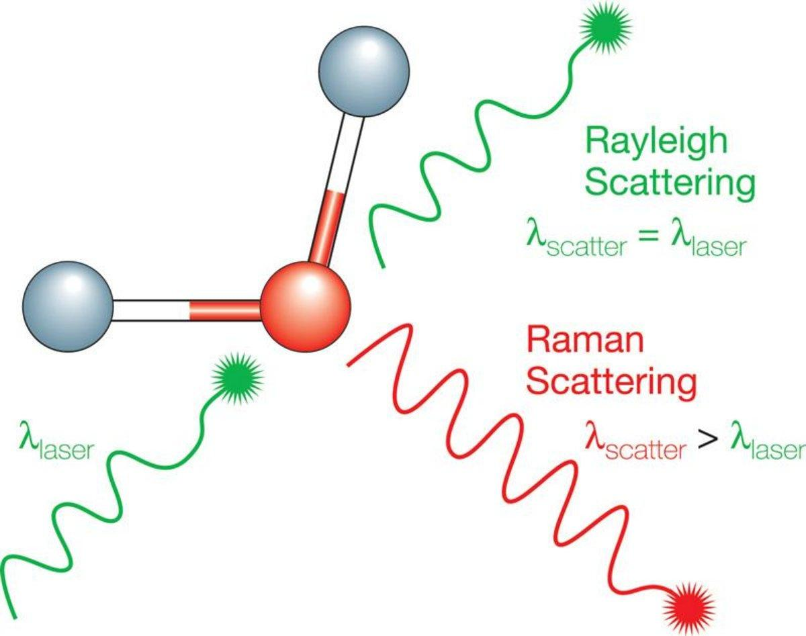
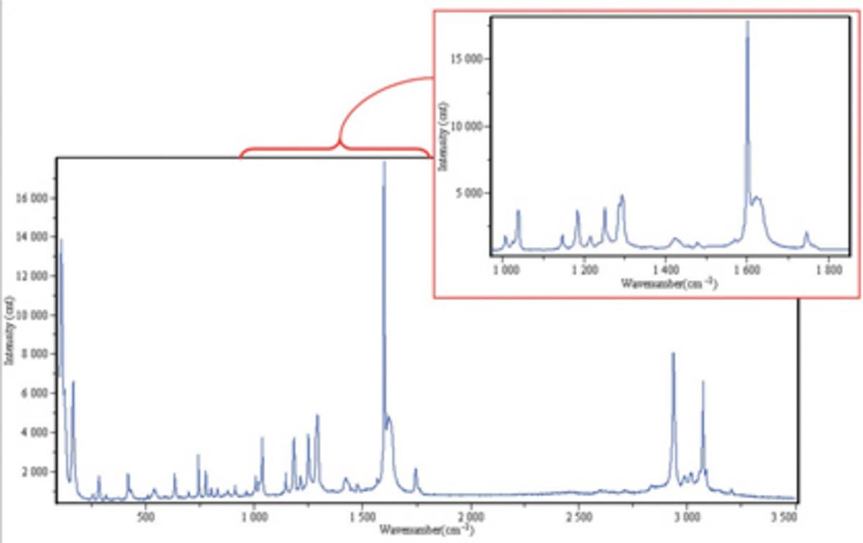
Raman Spectroscopy
Non-Destructive Technique: Provides detailed chemical information without altering the sample.
Light Scattering: Uses a high-intensity laser to scatter light, with most being Rayleigh scatter (same wavelength as the laser).
Raman Scatter: A small fraction of light is scattered at different wavelengths, providing useful chemical information.
Spectral Features: Peaks in the Raman spectrum correspond to specific molecular bond vibrations.
Specific Bonds: Includes vibrations of individual bonds (e.g., C-C, C=C, N-O, C-H) and collective modes (e.g., benzene ring breathing, polymer chain vibrations).
https://www.horiba.com/usa/scientific/technologies/raman-imaging-and-spectroscopy/raman-spectroscopy/
Notes:
Raman spectroscopy is a powerful tool for analyzing the vibrational modes of atoms in a material. When a material is hit with a laser, most light scatters without changing energy, but a small fraction undergoes an energy shift due to interactions with molecular vibrations.
This shift is called the Raman shift, and it provides a fingerprint of the material’s structure.
The shift is relative to the incident laser light. We look at how much energy the scattered light gained or lost.

Slide 3
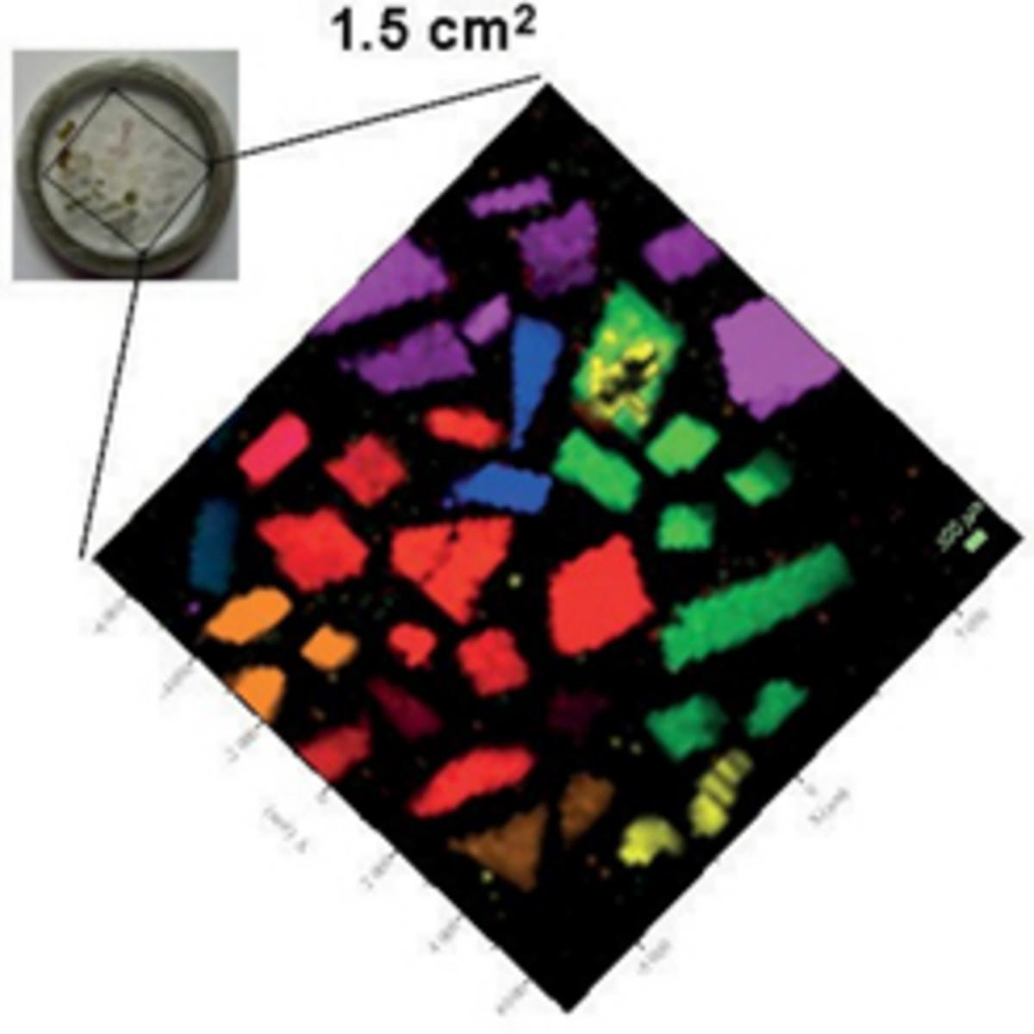
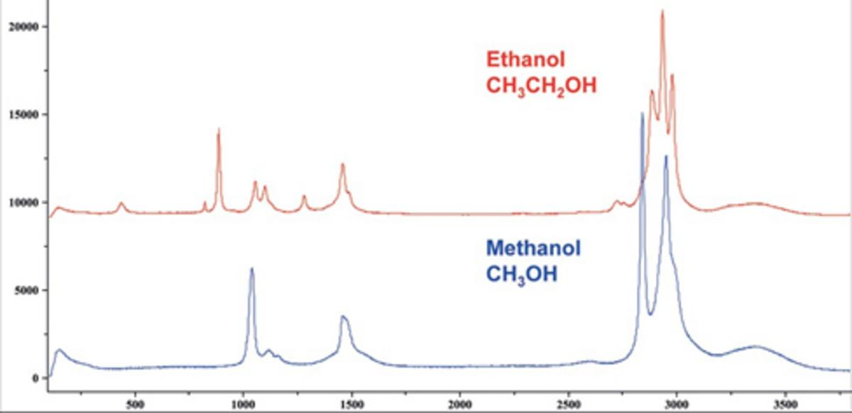
Information provided by Raman spectroscopy
Raman spectroscopy examines the chemical structure of materials, offering insights into:
Chemical Structure and Identity: Reveals the molecular composition.
Phase and Polymorphism: Identifies different forms or phases of a material.
Intrinsic Stress/Strain: Detects internal mechanical stresses.
Contamination and Impurity: Helps identify unwanted substances.
https://www.horiba.com/usa/scientific/technologies/raman-imaging-and-spectroscopy/raman-spectroscopy/
Notes:
Before next slide say:
Stronger, and shorter bonds vibrate at higher frequencies. So when a structure becomes disordered (like during amorphization) we often see peak shifts and broadening, which reflect the spread of new, less-uniform bond environments.

Slide 4
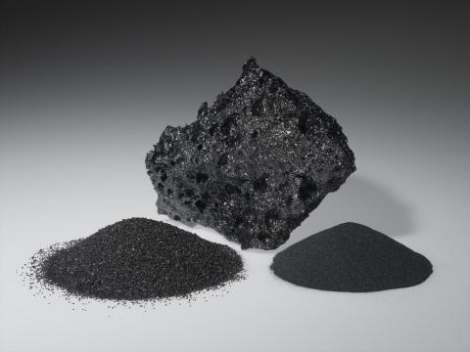
Boron Carbide
https://www.washingtonmills.com/products/boron-carbide
Application Area | Examples/Details | Key Property Utilized
Ballistic Armor | Body armor, vehicle armor, aircraft armor | Extreme hardness, low density
Abrasives & Cutting Tools | Lapping, polishing, cutting, water jet nozzles | Hardness, wear resistance
Wear-Resistant Components | Industrial nozzles, brake linings, coatings | Abrasion resistance, chemical inertness
Nuclear Industry | Control rods, shielding, neutron absorbers | Neutron absorption, stability
Composite Reinforcement | Filaments, nanoparticles in composites | Strength, low weight, radiation resistance
Electronics & Semiconductors | High-temp devices, dielectric barriers | Thermal stability, inertness
Aerospace & Defense | Turbine blades, lightweight armor | Strength, low density, thermal stability
Boron Carbide also known as Black Diamond is a light weight highly durable material use in a wide variety of Applications.
Notes:
Boron carbide’s strength comes from its 12-atom icosahedra and 3-atom interconnecting chains. During a high shear stress event, those chains rip the icosahedra apart called unzipping which drastically reduces the yield strength of boron carbide.

Slide 5
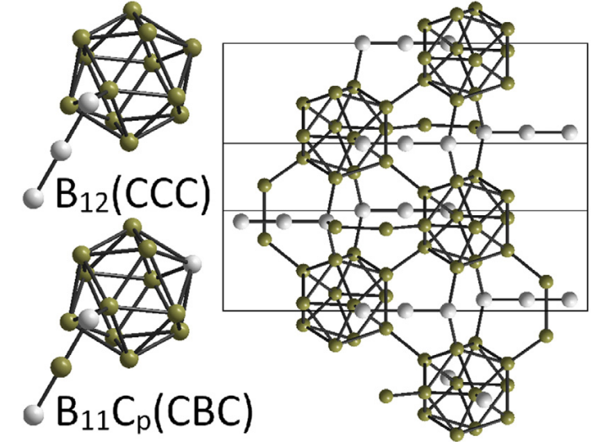
Weaknesses induced by Amorphization
Amorphization Weakness | Description | Impact on Material Performance
Formation of Amorphous Shear Bands | Under high shear stress, narrow amorphous bands (2-10 nm) form within the crystalline matrix. | These bands act as nucleation sites for microcracks and are "paths of least resistance" for crack propagation, leading to premature failure under impact or pressure.
Loss of Strength and Toughness | Amorphization disrupts the ordered crystal structure, causing localized softening and structural collapse. | Results in a significant reduction in mechanical strength and toughness, especially under ballistic or high-pressure loading.
Catastrophic, Brittle Fracture | Amorphous bands facilitate rapid crack growth and coalescence. | Leads to catastrophic, brittle fracture at lower-than-expected stress levels, limiting reliability in armor and structural applications.
Irreversible and Localized Change | The amorphization process is irreversible and localized, leaving most of the material crystalline but with weak zones. | Even small amorphous regions can critically undermine the integrity of the entire component.
Poor Damage Tolerance | Amorphization inhibits alternative energy dissipation mechanisms (e.g., dislocation slip, twinning). | Boron carbide cannot effectively absorb or dissipate impact energy, resulting in low damage tolerance compared to other ceramics.
Proctor, J. E., et al. (2015).
Notes:
Amorphization disrupts long-range order. In Raman spectra, this appears as peak broadening, measured by something called the Full Width at Half Maximum (FWHM). Wider peaks indicate a more disordered vibrational environment one where bond lengths and angles vary more than in a crystal.

Slide 6
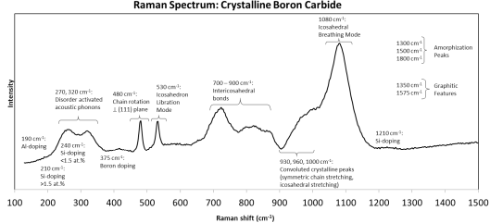
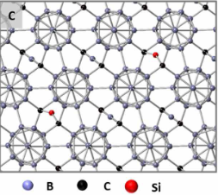
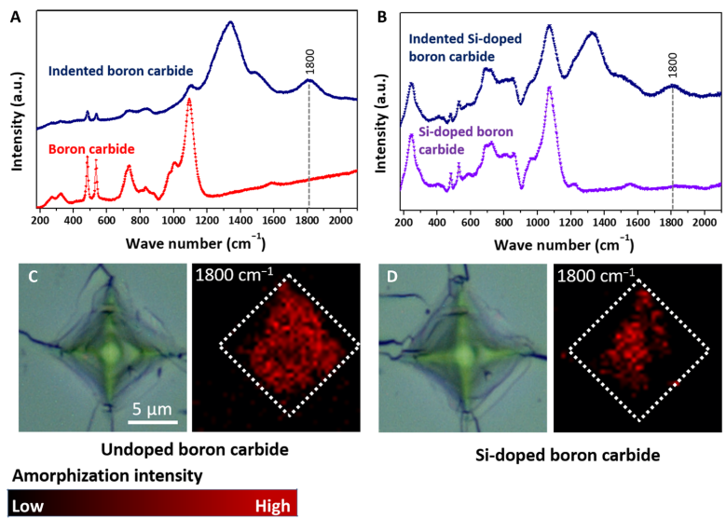
Si-doping of Boron Carbide
(Xiang, Ma et al. 2019)
(Christian, Kent 2022)
(Xiang, Ma et al. 2019)
Notes:
Silicon doping can stabilize or modify the amorphization process by altering bond structures which you can see reflected as changes in the relative intensity and broadness of specific peaks.

Slide 7
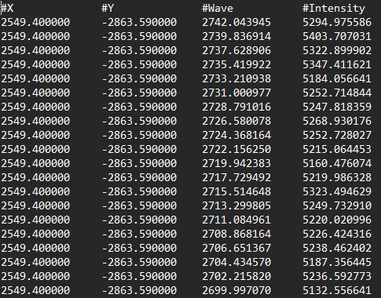
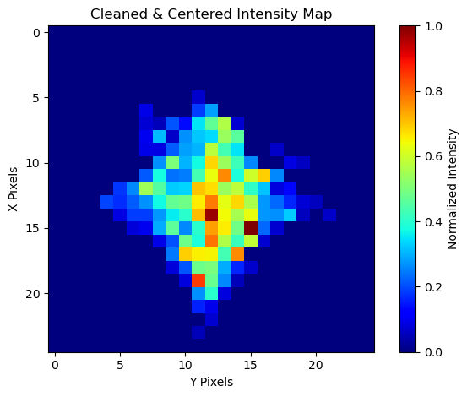
Quick Synopsis
Function:
Raw Data
Loads and reshapes the raw spectrum data into a 3D cube.
Locates spectral peaks (A and C), and measures intensity.
Computes a cleaned A/C ratio map by removing background and noise.
Centers the image based on signal distribution.
Visualizes the cleaned, aligned Raman map.
Output:
Notes:
Once the raw Raman map is loaded, I convert it into a 3D matrix where each pixel has a full spectrum. Then I calculate the A/C ratio to compare how the material’s vibrational behavior changes spatially.

Slide 8

Libraries used
OS: Allows me to interact with the computers Operating System so I can access files
os.path.basename(filepath) extracts just the file name (without the path) to use in the plot title.
Numpy(Numerical Python): A Python module that allows me to do numerical computations, and work with arrays
np.loadtxt(): Load text files into arrays.
np.abs(), np.argmin(): Find nearest neighbor indices.
np.max(): Find peak heights.
np.true_divide(), np.errstate(): Robust division handling.
np.bincount(), np.argmax(): Find largest connected region.
Matplot.pyplot: allows me to output and label graphs.
plt.figure()
plt.imshow()
plt.colorbar()
plt.xlabel(), plt.ylabel(), plt.title(), plt.tight_layout()
plt.show()
Tkinter: allows me to choose which files I want to process.
filedialog.askopenfilenames(): Opens a window to select one or more files.
Tk().withdraw(): Hide the main tkinter window you only want the file dialog to appear.
Scipy.ndimage: from the scientific python package I used the ndimage module to do image processing and specifically chosen three functions from the module.
center_of_mass(): Find the geometric center based on intensity.
Shift(): Move the image to center the main signal.
label(): Perform connected component analysis (noise cleaning).

Slide 9

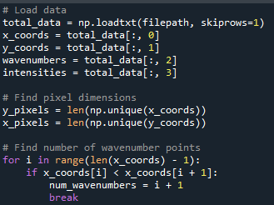



Methods
Data Loading
np.loadtxt()
Loads text file data into a structured array.
Needed to turn the text files into a Numerical array to that can be manipulated
Notes:
1.) first turn the .txt file into an array that can be manipulate, then store all the unique x and y values as the axis for the graph, then find how many wave number points exist in each pixel

Slide 10
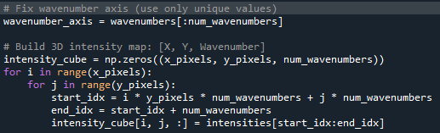
Methods
Data Structure Creation
Building a 3D intensity cube: (X_pixels, Y_pixels, Wavenumbers) array
Purpose: Organize Raman intensity data spatially and spectrally.
Why: You need a consistent structure to do pixel-by-pixel operations later.
Notes:
2.)first pull the full spectrum wavenumber range, then create a 3-d matrix with (X,Y, Number of wavenumbers) and fill it by looping through all x and y locations and filling that pixel with its Raman spectrum

Slide 11
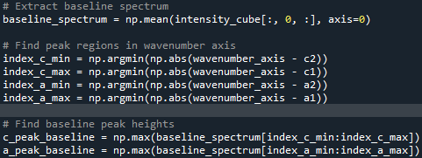
Methods
Baseline Spectrum Extraction
Takes the average of the x pixels spectra across the first row to give us a 1D array to use as the baseline
Nearest Neighbor Search (Finding Wavenumber Regions)
Finds the closest wavenumber (the x-axis along the spectrum of each pixel ) to the minimum and maximum of each peak
Local Maxima Finder
By looking only at the maximum within a small, known window you're reducing sensitivity to noise ignoring fluctuations outside the peak region
Notes:
3.)Average the spectra long the first column of pixels(y=0) to estimate baseline, then finds the start and end points for the C and A Raman peaks, lastly find the max value in each peak range for the baseline

Slide 12
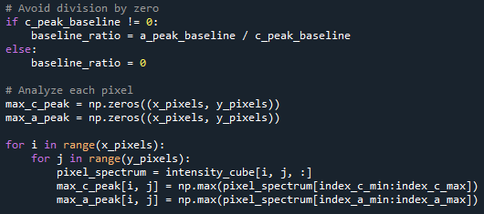
Methods
Analyzing Pixels
Looping over every pixel in your Raman map
At each pixel, extracting the spectrum (intensity vs. wavenumber)
Then extracting the peak height in the C and A spectral regions
Saving these peak heights into 2D arrays (one for each peak type)
Notes:
Create then fill in a 2-D map with the highest intensity in the A and C peak region

Slide 13
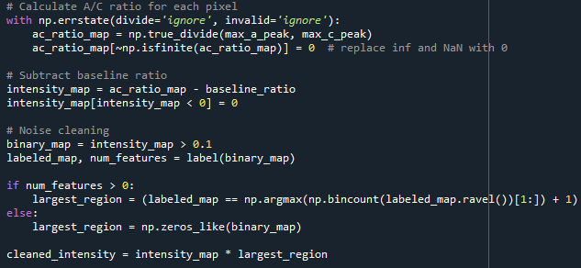

Methods
Chemical Contrast Normalization
This computes a pixel-by-pixel ratio of the A peak intensity to the C peak intensity in the Raman spectrum:
$$\frac{A}{C}Ratio_{i,j}=\frac{I_{A}\left(i,j\right)}{I_{C}\left(i,j\right)}$$
Then subtracts A/C ratio map from the baseline. This only leaves regions with material signal
Thresholding:
Converts intensity_map into a binary mask.
Pixels above a small threshold (0.1) are considered signal; others are noise.
After Thresholding not all High intensity regions are Valid (Random Noise spike), only want coherent, spatially- connected areas
Labeling lets you Detect all signal islands then keep only the biggest (the most probable sample)
Notes:
Calculates the A/C ratio then subtracts background to only having meaningful data. Then gets rid of noise by grouping all of the highest intensities together and any intensity that is not close to a group is considered noise
Connected-component labeling helps remove false positives isolated noise and keeps the largest, physically meaningful region. This gives a more accurate picture of how amorphization spreads.
By finding the local maximum in the A and C peak regions, I quantify the signal strength, after which subtracting the background ensures that what I’m measuring is due to the sample not artifacts or autofluorescence.

Slide 14


Methods
Centering:
This computes the intensity-weighted center of the signal blob. Mathematically: If I(x,y) is the 2D intensity map, then the center of mass is:
$$\overline{x}= {(Σ}_{x,y}x∗I(x,y)) / ({(Σ}_{x,y}I(x,y)) , y̅={(Σ}_{x,y} y∗I(x,y)) / ({(Σ}_{x,y}I(x,y))$$
Then turns the cleaned intensity into an array which we divide by two to get the midpoint of the image
Next, we need to calculate how much we need to shift the current center of the signal to the geometric center of the image.
Lastly, we apply that shift in the image. Anything moved off screen is lost and because the shifting moves pixels by exact values and not integers some pixels get lost and new spaces show up in the image interpolation(spline order = 3 by default) is used to fill those images based off near by pixels
Notes:
Then centers the cleaned image by finding how far off the image center is from the center of the map and then shifts it over to that center.
Centering lets us compare different images more fairly — whether between doped and undoped samples or before and after impact. The region of signal is aligned so we're not comparing misaligned noise.

Slide 15
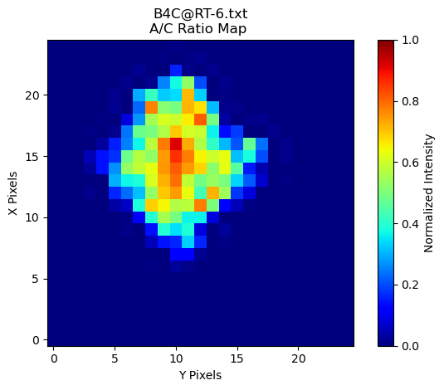
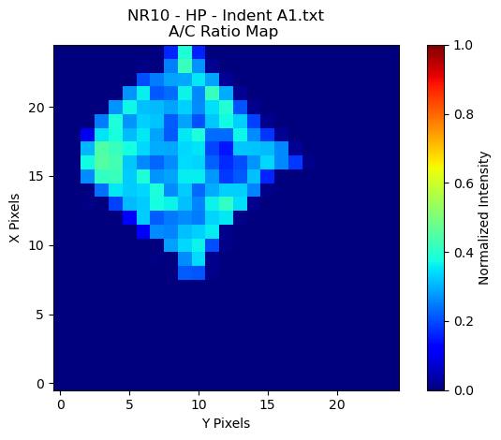
Conclusion
Boron Carbide
Si-Doped Boron Carbide

Slide 16
Future works
Make the code more Robust.
Add input Validation make sure the files I’m using are actually viable
Make my code more modular
Use configurable parameters instead of hard coding
Improve baseline correction. Instead of doing row averaging I could polynomial fitting.
Look into how the breathing mode is affected after the amorphization.

Slide 17
References
Xiang, Sisi, et al. "Tuning the deformation mechanisms of boron carbide via silicon doping." Science Advances, vol. 5, no. 10, 2019, p. eaay0352. DOI: 10.1126/sciadv.aay0352.
Yang, Qirong, et al. "Activating dislocation mediated plasticity in boron carbide through Al-doping." Acta Materialia, vol. 241, 2022, p. 118412. DOI: 10.1016/j.actamat.2022.118412.
Proctor, J. E., et al. "Stabilization of boron carbide via silicon doping." Journal of Physics: Condensed Matter, vol. 27, no. 1, 2015, p. 015401. DOI: 10.1088/0953-8984/27/1/015401.
Shen, Yidi, et al. "Mitigating the formation of amorphous shear band in boron carbide." Journal of Applied Physics, vol. 129, no. 14, 2021, p. 140902. DOI: 10.1063/5.0044526.
Domnich, Vladislav, et al. "Boron-Rich Boron Carbide: An Amorphous Semiconductor." Physical Review B, vol. 69, no. 4, 2004, p. 045206. DOI: 10.1103/PhysRevB.69.045206.
Zhou, Yu, et al. "Preparation and Properties of Boron Carbide-Aluminum Nitride Composites." Journal of the European Ceramic Society, vol. 35, no. 13, 2015, pp. 3683–90. DOI: 10.1016/j.jeurceramsoc.2015.06.018.
Domnich et al. (2004): Explores boron-rich boron carbide’s structural behavior, relevant to amorphization resistance.
Zhou et al. (2015): Discusses B₄C-AlN composites, aligning with your interest in hybrid materials for amorphization mitigation.
Christian, Kent. "Advancing Fracture Behavior of Boron Carbide with Arc Melt Processing." Order No. 29395079 Rutgers The State University of New Jersey, School of Graduate Studies, 2022. United States -- New Jersey: ProQuest. Web. 29 Apr. 2025.
Original code provided by Kent Christian

