Slide 1
Computational analysis on the desorption mechanism of CO2
Shibsankar Mondal
Course: CME_502
SBU ID: 170320834

Slide 2
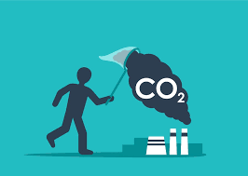
CO₂ Capture and Climate Change
The current atmospheric CO₂ concentration stands at 426 ppm, over 50% higher than the pre-industrial level of approximately 280 ppm.
According to IPCC, global average surface temperature will increase by 1.5 °C above pre-industrial levels between 2030 and 2052.
CO₂ Capture can cut Billions of Tons of CO₂ annually by 2050, enable net-zero emissions pathways and a circular carbon economy.
CO₂ capture is not just a technology — it's a cornerstone of sustainable industrial transition and climate resilience.

Slide 3
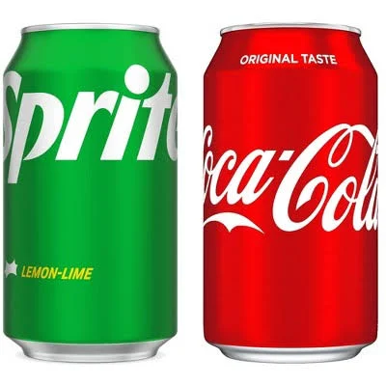
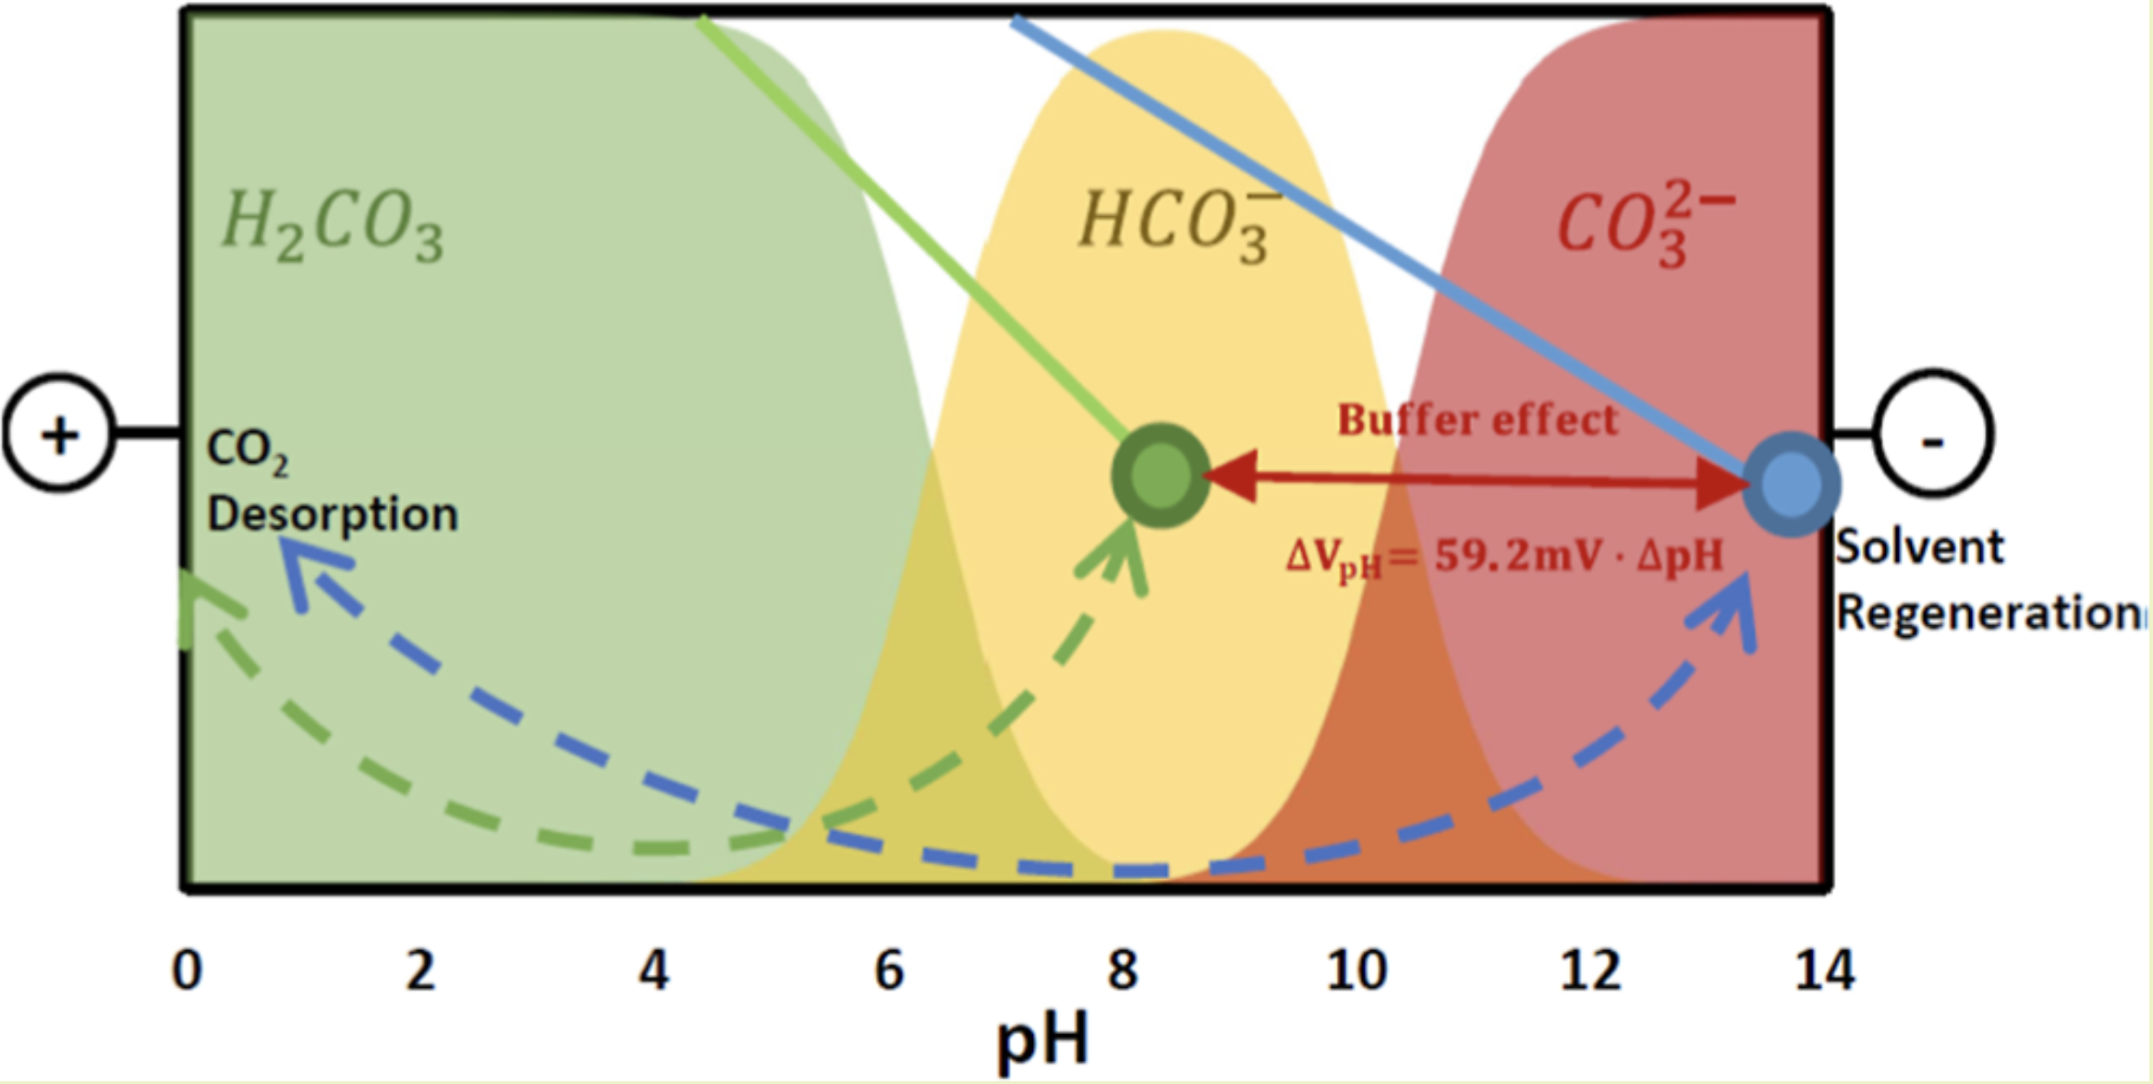
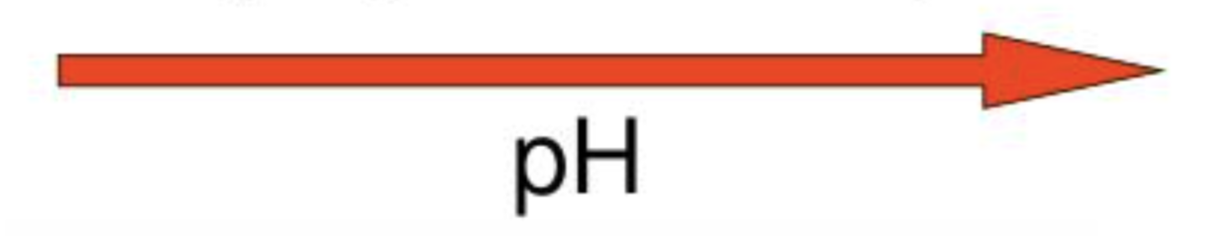
Absorption and Desorption of CO₂
Absorption: CO₂ (g) + H₂O (liq) ⇌ H₂CO₃ (aq)
Mild acidity due to dissociation of carbonic acid:
H₂CO₃ ⇌ HCO₃⁻ (bicarbonate ion) + H⁺ (hydrogen ion)
Desorption (Opening the can decreases pressure):
HCO₃⁻ + H⁺ ⇌ H₂CO₃ ⇌ H₂O (liq) + CO₂ (g)
The bicarbonate buffer system
CO₂ + H₂O ⇌ H⁺ + HCO₃⁻ ⇌ 2H⁺ + CO₃²⁻
https://doi.org/10.1021/acssuschemeng.3c08430

Slide 4
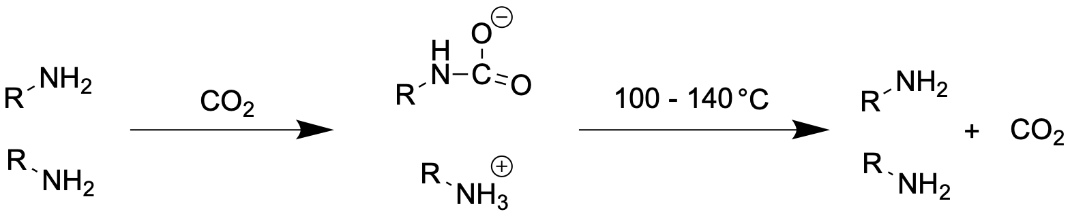

Conventional Amine based CO₂ Capture
20 – 30% of power generating capacity of Coal-powered plant.
Regeneration of amine takes up about 60-70% of of the total energy of CO2 capture systems.
Reducing the energy consumption for the regeneration process is essential

Slide 5
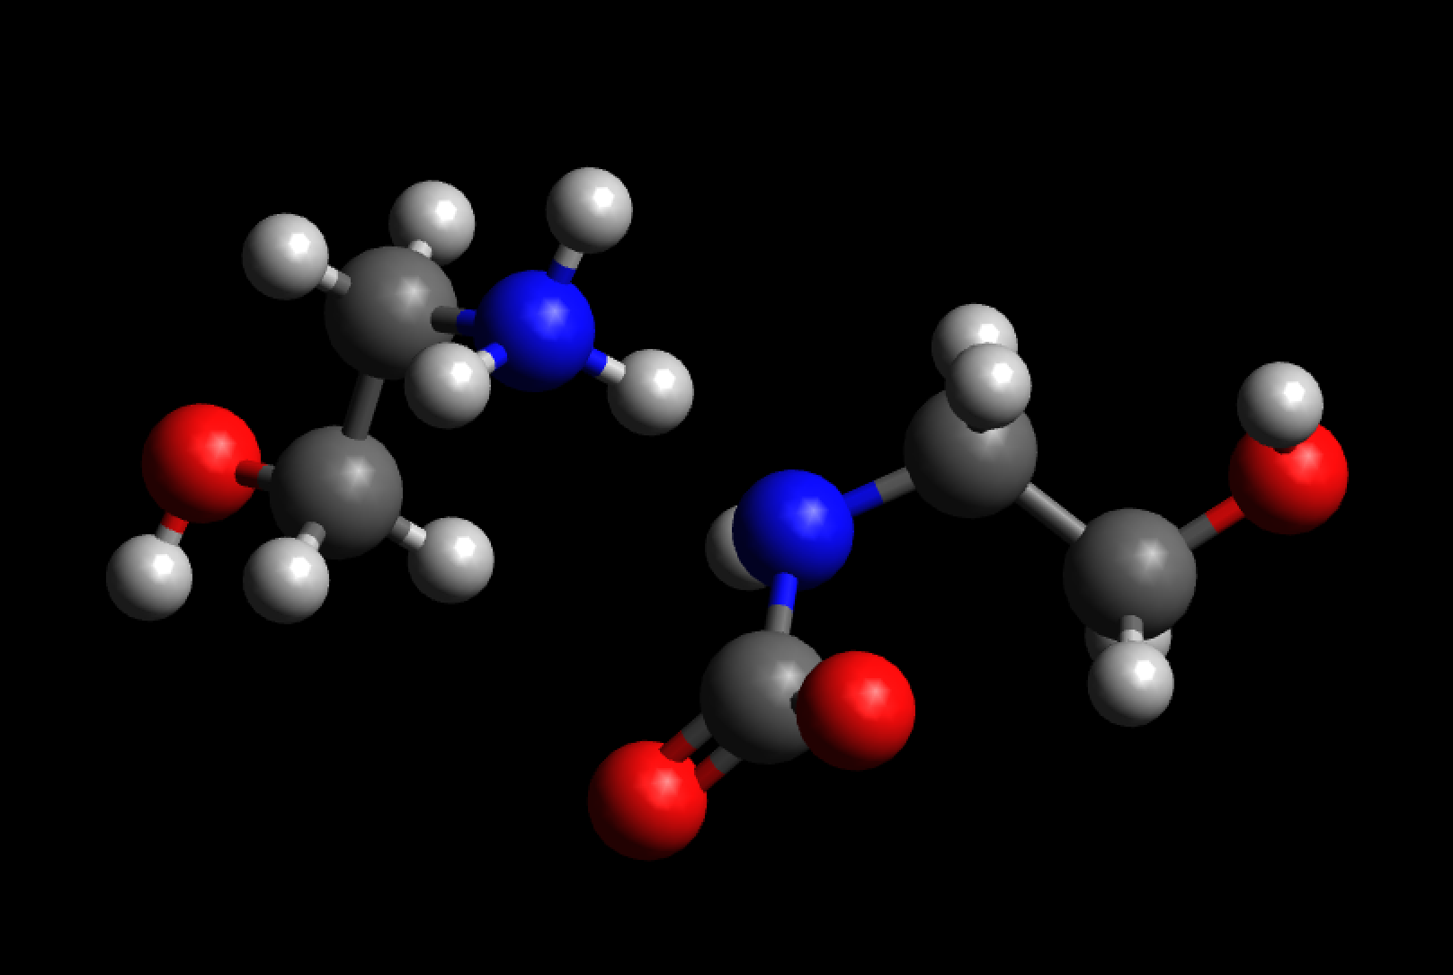
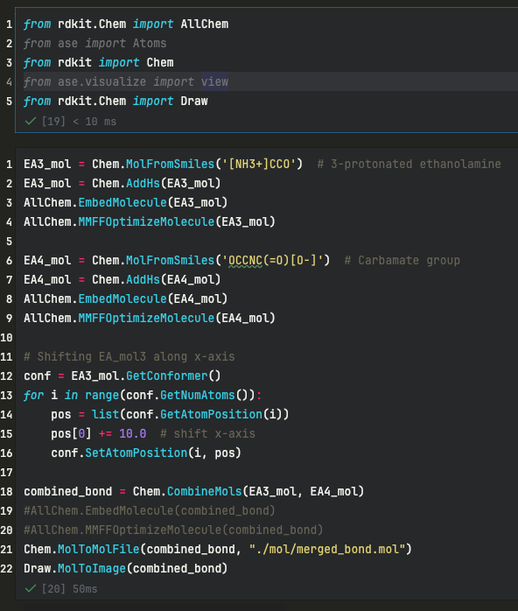

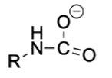
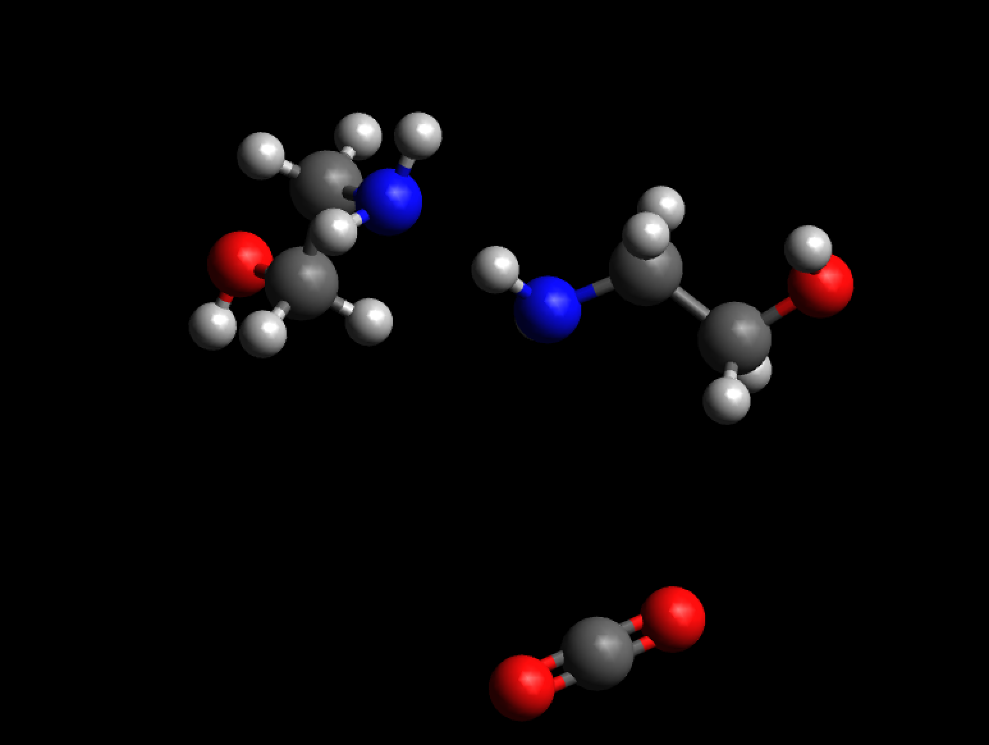
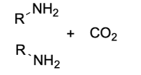
Molecule Preparation

Slide 6
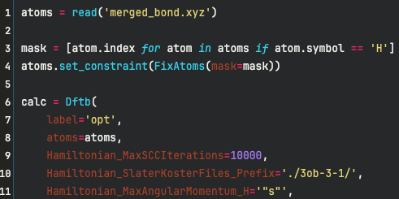
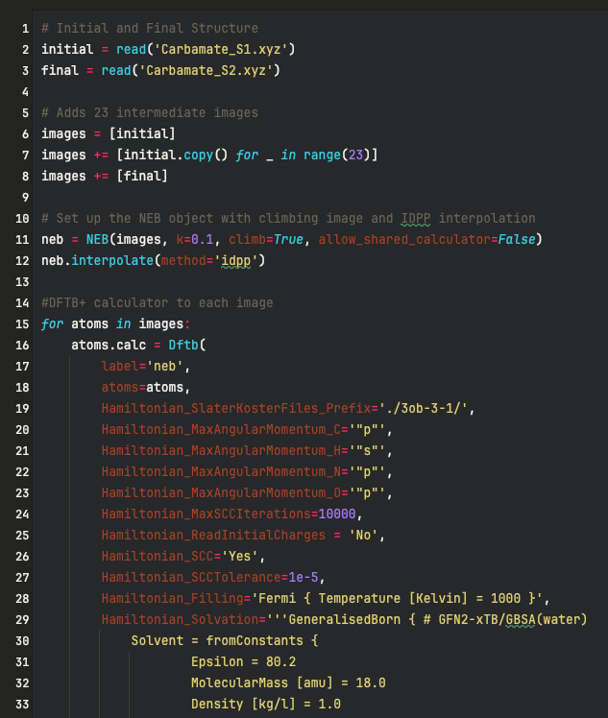
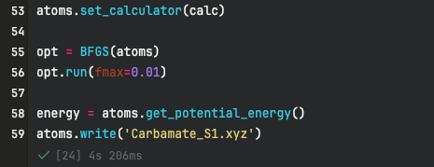
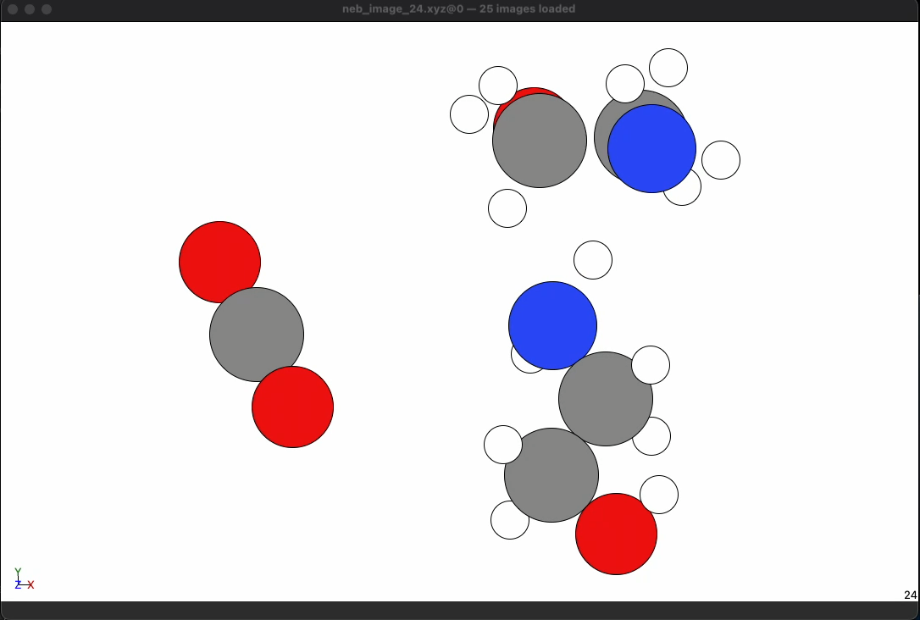
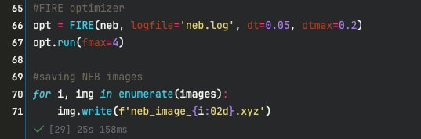
Optimization and Calculation

Slide 7
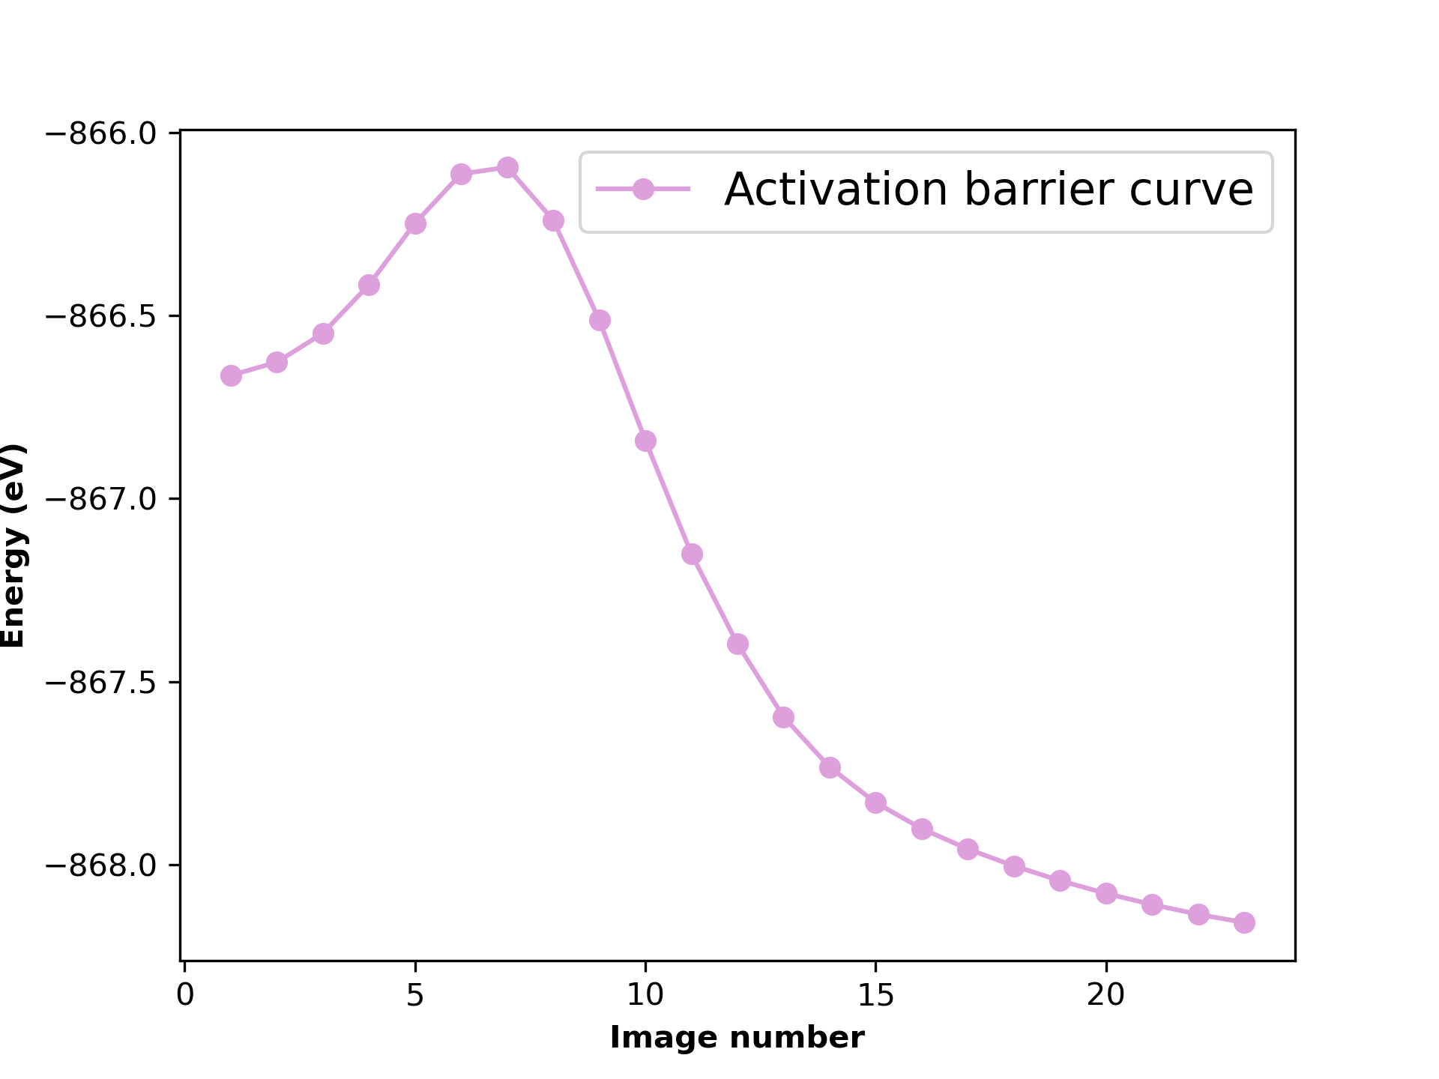
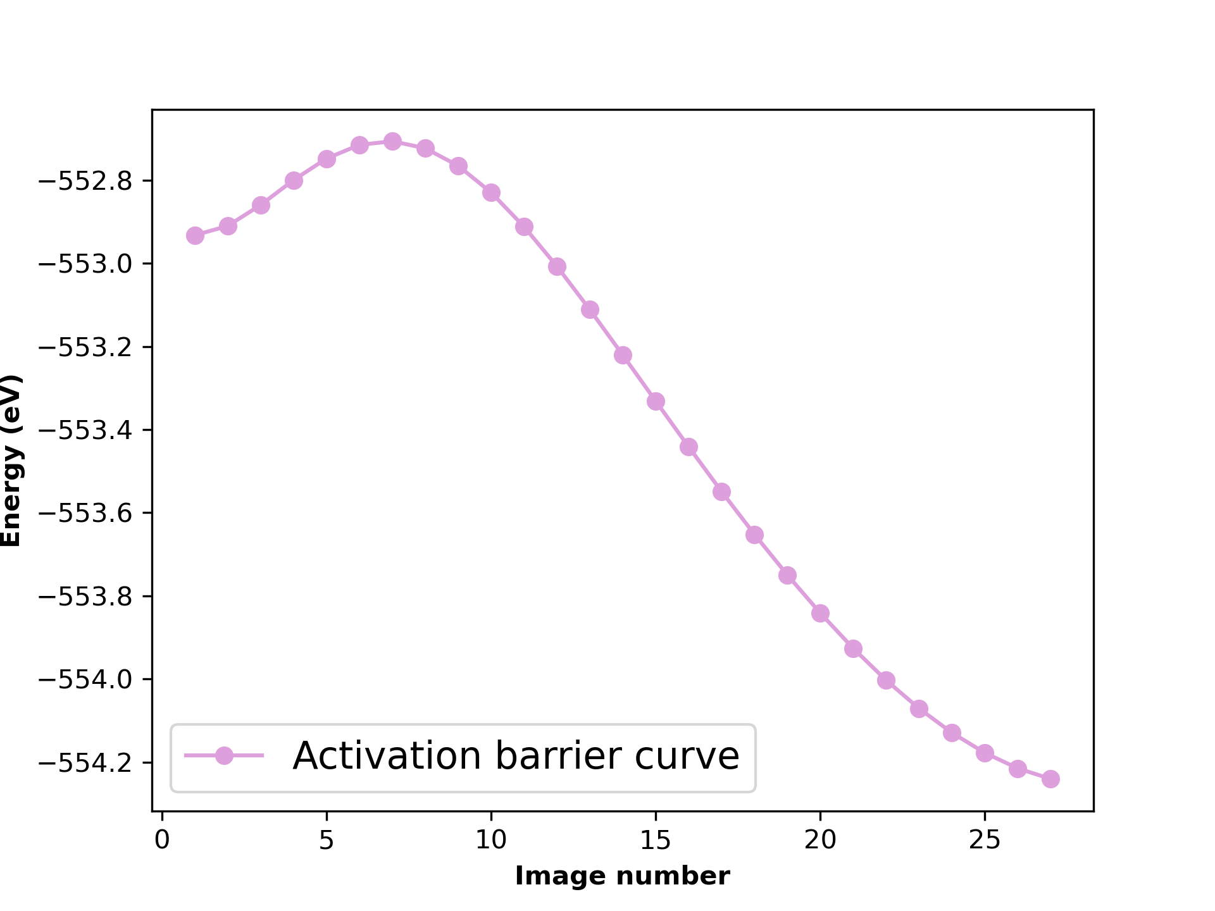
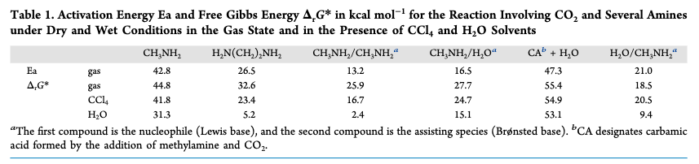
Result
HOCH₂CH₂NH₂ / HOCH₂CH₂NH₂ as solvent
CH₃NH₂ / CH₃NH₂ as solvent
0.569 eV
/Reaction profile
0.2263 eV
0.569 eV = 13.13 kcal
0.2263 eV = 5.22 kcal
https://doi.org/10.1021/acsomega.0c03727

Slide 8
Conclusion and Future goals
This model shows the mechanism of CO₂ desorption from amine.
DFTB based calculation predicted an activation energy of ~13 kcal for Monoethanolamine(MEA) and 5.5 kcal for Methylamine. The value is not very accurate since we are using DFTB.
Testing the models with different solvents
Adding Catalyst to the model and observe how the potential energy the structure change.

Slide 9
Thank You

