Slide 1
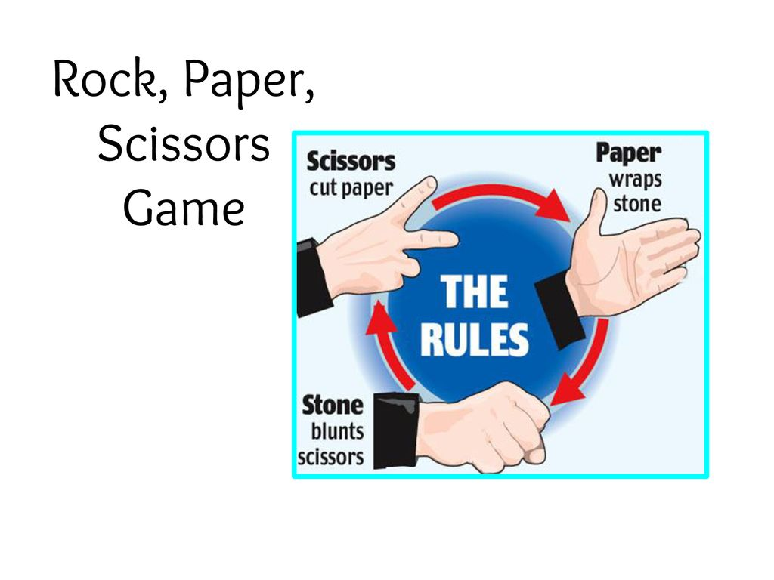

Slide 2
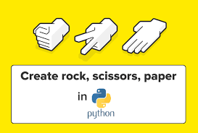
Rock Paper Scissor Game
This Python program implements a graphical version of the classic game "Rock Paper Scissors" using the Tkinter library for the graphical user interface (GUI). The game allows the user to play against the computer, with the computer's choice being randomly generated.

Slide 3
Features:
Graphical User Interface (GUI):
The game interface is created using Tkinter, a standard GUI library in Python.
Images of rock, paper, and scissors for both the user and computer are displayed using PIL and ImageTk.
Background Music:
Background music is played using the pygame mixer, providing an immersive experience.
Game Logic:
The game follows the traditional rules of Rock Paper Scissor.
The user can click on buttons to choose their move (rock, paper, or scissors).
The computer randomly selects its move.
After both the user and computer make their moves, the winner is determined based on the rules of the game, and appropriate messages are displayed.
Scoring:
The scores for both the user and computer are displayed on the GUI.
The scores are updated based on the outcome of each round.

Slide 4
Components:
Main Window (root)
The main window of the game is created using Tkinter.
It includes labels for displaying user and computer choices, scores, indicators, and messages.
Images:
Images of rock, paper, and scissors for both the user and computer are loaded using PIL and ImageTk.
These images are displayed on the GUI to represent the choices made by the user and computer.
Labels:
Labels are used to display user and computer choices, scores, indicators (USER and COMPUTER), and messages on the GUI.
Buttons:
Buttons are provided for the user to select their move (rock, paper, or scissors).
Each button is associated with a command that triggers the updatechoice() function with the corresponding choice.

Slide 5
Functions:
updateMessage(x) : Updates the message label with the given text ‘x’
updateUserScore() : Updates the user's score label by incrementing it by 1.
updatecompScore() : Updates the computer's score label by incrementing it by 1.
.checkwin(player, computer) : Determines the winner based on the player's and computer's choices and updates the message label and scores accordingly.
updatechoice(x) : Updates the choices made by the user and computer, checks for the winner, and updates the GUI accordingly.

Slide 6
Buttons:
Buttons are provided for the user to select their move (rock, paper, or scissors). .Each button is associated with a command that triggers the ‘updatechoice()’ function with the corresponding choice.
Usage:
Run the script.
Click on one of the buttons (Rock, Paper, or Scissor) to make your move.
The computer will randomly select its move.
The winner will be determined based on the game rules, and the scores will be updated accordingly.
Continue playing until you decide to exit the game.

Slide 7
Dependencies:
Tkinter (for GUI)
PIL (for image processing)
random (for generating random choices)
playsound (for playing sound effects)
pygame (for playing background music)

Slide 8
Note:
Make sure to have the required image and sound files ("rock-comp.jpeg", "paper-user.jpeg", "scissors-user.jpeg", "rock-user.jpeg", "paper-comp.jpeg", "scissors_comp.jpeg", "bg.mp3", "it's a tie.mp3", "you_loss.mp3", "you_win.mp3") in the same directory as the script for proper functioning.
This documentation provides an overview of the game, its features, components, usage instructions, and dependencies. You can refer to this documentation for understanding the functionality of the provided code.

Slide 9
Acknowledgment
We would like to express our gratitude to everyone who contributed directly or indirectly to the development and completion of this project.
Special thanks to [mention any specific individuals, organizations, or resources] for their support, guidance, and inspiration.
Your assistance and encouragement have been invaluable throughout the journey of creating this Rock Paper Scissors game.

