Slide 1
COMP.SEC.300-2024-2025-1 Secure Programming Secure Chat System
Hussn Ul Maab
Zannatun Nayeem Chowdhury
Sourav Podder

Slide 2
Introduction
Real-time communication is essential in both personal and professional domains.
Traditional chat apps often lack strong security features.
Our project aims to deliver a secure, real-time messaging platform with strong encryption and user controls.
Developed for both web and mobile using a full-stack architecture.

Slide 3
Project Objectives
Provide secure user authentication and access control.
Ensure data privacy using encryption techniques.
Prevent common web security vulnerabilities.
Enable smooth real-time communication with a good user experience.

Slide 4
System Implementation
Backend: Node.js + Express + SQLite
Frontend: Web & Mobile (with SharedPreferences and cookies) + Flutter(Mobile App)
Real-time: Socket.IO/WebSocket
Security-first design with 7 core features

Slide 5
Demo of Mobile App
https://drive.google.com/file/d/1236A28f6HQel-2nL7BXM-OUXSmicRnVY/view?usp=sharing

Slide 6
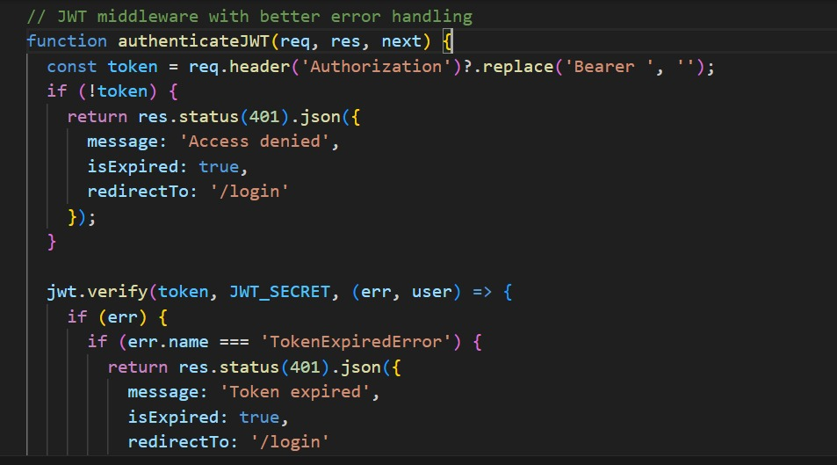
Security Features (1)
1. User Authentication
- Bcrypt password hashing
- JWT-based session control

Slide 7
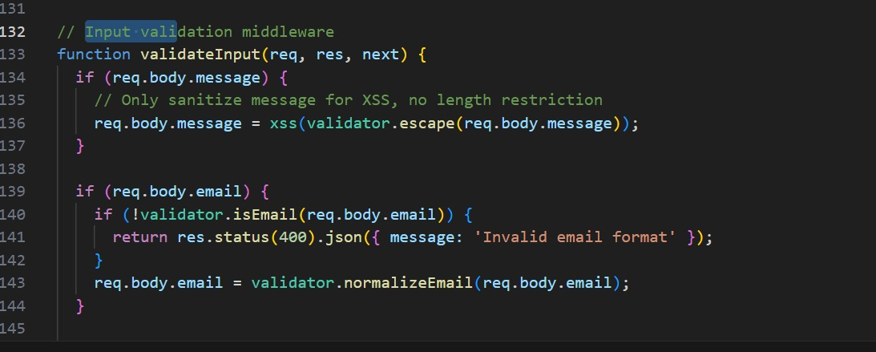
Security Features (2)
2. Input Validation & Sanitization
- Prevents XSS, SQL injection, and command injection
- Uses validator.js and xss libraries

Slide 8
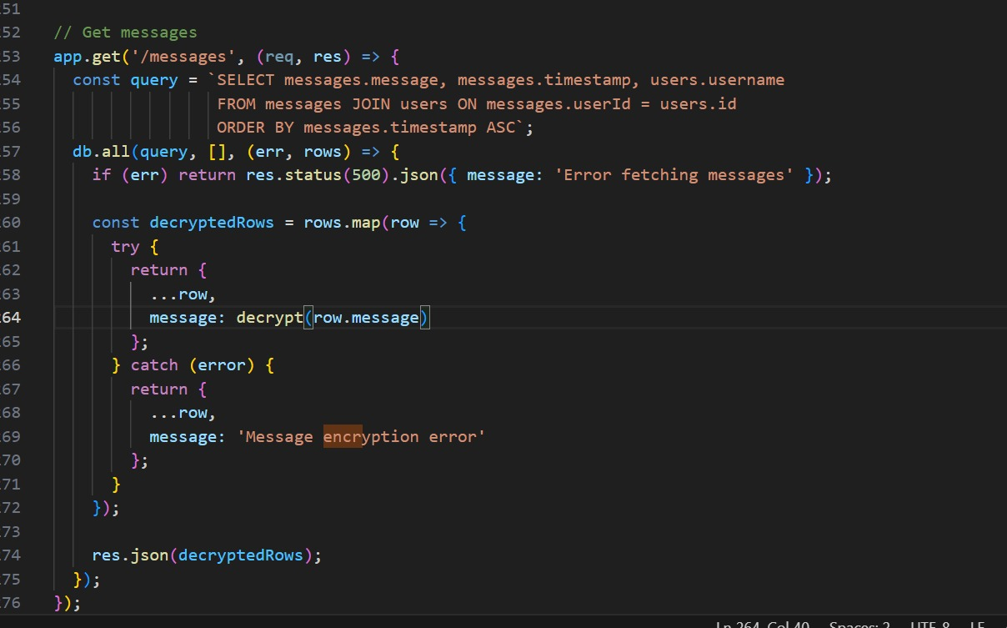
Security Features (3)
3. Data Encryption
- AES-256-CBC encryption at rest
- SSL/TLS for data-in-transit

Slide 9
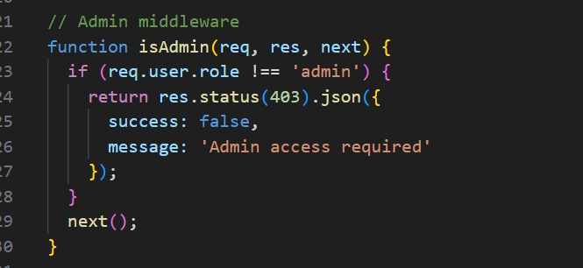
Security Features (4)
4. Role-Based Access Control
- Admin vs. regular users
- Admins can clear chat history and access protected routes

Slide 10
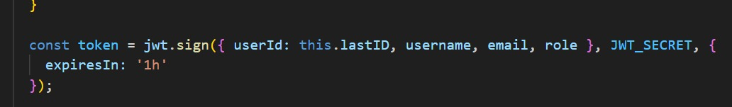
Security Features (5)
5. Session Management
- JWT with 1-hour expiration
- Secure, HTTP-only cookies

Slide 11
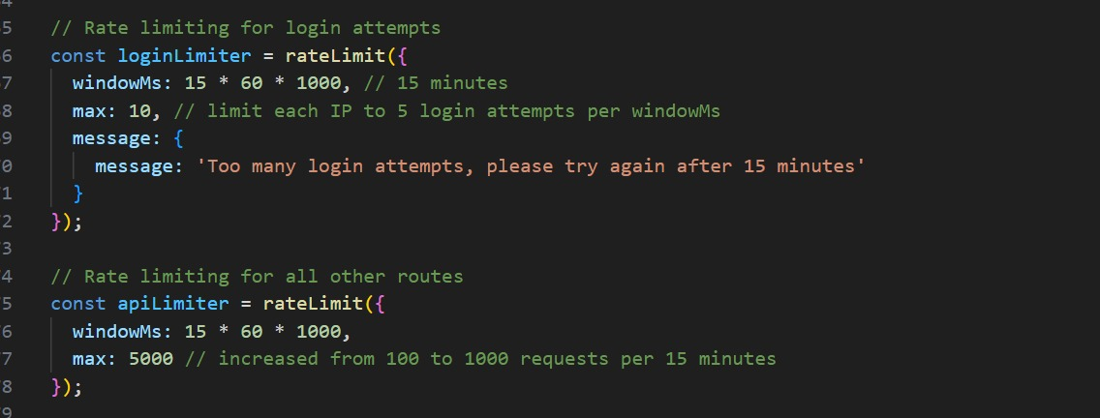
Security Features (6)
6. Rate Limiting & Account Lockout
- Prevents brute-force login attacks
- Uses express-rate-limit

Slide 12
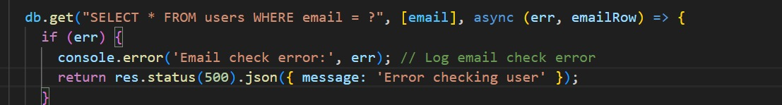
Security Features (7)
7. Secure Error Handling
- Custom middleware hides server errors

Slide 13
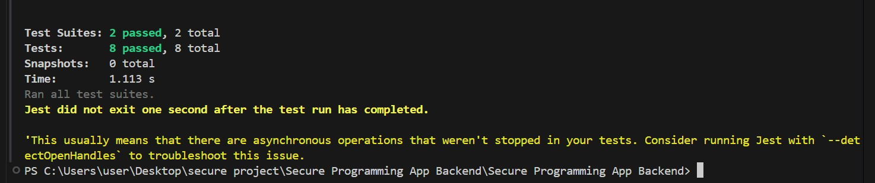
Testing

Slide 14
Testing Implementation
Testing Frameworks & Tools Used
Jest – JavaScript testing framework for assertions and test running.
Supertest – For making HTTP requests to your Express app endpoints.
SQLite (in-memory) – Used to isolate and simulate database operations for each test run.

Slide 15
Messaging & User Interface
Real-time messaging with Socket.IO
Features: avatars, timestamps, chat bubbles
Admin tools: clear chat, user role control
Smooth UI/UX with toast alerts and loaders

Slide 16
Scope of Improvements
1. Add End-to-End Encryption (E2EE)
2. Integrate Two-Factor Authentication (2FA)
3. Use scalable databases like PostgreSQL or MongoDB
4. Enable push notifications and offline support

Slide 17
Conclusion
The Secure Chat System integrates real-time features with strong security mechanisms.
Designed using security-by-design principles.
Future-ready: scalable, extensible, and cross-platform.
Suitable for institutional, educational, or organizational deployment.

