Slide 1

LONG -TERM ACTIVITY DETECTION FROM THE WRIST
Group Members(Group 2):
Sourav Poudyal (1607167)
Shishir Pokhrel (1603242)
Thitaree Sunticheewawong (1603226)
Dipanjan Mukherjee (1638965)
The chair for Ubiquitous Computing:
Dr. Kristof Van Laerhoven
Mr. Alexander Hölzemann
Mr. Marius Bock

Slide 2
Introduction
Human activity recognition with input data from wearable sensors.
Data from sensors collected, preprocessed and used for training.
12 subjects are used to train the data and one subject is used to cross validate the trained model.
Model is trained using Deep Convolutional LSTM
Validation and Hyperparameter Tuning is implemented to fine tune the network

Slide 3
Introduction
Temporal dependencies are mitigated better using feedback network models like LSTM and RNN.
Issues with HAR :
Class imbalance
Class similarity
Not all data is relevant for Human Activity recognition.

Slide 4
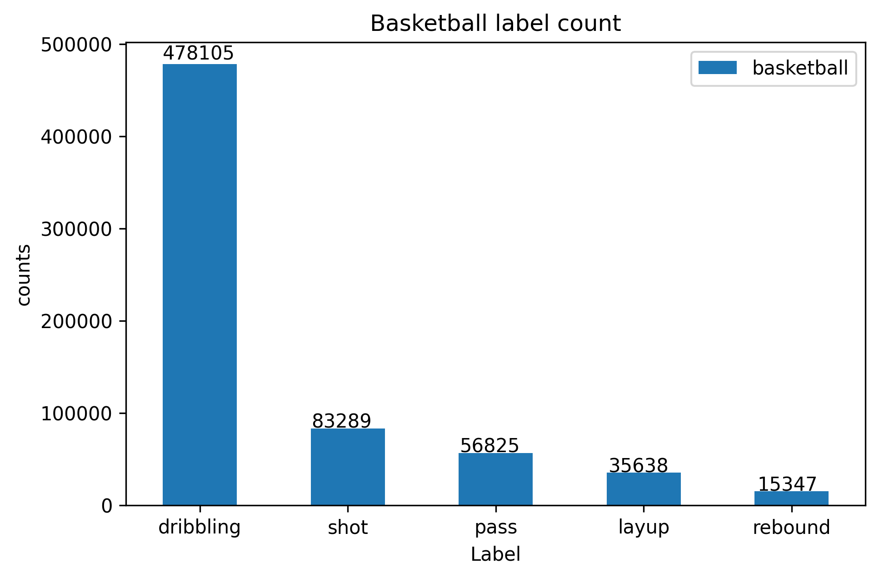
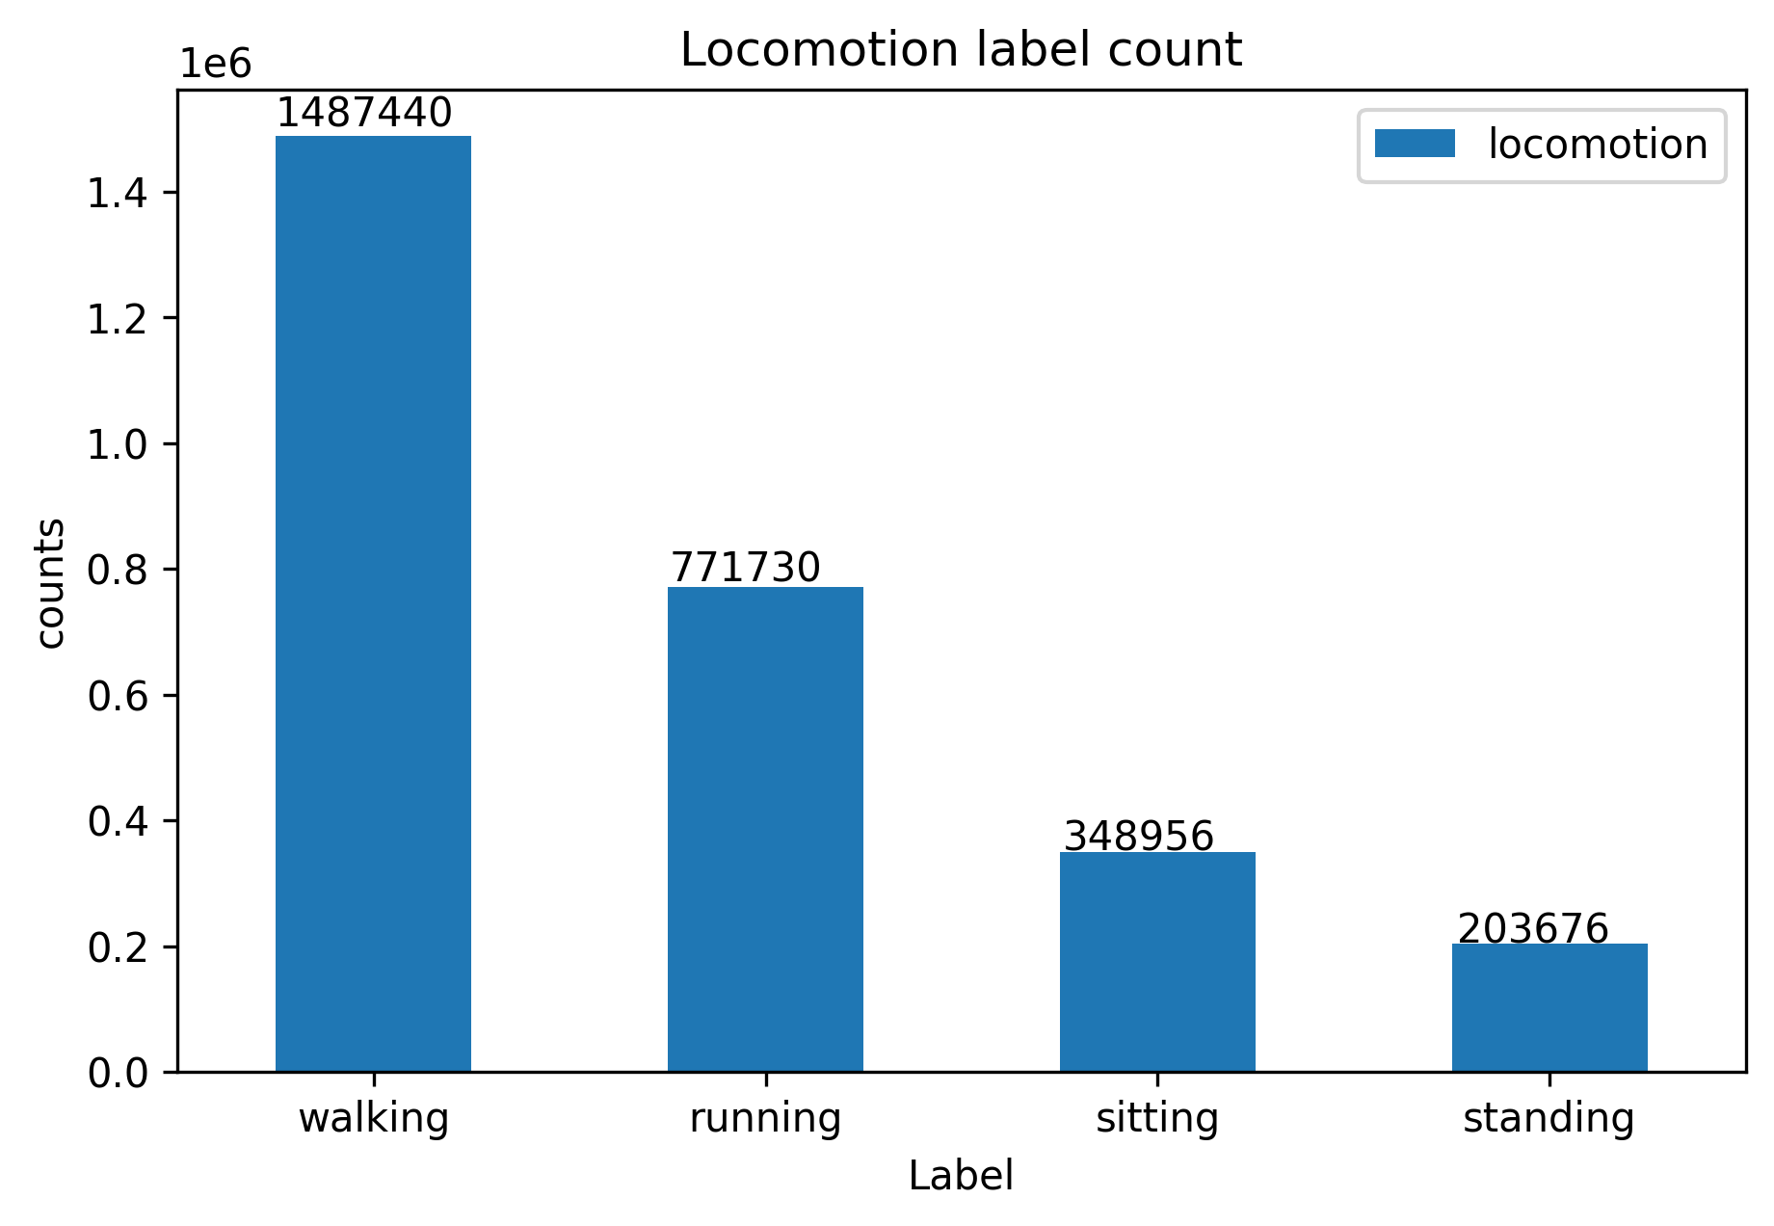
Aim: Classify a subject’s activity into the following classes

Slide 5
Methodology
For better classification, cross validation and to overcome the challenges, following techniques have been used in this project.
Min-Max scaling during Pre processing.
Sliding windows.
LSTM model.
Data augmentation and batch normalisation
Leave one Subject out Cross Validation.

Slide 6
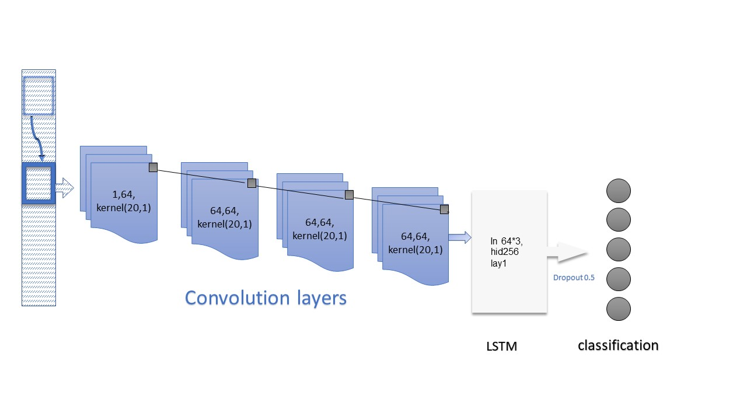
Network architecture
Sensor data

Slide 7
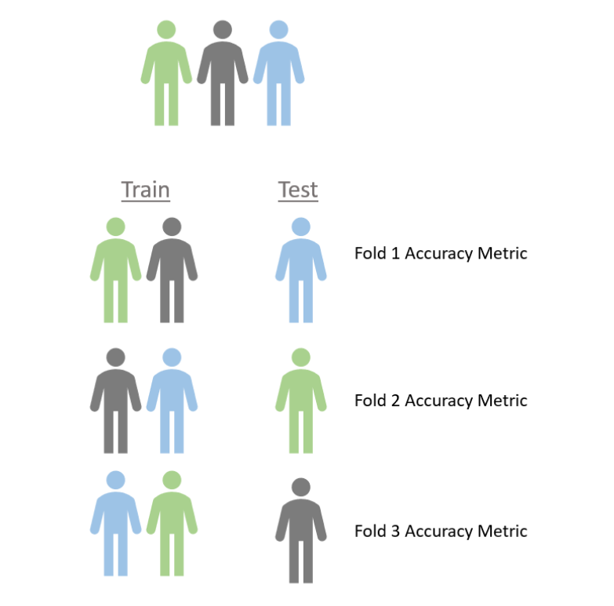
Leave one Subject out Cross Validation
Leave-One-Subject-Out can be described as k-fold Cross-Validation where a fold represents all data of one subject and thus k is equal to the number of subjects in the data. The validation loop is then k training cycles where each time a new subject becomes the validation dataset and all other subjects become the training set.

Slide 8
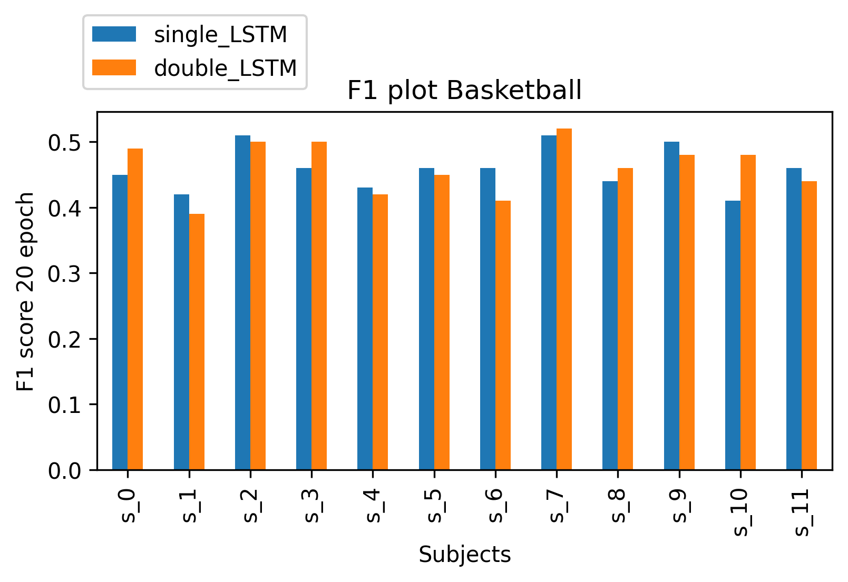
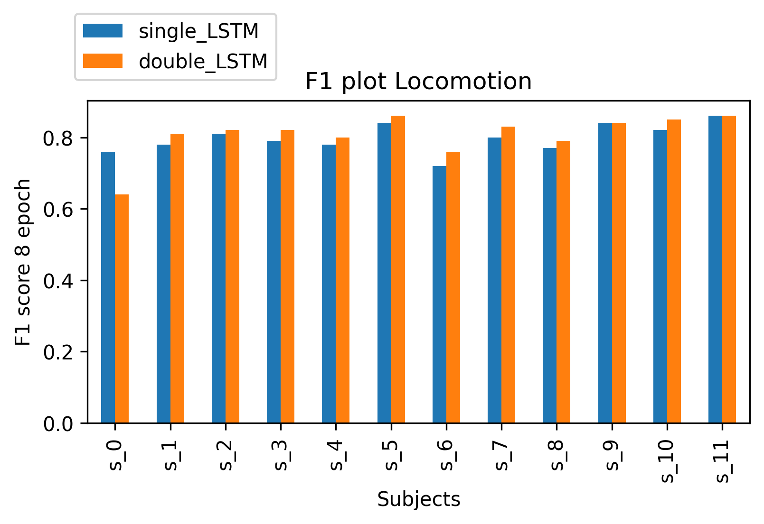
CROSS VALIDATION RESULTS
Comparison Single layer vs double layer LSTM.
Basketball dataset
Locomotion dataset

Slide 9
CROSS VALIDATION RESULTS
Subjects | Single_LSTM | Double_LSTM
S_0 | 0.48 | 0.49
S_1 | 0.46 | 0.39
S_2 | 0.53 | 0.50
S_3 | 0.48 | 0.50
S_4 | 0.42 | 0.42
S_5 | 0.44 | 0.45
S_6 | 0.46 | 0.41
S_7 | 0.53 | 0.52
S_8 | 0.42 | 0.46
S_9 | 0.48 | 0.48
S_10 | 0.46 | 0.48
S_11 | 0.43 | 0.44
Subjects | Single_LSTM | Double_LSTM
S_0 | 0.76 | 0.64
S_1 | 0.78 | 0.81
S_2 | 0.81 | 0.82
S_3 | 0.79 | 0.82
S_4 | 0.78 | 0.80
S_5 | 0.84 | 0.86
S_6 | 0.72 | 0.76
S_7 | 0.80 | 0.83
S_8 | 0.77 | 0.79
S_9 | 0.84 | 0.84
S_10 | 0.82 | 0.85
S_11 | 0.86 | 0.86
Basketball dataset
Locomotion dataset

Slide 10
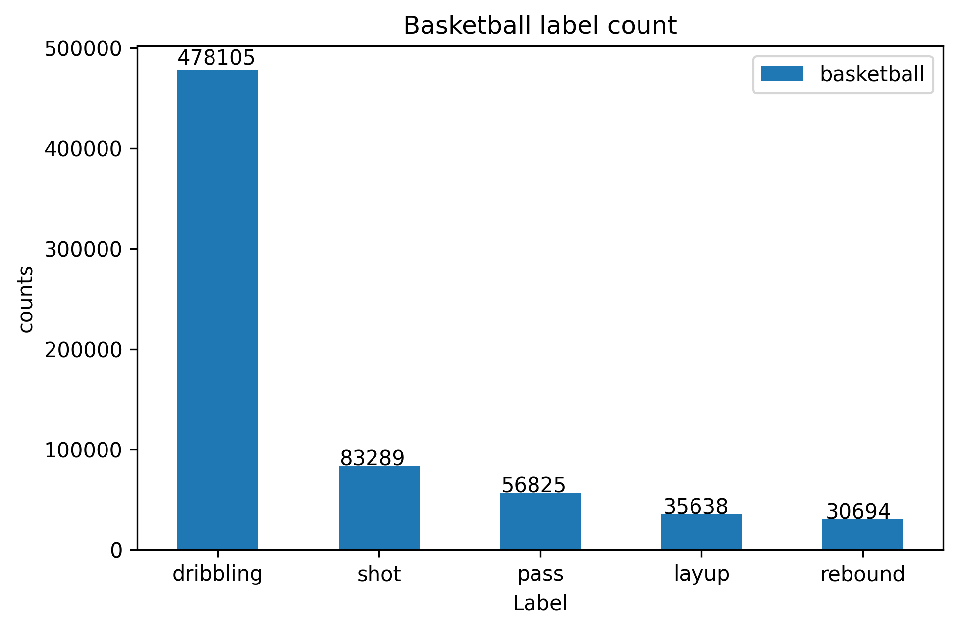
Data augmentation for rebound class
Without augmentation
With augmentation

Slide 11
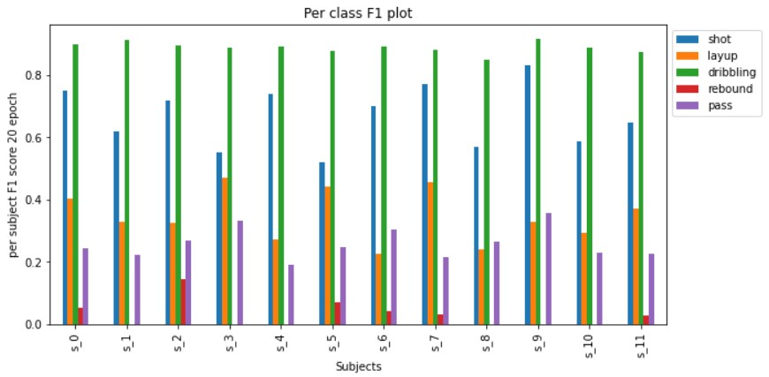
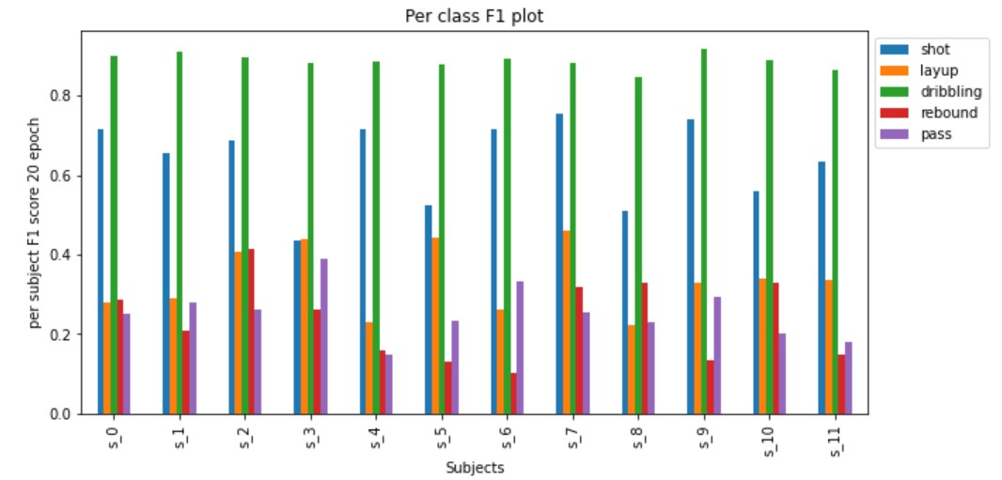
F1 scores for Basketball with Data augmentation and Batch Normalization.
Without augmentation
With augmentation

Slide 12
Subject | shot | layup | dribbling | rebound | pass
S_0 | 0.749507 | 0.403101 | 0.897844 | 0.051282 | 0.244604.
S_1 | 0.619565 | 0.328205 | 0.913197 | 0.000000 | 0.222222
S_2 | 0.719057 | 0.325991 | 0.896958 | 0.145455 | 0.267516
S_3 | 0.551402 | 0.470588 | 0.889481 | 0.000000 | 0.332155
S_4 | 0.741507 | 0.270968 | 0.890602 | 0.000000 | 0.191358
S_5 | 0.519417 | 0.442105 | 0.876967 | 0.068966 | 0.245989
S_6 | 0.699809 | 0.224719 | 0.891892 | 0.043478 | 0.302839
S_7 | 0.772894. | 0.457831 | 0.882483 | 0.030769 | 0.213836
S_8 | 0.570552 | 0.239521 | 0.849091 | 0.000000 | 0.266212
S_9 | 0.830769 | 0.329670 | 0.917347 | 0.000000 | 0.358209
S_10 | 0.587912 | 0.293706 | 0.887931 | 0.000000 | 0.228571
S_11 | 0.646967 | 0.371041 | 0.872968 | 0.027397 | 0.226562
Subject | shot | layup | dribbling | rebound | pass
S_0 | 0.716469 | 0.280374 | 0.900452 | 0.285714 | 0.250000
S_1 | 0.654545 | 0.290698 | 0.911775 | 0.207407 | 0.280543
S_2 | 0.685714 | 0.406015 | 0.897184 | 0.414894 | 0.262626
S_3 | 0.435000 | 0.437878 | 0.883690 | 0.261538 | 0.388489
S_4 | 0.714487 | 0.229730 | 0.884831 | 0.160000 | 0.146789
S_5 | 0.524390 | 0.443350 | 0.877944 | 0.132075 | 0.232558
S_6 | 0.714012 | 0.262911 | 0.891188 | 0.103448 | 0.331361
S_7 | 0.754221 | 0.462006 | 0.881281 | 0.318182 | 0.256250
S_8 | 0.508961 | 0.223684 | 0.845070 | 0.328125 | 0.229730
S_9 | 0.738916 | 0.327434 | 0.917929 | 0.132353 | 0.294416
S_10 | 0.559194 | 0.339623 | 0.890562 | 0. 327586 | 0.201923
S_11 | 0.635220 | 0.334928 | 0.864848 | 0.148571 | 0.178404
Without augmentation
With augmentation

Slide 13
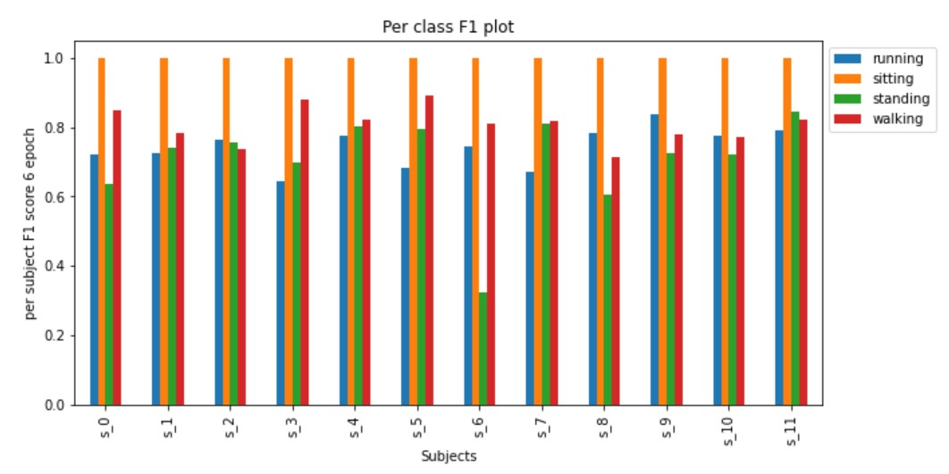
F1 per Class for locomotion dataset with and Batch Normalisation

Slide 14
F1 for locomotion dataset with Batch Normalisation
Subject | running | sitting | standing | walking
S_0 | 0.721035 | 0.998698 | 0.637985 | 0.848610
S_1 | 0.723779 | 0.998501 | 0.740458 | 0.781946
S_2 | 0.763528 | 0.999127 | 0.757969 | 0.736441
S_3 | 0.645051 | 1.000000 | 0.698690 | 0.878768
S_4 | 0.774125 | 0.998628 | 0.804408 | 0.823139
S_5 | 0.682315 | 0.999309 | 0.796920 | 0.891029
S_6 | 0.746673 | 1.000000 | 0.323232 | 0.810403
S_7 | 0.671776 | 0.998271 | 0.809947 | 0.818830
S_8 | 0.785237 | 0.998492 | 0.604101 | 0.715242
S_9 | 0.838289 | 0.998395 | 0.725471 | 0.777799
S_10 | 0.776681 | 0.999459 | 0.721221 | 0.772181
S_11 | 0.792078 | 0.998425 | 0.843945 | 0.822763

Slide 15
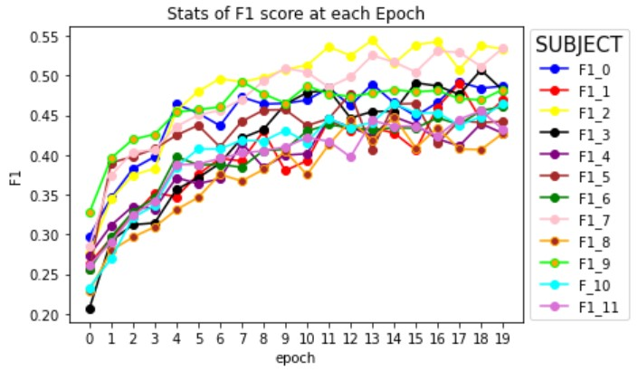
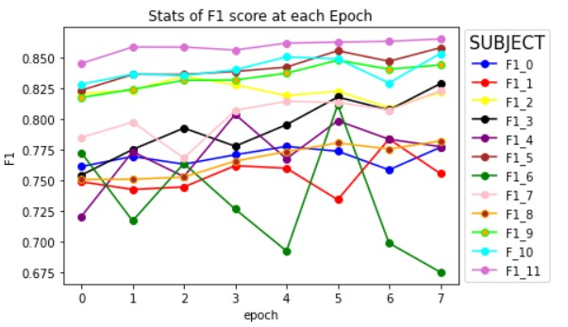
F1 Score at each epoch
Basketball Dataset
Locomotion Dataset

Slide 16
Hyper parameter changes and results
Basketball training
case | HidLayers | BatchSize | LearnRate | SlWindow | ovLapSize | DropOut | kernel
1 | 128 | 100 | 0.0001 | 50 | Unchanged | 0.5 | 11
2 | 128 | 100 | 0.00001 | 50 | Unchanged | 0.5 | 11 | worse
3 | 128 | 1000 | 0.0001 | 50 | Unchanged | 0.5 | 11 | worse
4 | 128 | 50 | 0.0001 | 50 | Unchanged | 0.5 | 11 | better
5 | 64 | 50 | 0.0001 | 50 | Unchanged | 0.5 | 11 | worse
6 | 256 | 50 | 0.0001 | 50 | Unchanged | 0.5 | 11 | better
7 | 256 | 50 | 0.0001 | 100 | Unchanged | 0.5 | 11 | worse
8 | 256 | 50 | 0.0001 | 10 | Unchanged | 0.5 | 10 | worse
9 | 256 | 50 | 0.0001 | 70 | Unchanged | 0.5 | 12 | worse
10 | 256 | 50 | 0.0001 | 70 | Unchanged | 0.5 | 13 | better
11 | 256 | 50 | 0.0001 | 80 | Unchanged | 0.5 | 20 | the best

Slide 17
THANK YOU

Slide 18
References
[1] Marius Bock, Alexander Hölzemann, Michael Moeller, and Kristof Van Laerhoven. Improving deep learning for HAR with shallow lstms. CoRR, abs/2108.00702, 2021
[2] Andreas Bulling, Ulf Blanke, and Bernt Schiele. A tutorial on human activity recognition using body-worn inertial sensors. ACM Computing Surveys, 46, 01 2013.
[3] Francisco Javier Ordóñez and Daniel Roggen. Deep convolutional and lstm recurrent neural networks for multimodal wearable activity recognition. Sensors, 16(1), 2016.
[4] Qingsong Wen, Liang Sun, Fan Yang, Xiaomin Song, Jingkun Gao, Xue Wang, and Huan Xu. Time series data augmentation for deep learning: A survey. arXiv preprint arXiv:2002.12478,2020.

