Slide 1
APPLICATION OF SOFT COMPUTING IN SUDOKU FORMATION

Slide 2

HOOGHLY ENGINEERING & TECHNOLOGY COLLEGE
PRESENTED BY | UNIVERSITY ROLL | CLASS ROLL
Tanya Anand | 17600116007 | 07
Suman Banerjee | 17600116012 | 11
Sourav Roy | 17600116016 | 15
Riya Saha | 17600116031 | 30
Project Supervisor:
Mr. Sandeep Bhowmik
Computer Science & Engineering Department,
Hooghly Engineering & Technology College
Computer Science & Engineering
8th Semester, 4th Year

Slide 3
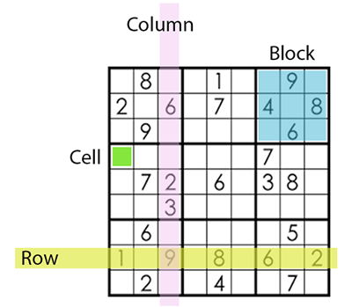
Overview of Sudoku
Sudoku puzzle with order 9×9 are composed of a 9 × 9 boxes (cells), divided into nine 3 x 3 sub-blocks.
When the Sudoku game is prepared to play, there are some pre-filled (fixed) numbers which are not allowed to changed or moved during the process of solving Sudoku puzzles, then you will start to fill other unfilled boxes.

Slide 4
We can summarize rules to solve Sudoku into three rules:
Rule 1: Each row should contain values from 1 to 9 without repeating any number.
Rule 2: Each column should contain values from 1 to 9 without repeating any number.
Rule 3: The sub-block should contain only values from 1 to 9 without repetition.

Slide 5
Goal
Our aim was not to generate a Sudoku solver algorithm but instead to create an algorithm to be used by a puzzle setter to produce a well-posed unique Sudoku grid.
Various methodologies used to generate Sudoku are as follows:
  Backtracking
  Constraints Satisfaction Problem
  Inverse Problem
  Digging Hole Strategy & Transformation Method
  Genetic Algorithm

Slide 6
We have implemented Genetic algorithm as a way-out of Soft Computing in Sudoku formation.
Also, Genetic algorithm is an appropriate method to find a solution faster and more efficient compared to any stochastic methods. The proposed algorithm is able to generate such puzzles with any level of difficulties in a short period of time.

Slide 7
Applications of Genetic Algorithm
Genetic algorithm is suitable for few optimization problems which depends on the amount of knowledge of the problem.
Example: Travelling Salesman Problem, timetabling and scheduling problems, etc.
Genetic Algorithms are often applied as an approach to solve global optimization problems.

Slide 8
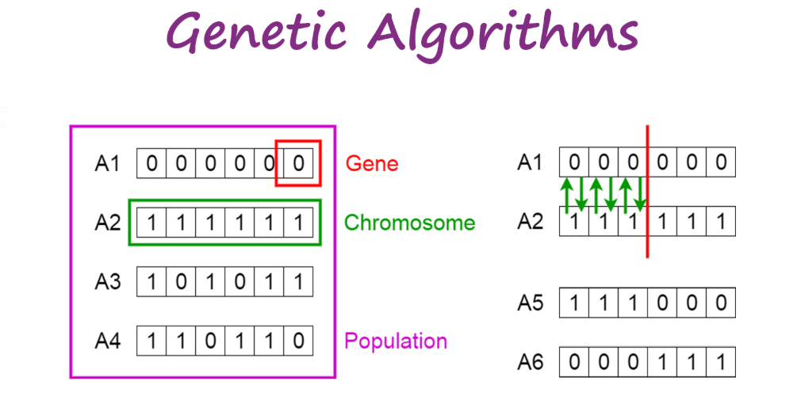
Concept of GENETIC ALGORITHM
A genetic algorithm is a heuristic search method that is inspired by Charles Darwin’s theory of natural evolution. This algorithm reflects the process of natural selection where the fittest individuals are selected for reproduction in order to produce offspring of the next generation.

Slide 9
Steps of Genetic Algorithm
Five phases are considered in a genetic algorithm :
Initial population :-
The process begins with a set of individuals which is called a Population. Each individual is a solution to the problem you want to solve.
Selection :-
The idea of selection phase is to select the fittest individuals and let them pass their genes to the next generation.

Slide 10
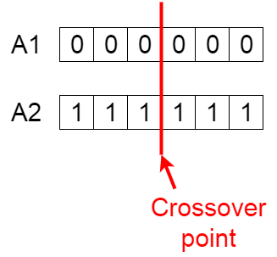
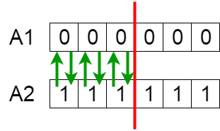
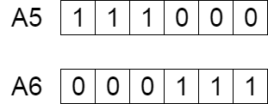
Fitness Function :-
The fitness function determines how fit an individual is (the ability of an individual to compete with other individuals). It gives a fitness score to each individual. The probability that an individual will be selected for reproduction is based on its fitness score.
Crossover :-
Crossover is the most significant phase in a genetic algorithm. For each pair of parents to be mated, a crossover point is chosen at random from within the genes.

Slide 11
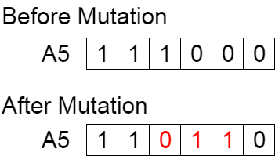
Mutation :-
In certain new offspring formed, some of their genes can be subjected to a mutation with a low random probability. This implies that some of the bits in the bit string can be flipped.

Slide 12
Software and Hardware Requirements
Hardware Requirements
1. Processor: Minimum Recommended 2 GHz or more
2. Storage space: Minimum 125MB for JRE
3. Memory (RAM): Minimum recommended 2GB or above
Operating Systems
1. Windows: 7 or newer
2. MAC: OS X v10.7 or higher
3. Linux: Ubuntu
Software Requirements
1. JDK 10.0.1
2. PDF Reader

Slide 13
Our Implementation
Matrix Initialization & Generation :-
At first, we generate matrix using random function and define a matrix which will resemble the initial configuration of the Sudoku grid and then will initialize the population size and maximum iterations accordingly.

Slide 14
Fitness Function Calculation :-
Fitness here is calculated every time whenever any repetitions of a number is identified in a single matrix. And once the Fitness is calculated, then we will proceed further depending upon the Fitness Score. This function is repeatedly invoked wherever necessary.

Slide 15
Selection :-
We will consider the fitness values of the matrices and select those who have it minimized. Our optimum target is to minimize the fitness function. So, we will select only the lower fitness valued matrices . If we get the fitness function of any matrix is equal to zero, then we will consider it as our solution.

Slide 16
Crossover :-
Swapping between different matrices takes place in this step. We have selected any two sub-grids of different matrices in random order. The elements of those two sub-grids are swapped and the rest of the matrix remains unchanged.

Slide 17
Mutation :-
Mutation is done by replacing any number of any random sub-grids of any single matrix by a random new number ranging from 1 to 9. Therefore, we have selected an index of an element of any sub-grid of the matrix randomly.

Slide 18
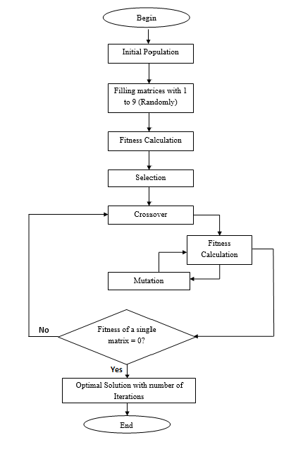
Flowchart
Notes:
18

Slide 19
Result & Discussion
Performance Evaluation
Our approaches have revealed that the implementation of the Genetic algorithm in our project is leading us to a possible way-out with less computing time to generate any puzzle. It can guarantee to find at least one optimal solution. However, this algorithm is efficient because the steps of it are based on random facts of the algorithm.

Slide 20
Analysis of Result
Results of implementation of GA on generating Sudoku puzzles were satisfactory, at least in the sense of obtaining an optimal solution in a reasonable amount of time. GA implementation in our project did not always generate a given Sudoku problem in single time execution. Allowing longer run times (more generations) matters here.

Slide 21
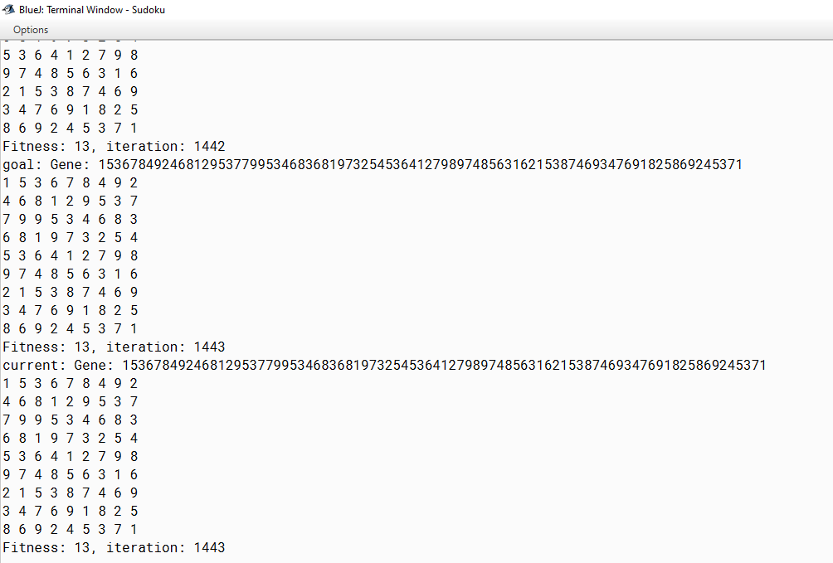
The intermediate state of the output has been captured as:

Slide 22
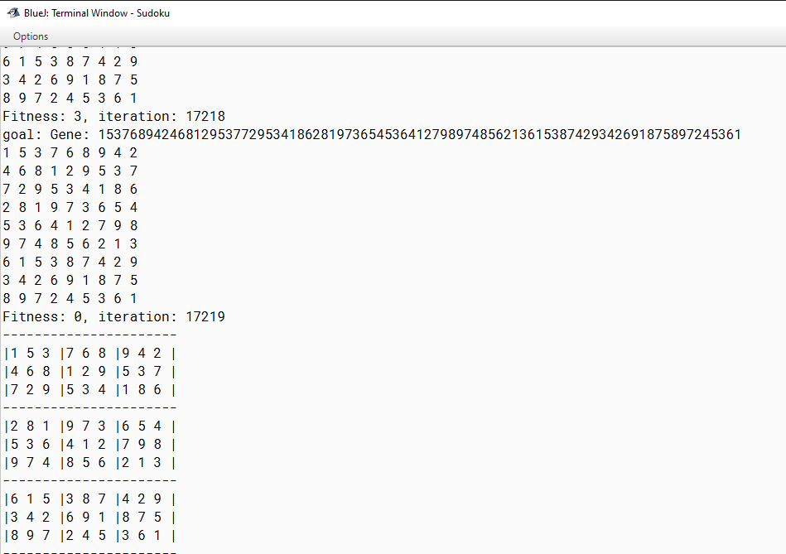
The final optimized result has been captured as:

Slide 23
BIBLIOGRAPHY
Aamulehti. Sudoku online via WWW: http://www.aamulehti.fi/sudoku/ (cited 10.10.2019)
Bharti (1994), Controlled random search technique and their applications. Ph.D. Thesis, Department of Mathematics, University of Roorkee,1994.
Deep, K. and Thakur, M. (2007a). A new crossover operator for real coded genetic algorithms. Applied Mathematics and Computation, 188(1), pp:895-911.
Gold, M. Using Genetic Algorithms to Come up with Sudoku Puzzles. WWW:http://www.csharpcorner.com/UploadFile/mgold/Sudoku0923005003323 AM/Sudoku.aspx?ArticleID-fba36449-ccf3-444f-a435-a812535c45e5 (cited 12.08.2019).

Slide 24
Thank You!

