Slide 1
Capstone Project
Hotel Booking Analysis
- Sourav Singh Baghel

Slide 2
Team Members
Pavan Kalyan (Team Lead)
Ashfaque Ahmad
Md Sohail Akhtar
Sourav Singh Baghel
Lawrence Dhar

Slide 3

Points to Discuss
Agenda
Data Summary
Steps Followed while analysing the data
Correlation Heatmap
ADP
ADR
Questions
Conclusion

Slide 4
Agenda
To analyse the csv data file given to answer specific questions.
When is the best time of the year to book a hotel.
What is the optimal length of stay in order to get the best rate.
Find whether we have high no of special requests from the guests.
Exploring various governing factors that govern hotel bookings.

Slide 5
Data Summary
We are given a hotel bookings dataset. The dataset contains booking information for both City hotel and Resort hotel. The below are columns and their classifications.
hotel: City Hotel and Resort Hotel.
is_canceled: Whether the booking is cancelled or not (0 for not cancelled and 1 for cancelled).
lead_time: time (in days) between booking transaction and actual arrival.
arrival_date_year: Year of arrival.
arrival_date_month: Month of arrival.
arrival_date_week_number: Week number of arrival date.
arrival_date_day_of_month: Day of month of arrival date.
stays_in_weekend_nights: No. of weekend nights spent in a hotel.
stays_in_week_nights: No. of weeknights spent in a hotel.
adults: No. of adults in single booking record.
children: No. of children in single booking record.
babies: No. of babies in single booking record.
meal: Type of meal chosen (BB, HB, SC ….).
country: Country of origin of customers (PRT, GBR, FRA, ESP, DEU….).
market_segment: Booking through medium (TA/TO, Direct, Corporate, ….).
distribution_channel: Medium through which bookings were made (TA/TO, Direct, Corporate, ….).
is_repeated_guest: Whether the guest visited before(0 for No and 1 for Yes)
previous_cancellations: No. of previous cancelled bookings.
previous_bookings_not_canceled: No. of previous non-cancelled bookings.
reserved_room_type: Room type reserved by guests.
assigned_room_type: Room type assigned to the guests.
booking_changes: No. of booking changes done by guests.
deposit_type: Type of deposit at the time of making a booking (No deposit/ Refundable/ No refund).

Slide 6
agent: I’d of agent for booking.
company: I’d of the company making a booking.
days_in_waiting_list: No. of days on waiting list.
customer_type: Type of guests(Transient, Group,…..).
adr: Average Daily rate.
required_car_parking_spaces: No. of car parking asked during booking rooms.
total_of_special_requests: total no. of special request made by guests.
reservation_status: Whether guest checked out, cancelled bookings or not failed to show up.
reservation_status_date: Date of making reservation status.
Total number of rows in data: 119390
Total number of columns: 32

Slide 7
Steps followed when analysing the data
Removing Duplicate rows
All duplicate rows were dropped.
Total number of rows cleaned: 31994
Handling null values
Null values in column country was replaced by “na”.
Null values in column agent was replaced by 0.
Null values in column children was replaced by 0.
Creating new columns
Column total guests adding adults, children, babies.
duplicate=df[df.duplicated()]
df.drop_duplicates(inplace=True)
df["country"]=df["country"].fillna("na")
df["agent"]=df["agent"].fillna(0)
df["children"]=df["children"].fillna(0)
df[“total_guests"]=df["adults"] + df["children"] + df["babies"]

Slide 8
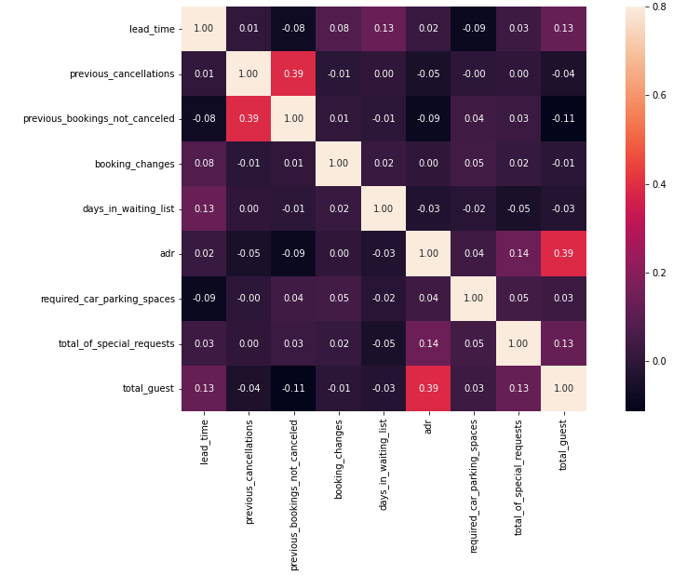
Heatmap
ADR and total guests have slight correlation. 0.39 is marked.
This makes sense as the more the no of guests, which means that the occupancy will be higher and that in turn leads to higher revenue for the hotels..
.Out of the 10 columns that we selected 2data columns seem to have some relation with each other that we can make inference and deductions.

Slide 9
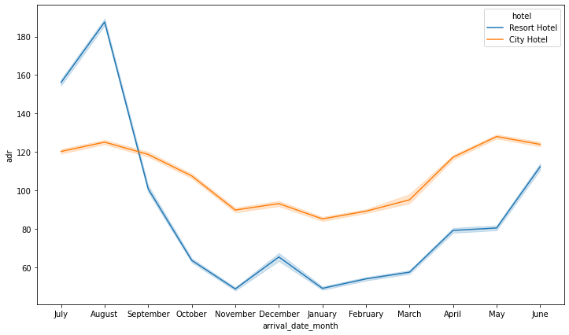
ADR (Average Daily Rate)
ADR is a KPI that shows hotels average revenue per occupied room per day. As it doesn’t include empty rooms, we can use it to compare hotel performance and revenue to previous periods, thus forecasting seasonal trends better.
ADR=room revenue/total no of rooms sold
We can see the we have a higher ADR in the middle of the year (i.e. July, August) and lowers down
towards the end of the year.
But after November again the ADR sees a
increasing trend.
Higher ADR means good revenue for the hotels.

Slide 10
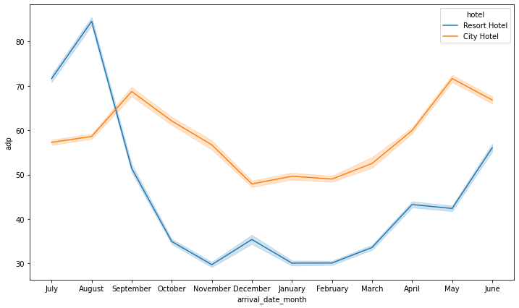
ADP (Average Daily Rate
Average Daily Rate (ADP) = ADR / Guests
The above is a measure to calculate average price per guest.
If we see the above trend, the following inferences are made. The Resort hotel sees peek in price for each guest in August and then seesa continuous fall.
On the other hand City hotel sees slight price hike September and May.
Overall we can say that prices of Resort hotel are higher as compared to City hotel.
Also City hotel prices remain almost constant throughout the year.

Slide 11
Questions
Q1- Which is the most booked hotel
Q2- which is busiest month in the year
Q3- Which hotel has the most booking for each year.
Q4- Which country has the highest booking and guest.
Q5- What is proportion of non-cancelled and cancelled reservations.
Q6- Which rooms in each hotel are the most frequently used.

Slide 12
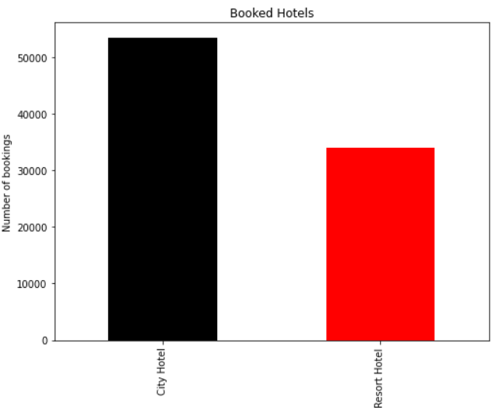
Popularity
Looking at the results above, we can see that city hotels have more booking than for resort hotels.

Slide 13
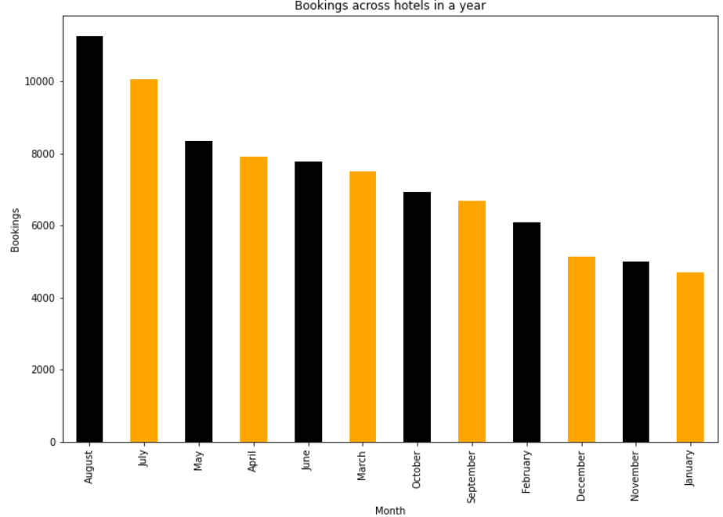
Busiest
The following hotel occupancy rates are highest in August and July and lowest in November and January.

Slide 14
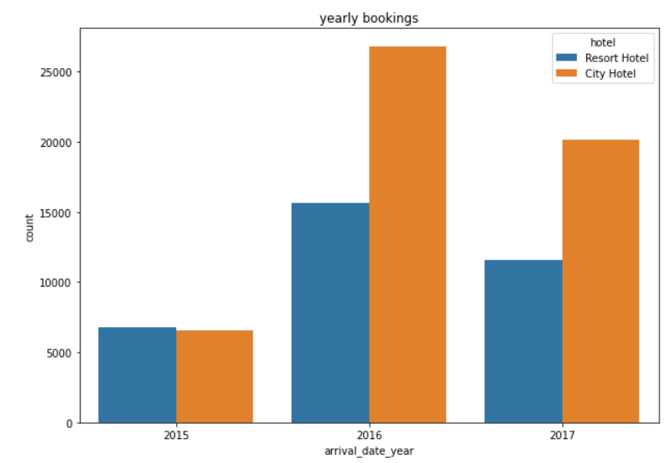
Yearly Booking
From above in 2015 resort hotel has more booking than city hotel whereas,In 2016 city hotel has far more booking than resort hotel moreover,In 2017 city hotel still ahs more booking.

Slide 15
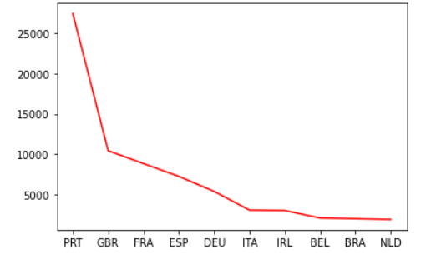
Highest Booking per Country
Above data shows PRT (Portugal) has the most guest, followed by GBR (United Kingdom), FRA (France), ESP (Spain) and DEU (Germany)..

Slide 16
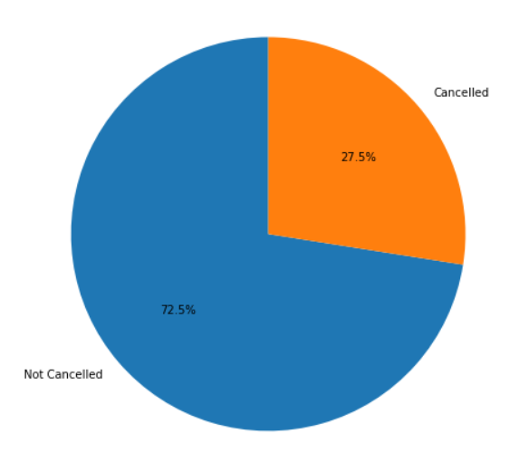
Proportion of reservations
Above pie chart shows that there are 27.5% Cancelled and 72.5% Non Cancelled reservations.

Slide 17
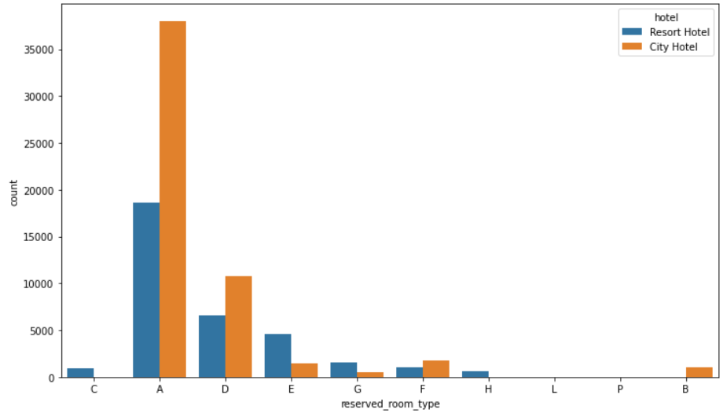
Frequently used rooms
Above data shows that A room is most used in both hotels ,followed by D room. However,C room in resort hotel has not used whereas,B room in city hotel is also not used

Slide 18
Conclusion
After a thorough analysis of the csv data file given to us we conclude that -
City hotel has more booking than resort hotel. Overall, there are 27.5% Cancelled and 72.5% Non-Cancelled reservations.
In the month of August and July hotel has more booking so there is lack vacant rooms available if, want to visit come in December and November months as there is less booking compared to peak times.
In 2015 resort hotel has more booking whereas in 2016 city hotel has more booking.
Most of the guests came from PRT (Portugal), followed by GBR (United Kingdom), FRA (France), ESP (Spain) and DEU (Germany).
Room A was the most used in both hotels, followed by Room D. However, room C at the resort hotel was unused while room B at the city hall was no longer in use.

Slide 19
References
AlmaBetter: https://grow.almabetter.com/auth/signup?redirectTo=https://grow.almabetter.com/my-dashboard
Matplotlib user guide : https://matplotlib.org/stable/users/index.html

