Slide 1
SegFormer: Simple and Efficient Design for Semantic Segmentation with Transformers
Enze Xie¹, Wenhai Wang², Zhiding Yu³ , Anima Anandkumar^{3,4}, Jose M., Alvarez3 Ping Luo¹
¹The University of Hong Kong ²Nanjing University ³NVIDIA ⁴Caltech
Accepted at NeurIPS 2021

Slide 2
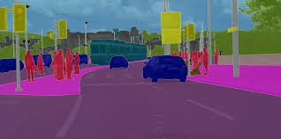
Semantic segmentation
Semantic segmentation is a process in computer vision that focuses on assigning a class label to every pixel in an image.

Slide 3
Related Works

Slide 4
CNN ERA (2015–2018): Building the Foundation
2015
2017
2017
2018
FCN¹
DeepLab v2²
PSPNet³
DeepLab v3+⁴
First end-to-end
pixel predictor.
Skip connections
fuse coarse +
fine features.
Dense Prediction
Dilated convolutions + Atrous Spatial Pyramid Pooling(ASPP): multi-scale receptive field without losing resolution. Multi-scale context
Pyramid Pooling
Module pools at 4
fixed scales for full
scene-level context.
Global scene understanding
ASPP encoder
+ lightweight
decoder. Depthwise
convs. Sharpest
CNN boundaries.
Efficient encoder-decoder
Shared ceiling across all CNN methods: convolution has a bounded local receptive field — true global, non-local, long-range dependence modelling is architecturally impossible. This is the gap transformers were built to fill

Slide 5
Transformer Era (2020–2021): From Classification to Segmentation
2020
2021
2021
2021
ViT⁵
DeiT⁶
SETR⁷
Swin⁸
Patches as tokens.
Global self-
attention. Needs
JFT-300M pre-
training to shine.
Global attention
ViT trained on
ImageNet-1K
only via CNN
distillation token.
Data-efficient.
Data efficiency
First ViT applied
to segmentation.
Proved transform-
ers beat CNNs
on dense tasks.
Dense prediction
Hierarchical
stages + shifted
local windows.
Linear attention.
Multi-scale output.
Hierarchy + linear att

Slide 6
Hard Requirements of Segmentation on a Encoder
Multi-scale Features – small objects need fine resolution, large regions need global context; both at once.
Spatial precision – encoder must preserve enough details for per-pixel boundary recovery.
Resolution flexibility – traina t 512 × 512, evaluate at 1024 × 2048 (standard in Cityscapes)
Computational feasibility – high-res features maps create large N.
SETR¹ uses ViT² which was designed for image classification at 224 × 224. It was never built to meet any of these four requirements. The authors examined ViT against each one and found it failing on all four.

Slide 7
Methodology

Slide 8
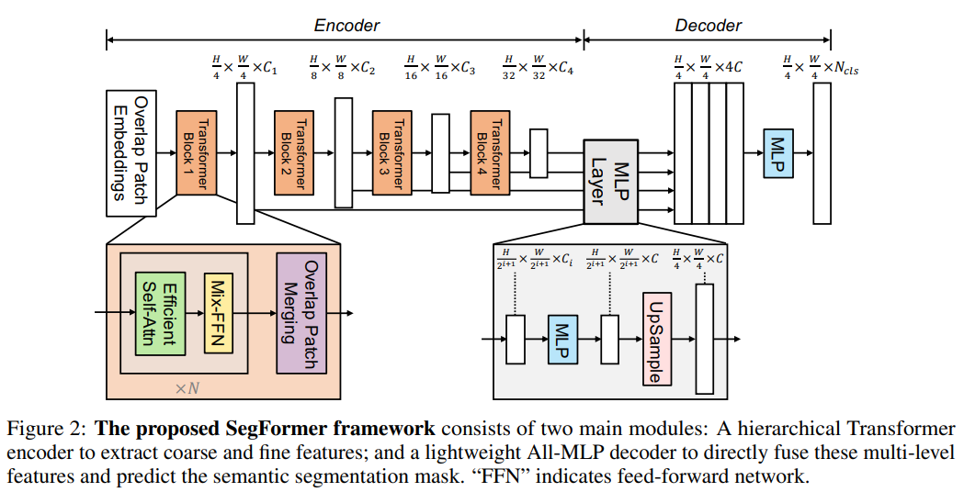
Proposed Architecture

Slide 9
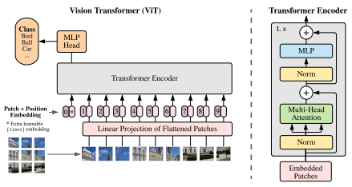
ViT Pipeline
Divide images into non-overlapping 16 × 16 patches
Flatten + Linear project each patch →one token
Add Positional Encoding (PE) : a fixed lookup table, one vector per position
Pass all tokens through transformer blocks.
Output:
Exactly one feature map at H/16 × W/16 resolution. For 512 × 512 input : a 32 × 32 grid

Slide 10
Problem 1 – Single-Scale, Low-Resolution Output
ViT outputs exactly one feature map at H/16 × W/16. For 512 × 512: a 32 × 32 grid. Every 16 × 16 pixel block is compressed to a single vector — all fine detail permanently lost.
Why this breaks segmentation:
Must predict label for every pixel ⇒ need to upsample 32 → 512: a 16× upsampling
Upsampling cannot recover discarded information
SETR attaches a heavy CNN decoder to compensate – architectural ceiling imposed by the single-scale design

Slide 11
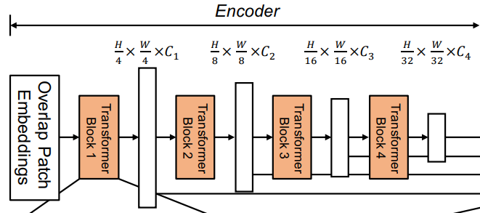
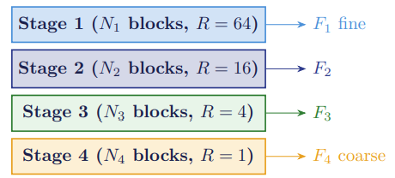
Change 1: Hierarchical Feature Representation
Start with H × W × 3. Each stage downsamples spatially and increases channels
C₁ < C₂ < C₃ < C₄: channels grow as resolution shrinks.
Why a hierarchy ?
F1 has spatial precision but no semantic understanding. F4 has global semantics but no spatial precision. Segmentation needs both. ViT only gives F4 equivalent. The decoder combines all four and gets every scale.

Slide 12
Problem 2 — Non-Overlapping Patches Lose Boundary Information
ViT cuts the image into strictly disjoint 16 × 16 tiles. Any feature crossing the seam between two tiles is split. Tile A sees the left half. Tile B sees the right half. Neither knows the other exists at patch creation time.
Why this damages segmentation specifically:
Fine boundaries are the primary object of interest in segmentation
Edges, outlines do not align with 16 × 16 grid seams
Information lost at patch creation cannot be recovered by attention layers
Every grid seam is an artificial discontinuity injected before any learning occurs

Slide 13
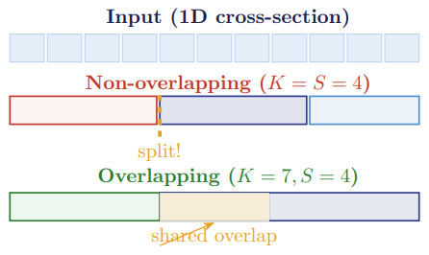
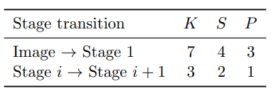
Change 2: Overlapping Patch Merging
Parameters: 𝐾 (kernel), 𝑆 (stride), 𝑃 (padding). Implemented as a single nn.Conv2D in PyTorch.
What overlapping means: Stride 𝑆 < 𝐾, so adjacent output positions draw from overlapping input regions. With 𝐾 = 7, 𝑆 = 4: overlap of 3 pixels on each side.
Why overlapping?
Every output token now sees into its neighbors’ territory. The model can coherently learn features that span patch boundaries — crucial for detecting edges and contours that are not confined to neat squares.

Slide 14
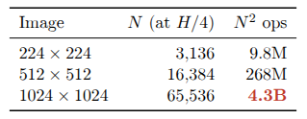
Problem 3 – Self-Attention Cost
Standard self-attention computes the matrix product QKT where Q, K ∈ R^{N×C.} The resulting attention matrix is N × N. Memory and computational cost scale as O(N² ), where N is the number of tokens.
ViT was designed for image classification at 224 × 224 with 16 × 16 patches, giving N = 196. N² = 38,416
Cost at high resolution:

Slide 15
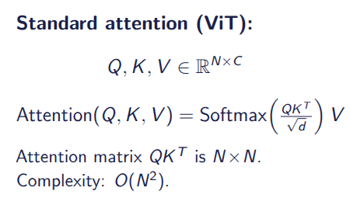
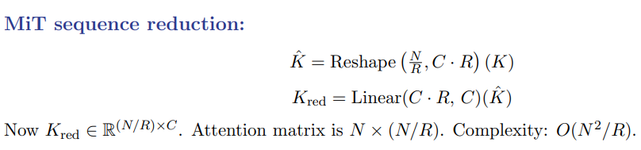
Change 3 – Efficient Self-Attention Cost
Elegant pattern: The effective 𝐾/𝑉 length is approximately constant at 256 across all stages. As spatial resolution shrinks 4×, 𝑅 (reduction ratio) also shrinks 4×. Attention cost is roughly constant across all stages.
Why reduce 𝐾, 𝑉 but not 𝑄?
𝑄 determines what each token asks for (𝑁 tokens must ask). 𝐾 and 𝑉 answer the questions compressing similar adjacent tokens into one group loses little in early stages where tokens are highly correlated.

Slide 16

Problem 4 — Positional Encoding is Resolution-Locked
PE is a fixed lookup table of learned vectors — one per patch position. The table size is fixed at training time. At a different evaluation resolution, missing vectors must be interpolated — values the model has never seen
Train at 512 × 512 with 16 × 16 patches ⇒ 32 × 32 = 1024 PE vectors learned.
Eval at 1024 × 2048 ⇒ need 64 × 128 = 8192 PE vectors. 7168 must be interpolated.
3.3% drop simply from changing the evaluation resolution is an unacceptable fragility for a production segmentation model

Slide 17
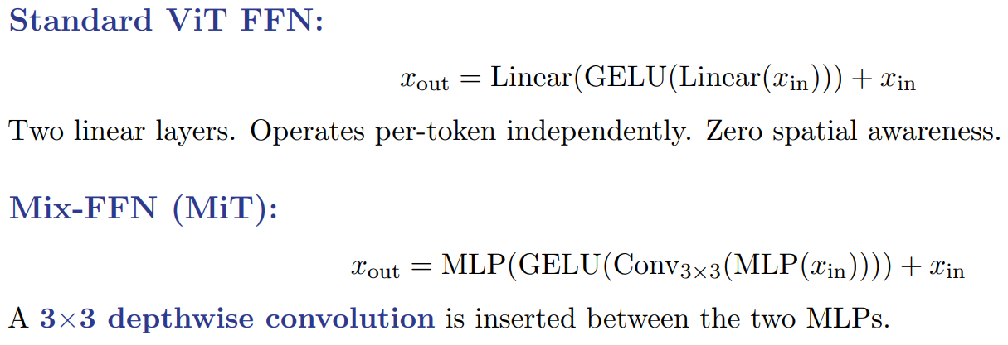
Change 4: Mix-FFN — Replacing Positional Encoding

Slide 18
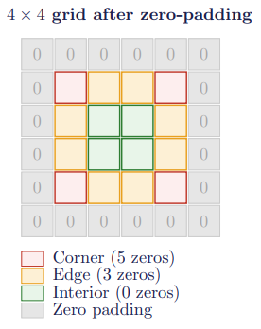
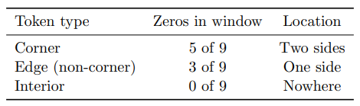
Why Does Conv_{3×3} Encode Positional Information?
Zero-padding mechanism : With padding=1, a frame of zeros is added around the entire feature map border. The 3 × 3 kernel slides over every position in the padded grid.
A
B
C
D
E
F
G
H
I
K
L
M
N
O
P
Q

Slide 19
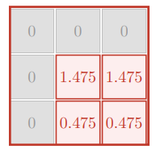
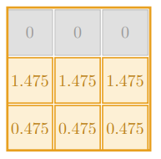
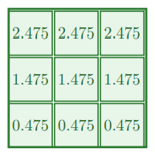
What Each Token Type Sees: Corner, Edge, and Interior
Corner: Token A (0,0) – 5 zeros, 4 real. Zeros on top row + left col. Unique to top-left corner
Edge: Token B (0,1) – 3 zeros, 6 real. Zeros across top row only. Same zero pattern as C.
Interior: Token F (1,1) – 0 zeros, 9 real. Fully surrounded by real. Same pattern as G, J, K.

Slide 20
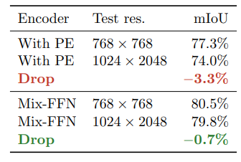
What Each Token Type Sees: Corner, Edge, and Interior
Experiment (Table 1c of paper): Train on Cityscapes at 768 × 768. Test at two different resolutions. Compare PE encoder vs Mix-FFN encoder.
Conclusion: Mix-FFN makes the model essentially resolution-agnostic. The tiny 0.7% drop is from the image content being at a different scale not from any position encoding issue. PE’s 3.3% drop is entirely avoidable overhead.

Slide 21
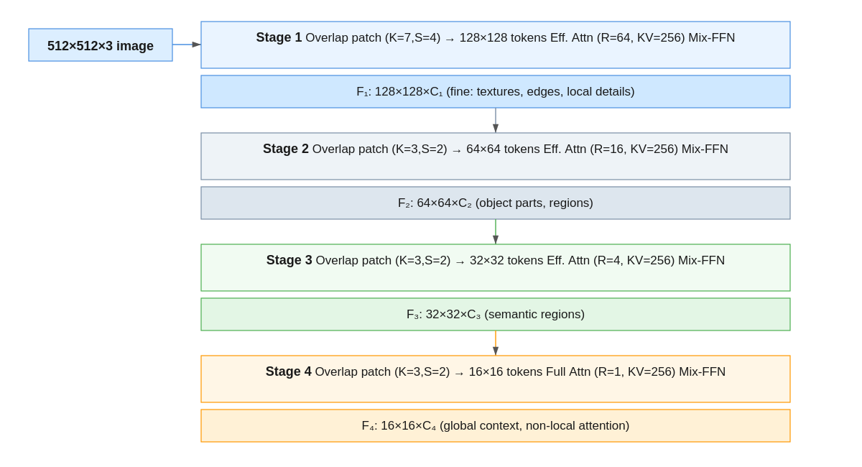
Full Encoder Pipeline

Slide 22
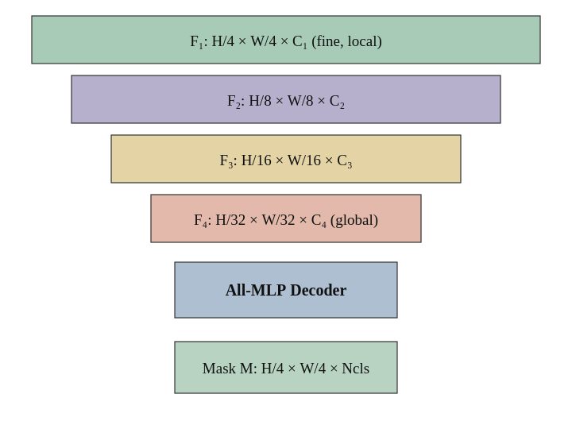
The All-MLP Decoder
Four sequential steps:
1. Unify channel dimensions across all encoder feature maps
2. Upsample all maps to the same spatial resolution
3. Concatenate and fuse with an MLP
4. Predict the segmentation mask with a final MLP
Heavy CNN decoders (ASPP, PPM) exist to compensate for the CNN encoder’s small receptive field, they must artificially inject global context the encoder cannot provide. The Transformer encoder already captures global context through self-attention, making those modules redundant. A simple MLP decoder is therefore not a compromise, it is the correct design given a Transformer backbone.

Slide 23
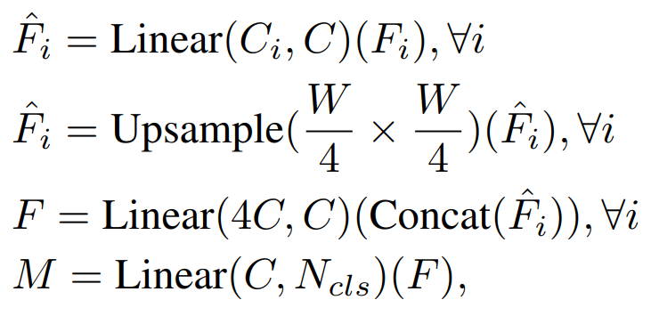
What Each Token Type Sees: Corner, Edge, and Interior
•Linear(𝐶_{in}, 𝐶_{out})(·) — learnable linear layer, applied independently at each spatial position (no spatial mixing)
• C — unified channel dim: 256 for B₀/B₁, 768 for B₂–B₅
• 𝑁_{cls} — category count: 150 (ADE20K), 19 (Cityscapes)
• 𝑀 — predicted segmentation mask
• Every learnable operation is a pointwise linear layer
• No convolution, no spatial cross-position mixing
• Spatial context is already encoded by the Transformer encoder; the decoder only needs to aggregate and classify

Slide 24

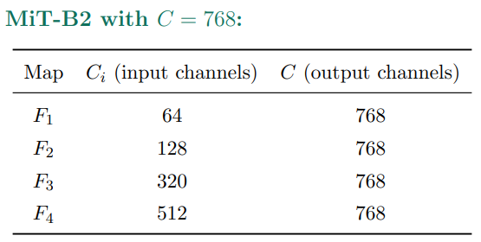
Step 1: Unify Channel Dimensions
Each encoder stage outputs a different channel count. Deeper stages encode richer semantic information in more channels.

Slide 25

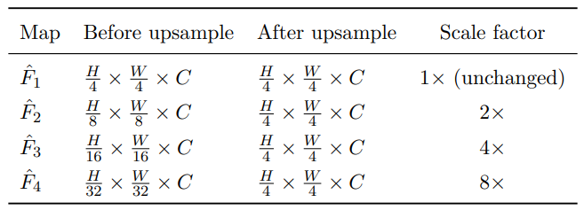
Step 2: Upsample to a Common Spatial Resolution
Bilinear interpolation — no learnable parameters, zero training overhead.
Why bilinear, not a learned upsample?
The features are already semantically rich from the Transformer; spatial alignment only requires interpolation, not additional learning. Learned upsamplers would add parameters without improving the receptive field.

Slide 26
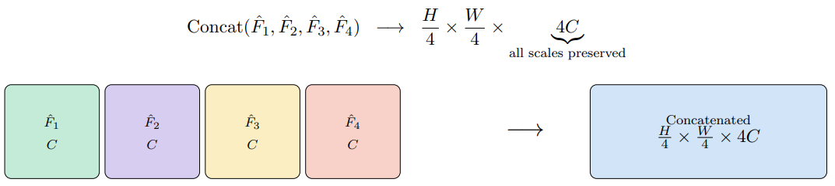
Step 3a: Concatenate Multi-Scale Features
Concatenation is used instead of summation or averaging because it preserves all information from every scale. Summation irreversibly merges fine-grained local detail (from Fˆ₁) with coarse global context (from Fˆ₄), making it impossible for the next layer to separate them. Concatenating lets the subsequent fusion MLP (Step 3b) learn precisely how much to weight each scale at each spatial location.

Slide 27

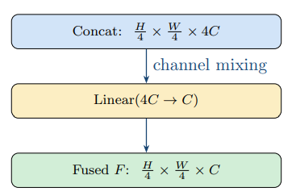
Step 3b: Feature Fusion MLP
Compress 4C concatenated channels back to C learning a weighted cross-scale combination at each spatial position.

Slide 28
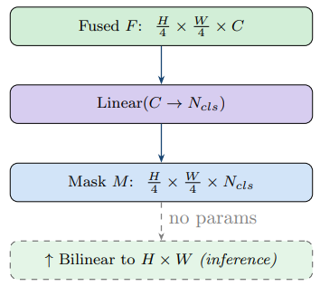
Step 4: Predict the Segmentation Mask
•Input: C-dimensional feature vector encodes “what semantic content is at this patch”
• Output: N_{cls} logit scores, one per category
• Prediction: yˆ = arg max_{k} M[ ·, ·, k ]
A single linear layer over C-dimensional features suffices because F already contains contextually rich, multi-scale representations built by the encoder and the fusion step. Predicting at H/4 instead of H × W keeps this layer 16× cheaper. The bilinear resize to full resolution at inference is parameter-free.

Slide 29
Why can an MLP decoder work for Transformers but not for CNNs?
CNN encoder (e.g. DeepLabv3+)
• Effective residual Field (ERF) remains small even at Stage 4 (only local neighborhoods )
• Cannot “see” the full image context from features alone
• Decoder must supply global context via ASPP, dilated convolutions, PPM, etc.
• Complex, heavy decoder is a necessity
Transformer encoder (MiT)
• Stages 1–2: local attention ≈ convolutions (captures fine detail)
• Stage 4: fully non-local attention, ERF spans the entire image
• MLP head adds strong local attention on top of Stage-4 global context
• Complex decoder is redundant

Slide 30
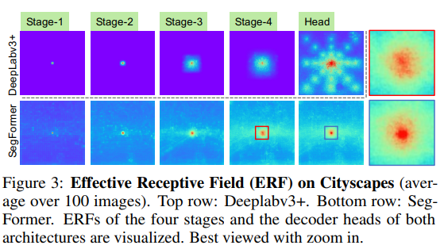
Effective Receptive Field Analysis.
• The ERF of DeepLabv3+ is relatively small even at Stage-4, the deepest stage.
• SegFormer’s encoder naturally produces local attentions which resemble convolutions at lower stages, while able to output highly non-local attentions that effectively capture contexts at Stage-4.
• As shown with the zoom-in patches in Figure 3, the ERF of the MLP head (blue box) differs from Stage-4 (red box) with a significant stronger local attention besides the non-local attention.

Slide 31
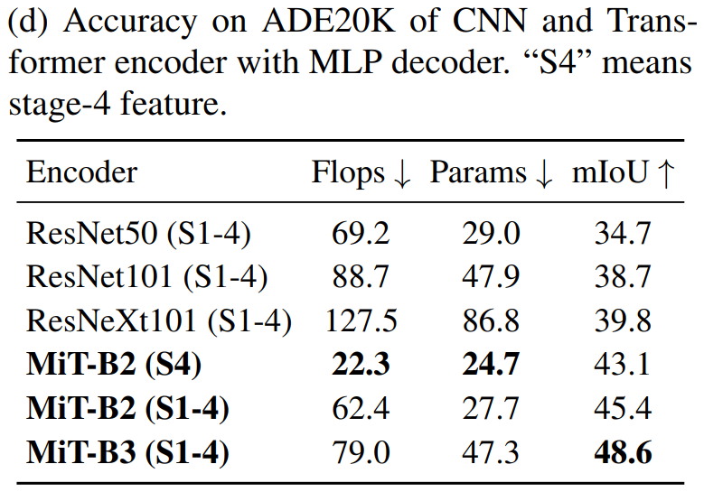
Same MLP decoder, different encoders (Table 1d, ADE20K)
The MLP decoder is not independently powerful, it derives its strength from the Transformer encoder. Self-attention provides a large ERF that CNNs can only approximate through expensive hand-crafted modules. Using Stage 4 alone is insufficient (43.1% vs 45.4%): the multi-stage combination blending local (Stages 1–2) and global (Stage 4) attention is what makes the MLP decoder effective.

Slide 32
Experiments & Results

Slide 33
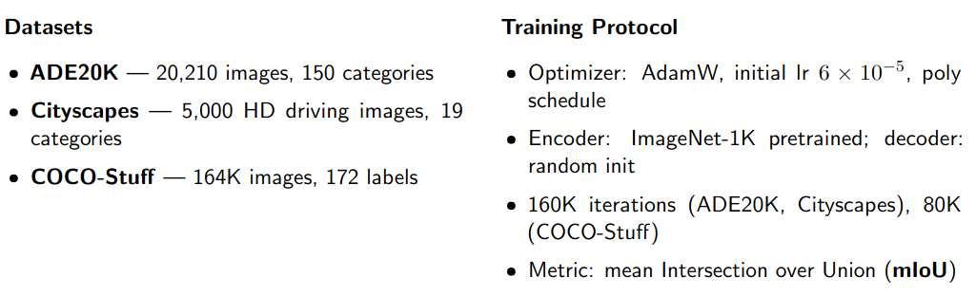
Experimental Setup

Slide 34
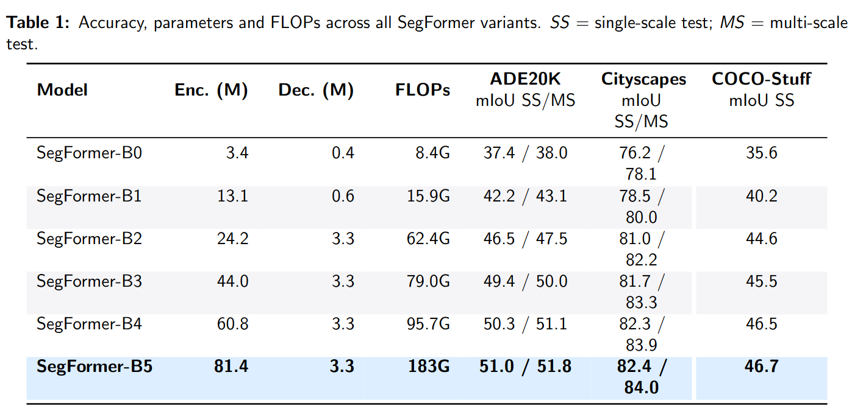
Model Scaling: B0 to B5
The decoder stays fixed at 3.3M parameters from B2 to B5, only ≈4% of the total model while
accuracy scales consistently with encoder size. This confirms that the encoder, not the decoder, drives performance.

Slide 35
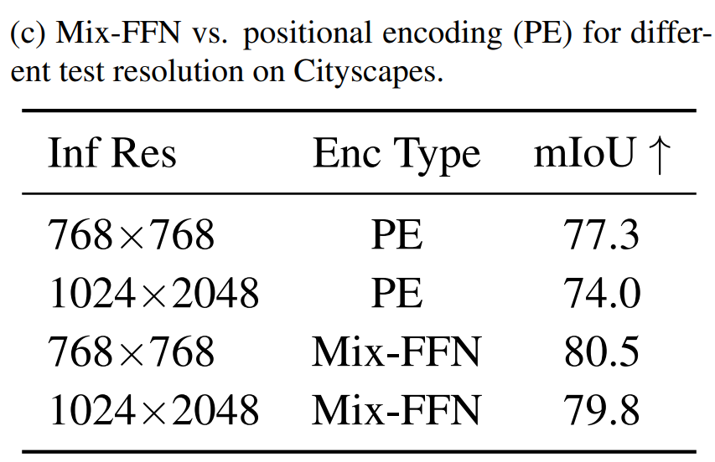
Ablation Studies: Mix-FFN vs. Positional Encoding
Positional encoding is tied to the training resolution. When the test resolution differs, it
must be interpolated, causing a 3.3% accuracy
drop. Mix-FFN — a 3×3 depth-wise convolution inside the FFN implicitly encodes position through zero-padding, without any fixed-resolution constraint. The drop shrinks to just 0.7%, and absolute accuracy is higher at both resolutions.

Slide 36
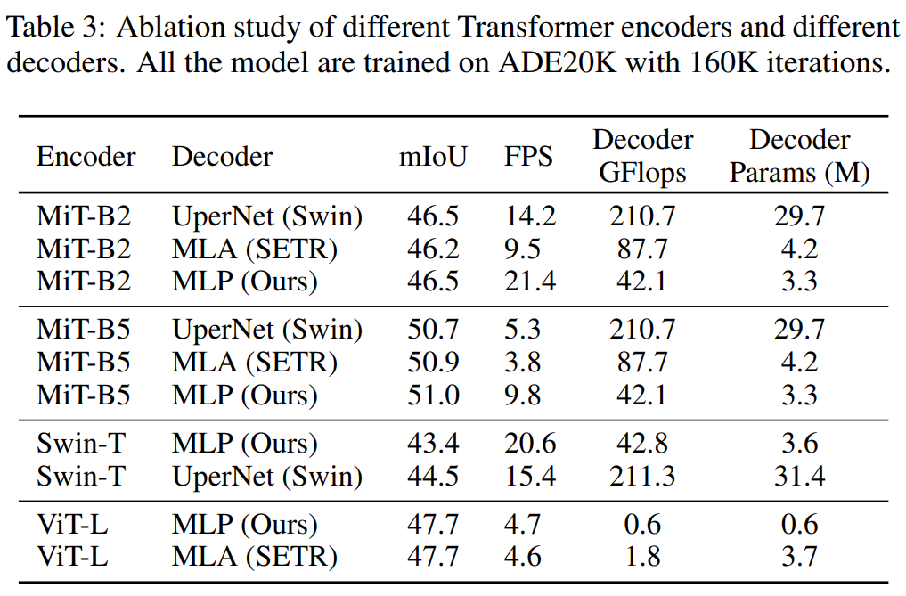
Decoder Architecture Comparison
The MLP decoder matches UperNet’s accuracy at 9× fewer parameters and 5× fewer FLOPs, running 1.5× faster. The MLP decoder underperforms on Swin-T (43.4% vs. 44.5%) because Swin’s windowed
attention limits the ERF — confirming the MLP decoder only reaches its potential with a Transformer that provides truly global attention.

Slide 37
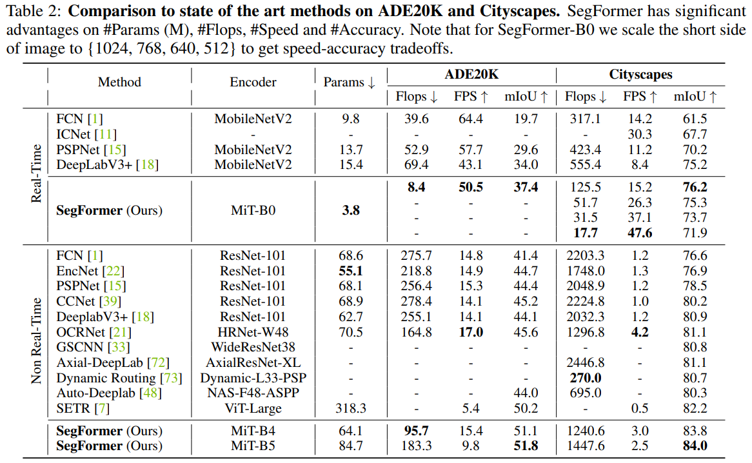
State-of-the-Art Comparison
SegFormer-B0 outperforms all real-time methods despite being 4× smaller than the next lightest competitor.
SegFormer-B5 surpasses SETR by +1.6% mIoU on ADE20K while using 4× fewer parameters and running 5× faster, using only ImageNet-1K pre training versus SETR’s ImageNet-22K.

Slide 38
State-of-the-Art Comparison
SegFormer-B0 outperforms all real-time methods despite being 4× smaller than the next lightest competitor.
SegFormer-B5 surpasses SETR by +1.6% mIoU on ADE20K while using 4× fewer parameters and running 5× faster, using only ImageNet-1K pre training versus SETR’s ImageNet-22K.

Slide 39
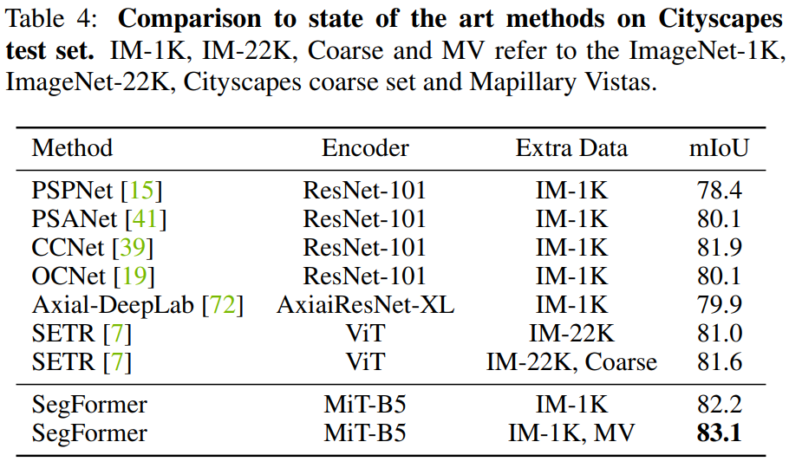
Cityscapes Test Set
SegFormer-B5 achieves 82.2% using only fine Cityscapes labels and ImageNet-1K pretraining, surpassing SETR which uses ImageNet-22K (14× more pre training data) and the additional Cityscapes coarse set. With Mapillary Vistas pretraining, SegFormer reaches 83.1%, a new state of the art on the Cityscapes test server.

Slide 40
State-of-the-Art Comparison
SegFormer-B0 outperforms all real-time methods despite being 4× smaller than the next lightest competitor.
SegFormer-B5 surpasses SETR by +1.6% mIoU on ADE20K while using 4× fewer parameters and running 5× faster, using only ImageNet-1K pre training versus SETR’s ImageNet-22K.

Slide 41
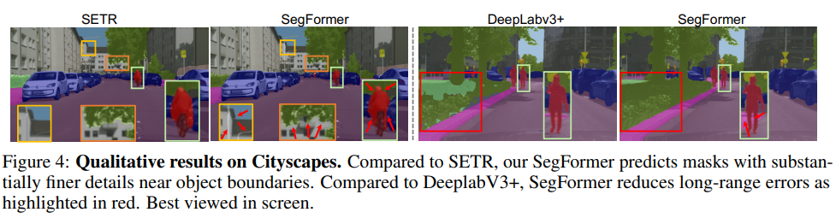
Qualitative Analysis

Slide 42
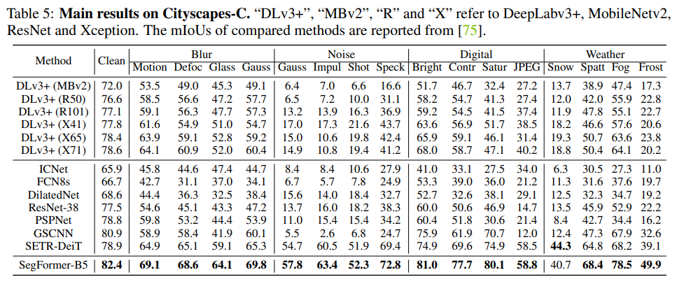
Robustness to Natural Corruptions (Cityscapes-C)

Slide 43
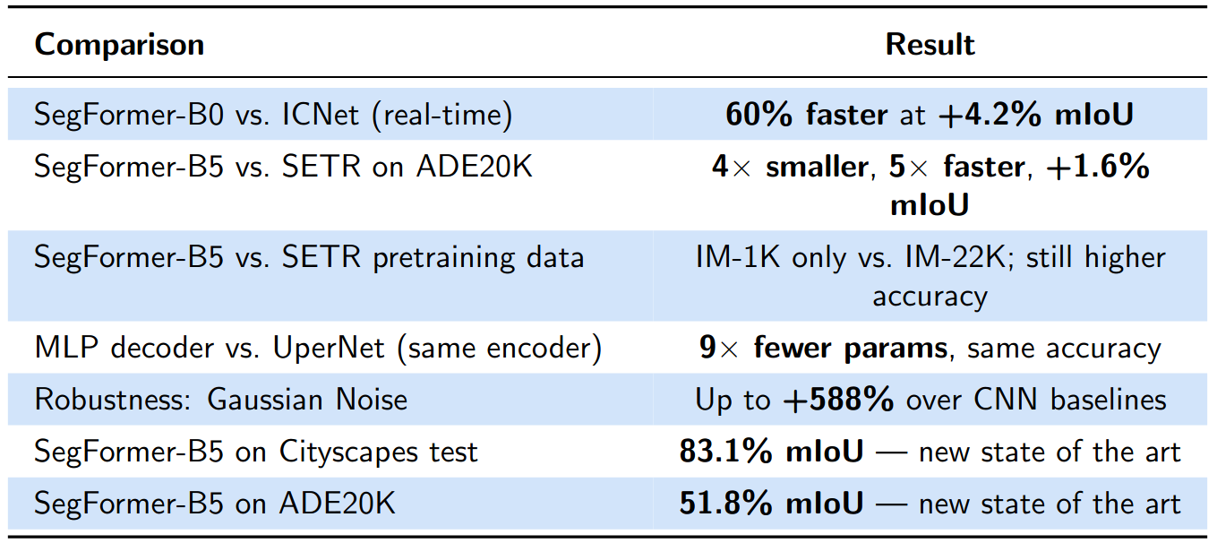
SegFormer vs other models – Comparison

Slide 44
References
[1] Long, Jonathan, Evan Shelhamer, and Trevor Darrell. "Fully convolutional networks for semantic segmentation." Proceedings of the IEEE conference on computer vision and pattern recognition. 2015.
[2] Chen, Liang-Chieh, et al. "Deeplab: Semantic image segmentation with deep convolutional nets, atrous convolution, and fully connected crfs." IEEE transactions on pattern analysis and machine intelligence 40.4 (2017): 834-848.
[3] Zhao, Hengshuang, et al. "Pyramid scene parsing network." Proceedings of the IEEE conference on computer vision and pattern recognition. 2017.
[4] Chen, Liang-Chieh, et al. "Encoder-decoder with atrous separable convolution for semantic image segmentation." Proceedings of the European conference on computer vision (ECCV). 2018.
[5] Dosovitskiy, Alexey, et al. "An image is worth 16x16 words: Transformers for image recognition at scale." arXiv preprint arXiv:2010.11929 (2020).
[6] Touvron, Hugo, et al. "Training data-efficient image transformers & distillation through attention." International conference on machine learning. PMLR, 2021.
[7] Zheng, Sixiao, et al. "Rethinking semantic segmentation from a sequence-to-sequence perspective with transformers." Proceedings of the IEEE/CVF conference on computer vision and pattern recognition. 2021.
[8] Liu, Ze, et al. "Swin transformer: Hierarchical vision transformer using shifted windows." Proceedings of the IEEE/CVF international conference on computer vision. 2021.

