Slide 1
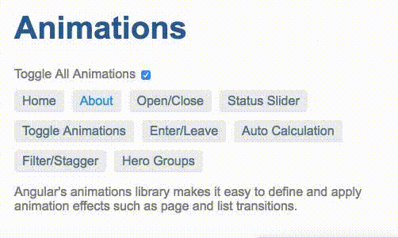
Why routing is necessary?
How Angular Router Works?

Slide 2

ROUTING IN ANGULAR

Slide 3
Why routing is necessary?
Routing helps in directing users to different pages based on the option they choose on the main page. Hence, based on the option they choose, the required Angular Component will be rendered to the user.

Slide 4
How Angular Router Works?
it reads the browser URL the user wants to navigate to
it applies a URL redirect (if one is defined)
it figures out which router state corresponds to the URL
it runs the guards that are defined in the router state
it resolves the required data for the router state
it activates the Angular components to display the page
it manages navigation and repeats the steps above when a new page is requested.

Slide 5
Major Components Of Routing
Routes
Describes the routes application supports
RouerOutlet
A “placeholder” component that gets expanded to each content
RouterLink
Directive is used to link to routes

Slide 6
ROUTES
To define routes for application, create a Routes configuration and then use
RouterModule.forRoot(routes)to provide application with the dependencies necessary to use the router.
path: it specifies the URL this route will handle
Conponent: it maps to the Component and its template
redirectTo (optional): it is used to redirect a given path to an existing route
const routes: Routes = [
{ path: ‘’, redirectTo: ‘home’, pathMatch: ’full’},
{ path: ‘home', component: HomeComponent },
{ path: ‘about', component: AboutComponent },
{ path: ‘contact', component: ContactComponent },
{ path: ‘contactus’, redirectTo: ‘contact’ },
];

Slide 7
RouterOutlet
The router-outlet element indicates where the contents of each route component will be rendered.
RouterOutlet directive is used to describe to angular where in our page we want to render the contents for each route.
@Component({
Selector: ‘my-app’,
Template: `<div class=“container”>
<router-outlet>< /router-outlet>
</div>`
})

Slide 8
RouterLink
It generates link based on the route path.
routerLink navigates to a route
<div>
<a [routerLink]=“[‘Home’]”>Home</a>
<a [routerLink]=“[‘About’]”>About</a>
</div>

Slide 9
Thank You!

