Slide 1


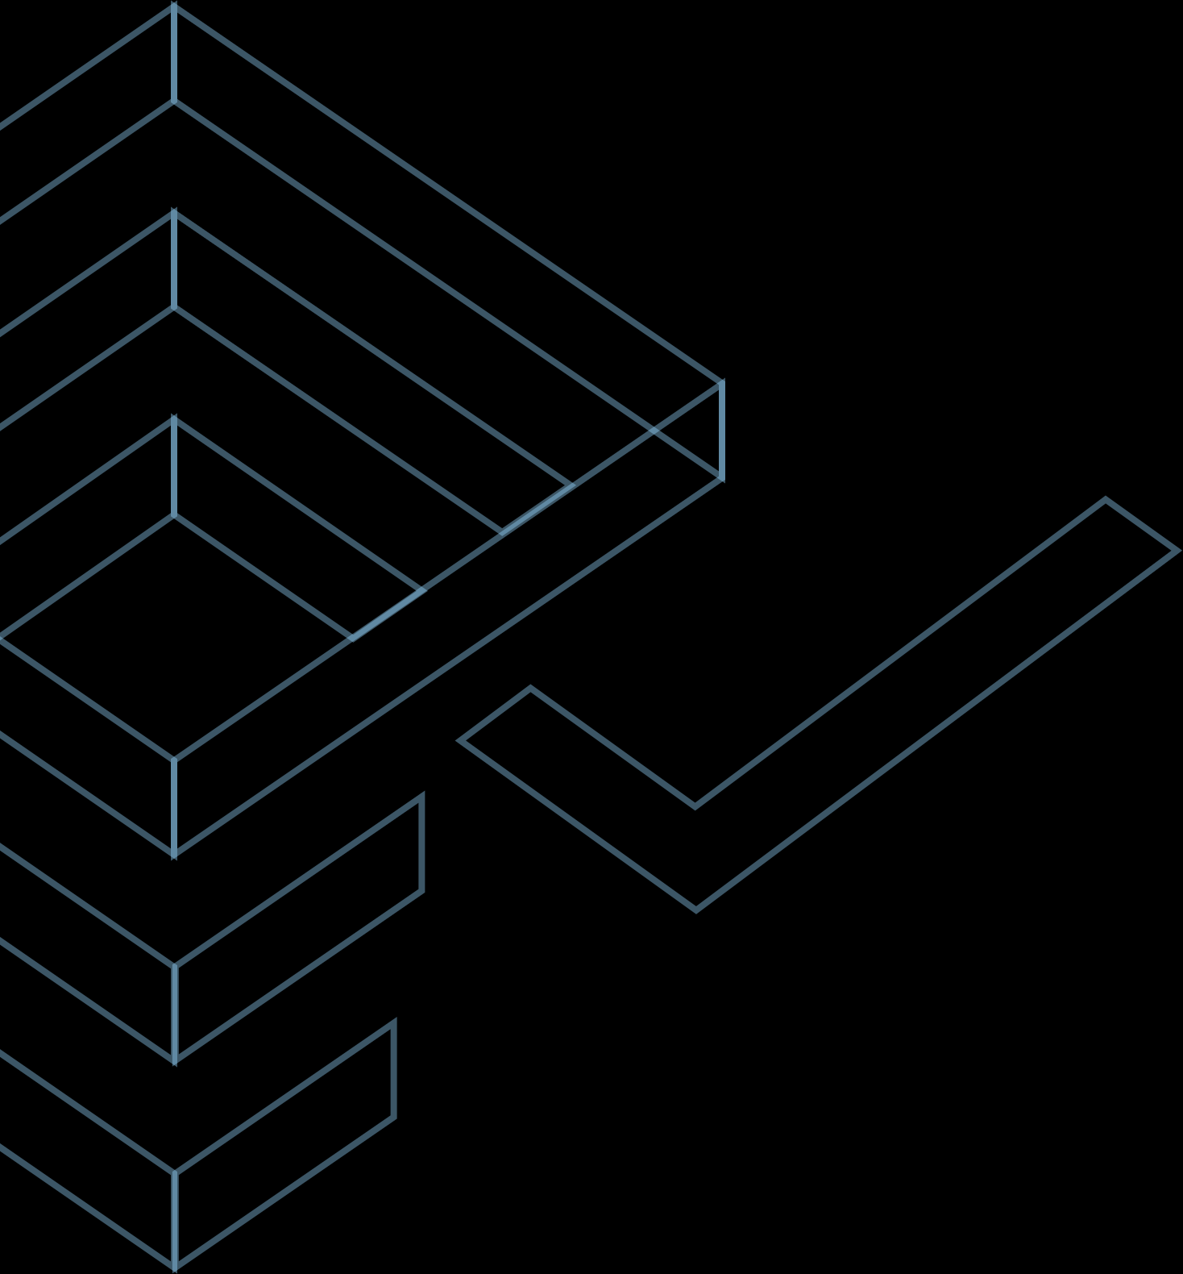


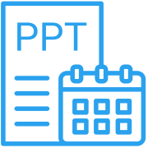

Project
Client name
Report date
tendermint
Toptal
Thursday, 10 February 2022

Slide 2
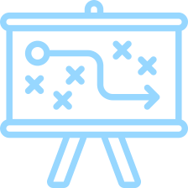
Risks Overview
2 of 16
Overall code quality indicates caution
Code refactoring is recommended.
Overall application security indicates caution
Code refactoring is recommended.
Overall license compliance indicates caution
License risk mitigation is recommended (0 reciprocal license risks, 21 total license risks).
Overall development team analysis does not raise concerns
70% of top 10 developers are still active.
Technical Due Diligence
Code Quality |  |  |  | Security |  | Licenses | Team
Defects | Code Smells | Duplications | Hardcoded Items | Vulnerabilities | Hotspots
● | ● | ● | ● | ● | ● | ● | ●

Slide 3

3 of 16
The total size of code is 2,789,380 lines, excluding comments and blank lines.
The codebase has been developed using 50 programming languages.
82.2% of the code has been developed using modern programming languages that appear in GitHub Top 50 ranking.
Tech
Stack
Top 5 programming languages

Slide 4
4 of 16
1,425 Git commits were made during the past 6 months.
Those changes were made using 20 programming languages in 20 repositories.
Tech
Stack
Activity
5 most used programming languages in the last 6 months
5 most ACTIVE REPOSITORIES in the last 6 months

Slide 5

Duplicate Code
5 of 16
18,625 total duplicated blocks. The percentage of duplicated code lines is 21.1%. This is above the 4% threshold. 18,625 duplicated blocks require resolution.
Code Complexity
Long Methods
0 total. 0 long methods require resolution.
Long Classes
2 total. 2 long classes require resolution.

Slide 6

Defects
6 of 16
6,525 total. Average number of defects per 10K LOC is 23. This is above the threshold of 20 issues per 10K LOC. 58 critical issues require resolution.
Code
Reliability
Code Smells
37,572 total. Average number of code smells per 10K LOC is 134. This is below the threshold of 200. 98 blocker issues require resolution.
Hardcoded Risks
6,499 total. Average number of hardcoded tokens per 10K LOC is 23. This is below the threshold of 50. 6,499 critical issues require resolution.

Slide 7
Code Structure
7 of 16
47.2% of code is proprietary.
14.5% of code is third-party (well-known libraries).
49.1% of code is auto-generated.
13.4% of all lines are comments.
Code Structure

Slide 8
Contributors Overview
8 of 16
152 developers have been working on the code base during past year.
29.6% of those developers are still active (they have committed code during past 60 days).
Code Structure

Slide 9
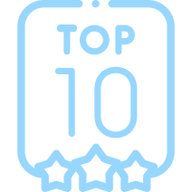
Top 10 Contributors
9 of 16
Name | Commits | Fixes | Features | Languages
dongsam <dongsamb@gmail.com> | 285 | 73 | 212 | Go, Markdown, Protocol Buffers, make, Bourne Shell, TypeScript, YAML
Bitcoinera <anagjordano@gmail.com> | 264 | 101 | 163 | Vuejs Component, JavaScript, TOML, JSON
Jordan Bibla <jbibla@gmail.com> | 238 | 30 | 208 | Vuejs Component, JavaScript, CSS, Markdown, SVG, JSON, Yarn
İlker G. Öztürk <ilkergoktugozturk@gmail.com> | 217 | 64 | 153 | Go, YAML, Markdown, make, Protocol Buffers, TypeScript, Vuejs Component, Dockerfile, JSON
Hanjun Kim <hallazzang@gmail.com> | 192 | 71 | 121 | Go, Markdown, TypeScript, make, YAML, Bourne Shell, Protocol Buffers
Lucas Bertrand <lucas.bertrand.22@gmail.com> | 178 | 62 | 116 | Go, Markdown, YAML, Dockerfile, TypeScript
Sam Kleinman <garen@tychoish.com> | 172 | 19 | 153 | Go, Markdown, YAML, Bourne Shell
Fabian Weber <frznhope@gmail.com> | 153 | 45 | 108 | JavaScript, Vuejs Component, Markdown, JSON, SVG, TOML
Callum Waters <cmwaters19@gmail.com> | 141 | 26 | 115 | Go, Markdown, YAML, TOML
Marko <marbar3778@yahoo.com> | 128 | 13 | 115 | Go, Markdown, YAML, Dockerfile, Protocol Buffers, JavaScript, make, Python, JSON
Code
Structure

Slide 10
Top 5 Active Contributors by Commits
10 of 16
Code Structure

Slide 11

Security Overview
11 of 16
268 total potential vulnerabilities. Average number of vulnerabilities per 10K LOC is 0. This is below the threshold of 0.5.
27 critical vulnerabilities require resolution.
552 total security hotspots. Average number of security hotspots per 10K LOC is 1. This is below the threshold of 2.
552 critical security hotspots require resolution.
Code
Security

Slide 12
Top 10 Security Rule Violations
12 of 16
Rule | Count | Risks
Using regular expressions is security-sensitive | 414 | CVE-2017-16021, CVE-2018-13863, OWASP A1:2017
Using hardcoded IP addresses is security-sensitive | 257 | CVE-2006-5901, CVE-2005-3725, OWASP A3:2017
Using pseudorandom number generators (PRNGs) is security-sensitive | 56 | CVE-2013-6386, CVE-2006-3419, CVE-2008-4102, OWASP A3:2017
Dynamically executing code is security-sensitive | 43 | CVE-2017-9807, CVE-2017-9802, OWASP A1:2017
Using clear-text protocols is security-sensitive | 6 | CVE-2019-6169, CVE-2019-12327, CVE-2019-11065, OWASP A3:2017
Permissive Cross-Origin Resource Sharing policy is security-sensitive | 5 | CVE-2018-0269, CVE-2017-14460, OWASP A6:2017
Credentials should not be hard-coded | 5 | OWASP A2:2017
Hashing data is security-sensitive | 3 | CVE-2018-9233, CVE-2013-5097, CVE-2007-1051, OWASP A3:2017, OWASP A6:2017
Using publicly writable directories is security-sensitive | 3 | CVE-2012-2451, CVE-2015-1838, OWASP A5:2017, OWASP A3:2017
Cross-document messaging domains should be carefully restricted | 2 | OWASP A7:2017
Code
Security

Slide 13

Packages Overview
13 of 16
616 total package dependencies detected (Npm, Cargo, RubyGem & Yarn).
406 packages are outdated.
146 critically outdated packages should be updated.
Package
Dependencies

Slide 14
Top 10 Package Issues
14 of 16
Package | Type | Version | Latest Version | Message
js-merkleeyes | Npm | 0.0.4, 18 Feb 2016 | 0.0.6, 21 May 2016 | Package version is more than 3 years old.
js-tmsp | Npm | 0.0.11, 18 Mar 2016 | 0.0.13, 24 Oct 2016 | Package version is more than 3 years old.
js-wire | Npm | 0.0.2, 25 Jan 2016 | 0.0.3, 03 Feb 2016 | Package version is more than 3 years old.
js-nacl | Npm | 0.6.0, 25 Feb 2014 | 1.3.2, 19 Nov 2018 | Package is 1 major version behind the latest. Package version is more than 3 years old.
long | Npm | 3.0.3, 07 Jan 2016 | 4.0.0, 03 Feb 2018 | Package is 1 major version behind the latest. Package version is more than 3 years old.
async | Npm | 1.5.2, 08 Jan 2016 | 3.2.1, 05 Aug 2021 | Package is 2 major versions behind the latest. Package version is more than 3 years old.
bcryptjs | Npm | 2.3.0, 24 Sep 2015 | 2.4.3, 07 Feb 2017 | Package version is more than 3 years old.
commander | Npm | 2.9.0, 13 Oct 2015 | 8.2.0, 10 Sep 2021 | Package is 6 major versions behind the latest. Package version is more than 3 years old.
bl | Npm | 1.2.2, 21 Mar 2018 | 5.0.0, 02 Apr 2021 | Package is 4 major versions behind the latest. Package version is more than 3 years old.
debug | Npm | 3.1.0, 26 Sep 2017 | 4.3.2, 09 Dec 2020 | Package is 1 major version behind the latest. Package version is more than 3 years old.
Package
Dependencies

Slide 15
Licenses Overview
15 of 16
1,853 total libraries and third party components are linked.
67% (1,242) of the linked libraries and third party components are protected by permissive licenses.
31.3% (580) of the linked libraries and third party components have uncertain licenses and require attention.
1.7% (31) of the linked libraries and third party components are protected by reciprocal licenses.
Licenses

Slide 16
Top 10 License Issues
16 of 16
License | Count | Allows SaaS | Allows Distribution | Allows Modification
UnclassifiedLicense | 354 | Uncertain | Uncertain | Uncertain
WebM | 36 | Uncertain | Uncertain | Uncertain
MIT OR Apache-2.0 | 36 | Uncertain | Uncertain | Uncertain
MIT/Apache-2.0 | 27 | Uncertain | Uncertain | Uncertain
Public-domain | 24 | Uncertain | Uncertain | Uncertain
Apache-2.0 OR MIT | 23 | Uncertain | Uncertain | Uncertain
See-URL | 20 | Uncertain | Uncertain | Uncertain
General Public License | 12 | True | True | False
Dual-license | 8 | Uncertain | Uncertain | Uncertain
Apache-possibility | 5 | Uncertain | Uncertain | Uncertain
Licenses

