Slide 1
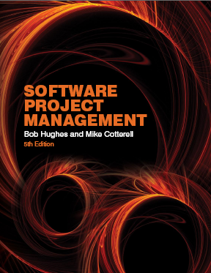
Software Project Management
Chapter Two
Project evaluation and programme management
SPM (5e) Project evaluation and programme management© The McGraw-Hill Companies, 2009
Notes:
This lecture examines the activities that can lead to a project being initiated: In particular it looks at:
How the business justification for the project is recorded
How an organization will take account of the range of projects it is involved with at any one time when assessing the business value of projects
How proposed projects can be evaluated
How groups of projects that contribute to common organizational objectives can be co-ordinated
How steps can be taken to ensure that the hoped-for benefits of a project can actually by obtained – i.e. benefits management

Slide 2


Main topics to be covered
The business case for a project
Project portfolios
Project evaluation
  Cost benefit analysis
  Cash flow forecasting
Programme management
Benefits management
SPM (5e) Project evaluation and programme management© The McGraw-Hill Companies, 2009

Slide 3
The business case
Feasibility studies can also act as a ‘business case’
Provides a justification for starting the project
Should show that the benefits of the project will exceed development, implementation and operational costs
Needs to take account of business risks
SPM (5e) Project evaluation and programme management© The McGraw-Hill Companies, 2009
Notes:
See page 22
It is worth recalling the difference between project success (the project is successfully completed) and business risks (the new product or system successfully established by the project goes on to generate benefits for the organization).

Slide 4
Contents of a business case
Introduction/ background
The proposed project
The market
Organizational and operational infrastructure
The benefits
Outline implementation plan
Costs
The financial case
Risks
Management plan
SPM (5e) Project evaluation and programme management© The McGraw-Hill Companies, 2009
Notes:
Page 22
The sections are described in more detail on the next overhead

Slide 5
Content of the business case
Introduction/background: describes a problem to be solved or an opportunity to be exploited
The proposed project: a brief outline of the project scope
The market: the project could be to develop a new product (e.g. a new computer game). The likely demand for the product would need to be assessed.
SPM (5e) Project evaluation and programme management© The McGraw-Hill Companies, 2009

Slide 6
Content of the business case - continued
Organizational and operational infrastructure: How the organization would need to change. This would be important where a new information system application was being introduced.
Benefits These should be express in financial terms where possible. In the end it is up to the client to assess these – as they are going to pay for the project.
SPM (5e) Project evaluation and programme management© The McGraw-Hill Companies, 2009

Slide 7
Content of the business case - continued
Outline implementation plan: how the project is going to be implemented. This should consider the disruption to an organization that a project might cause.
Costs: the implementation plan will supply information to establish these
Financial analysis: combines costs and benefit data to establish value of project
SPM (5e) Project evaluation and programme management© The McGraw-Hill Companies, 2009
Notes:
Financial analysis – we will see later that the comparative value of costs and benefits may not be obvious as the timing of costs and benefits need to be taken into consideration.

Slide 8
Project portfolio management
The concerns of project portfolio management include:
Evaluating proposals for projects
Assessing the risk involved with projects
Deciding how to share resources between projects
Taking account of dependencies between projects
Removing duplication between projects
Checking for gaps
SPM (5e) Project evaluation and programme management© The McGraw-Hill Companies, 2009
Notes:
See page 24

Slide 9
Project portfolio management - continued
There are three elements to PPM:
Project portfolio definition
  Create a central record of all projects within an organization
  Must decide whether to have ALL projects in the repository or, say, only ICT projects
  Note difference between new product development (NPD) projects and renewal projects e.g. for process improvement
SPM (5e) Project evaluation and programme management© The McGraw-Hill Companies, 2009

Slide 10
Project portfolio management - continued
Project portfolio management
Actual costing and performance of projects can be recorded and assessed
- More detailed costing of projects are recorded
- The value that managers hope will b generated by each project can also be recorded
Project portfolio optimization
The performance of the portfolio can be tracked by high-level managers on a regular basis.
Information gathered above can be used achieve better balance of projects e.g. some that are risky but potentially very valuable balanced by less risky but less valuable projects
You may want to allow some work to be done outside the portfolio
SPM (5e) Project evaluation and programme management© The McGraw-Hill Companies, 2009

Slide 11
Cost benefit analysis (CBA)
This relates to an individual project. You need to:
Identify all the costs which could be:
  Development costs
  Set-up
  Operational costs
Identify the value of benefits
Check benefits are greater than costs
SPM (5e) Project evaluation and programme management© The McGraw-Hill Companies, 2009
Notes:
Section 2.4 of the text expands this material.
Exercise 2.1 requires students to identify the potential costs and benefits of the Brightmouth College payroll application.

Slide 12
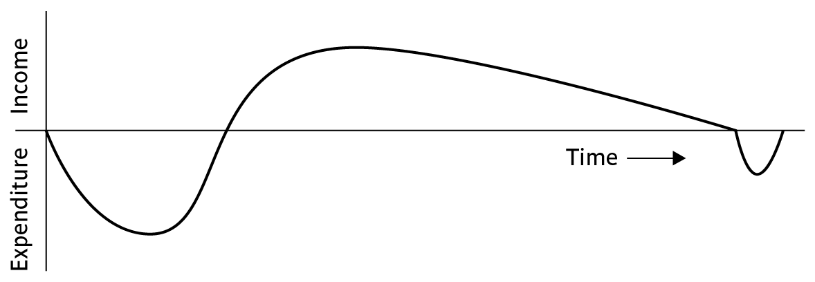

Product/system life cycle cash flows
The timing of costs and income for a product of system needs to be estimated.
The development of the project will incur costs.
When the system or product is released it will generate income that gradually pays off costs
Some costs may relate to decommissioning – think of demolishing a nuclear power station.
SPM (5e) Project evaluation and programme management© The McGraw-Hill Companies, 2009

Slide 13
Net profit
Year | Cash-flow
0 | -100,000
1 | 10,000
2 | 10,000
3 | 10,000
4 | 20,000
5 | 100,000
Net profit | 50,000
‘Year 0’ represents all the costs before system is operation
‘Cash-flow’ is value of income less outgoing
Net profit value of all the cash-flows for the lifetime of the application
SPM (5e) Project evaluation and programme management© The McGraw-Hill Companies, 2009
Notes:
See Section 2.5 for further details. Exercise 2.3 is applicable here

Slide 14
Pay back period
This is the time it takes to start generating a surplus of income over outgoings. What would it be below?
Year | Cash-flow | Accumulated
0 | -100,000 | -100,000
1 | 10,000 | -90,000
2 | 10,000 | -80,000
3 | 10,000 | -70,000
4 | 20,000 | -50,000
5 | 100,000 | 50,000
SPM (5e) Project evaluation and programme management© The McGraw-Hill Companies, 2009
Notes:
The payback period would be about 4.5 years. This can be calculated as the last year in which the accumulated cash flow was negative + (absolute accumulated cash flow at the end of that year / cash-flow for the next year) e.g. year 4 + (50,000/100,000). This assumes that the flow of cash is constant throughout the year in question e.g. £100,000/12 or £8,333 a month in year 5
Exercise 2.3. in the text is relevant here.

Slide 15
Return on investment (ROI)
ROI =
Average annual profit
Total investment
X 100
In the previous example
average annual profit
= 50,000/5
= 10,000
ROI = 10,000/100,000 X 100 = 10%
SPM (5e) Project evaluation and programme management© The McGraw-Hill Companies, 2009
Notes:
Exercise 2.4. gives further practice is calculating ROI.

Slide 16
Net present value
Would you rather I gave you £100 today or in 12 months time?
If I gave you £100 now you could put it in savings account and get interest on it.
If the interest rate was 10% how much would I have to invest now to get £100 in a year’s time?
This figure is the net present value of £100 in one year’s time
SPM (5e) Project evaluation and programme management© The McGraw-Hill Companies, 2009
Notes:
If you invested £91 now you would get £9.10 in interest which would give you £100.10 in 12 months. The interest rate of 10% is used purely to make it easy to do the calculations, not because it is a realistic rate.

Slide 17
Discount factor
Discount factor = 1/(1+r)^{t}
  r is the interest rate (e.g. 10% is 0.10)
  t is the number of years
In the case of 10% rate and one year
Discount factor = 1/(1+0.10) = 0.9091
In the case of 10% rate and two years
Discount factor = 1/(1.10 x 1.10) =0.8294
SPM (5e) Project evaluation and programme management© The McGraw-Hill Companies, 2009

Slide 18
Applying discount factors
Year | Cash-flow | Discount factor | Discounted cash flow
0 | -100,000 | 1.0000 | -100,000
1 | 10,000 | 0.9091 | 9,091
2 | 10,000 | 0.8264 | 8,264
3 | 10,000 | 0.7513 | 7,513
4 | 20,000 | 0.6830 | 13,660
5 | 100,000 | 0.6209 | 62,090
 |  | NPV | 618
SPM (5e) Project evaluation and programme management© The McGraw-Hill Companies, 2009
Notes:
NPV is the sum of the discounted cash flows for all the years of the ‘project’ (note that in NPV terms the lifetime of the completed application is included in the ‘project’)
The figure of £618 means that £618 more would be made than if the money were simply invested at 10%. An NPV of £0 would be the same amount of profit as would be generated by investing at 10%.

Slide 19
Internal rate of return
Internal rate of return (IRR) is the discount rate that would produce an NPV of 0 for the project
Can be used to compare different investment opportunities
There is a Microsoft Excel function which can be used to calculate
SPM (5e) Project evaluation and programme management© The McGraw-Hill Companies, 2009
Notes:
The Excel function in question is =IRR.

Slide 20
Dealing with uncertainty: Risk evaluation
project A might appear to give a better return than B but could be riskier
Could draw up draw a project risk matrix for each project to assess risks – see next overhead
For riskier projects could use higher discount rates
SPM (5e) Project evaluation and programme management© The McGraw-Hill Companies, 2009

Slide 21
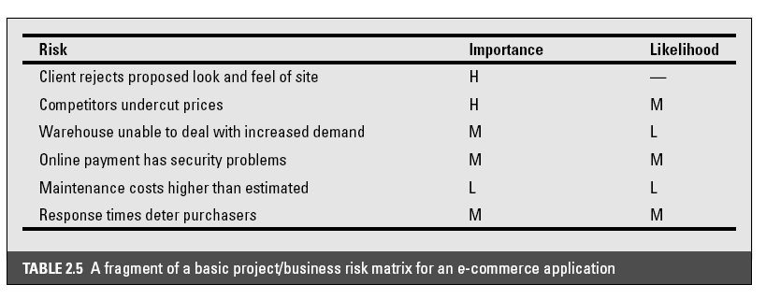
Example of a project risk matrix
SPM (5e) Project evaluation and programme management© The McGraw-Hill Companies, 2009
Notes:
In the table ‘Importance’ relates to the cost of the damage if the risk were to materialize and ‘likelihood’ to the probability that the risk will actual occur. ‘H’ indicates ‘High’, ‘M’ indicates ‘medium’ and ‘L’ indicates ‘low’. The issues of risk analysis are explored in much more depth in lecture/chapter 7.

Slide 22
Programme management
One definition:
‘a group of projects that are managed in a co-ordinated way to gain benefits that would not be possible were the projects to be managed independently’ Ferns
SPM (5e) Project evaluation and programme management© The McGraw-Hill Companies, 2009
Notes:
The quotation is from a paper that appeared in the International Journal of Project Management August 1991

Slide 23
Programmes may be
Strategic
Business cycle programmes
Infrastructure programmes
Research and development programmes
Innovative partnerships
SPM (5e) Project evaluation and programme management© The McGraw-Hill Companies, 2009
Notes:
See Section 2.7 on page 38
Strategic
Several projects together implement a single strategy. For example, merging two organizations will involve many different activities e.g. physical re-organization of offices, redesigning the corporate image, merging ICT systems etc. Each of these activities could be project within an overarching programme.
Business cycle programmes
A portfolio of project that are to take place within a certain time frame e.g. the next financial year
Infrastructure programmes
In an organization there may be many different ICT-based applications which share the same hardware/software infrastructure
Research and development programmes
In a very innovative environment where new products are being developed, a range of products could be developed some of which are very speculative and high-risk but potentially very profitable and some will have a lower risk but will return a lower profit. Getting the right balance would be key to the organization’s long term success
Innovative partnerships
e.g. pre-competitive co-operation to develop new technologies that could be exploited by a whole range of companies

Slide 24

Programme managers versus project managers
Programme manager
  Many simultaneous projects
  Personal relationship with skilled resources
  Optimization of resource use
  Projects tend to be seen as similar
Project manager
  One project at a time
  Impersonal relationship with resources
  Minimization of demand for resources
  Projects tend to be seen as unique
SPM (5e) Project evaluation and programme management© The McGraw-Hill Companies, 2009
Notes:
The programme manager may well have a pool of staff upon which to call. He/she will be concerned with ensuring the best use of staff e.g ensuring that staff have regular work with no periods of enforced idleness between project tasks. The project leader would think in terms of ‘I need a Java programmer for four weeks’ without being concerned which specific person it is (beyond obvious concerns that they are fully capable).

Slide 25
Strategic programmes
Based on OGC (Office of Government Commerce) approach
Initial planning document is the Programme Mandate describing
  The new services/capabilities that the programme should deliver
  How an organization will be improved by the use of new services or capability
  Fit with corporate goals and any other initiatives (existing organizational goals)
A programme director appointed a champion for the scheme (someone in a prominent position within the organization)
SPM (5e) Project evaluation and programme management© The McGraw-Hill Companies, 2009
Notes:
The material here is based on the UK government’s Office of Government Commerce (OGC) approach which is described in detail in their publication Managing successful programmes.
The programme director should be someone who is in a prominent position in the organization so that the seriousness and commitment of the organization to the programme are made clear.
An example of what might be a programme is given in Section 2.9 in the text. It might be found at the IOE company that the customers’ experience of the organization can be very variable and inconsistent. The employee who records the customer’s requirements is different from the people who actually carry out the work and different again from the clerk who deals with accounts. Different maintenance engineers deal with different types of equipment. A business objective might be to present a consistent and uniform interface to the client. This objective might need changes to a number of different systems which until now have been largely self-contained. The work to reorganize each individual area might be treated as separate projects, co-ordinated at a higher level as a programme.

Slide 26
Next stages/documents
The programme brief – equivalent of a feasibility study: emphasis on costs and benefits
The vision statement – explains the new capability that the organization will have (e.g. one might be able to say that repeat business will be increased)
The blueprint – explains the changes to be made to obtain the new capability
SPM (5e) Project evaluation and programme management© The McGraw-Hill Companies, 2009
Notes:
The programme brief – is it worth it?
The vision statement – the ‘what’
The blueprint – the ‘how’

Slide 27
Benefits management
developers
users
organization
use
for
the
application
benefits
build
to deliver
Providing an organization with a capability does not guarantee that this will provide benefits envisaged – need for benefits management
This has to be outside the project – project will have been completed
Therefore done at programme level
SPM (5e) Project evaluation and programme management© The McGraw-Hill Companies, 2009

Slide 28
Benefits management
To carry this out, you must:
Define expected benefits
Analyse balance between costs and benefits
Plan how benefits will be achieved
Allocate responsibilities for their achievement
Monitor achievement of benefits
SPM (5e) Project evaluation and programme management© The McGraw-Hill Companies, 2009
Notes:
Benefit profiles can be produced that document when and how it is planned that the benefits will be experienced.
As different components of the new capability are developed, a series of tranches of projects (projects grouped in different steps of the programme) may be completed, each with a set of associated benefits.
The achievement of benefits might be made the responsibility of staff who are designated as business change managers.

Slide 29
Benefits
These might include:
Mandatory requirement
Improved quality of service
Increased productivity
More motivated workforce
Internal management benefits
SPM (5e) Project evaluation and programme management© The McGraw-Hill Companies, 2009
Notes:
You could argue that as you have to comply with a mandatory requirement, the question of benefits is irrelevant in this case. However as failure to comply will a negative outcome (e.g. not being able to trade), avoiding that negative outcome is clearly a benefit which could be costed.
‘Internal management benefits’ includes things like better decision-making. In the case of an insurance company a deeper analysis of insurance claims might help identify types of business that are most risky and allow the company to adjust premiums to cover these.

Slide 30
Benefits - continued
Risk reduction
Economies
Revenue enhancement/acceleration
Strategic fit
SPM (5e) Project evaluation and programme management© The McGraw-Hill Companies, 2009
Notes:
‘Economies’ refers to cost-cutting e.g. using an automated telephone system to direct calls without human intervention could allow an organization to reduce staff.
Revenue enhancement/acceleration e.g. the sooner that bills reach the customers, the sooner they can pay them.
‘Strategic fit’ A change might not benefit any single group within an organization but might have to be made to obtain a benefit for the organization as a whole.

Slide 31
Quantifying benefits
Benefits can be:
Quantified and valued e.g. a reduction of x staff saving £y
Quantified but not valued e.g. a decrease in customer complaints by x%
Identified but not easily quantified – e.g. public approval for a organization in the locality where it is based
SPM (5e) Project evaluation and programme management© The McGraw-Hill Companies, 2009

Slide 32
Remember!
A project may fail not through poor management but because it should never have been started
A project may make a profit, but it may be possible to do something else that makes even more profit
A real problem is that it is often not possible to express benefits in accurate financial terms
Projects with the highest potential returns are often the most risky
SPM (5e) Project evaluation and programme management© The McGraw-Hill Companies, 2009

