Slide 1
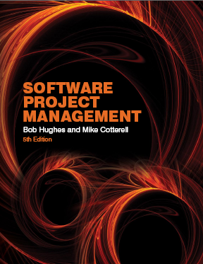
Software Project Management
Chapter 3
Step Wise: An approach to planning software projects
Notes:
This talk provides an overview of the basic steps needed to produce a project plan. The framework provided should allow students to identify where some of the particular issues discussed in other chapters are applied to the planning process. As the focus is on project planning, techniques to do with project control are not explicitly described. However, in practice, one element of project planning will be to decide what project control procedures need to be in place.

Slide 2


‘Step Wise’ - aspirations
Practicality
  tries to answer the question ‘what do I do now?’
Scalability
  useful for small project as well as large
Range of application
Accepted techniques
  e.g. borrowed from PRINCE etc
Notes:
The motivation for identifying an overall framework was that students, and others, were often at a loss as to where to start when new to project planning. A structured approach was seen as catering for the needs of such people.
Students are perhaps most likely to come into contact with some kind of project planning (i) when they are involved in student projects, especially those carried in groups and (ii) if they are members of a project team when they are undertaking a placement year in industry. The first situation is probably quite small-scale compared to the second. The same general principles of planning however relate to both.
The approach described here is designed to be applicable to a range of different types of project. For example, multimedia projects are not explicitly discussed, but one of the authors teaches a course project management for multimedia and the general approach described here seems to work satisfactorily when applied to these type of projects.
It might be asked why a standard approach such as PRINCE2 has not been adopted. In fact there is an outline of the PRINCE2 framework in an Appendix to the textbook. There has been caution about using PRINCE2 more centrally because:
PRINCE2 tend to be used mainly in the UK and many users of the Software Project Management textbook are from elsewhere
The content of this course would be vulnerable to changes to the method imposed by its design authority
PRINCE2 tends to focus more on procedural and bureaucratic matters at the expense of techniques – the few planning techniques that are associated with PRINCE, for example, the development of product flow diagrams, are used in the Step Wise approach as well.

Slide 3
‘Step Wise’ - an overview
0.Select
project
1. Identify
project objectives
2. Identify project
infrastructure
3. Analyse
project
characteristics
Review
4. Identify products
and activities
Lower
level
detail
5. Estimate effort
for activity
For each
activity
6. Identify activity
risks
10. Lower level
planning
7. Allocate
resources
9. Execute plan
8. Review/ publicize
plan
Notes:
This is an overview of the main steps, details of which will be discussed in the following overheads:
0. Select project There must be some process by which the project to be executed was selected. Chapter 3 on project evaluation looks at this in more detail.
1. Identify project objectives It is important that at the outset the main stakeholders are all aware of the precise objectives of the project. This has already been discussed in Chapter 1.
2. Identify project infrastructure This may not be a significant step where you are working on an in-house project in a very familiar environment. However, where the project is being carried out for external clients then you may need to investigate the characteristics of the environment in which the project is to be carried out.
3. Analyse project characteristics Different types of project will need different technical and management approaches. For example, a project to implement control software embedded in industrial equipment will need a different set of methods than a project to implement a business information system. A multimedia application would again need a different set of activities. (This is not to say that there could not be considerable overlaps in the approaches).
4. Identify products and activities With software projects, it is best to start by listing the products, both deliverable and intermediate, to be created. The activities needed to create the products can then be identified
5. Estimate effort for activity.
6. Identify activity risks Having assessed the amount of effort and the elapsed time for a project, the reasons why these might be vary during the actual execution of the project need to be considered. Where there is a very high risk of additional effort/time being needed then actions to reduce this risk may be formulated.
7. Allocate resources With software projects, these resources will mainly be staff, but could be equipment etc.
8. Review/publicize It is no good having a plan if no one knows about it
9. Execute Plan
10. Lower level planning Not all of a project, especially when it is large, can be planned in detail at the outset. Not all the information needed to plan the later stages will be available at the beginning: for example software development cannot be broken down into precise sub-tasks with realistic target times until more is known about what the overall design of the system is known.

Slide 4
A project scenario: Brightmouth College Payroll
College currently has payroll processing carried out by a services company
This is very expensive and does not allow detailed analysis of personnel data to be carried out
Decision made to bring payroll ‘in-house’ by acquiring an ‘off-the-shelf’ application
Notes:
In the chapter in the textbook two scenarios are explored. In this lecture we’ll only deal with one, which develops some aspects on the Brightmouth College payroll project that is mentioned in Chapter 1 of the textbook, but was not explored in depth in the lecture slides for that chapter.

Slide 5
Project scenario - continued
The use of the off-the-shelf system will require a new, internal, payroll office to be set up
There will be a need to develop some software ‘add-ons’: one will take payroll data and combine it with time-table data to calculate the staff costs for each course run in the college
The project manager is Brigette.
Notes:
The last requirement – to build an ‘add-on’ – allows some software development issues to be addressed!

Slide 6
Step 1 establish project scope and objectives
1.1 Identify objectives and measures of effectiveness
  ‘how do we know if we have succeeded?’
1.2 Establish a project authority
  ‘who is the boss?’
1.3 Identify all stakeholders in the project and their interests
  ‘who will be affected/involved in the project?’
Notes:
1.1. Identifying objectives and measures of effectiveness. This was discussed in chapter/lecture 1. To revise this students could be asked to try to produce a succinct statement of the objectives for the student described previously. Key points are that the student project objectives must be such that a student can realistically be responsible for their achievement. For instance, an objective to reduce conflict between project team members would be at too high a level for a software developer: he or she is there to produce software and evaluation of the particular pyschometric test would be outside their capabilities. If the student was a psychology student and the project was regarded as a psychological one, then things might be different.
1.2.Establishment of a project authority In the case of students on placement or carrying final year projects for outside organizations, the problem of identifying who has the final say on the project can occur surprisingly often, particular when different user groups have conflicting requirements. In larger, more formal projects, the project authority might reside in a Project Board or steering committee.
1.3 Identify all stakeholders in the project and their interests. Stakeholders can be anyone who has an interest in the project. They may be users of the final application or might be involved in the development or implementation of the project.

Slide 7
Step 1 continued
1.4 Modify objectives in the light of stakeholder analysis
  ‘do we need to do things to win over stakeholders?’
1.5 Establish methods of communication with all parties
  ‘how do we keep in contact?’
Notes:
1.4 Modify objectives in the light of stakeholder analysis. The key point here is the need to ensure commitment to the project from the important stakeholders. This might need to be done by ensuring that there is some benefit from the project for them. Note this is a similar idea to Barry Boehm’s ‘Theory W’ (‘W’ stands for ‘everyone a winner’)
1.5 Establish methods of communication with all parties In the case of a small student project, it might be mainly swapping email addresses and mobile phone numbers. With larger projects, it could involve setting up groups who meet regularly to co-ordinate action. Sometimes specific ‘communication plans’ are drawn up to deal with these issues.

Slide 8
Back to the scenario
Project authority
  Brigette finds she has two different clients for the new system: the finance department and the personnel office. A vice principal agrees to be official client, and monthly meetings are chaired by the VP and attended by Brigette and the heads of finance and personnel
  These meetings would also help overcome communication barriers
Notes:
Applying these ideas to the scenario introduced earlier:
Project authority
Stakeholders/revision to objectives The application will not ultimately be a success if project team members are not happy to use the system. They might be happier to use the testing system if the results of their own tests were automatically notified to them personally by the software application, so that this might have to be added as a requirement for the project.

Slide 9
Back to the scenario - continued
Stakeholders
  For example, personnel office would supply details of new staff, leavers and changes (e.g. promotions)
  To motivate co-operation Brigette might ensure new payroll system produces reports that are useful to personnel staff

Slide 10
Step 2 Establish project infrastructure
2.1 Establish link between project and any strategic plan
  ‘why did they want the project?’
2.2 Identify installation standards and procedures
  ‘what standards do we have to follow?’
2.3. Identify project team organization
  ‘where do I fit in?’
Notes:
At the same time as establishing exactly what the project objectives are, the person responsible may know little about the organizational environment in which the application is to be developed and implemented. The actions in Step 2 address this problem.

Slide 11
Step 3 Analysis of project characteristics
3.1 Distinguish the project as either objective or product-based.
  Is there more than one way of achieving success?
3.2 Analyse other project characteristics (including quality based ones)
  what is different about this project?
Notes:
Step 3 is about examining the nature of the application to be built and the environment in which it is to be built and implemented and identifying the most appropriate technical approach.
3.1 Objective-based versus product-based projects. With a product-based project the developers have to create a product, the specification of which is often (but not always) clearly defined. In an objective-based project, a problem is defined that needs to be solved but there could be more than one solution. For example, if an organization needed a payroll application they might consider (a) writing the system themselves (b) using a service company to do the payroll for them (c) acquire an off-the-shelf package
3.2 Analyse other project characteristics – such as is it an information system or an embedded real time or a multimedia application? Is it safety-critical? Etc etc. The payroll application is clearly an information system. If an off-the-shelf application is adopted, there is plenty of guidance on how off-the-shelf applications can be accessed and selected that could be consulted by Brigette

Slide 12
Step 3 continued
Identify high level project risks
  ‘what could go wrong?’
  ‘what can we do to stop it?’
Take into account user requirements concerning implementation
Select general life cycle approach
  waterfall? Increments? Prototypes?
Review overall resource estimates
  ‘does all this increase the cost?’
Notes:
Identifying high level risks could influence the general approach to the project. For example, if the users appeared to be uncertain about the precise nature of the requirement then a more iterative approach, including the use of prototypes to refine user needs, might be selected.
If the application is very large and complex then breaking it down into increments might be the way to proceed. Chapter/lecture 4 looks at this in more detail.

Slide 13
Back to the scenario
Objectives vs. products
  An objective-based approach has been adopted
Some risks
  There may not be an off-the-shelf package that caters for the way payroll is processed at Brightmouth College
Answer?
  Brigette decides to obtain details of how main candidate packages work as soon as possible; also agreement that if necessary processes will be changed to fit in with new system.

Slide 14
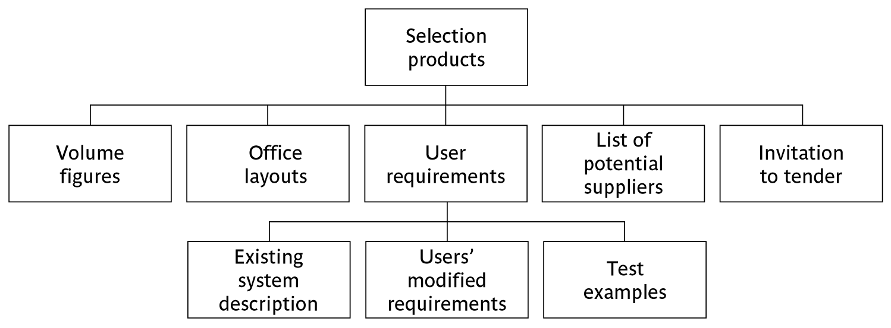

Step 4 Identify project products and activities
4.1 Identify and describe project products - ‘what do we have to produce?’
Notes:
Here we follow the PRINCE approach of firstly identifying the products to be created. These products could be deliverables that will eventually be handed over to the customer, or intermediate products such as specifications and design documents, that are produced along the way.
The PBS is a way of listing these products.
In the scenario, one set of products will relate to the products needed to produce one or more invitations to tender (ITTs) to supply the hardware and software needed to operate the new payroll application. In order to allow the most suitable configuration to be identified the number of transactions and the size of the database needed will have to be identified – volume figures. To set up an appropriate network attached to secure printers and servers, a layout of the proposed office will need to be created. A user requirement will need to be produced which describes the existing system, identifies additional requirements (such as the need to be able to access database details in order to produce one-off queries and reports), and some test data and expected results which further illuminate the details of the requirements. This test data could form the basis of user acceptance tests. A list of potential suppliers to whom ITTs could be sent will be needed, and the actual ITT itself which will, among other things, explain how the proposals of potential suppliers are to be submitted.

Slide 15
Products
The result of an activity
Could be (among other things)
  physical thing (‘installed pc’),
  a document (‘logical data structure’)
  a person (‘trained user’)
  a new version of an old product (‘updated software’)

Slide 16
Products
The following are NOT normally products:
  activities (e.g. ‘training’)
  events (e.g. ‘interviews completed’)
  resources and actors (e.g. ‘software developer’) - may be exceptions to this
Products CAN BE deliverable or intermediate

Slide 17
Product description (PD)
Product identity
Description - what is it?
Derivation - what is it based on?
Composition - what does it contain?
Format
Relevant standards
Quality criteria
Create a PD for ‘test data’
Notes:
The names of products on the PBS can be rather vague. If you were to ask someone to produce, for example, the ‘analysis report’ in the usability testing scenario, then you would need to explain exactly what you mean by that. This is done via a Product Description. PDs can usually be re-used from one project to another.
Note that they are different from specifications – the explain in general terms what a product is and the description is relevant to all instances of that product. A specification describes a particular instance within the class of products.

Slide 18
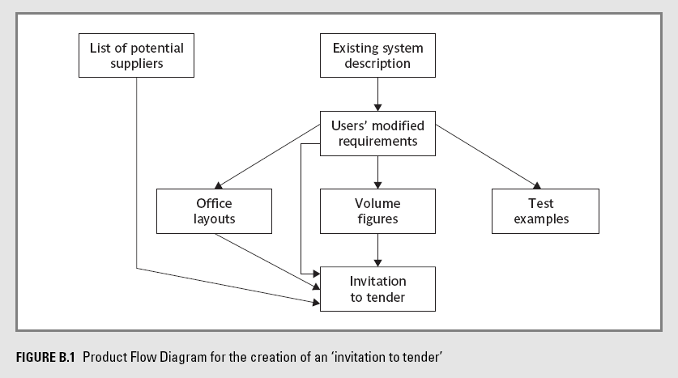
Step 4 continued
4.2 document generic product flows
Notes:
The product flow diagram shows the order in which the products have to be completed. Effectively it defines a method of working. The example above is a possible solution to Exercise 3.3 in the textbook.
The flow of the PFD is generally from top to bottom and left to right. We do no put in lines which loop back. This is not because iterative and back-tracking is not accepted. Rather it is that you can in theory jump back to any preceding product.

Slide 19
Step 4.3 Recognize product instances
The PBS and PFD will probably have identified generic products e.g. ‘software modules’
It might be possible to identify specific instances e.g. ‘module A’, ‘module B’ …
But in many cases this will have to be left to later, more detailed, planning

Slide 20
4.4. Produce ideal activity network
Identify the activities needed to create each product in the PFD
More than one activity might be needed to create a single product
Hint: Identify activities by verb + noun but avoid ‘produce…’ (too vague)
Draw up activity network

Slide 21
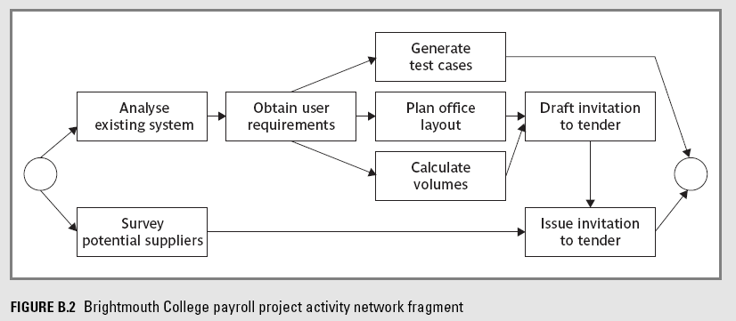
An ‘ideal’ activity
Notes:
The activity network is the basis of the data that is input to planning software tools like MS Project.

Slide 22
Step 4.5 Add check-points if needed
Design
module A
Code
module A
Design
system
Design
module B
Code
module B
Test
system
Design
module C
Code
module C
put in a
check point
Design
module A
Code
module A
Design
system
Design
module B
Check-point
Code
module B
Test
system
Design
module C
Code
module C
Notes:
There are some points in the project when we want to check that the quality of what we have done so far is a sound basis for further work. In the example we have decided to check that all the module designs are compatible with one another before continuing. Note that the benefit of reducing wasted work at a later stage when incompatibilities lead to products being reworked, has to be balanced against the delay caused by the check-point. The start of coding of modules A, B and C all have to wait for the completion of the design of all the modules A, B and C. With no check-point, module A could be coded as soon as the design of module A had been done without having to wait for B and C.

Slide 23
Step 5:Estimate effort for each activity
5.1 Carry out bottom-up estimates
  distinguish carefully between effort and elapsed time
5.2. Revise plan to create controllable activities
  break up very long activities into a series of smaller ones
  bundle up very short activities (create check lists?)
Notes:
Effort is the total number of staff-hours (or days etc) needed to complete a task. Elapsed time is the calendar time between the time task starts and when it ends. If 2 people work on the same task for 5 days without any interruption, then the effort is 10 staff-days and the elapsed time is 5 days.
Using the PBS/PFD to generate the activities often means that some activities are very small and others are huge. Often there is an activity called ‘write software’ which is 70% of a software development project. These large activities need to be broken down into more manageable small tasks. You should aim for the average length of your activities to be about the time between progress meetings e.g. if you have team progress meeting once a fortnight, try to make the tasks last about 2 weeks.
Lecture/chapter 5 explores estimating in some depth.

Slide 24
Step 6: Identify activity risks
6.1.Identify and quantify risks for activities
  damage if risk occurs (measure in time lost or money)
  likelihood if risk occurring
6.2. Plan risk reduction and contingency measures
  risk reduction: activity to stop risk occurring
  contingency: action if risk does occur
Notes:
Note that we have already considered some high level risks that could affect the project as a whole at Step 3. Estimates of the effort and duration of activities can be quite tricky. When you produce an estimate for an activity it is worth reflecting about the events which could cause the assumptions upon which you have based your estimate to be wrong. Where the risk seems very high, then you might try to introduce new activities specifically designed to reduce the risk, or to formulate a contingency action if the risk should materialize. For example, there is not much you can do to stop people getting the flu at a critical time in the project, but you might be able to have a plan to bring in temporary cover for sickness in the case of time-critical activities.
Lecture/chapter 7 focuses particularly on risk.

Slide 25
6.3 Adjust overall plans and estimates to take account of risks
  e.g. add new activities which reduce risks associated with other activities e.g. training, pilot trials, information gathering

Slide 26
Step 7: Allocate resources
7.1 Identify and allocate resources to activities
7.2 Revise plans and estimates to take into account resource constraints
  e.g. staff not being available until a later date
  non-project activities
Notes:
You now need to allocate resources (in particular, staff) to the activities in the plan. Where there is a resource constraint, that is there are not enough staff (or other resource) of the right type to start all the activities that run in parallel at the planned time, then the start of some activities may need to be delayed until the appropriate resources are available.

Slide 27
Gantt charts
LT = lead tester
TA = testing assistant
Week commencing
MARCH
APRIL
5
12
19
26
2
9
16
Survey potential
suppliers
Finance assistant
Analyse existing
system
Business analyst
Obtain user requirements
Business analyst
Generate test cases
Systems assistant
Plan office layouts
Premises office
Calculate volumes
Systems assistant
Business
analyst
Draft and issue ITT
Notes:
We now have the basic information needed to produce a plan. One way of presenting the plan is by means of a Gantt chart (named after Henry Gantt).

Slide 28
Step 8: Review/publicise plan
8.1 Review quality aspects of project plan
8.2 Document plan and obtain agreement
Step 9 and 10: Execute plan and create lower level plans
Notes:
We have noted already that it is not feasible to produce a detailed plan for all stages of the project right at the beginning of the project planning process and not all the information needed for the detailed planning of the later stages is available at the outset. Initially an outline plan for the whole project would be produced, plus a detailed plan for the first stage.

Slide 29
Key points
Establish your objectives
Think about the characteristics of the project
Discover/set up the infrastructure to support the project (including standards)
Identify products to be created and the activities that will create them
Allocate resources
Set up quality processes

