Slide 1
What practitioners consider to be the skills and behaviours of an effective people project manager
International Journal of Project Management 29 (2011) 994 – 1002
Eddie Fisher

Slide 2
Contents
Summary
Introduction
  Literature Review
  Research Questions
Research Methodology
  Method
  Data Analysis
Results
  Face-to-face Interviews
  Focus Group Meetings
Discussion
Conclusion

Slide 3
Summary
Management of people.
Recent studies expresses the need to develop a better understanding of what good people management is.
This paper proposes what project management practitioners consider to be skills and behaviours of an effective people project manager.
A combination of literature review, face to face interviews and focus group meetings was applied to complete the research objective.
Six skills and associated behaviours were identified as being most important.

Slide 4
Introduction
More companies have adopted project management methodologies and processes such as Prince 2, Six Sigma, or Managing Successful Programmes (MSP) to deliver work packages in a more conscious and controlled way, to make the best use of their often limited human resources to create competitive advantage and to meet customer requirements.

Slide 5
Introduction
Customers have placed higher demands on product and service quality.
They no longer accept product or service limitations forced upon them by suppliers such as design options.
Blackburn(2001), Huemann (2002), Dainty et al. (2005) and Moore et al. (2003) suggest further insights that support the need for new and improved effective people skills and associated behaviours for project managers.

Slide 6
Introduction
This paper discusses people skills and associated behaviours of project managers, therefore, had to deal with the meaning that people put on their observations.
Their descriptions have been collected, analysed and interpreted by applying a constructivist interpretivist approach within a phenomenological research paradigm.
Deductive reasoning has been applied, starting off from the more general (literature review) to the more specific (face to face interviews and focus group meetings).

Slide 7
Literature Review
McGregor (1967), Blake and Mouton (1964), and Likert and Hayes (1957) consider that an effective manager needs to show concern for people, build trust, show sympathy, and involve people’s emotions, for example, in solving problems.
Honey (1988) developed this further in the early 1980s by suggesting that interpersonal skills are face to face behaviours that people use when they wish to achieve something useful with the help and through others.
Peter and Waterman (1982) consider that it is behaviours and competences that make an effective people manager. They suggest that an effective manager needs to be able to communicate well, inspire others, lead their people and show empathy.

Slide 8
Literature Review
Fisher (2006) suggests that the behaviours that underpin these competences are becoming increasingly recognized as the driving force that makes a difference to the effective management of people.
Trompenaars and Hampden-Turner (1993, 1997) consider that understanding different cultures is an important people skill.
Kliem and Ludin (1992) suggest that project managers need to develop and apply good interpersonal skills such as showing empathy for feelings of others, being able to see things from the perspectives of others and respecting others for what they are.

Slide 9
Literature Review
Thamhain (2004) considers that effective project leaders inspire their people and make everyone feel proud to be part of project organization and its mission.
Kadefors (2004) suggests that the building of trust is an important competence for project managers to have.
Rosenau (1998) considers that project managers are more likely to accomplish their tasks if they win the respect of their team members by displaying behaviours such as being polite and reasonable.
He suggests that effective people project managers must be people-oriented with strong leadership and superb communication abilities.

Slide 10
Literature Review
Edmondson et al. (2005) considers that project managers need to be accessible in order to make clear that others’ opinions are welcomed and valued.
Wysocki (2007) suggests that effective people project managers encourage their team members to think ‘outside the box’ and find creative solutions to problems and to make informed decisions based on the strength of evidence from collected information.

Slide 11
Literature Review
Jiang et al. (2003) suggest that some people skills that make an effective project manager are; being diplomatic, and tactful when dealing with others, understanding what motivates the individuals, effective conflict management, and reinforcing messages to others through gestures and facial expressions.
Barkley (2006) suggests that effective people project managers create an environment of honesty, trust, open communications, pride of workmanship and commitment. They developed a ‘can do’ attitude and they listen actively to others.

Slide 12
Literature Review
Cicmil and Hodgson (2006) suggest that project managers, it appears, are play-acting rather than apply authentic behaviours.
Lewis (2003) suggests that people generally behave consistently with their beliefs. It does not matter what people say they believe in – it is usually possible to tell what they believe in by observing their behaviours. In a project environment, this means that many project managers are play-acting either to live up to expectations or to fulfil their own self-esteem needs.

Slide 13
Literature Review
Whitty and Schulz (2006) suggest that project managers are like actors within the theatre of project management and that they wear customes, read a script, and use props, in front of the audience made up of senior management and key stakeholders within their project.

Slide 14
Literature Review - Results
The literature review for both the general and project management publications has revealed that some people skills from the early management years such as effective communications, negotitations and conflict management have now become part of what management experts refer to as general management practice.
More recent publications suggest appropriate people skills managers should have and adopt such as authentizotic behaviours, being culturally aware, apply some play-acting and managing the emotions of people.
The literature revealed a number of people skills but did not provide conclusive evidence which of these skills makes an effective people project manager.

Slide 15
Literature Review
This paper considers that it is the application of the associated behaviours that are important to the successful application of the people skills.
  To suggest what the most important people skills are that make an effective people project manager.
  To suggest what the associated behaviours are for each of the these skills.

Slide 16
Main Research Questions
What are the most important skills practitioners consider make an effective people project manager?
What specific behaviours do practitioners associate with each of these skills?

Slide 17
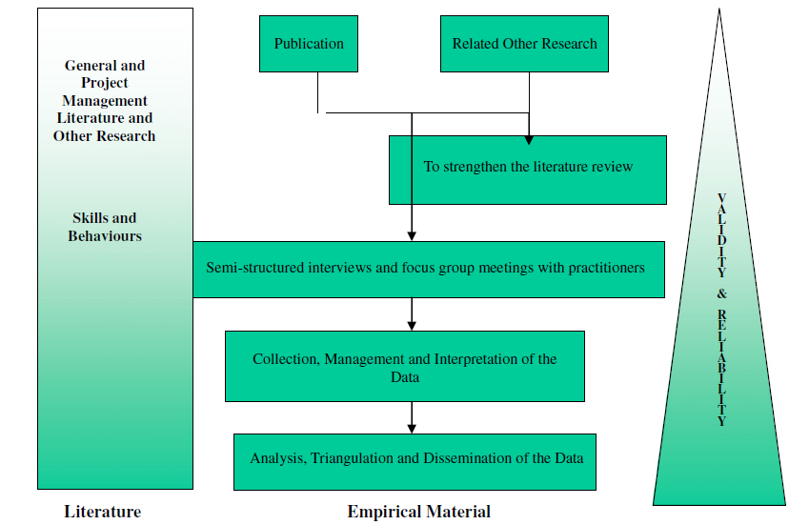
Research Design Process Diagram

Slide 18
Methods
Real people behave differently in the real and socially constructed world (practice) as compared to a world that only exists within the people’s imagination (theory).
The literature review did not provide conclusive evidence of what specific skills and accociated behaviors make an effective people project manager.

Slide 19
Methods
To close this gap and provide some practical insights as to what makes an effective people project manager, ten members of the community of practice were interviewed individually and together in two focus group meetings (one year apart) to share their practical knowledge and experience to help answer the main research questions.
Erickson and Gutierrez (2002) consider that ‘… we need practitioner research… the knowledge of practitioners and of research specialists must grow together in new ways’.
Practitioners provide valuable perspectives of what they suggest works in the real and commercial world project managers operate in.

Slide 20
Methods
Interviews lasted for one and a half hours.
All interviews were recorded with the permissions of the participants, transcribed and then checked for accuracy.
The practitioners were initially asked questions that related to their own people skills, looking at the past and the present.
Everyone’s attention was then focused on what they considered to be specific skills and associated behaviours of an effective people project manager.
A focus group meeting was held with the same practitioners from the face to face interviews to validate and check the realiability of the findings from the literature review and interviews.
Practitioners used their own practical experiences and suggested the skills and behaviours for an effective people project manager.
They applied these in their own projects at work and reconvened a year later to review their initial suggestions and to make final recommendations.

Slide 21
Participants
Five male and five female project managers were interviewed to manage any gender bias.
They worked in the Telecommunications, Banking, Consultancy, and Engineering industries.
Ages ranged from 28 to 47 years.
Years of experience as a professional project manager ranged from 3 to 15 years.
The number of projects they managed ranged from; 5 to 50 for projects up to 6 months duration and from 0 to 12 for projects up to 18 months duration.

Slide 22
Face to Face Interviews
Project managers placed a high importance on valuing people and rewarding them for a job well done.
They placed high importance on understanding what it is that actually makes individuals tick.
Effective communication scored highly amongst the practitioners. Active listening is a part of effective communication.
The ten project managers who were interviewed individually, identified a number of people skills and behaviours that make an effective people project manager.

Slide 23
Face to Face Interviews
‘Effective people project managers need to bring people together who do not want to work together. They need to become skilled negotiators, hard on issues and soft on people. They need to show their own behaviour in a calibre and quality that others can respect’ (Martin, Kelly).
‘Project managers need to have better training in skills in working with people so they understand the people side better and to communicate to others more effectively what project management is all about. They need to understand much better how people are made up, for example, how they might react to the project manager’s approaches and how they themselves need to change their approaches toward people’ (Christopher).

Slide 24
Face to Face Interviews
‘Project managers need to be more cross-culturally aware and apply what they have learned about the different culture more effectively. They need to build stronger trust with the team members and they need to exercise better influencing skills to get, for example, what they want or need for their projects and themselves (Steve).
‘Project managers need to have improved leadership skills, matching these to local conditions and company cultures they operate in. They need to communicate clearly and build the team well. They must demostrate enthusiasm and drive to get things done (Melissa, Lawrence)’.

Slide 25
Face to Face Interviews
‘Effective project managers of the future need to understand more what makes people tick. They need to be friendlier with people, being helpful and seen to be more in control of the projects. They need to praise peope more for work well done’ (Maria).
‘Good people project managers need to have good effective communication skills with people at all levels of the organisation. They need to understand cross-cultural behaviours better and need to accept people more for what they are. They need to be resilient to adverse situations in the project, both at people and at work level’ (Lisa).

Slide 26
Skill, Application and Rankings of the Examined Skills Set
Skill | Application | Ranking
Managing emotions | Show an honest understanding for the needs of other people and show an understanding of the motives of others and act accordingly (authentizotic behaviour) | Identified as being highly important by all parties.
Building trust | Accept people for what they are. Empower people more and ask them to take on board more responsibilities. | Highly important skill set according to all involved parties.
Effective communication | Explore the viewpoints of the others before making decisions. | Identified as being important by only the literature review and the face to face interviews.
Motivating others | Tell people that they are talented and skilled. | Identified as being important by only the literature review and the face to face interviews.

Slide 27
Skill, Application and Rankings of the Examined Skills Set
Skill | Application | Ranking
Influencing others | Share with others what it feels like to work in a highly successful team so they adopt the behaviours that are associated with success. | Identified as being highly important by all parties.
Cultural awareness | Develop, display, and apply awareness of the cultural differences of team members. Show an understanding and knowledge of the values and beliefs of other cultures. | Identified as being highly important by all parties.
Leading others | Knowing when not to act authoritatively. Lead by example through behaviour and by displaying appropriate levels of competence and self-confidence. | Identified as being highly important by all parties.
Team building | Show an open appreciation for the contributions of team members. Reward people openly for good work. | Identified as being highly important by all parties.

Slide 28
Focus Group Meetings
Face to face meetings did not elicit this new valuable knowledge on their own.
The group confirmed, through in depth discussions based on their combined years of practical experience, what they consider the skills and behaviours of an effective people project manager are.

Slide 29
Focus Group Meetings
‘Project managers need to be seen to be leading the project team through an appropriate manner and self-confidence’ (Melisa).
‘Project managers need to organise all meetings appropriately, talk to the right people at the right time, be compassionate, be approachable. And sometimes they may have to display behaviours that do not come natural to them in order to create a professional image in others’ (Andrew, Kelly).

Slide 30
Focus Group Meetings
‘Effective people project manager admits when they are wrong’ (Maria).
‘Competent people project managers display confidence when speaking to any audience’ (Martin, Lawrence).
‘Self-development is an important competence for project managers to have’ (Sarah).
‘It is not a weakness of an effective people project manager to ask for help. I consider this to be rather a strength’ (Lisa).
‘Good people project managers sell them in the best possible light at all times’ (Christopher).

Slide 31
Focus Group Meetings
‘Good people project managers listen actively to the problems discussed by their team members and do their best to help them and be seen doing this’ (Andrew and Kelly).
‘Effective people project managers are able to do more than one thing and are able to stay focused with the team at all times. Playing games is not acceptable – people will know straight away if the PM is acting or not. Acting might give some short-term gains but it will damage the personal relationships of PM in long term’ (Maria).
‘Effective people project managers own issues, encourage their teams to discuss these openly and honestly and driving their teams towards finding solutions to problems’ (Lisa).

Slide 32
Six Specific Skills and Behaviours of an Effective People Project Managers
Understanding behavioural characteristics.
Leading others.
Influencing others.
Authentizotic behaviour.
Conflict management.
Cultural awareness.

Slide 33
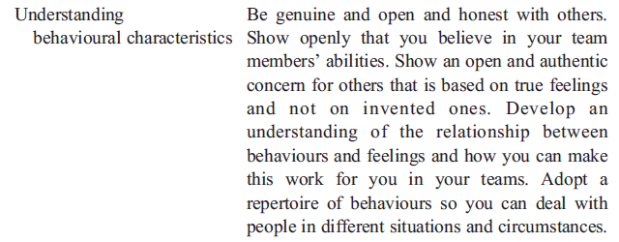
Six Specific Skills and Behaviours of an Effective People Project Managers

Slide 34
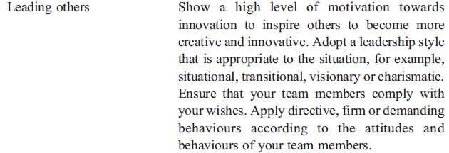
Six Specific Skills and Behaviours of an Effective People Project Managers

Slide 35
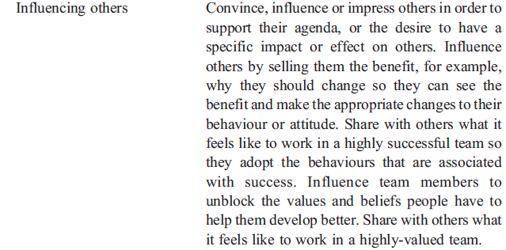
Six Specific Skills and Behaviours of an Effective People Project Managers

Slide 36
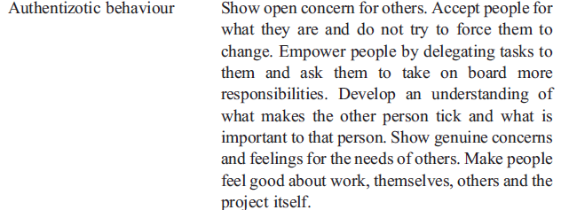
Six Specific Skills and Behaviours of an Effective People Project Managers

Slide 37
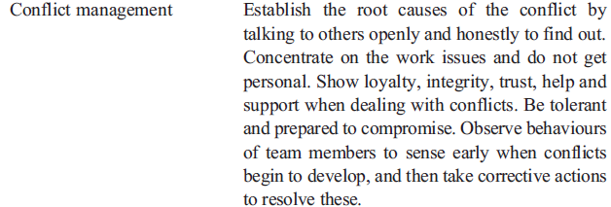
Six Specific Skills and Behaviours of an Effective People Project Managers

Slide 38
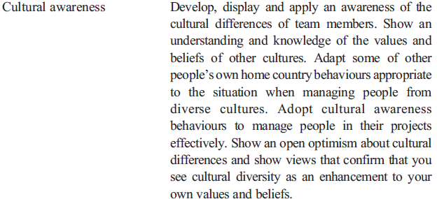
Six Specific Skills and Behaviours of an Effective People Project Managers

Slide 39
Discussions
The research was limited to project managers from industries such as Telecommunications, Engineering, Consultancy, and Banking.
A larger number of practitioners would have been useful to increase the validity and reliability of the research data.
This paper suggests a number of skills and behaviours that could, if adopted, help project managers to become better at managing people in their projects and deliver projects successfully in the increasingly challenging and competitive working environments.

Slide 40
Conclusion
Skills on their own, including their applications, do not make an effective people project manager.
This paper contributes to a better understanding of what practitioners consider makes an effective project manager.
As an outcome, a set of six specific managing people skills and associated behaviours have been presented.
The main research questions were answered.

Slide 41
References
APM Body of Knowledge, 2006. Body of Knowledge, Association for Project Management, Fifth Edition. Published by the Association for Project Management, United Kingdom.
Barkley, B.T., 2006. Integrated Project Management. Mc Graw-Hill. Snr.,.
Blackburn, S. (2001).Understanding project managers at work, Henley Management College/Brunel University, DBA Thesis
Blake, R.R., Mouton, J.S., 1964. The Managerial Grid. Gulf Publishing, Houston, Texas, USA.
Byrd, T.A., Turner, D.E., 2001. An exploratory analysis of the value of the skills of IT personnel: their relationship to IS infrastructure and competitive advantage. Decision Sciences 32 (1), 21–54.
Cicmil, S., Hodgson, D. (Eds.), 2006. Making Projects Critical, Management, Work and Organisations. Macmillan, Palgrave.
Cleland, D.I., 1994. Project Management-Strategic Design and Implementation, Second Edition. McGraw-Hill, Inc.
Crawford, L.H. (2000). Project management competence: the value of standards, thesis submitted for the degree of Doctor of Business Administration, Henley Management College/Brunel University, United Kingdom.
Dainty, A.R.J., Cheng, M.-I., Moore, D.R., 2005. A Comparison of the Behavioural Competencies of Client-Focused and Production-Focused Project Managers in the Construction Sector. : Project Management Journal, Vol. 36, No 1. Project Management Institute, pp. 39–48.
Edmondson, A., Bohmer, R., Pisano, G., 2005. Harvard Business Review on managing projects. Speeding Up Team Learning. Harvard Business School Press, pp. 137–157.
Erickson, F., Gutierrez, K., 2002. Comment: culture, rigor and science in educational research, educational researcher. Vol. 31 (8), 21–24.
Fisher, E.J.P. (2006).Development of a new competence and behaviour model for skills in working with people for project managers, Ph.D. Thesis, Open University, Milton Keynes, United Kingdom.
Gareis, R. (Ed.), 1990. The Handbook of Management by Projects. Manz.
Honey, P., 1988. Face to Face Skills. Gower Publishing.

Slide 42
References
Huemann, M. (2002).Individuelle Projektmanagement-Kompetenzen in Projektorientierten Unternehmen, University for Economics and Management, Vienna, Ph.D. Thesis
Huemann, M., 2010. Considering human resource management when developing a project-oriented company: case study of a telecommunication company. International Journal of Project Management 28 (4), 361–369.
Jiang, J.J., Klein, G., Means, T., 1999. The Missing Link between Systems Analysts' Actions and Skills, Info Systems Journal, vol. 9. Blackwell Science Ltd, pp. 21–33.
Jiang, J.J.,Klein,G.,Van Slyke, C., Cheney, P., 2003.ANote on Interpersonal and Communication Skills for IS Professionals: Evidence of Positive Influence, Decision Sciences, vol. 34 (4). Blackwell Publishing Ltd, pp. 799–812.
Kadefors, A., 2004. Trust in project relationships-inside the black box. International Journal of Project Management 22 (3), 175–182.
Kets De Vries, M., 2001. Creating authentizotic organisations: well-functioning individuals in vibrant companies. Human Relations 54 (1), 101–111.
Kliem, R.L., Ludin, I.S., 1992. The People Side of Project Management. Gower. The Project Manager's Pocket Survival Guide. McGraw-Hill.
Likert, R., Hayes, S.P., 1957. Some Applications of Behavioral Research. Unesco.
Mc Gregor, D., 1967. The Professional Manager. McGraw-Hill, International Student Edition.
Moore, D.R., Cheng, M.-I., Dainty, A.R.J., 2003. What makes a Superior Management Performer: The Identification of Key Behaviours in Superior Construction Managers, Construction Information Quarterly, CIQ Paper, vol. 5, Issue 2, pp. 6–9. 155.

Slide 43
References
Morris, P.W.G., 1994. The Management of Projects, 1st Edition. Thomas Telford, London.
Peters, T.J., Waterman, R.H., 1982. In Search of Excellence. Harper and Row.
PMI, 2004. A Guide To The Project Management Body of Knowledge. PMI Publications, Upper Darby, PA.
Rosenau, M.D., 1998. Successful Project Management, Third Edition. John Wiley & Sons, Inc.
Thamhain,H.J., 2004. Linkages of project environment to performance: lessons for teamleadership. International Journal of Project Management 22 (7), 533–544.
Trompenaars, F., Hampden-Turner, C., 1993, 1997. Riding the Waves of Culture — Understanding Cultural Diversity in BusinessSecond Edition. Nicholas Brealey Publishing.
Turner, J.R., 1993. The Handbook of Project-Based Management. McGraw-Hill Publishing Company.
Verma, K., 1996. Human Resource Skills for the Project Manager—the Human Aspects of Project Management. Volume Two Project Management Institute, PA.
Whitty, S.J., Schulz, M.F., 2006. The PM BOK Code. Proceedings of the 20th IPMA World Congress on Project Management 1, 466–472.
Wysocki, R.K., 2007. Effective Project Management — Traditional, Adaptive, Extreme, Fourth Edition. Wiley Publishing Inc.

