Slide 1
Annual Financial Summary
Author: Pygramattic Demo
Date: 2026-02-06

Slide 2
Executive Summary
This report summarizes the financial performance for the fiscal year. Revenue showed consistent growth.

Slide 3
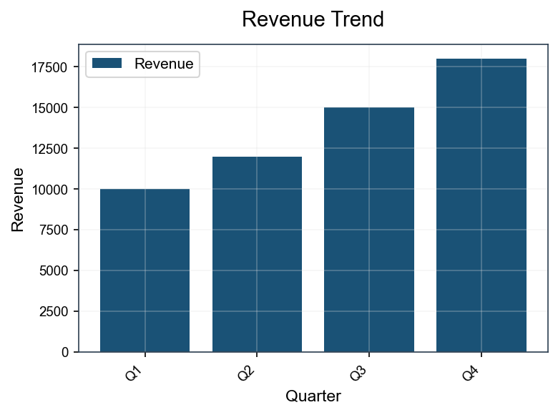
Revenue Trend

