Slide 1
Attack Graph Generation and Analysis Techniques
刘若愚 2016年11月24日

Slide 2
Why Use AG？
attackers combine elementary attacks to launch multistage attacks against critical assets
These elementary attacks exploit vulnerabilities of individual hosts and may be either remote or local
Intrusion Detection Systems, either network or host based, can detect those elementary attacks but cannot report whether they are part of a larger attack chain or not
Using attack graphs, network administrators can understand how an attacker can combine vulnerabilities in multiple hosts in a multi-stage attack to compromise critical resources in a network
Moreover the size of an attack graph has direct impact on the perceived risk. An exhaustive attack graph of a network provides global view of its security posture, enabling quantitative assessment（定量评价） of the same

Slide 3
Why Automated Generation？
In its earlier days, dedicated security teams (called Red teams) used to determine overall security of networks by hand-drawing gigantic attack graphs and then analysing them tedious, error prone and did not scale up as the network size grew—>need for automated methods of attack graph generation
Guarantee that the generated attack graph is exhaustive（详尽的） and succinct(简洁的).An exhaustive attack graph contains all possible attack paths and a succinct attack graph contains only those initial network states from where the attacker can reach the goal

Slide 4
Attack Graph Generation
Some Concepts
privilege graph: Each node in a privilege graph represents a set of privilege owned by a user or a set of users , each edge represents a vulnerability
In an attack tree each path to a leaf node represents sequence of attacks by which an attacker can reach goal state from its initial state
An attack graph essentially is a consolidated representation of an attack tree where some or all common nodes across different attack paths are merged（合并）

Slide 5
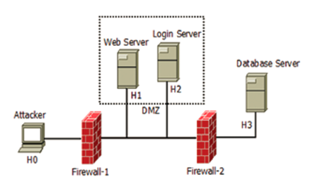
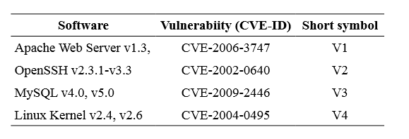
A running example
Host H1 is running a vulnerable version of Apache web server, which has vulnerability (CVE-2006-3747) that allows a remote attacker to exploit and gain user privilege on the Web Server
The ssh service on H2 has a vulnerability (CVE-20020640), which allows remote attackers to gain user privilege
Database server H3 is a Linux box running MySQL database which has a remotely exploitable vulnerability (CVE-20092446), enabling attacker to gain user privilege
The Linux kernel in host H3 also has vulnerability (CVE-2004-0495) that allows local user to gain root privilege
Objective: Attacker’s objective is to gain root privilege on the database server.

Slide 6
State Enumeration Based Approach（基于状态枚举的方法）
These approaches are based on either custom algorithms or based on model checking techniques

Slide 7
State Enumeration Based Approach
—custom algorithms
Nodes represent possible system state during execution of an attack. A system state comprises of information on host(s), user access levels and effects of the attack so far
Edges represent a change of state, caused by a single action of the attacker and may be weighted（赋权值）based on the attacker’s effort required or the time to succeed
自动生成攻击图需要三种信息：attack templates, a configuration file and an attacker profile
Attack templates represent attacks (both known and hypothesised) in the form of a sub-graph describing conditions necessary for successful execution of the attack and also any new conditions that it may enable
A configuration file contains information about the network system under consideration. This information includes network topology, configuration of network elements such as hosts, routers, firewalls, etc
Attacker profile contains information about attacker’s capabilities

Slide 8
State Enumeration Based Approach
—custom algorithms
方法：The attack graph generation algorithm starts from the initial state. It matches attack templates to the configuration of the network system and attacker’s profile in a forward exploration manner and generates the graph iteratively
解决：The generation method addressed the issues of redundant path, node and directed cycle elimination（去除有向环）
问题：But the authors have not provided any complexity analysis; only empirical results on small examples are given. The obvious problem with this kind of formalism is the issue of state-space explosion（状态空间爆炸）
产生图：the state enumeration graph

Slide 9
State Enumeration Based Approach
—custom algorithms
Model checking in general is a technique which checks whether a formal model M of a system satisfies a given property p or not

