Slide 1
INTRODUCTION TO DATA MANAGEMENT
END TERM PROJECT

Slide 2
DATASET The dataset is taken from Kaggle and this dataset contains two worksheets one having bikeshare data of Chicago city and other having the bikeshare data of New York city

Slide 3
The Analytics team wishes to answer the following objectives for both Chicago and New York: - 1. Total duration of bike usage in New York and Chicago separately. 2. Gender distribution 3. Type of user using the bike 4. Top 10 busy stations in New York and Chicago separately 5. Average trip durations according to weekdays 6. Total trips according to hours

Slide 4
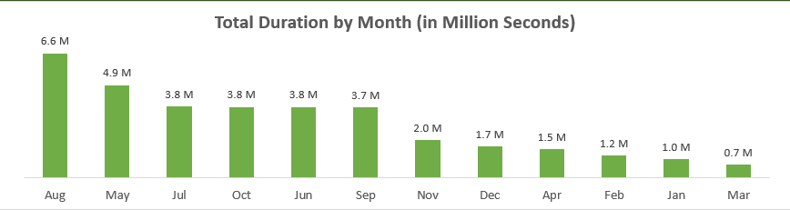
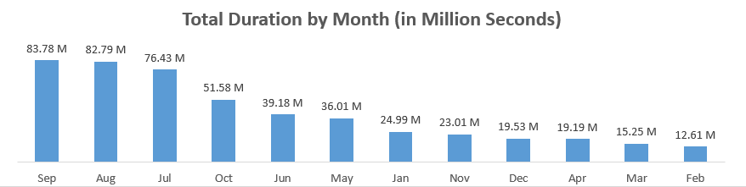
1.Total duration of bike usage in New York and Chicago separately:

Slide 5
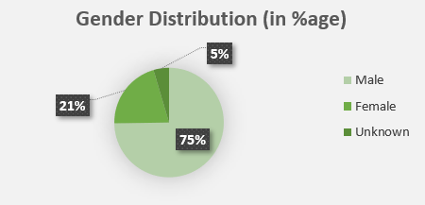
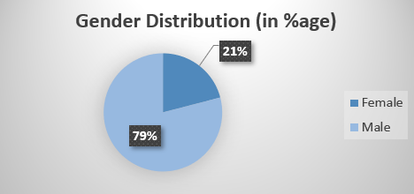
2.Gender distribution:

Slide 6
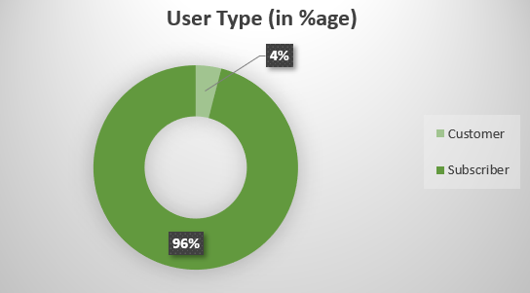
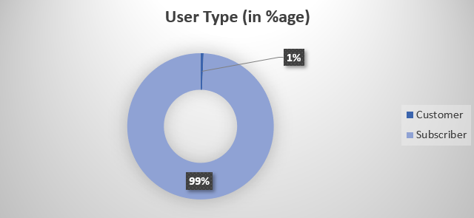
3.Type of user using the bike:

Slide 7
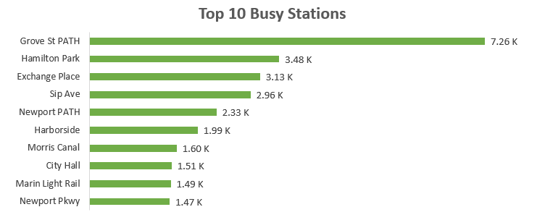
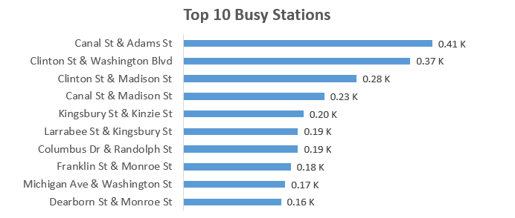
4.Top 10 busy stations in New York and Chicago separately:

Slide 8
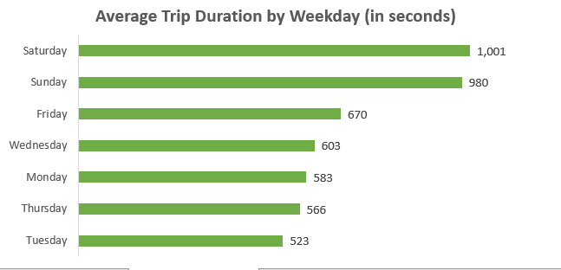
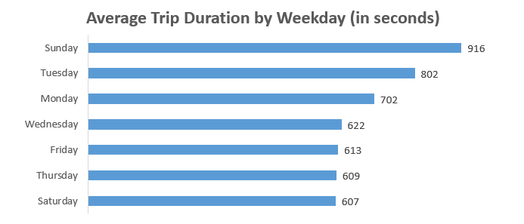
5. Average trip durations according to weekdays:

Slide 9
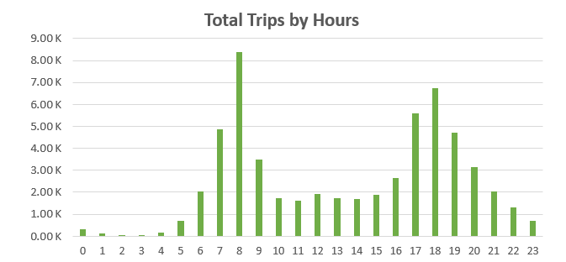
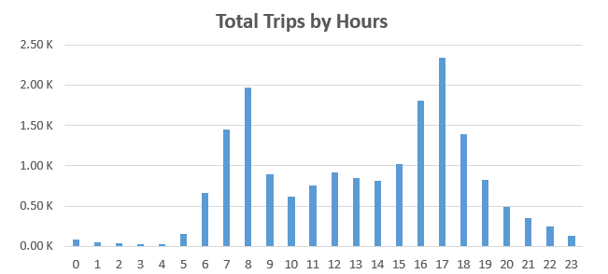
6.Total trips according to hours:

Slide 10
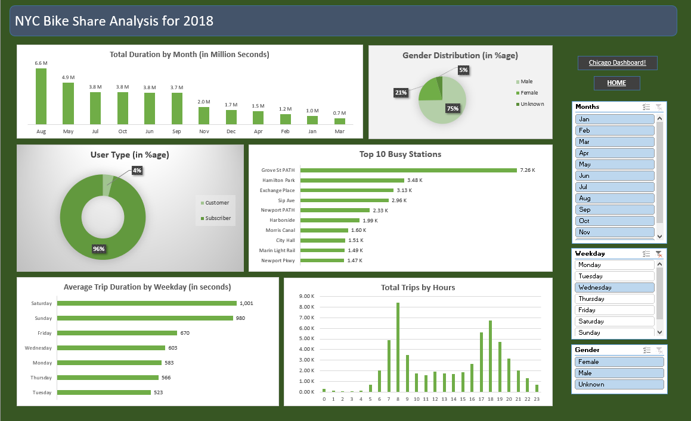
Final Dashboard

Slide 11
