Slide 1
Extracting synthesis procedure from solar cell perovskite based scientific publications using Natural Language Processing.
Presented By: Sourin Dey

Slide 2
Background
Valuable information has been largely un-explored which has the potential to tell us which materials can be used and which materials will produce bad solar cells.
Exploring scientific articles and extracting useful information from solar cells using NLP.
Using Bio-BERT pretrained model and fine-tune to model NER and relation extraction.

Slide 3
Background

Slide 4
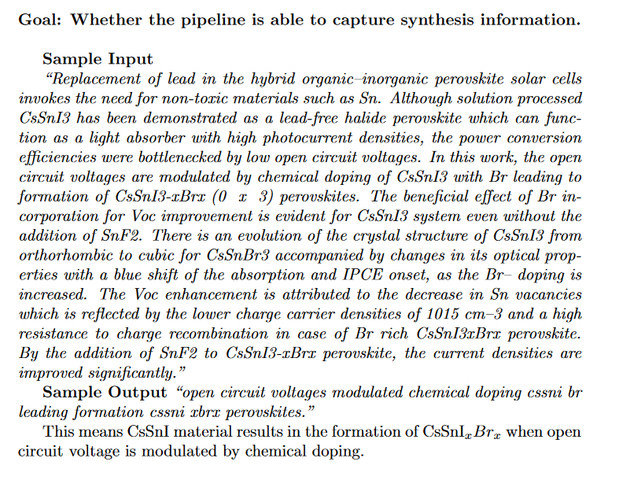
Problem

Slide 5
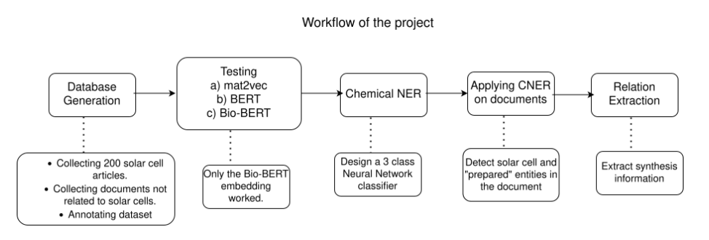
Method

Slide 6
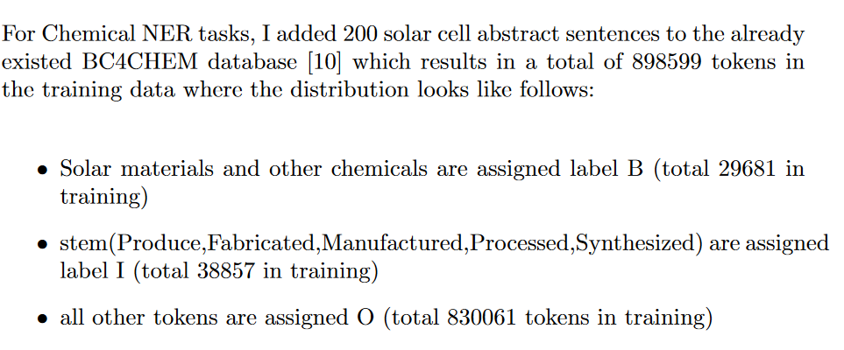
Method

Slide 7
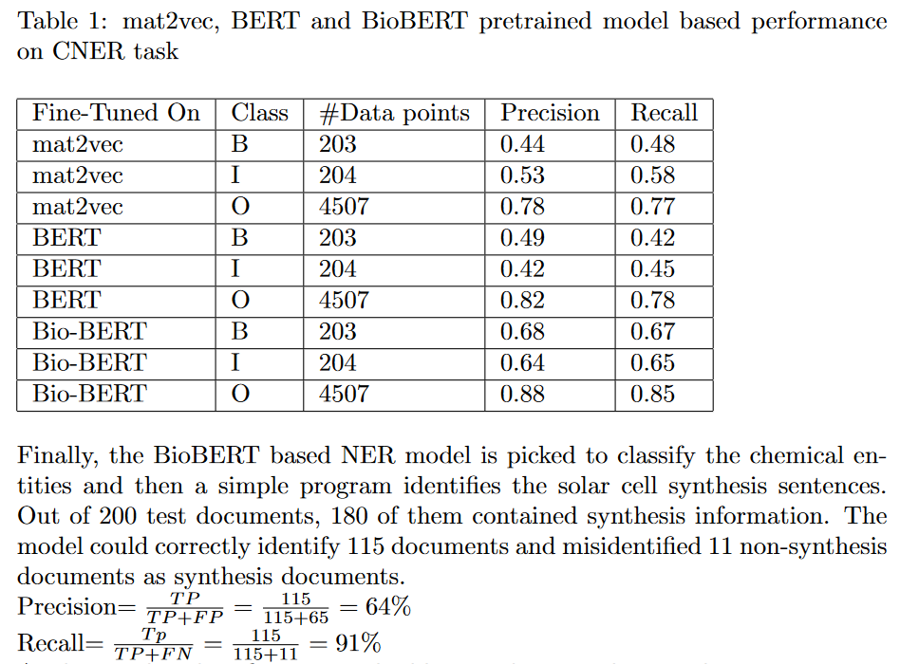
Results and Discussion

