Slide 1
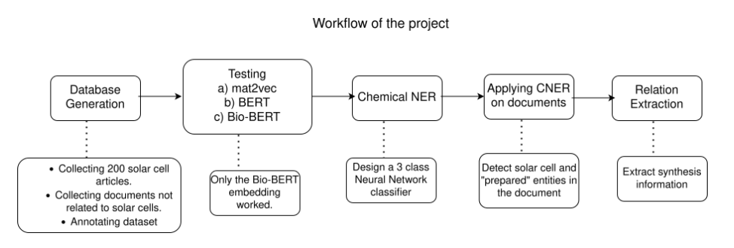
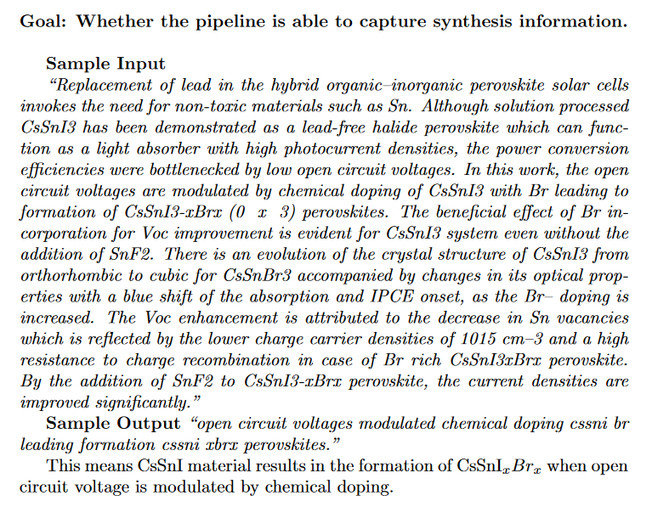
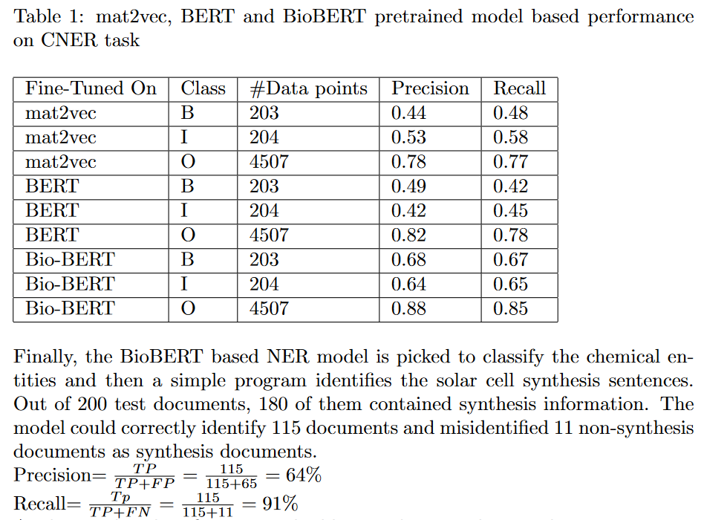
Extracting synthesis procedure from solar cell perovskite based scientific publications using Natural Language Processing
Presented By: Sourin Dey
Exploring scientific articles and extracting useful information
from solar cells using NLP.
Using Bio-BERT pretrained model
and fine-tune to model NER and relation extraction.

