Slide 1

Deep Learning and IoT-Based Real-Time
Variable-Rate Chemical Spraying System
for Disease Control in Paddy Crop
Sourish Das (23BCE1179) & Aditya Singh (23BCE1293)
Guide – Dr. Vergin Raja Sarobin M.
BCSE497J - Project I | Fall Semester 2026-27
School of Computer Science and Engineering (SCOPE)
VIT Chennai

Slide 2
Problem Statement & Objective
Problem
Our Solution
• 20-40% of global crop yield lost to plant diseases
• CNN classifier identifies the disease type (6 classes incl. Healthy)
• Traditional uniform spraying wastes chemicals & harms environment
• Trained segmentation model measures actual diseased area
• Manual disease diagnosis is slow and subjective
• Disease-specific dosing: different diseases get different spray intensity
• Existing systems lack real severity measurement
• Variable-rate spray: solenoid open time proportional to severity
• Interactive web demo for real-time diagnosis

Slide 3
System Architecture — Pipeline
1. Upload
2. Classify
3. Segment
4. Severity
5. Spray
User uploads
a leaf image
EfficientNetV2-B0
identifies disease
U-Net detects
lesion pixels
diseased ÷ leaf
= severity %
C_eff → solenoid
open time (t_s)
Key novelty: The CNN diagnoses WHICH disease; segmentation measures HOW MUCH.
These are independent — the disease type then scales the spray dose via a per-disease factor.
Interactive leaf tracing (MobileSAM / free-form polygon) isolates the main leaf from cluttered backgrounds.

Slide 4

Modules Implemented
Module | Method | Status
Disease Classifier | EfficientNetV2-B0 (transfer learning) | Trained & deployed
Lesion Segmenter | U-Net (MobileNetV2 encoder), Dice+BCE | Trained & deployed
Leaf Isolation | MobileSAM + free-form lasso | Deployed
Severity Measurement | diseased px ÷ leaf px × 100 | Deployed
Disease-Specific Dosing | Per-disease factor × base coefficient | Deployed
Variable-Rate Spray | Standardized solenoid timing (0.5–3.0s) | Deployed
Confidence Gate | Flag uncertain predictions (<70%) | Deployed
Web Demo (PaddyGuard) | Flask + animated frontend (3 tabs) | Deployed

Slide 5
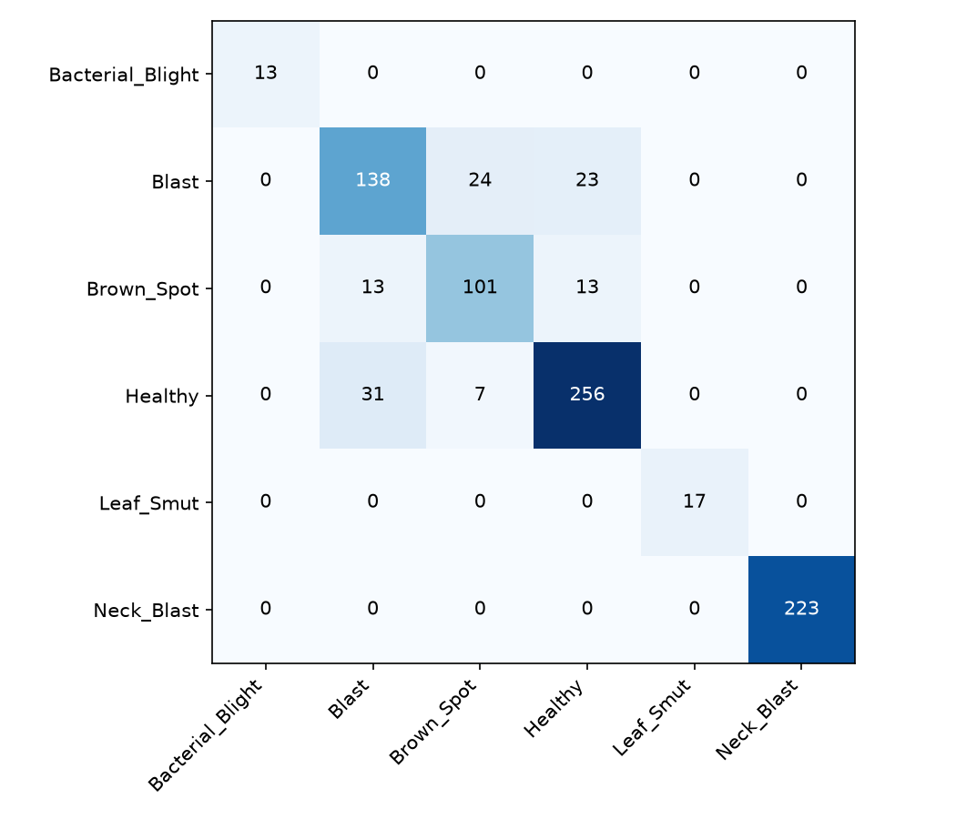
Classifier Results — 3-Class Model (UCI Dataset)
Held-out test set: 164 images the model never saw
Class | Precision | Recall | F1 | Support
Bacterial leaf blight | 1.00 | 1.00 | 1.00 | 55
Brown spot | 0.86 | 0.89 | 0.87 | 54
Leaf smut | 0.89 | 0.85 | 0.87 | 55
Overall accuracy |  |  | 0.915 | 164
Bacterial leaf blight classified perfectly. The small error is
Brown spot ↔ Leaf smut (visually similar tan lesions).
91.5% on a fully held-out set shows the architecture works well
when class data is sufficient.

Slide 6
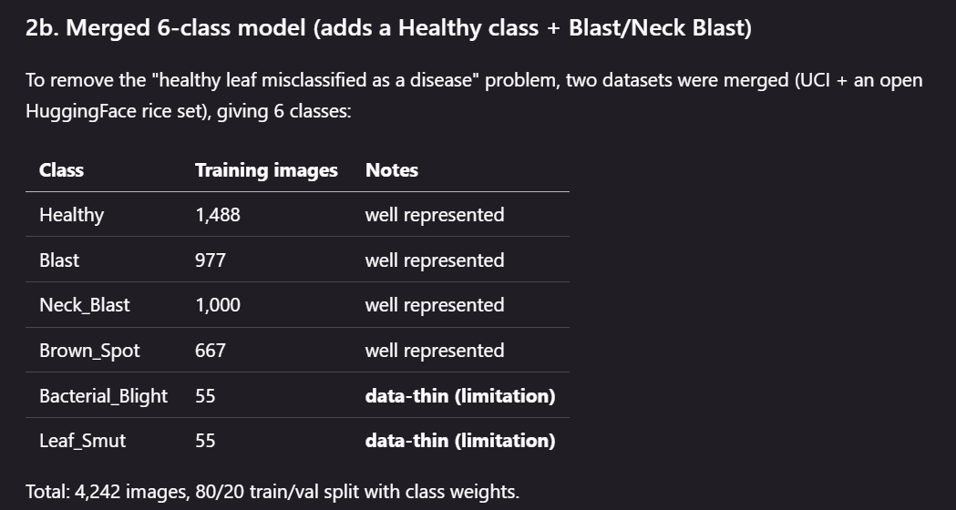

Slide 7
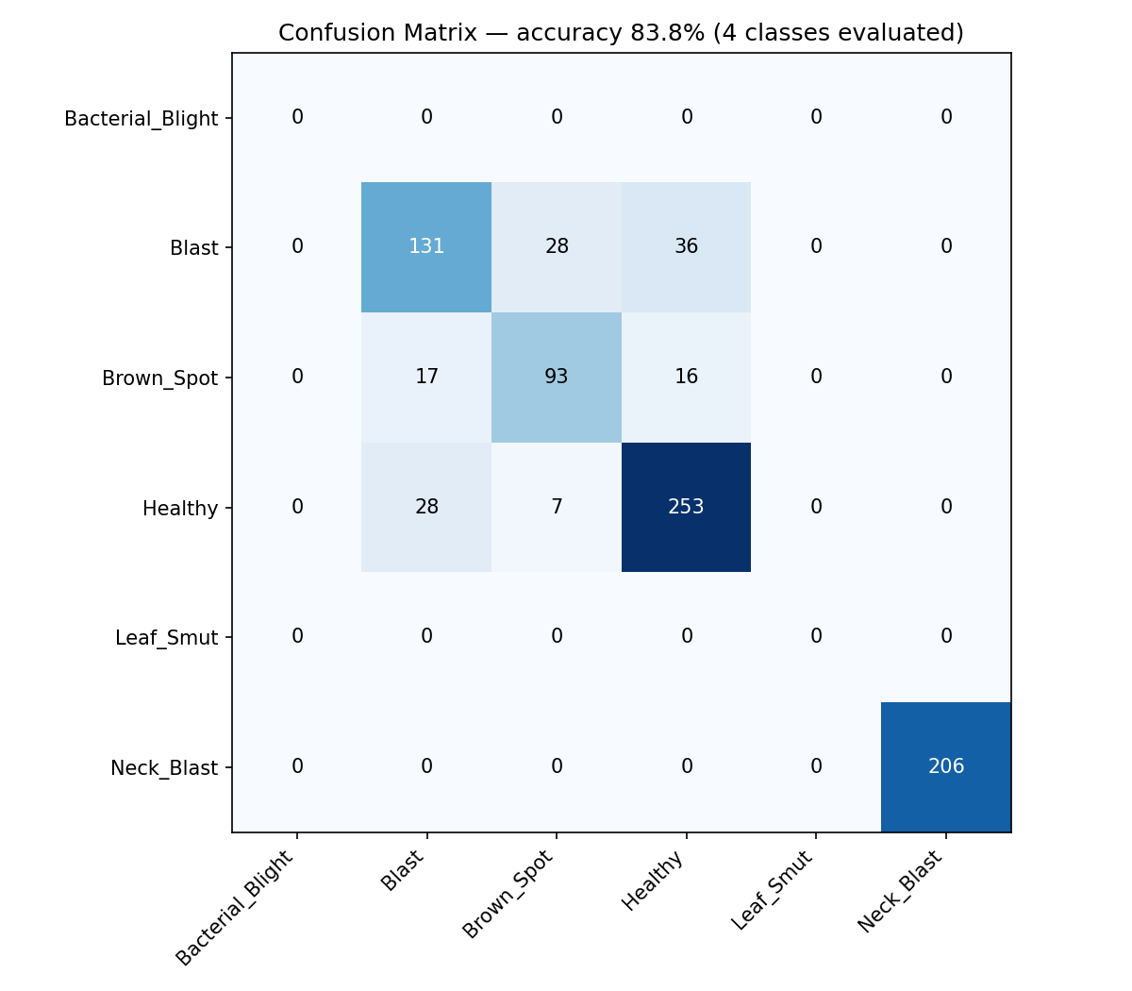
Classifier Results — 6-Class Merged Model
Held-out validation: 815 images · 4 of 6 classes evaluated (HF dataset)
Class | Precision | Recall | F1 | Support
Neck_Blast | 1.00 | 1.00 | 1.00 | 206
Healthy | 0.83 | 0.88 | 0.85 | 288
Brown_Spot | 0.73 | 0.74 | 0.73 | 126
Blast | 0.74 | 0.67 | 0.71 | 195
Overall accuracy |  |  | 0.838 | 815
Neck blast: perfect (1.00) · Healthy: strong (0.85) — the spray/
don't-spray decision is reliable. Blast vs Brown spot are the
weaker pair (both tan lesions). Bacterial Blight & Leaf Smut
(55 imgs each) — known data limitation.

Slide 8
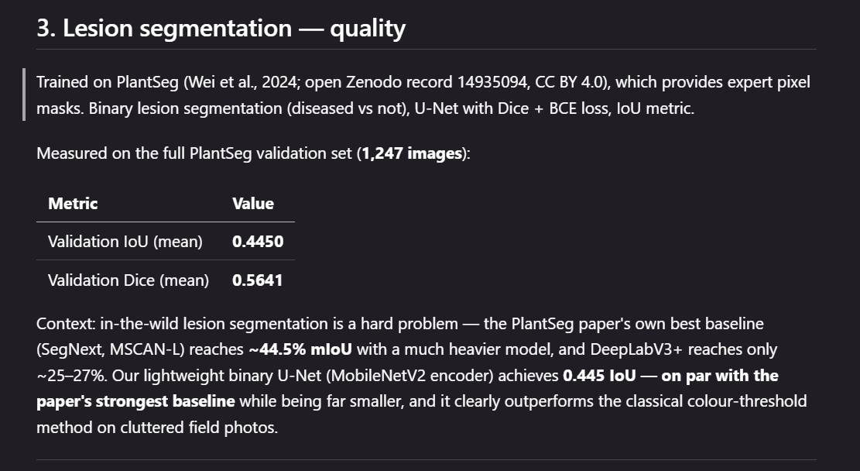

Slide 9
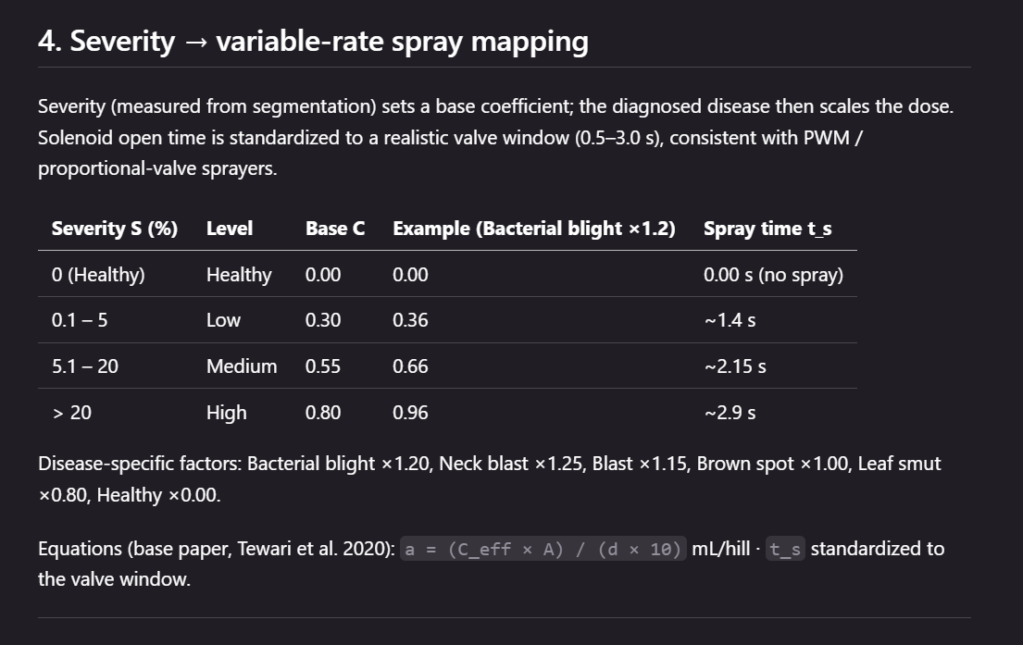

Slide 10
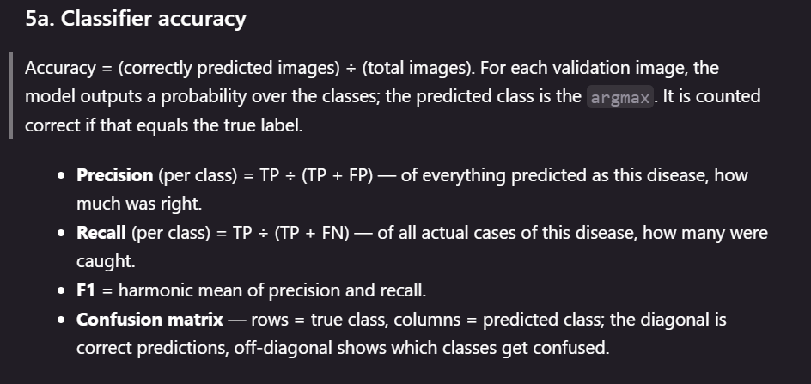

Slide 11
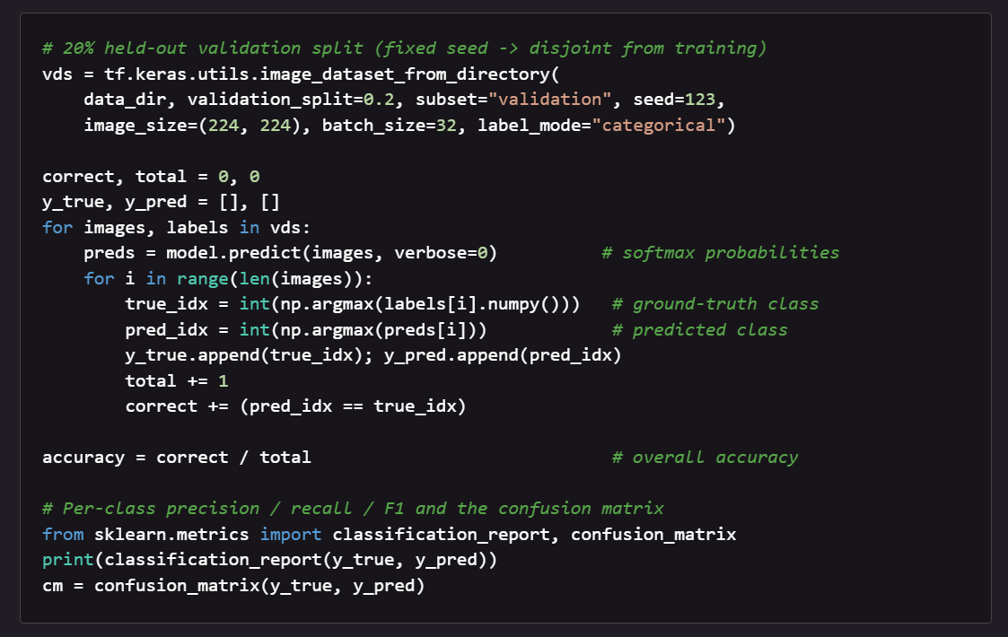

Slide 12
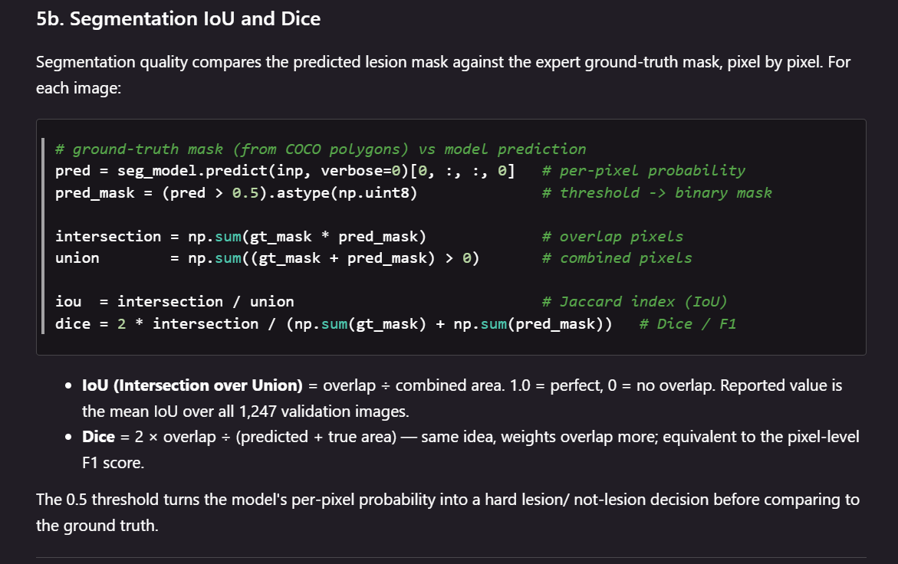

Slide 13
Robustness & Safety Features
Confidence Gate (70%)
Severity Floor (1.5%)
Sub-70% predictions flagged as 'uncertain' —
stops the system from asserting shaky guesses.
If diseased area < 1.5% of leaf, treated as Healthy →
no spray. Eliminates false positives from stray specks.
Graceful Fallbacks
Interactive Leaf Tracing
Trained segmenter → colour method; SAM → auto leaf mask.
Every component degrades gracefully if unavailable.
Free-form polygon drawn by user becomes the leaf mask.
Solves the 'background counted as leaf' problem.

Slide 14
Known Limitations & Future Work
Current Limitations
Future Work
• Bacterial Blight & Leaf Smut: only 55 training images each → weakest classes
• Collect more balanced training data for weak classes (biggest accuracy lever)
• Blast vs Brown Spot confusion (visually similar tan lesions)
• Higher input resolution (299/384 px) to distinguish similar lesions
• Field-photo segmentation imperfect on very cluttered backgrounds
• Larger backbone (EfficientNetV2-B2/B3) for better feature extraction
• Spray timing (0.5–3.0s) is a research-backed default, not hardware-calibrated
• Hardware calibration: measure actual pump/nozzle → tune spray timing
• PlantSeg segmenter evaluated at 0.445 IoU — strong but not pixel-perfect
• Deploy on edge device (TFLite on Raspberry Pi / ESP32 for field use)

Slide 15
We are open to take questions…
Thank you…

