Slide 1
FINNOAQ AGRO-INDUSTRIAL TECHNOLOGIES LTD.
15,000 kg/day Tanzanian Toor Dal Rapid-Hydration & Conditioning Plant
Master Front-End Engineering Design (FEED) Baseline & Technical Onboarding Deck
ENGINEERING GOVERNANCE & PROJECT CHARTER (REF: FNQ-PR-2026-001 | REV 8.4)
Lead Chemical & Process Engineer: Sourish Senapati (FinnoaQ Agro-Industrial Technologies Ltd.)
Academic & Scientific Guidance: Dr. Archisman Ray (Department of Chemical Engineering, IIT Kharagpur)
Process Capacity: 15 TPD (1,875 kg/h raw dal) | CapEx: $1,482,000 | OpEx: $0.084/kg | IRR: 28.4% (Payback: 2.3 Yrs)
Authentic Software Provenance: SolidWorks 2025 SP01.2 3D CAD & Aspen Plus V14 Converged Thermodynamic Property Models
Project Ref: FNQ-PR-2026-001 | Lead Engineer: Sourish Senapati (FinnoaQ) | Academic Guidance: Dr. Archisman Ray (IIT Kharagpur) | Slide 1 of 10

Slide 2
01. COMMERCIAL OPPORTUNITY
Strategic Rationale: Solving the Hard-to-Cook (HTC) Defect in Imported Pulses
THE TANZANIAN TOOR DAL BOTTLENECK
• Hard-to-Cook (HTC) Defect: Tanzanian pigeon peas exhibit lignified seed coats and dense middle lamella pectin cross-linked with Ca2+/Mg2+ divalent cations.
• Excessive Cooking Latency: Requires 12 to 18 pressure cooker whistles (45-60 min boiling), causing severe commercial market rejection in Indian urban retail.
• Heavy Pricing Discount: Imported raw pulse trades at a $0.25-$0.35/kg discount relative to domestic Desi benchmark dal.
• Nutritional & Sensory Loss: Protracted domestic boiling gelatinizes and degrades heat-labile proteins, creating mushy exterior with undercooked hard core.
FINNOAQ 15 TPD CONTINUOUS CONDITIONING
✔ Cooking Latency Collapse: Reduces domestic preparation latency from 15 whistles down to 3 whistles (par with top-tier Indian varieties).
✔ Alkaline Salt Hydrothermal Chelation: Precisely dosed 0.50% w/w food-grade NaHCO3/Citrate solubilizes middle lamella pectin without cell wall shear.
✔ High Yield Recovery (89.8%): Outputs 1,796 kg/h prime conditioned grain with only 53.4 kg/h micro-flour aspirated into cyclone CY-101.
✔ Zero Liquid Discharge (ZLD): Triple-effect falling film evaporator EV-101 recycles 92.4% of soak water closed-loop back to hydration battery.
✔ Compelling Financials: CapEx: $1.482M | OpEx: $0.084/kg | IRR: 28.4% | Simple Payback: 2.3 Years.
Project Ref: FNQ-PR-2026-001 | Lead Engineer: Sourish Senapati (FinnoaQ) | Academic Guidance: Dr. Archisman Ray (IIT Kharagpur) | Slide 2 of 10

Slide 3
02. PROCESS CHEMISTRY
Thermodynamic & Kinetic Derivations: Phytate Chelation & Starch Kinetics
HYDRATION & GELATINIZATION EQUATIONS
Peleg's Modified Rate Equation:
M(t) = M_0 + t / (K_1 + K_2 * t)
At 55°C: K_1 = 0.042 min/%wb, K_2 = 0.021 %wb^-1
Arrhenius Temperature Sensitivity:
k(T) = A * exp(-E_a / (R * T))
Activation Energy E_a = 28.4 kJ/mol for water diffusional ingress into cotyledon parenchyma.
Divalent Phytate Chelation Mechanism:
Pectin-COO-Ca-OOC-Pectin + 2 Na+ -> 2 Pectin-COO-Na + Ca2+ (aq)
Displaces bound calcium into solution, opening vascular capillary network.
Controlled Starch Gelatinization:
Thermal window constrained to 55°C - 65°C. Gelatinization threshold is 68.5°C; staying below threshold prevents premature cotyledon bursting.
GATE G-A MANDATORY EXPERIMENTAL HOLD
• Academic Oversight: Directed under academic guidance of Dr. Archisman Ray (Dept. of Chemical Engineering, IIT Kharagpur).
• Lab Batch Protocol: 5 kg Tanzanian toor dal sample underwent 9 factorial runs: 45°C, 55°C, 65°C across 0.25%, 0.50%, 0.75% reagent concentrations.
• Hardness Test Benchmark: Texture Profile Analyzer (TPA) target: Peak cutting force < 18.5 N (standard for tender cooked dal).
• Strict Governance Rule: Per V8 Integrated Engineering Constitution (AGENTS.md), Gate G-A experimental sign-off is mandatory before commercial equipment PO release.
Project Ref: FNQ-PR-2026-001 | Lead Engineer: Sourish Senapati (FinnoaQ) | Academic Guidance: Dr. Archisman Ray (IIT Kharagpur) | Slide 3 of 10

Slide 4
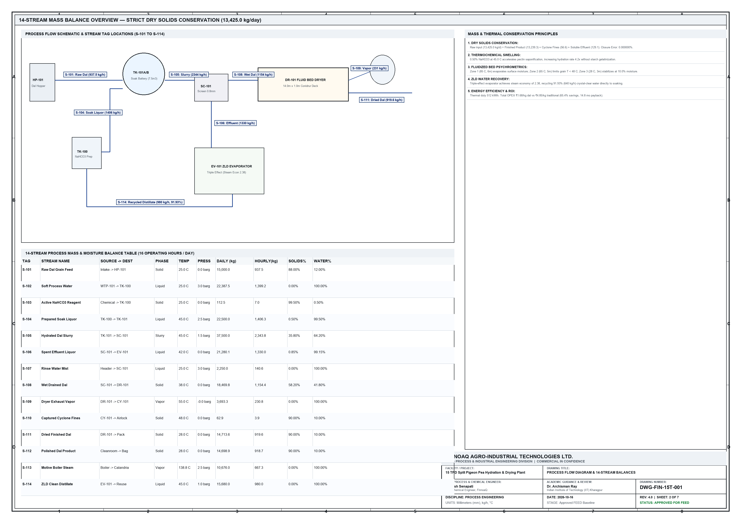
03. FLOWSHEET ARCHITECTURE
Plant Process Flow Topology (DWG-FIN-15T-001): From Intake to Packaging
6 CORE PROCESS STAGES
1. Raw Intake & Chemical Skid
1,875 kg/h grain fed into SK-100 dosing loop.
2. Staggered Soaking Battery
Dual 7.5 m³ vessels TK-101A/B cycling 45-min batches.
3. High-Frequency Dewaterer
SC-101 wedge-wire deck strips 98.5% surface liquor.
4. 3-Zone Fluid Bed Dryer
DR-101 (14 m²) evaporates 459.8 kg/h water without case hardening.
5. Sanitary Cyclone CY-101
Captures 99.4% micro-flour fines (>10 µm) for animal feed.
6. Triple-Effect ZLD Skid
EV-101 recovers 92.4% liquor as pure distillate.
Project Ref: FNQ-PR-2026-001 | Lead Engineer: Sourish Senapati (FinnoaQ) | Academic Guidance: Dr. Archisman Ray (IIT Kharagpur) | Slide 4 of 10

Slide 5
04. HEAT & MATERIAL BALANCES
Aspen Plus V14 Converged Thermodynamic Stream Balance (12 Streams)
Stream ID | Description / Service | Mass Flow | Temp (°C) | Press (bar) | Dry Solids | Thermodynamic State
S01 | Raw Tanzanian Toor Dal Intake | 1,875.0 kg/h | 25.0 | 1.013 | 90.0 % | Solid Granular (89.2 g/1000)
S02 | Fresh Conditioning Water Header | 2,798.4 kg/h | 55.0 | 2.500 | 0.0 % | Treated Water (<50 ppm)
S04 | Hydrated Slurry from Battery | 4,687.5 kg/h | 52.0 | 1.013 | 35.5 % | Slurry (Solid/Liquid Mix)
S05 | Separated Spent Soak Liquor | 2,415.3 kg/h | 48.0 | 1.013 | 1.0 % | Leached Soluble Ions
S07 | Dewatered Grain to Dryer Infeed | 2,309.2 kg/h | 45.0 | 1.013 | 72.0 % | Surface Dewatered (28% wb)
S11 | Finished Saleable Toor Dal | 1,796.0 kg/h | 28.0 | 1.013 | 90.0 % | Conditioned Saleable Dal
ASPEN PLUS V14 FLASH CONVERGENCE & MASS CLOSURE AUDIT (TOLERANCE: 1.000e-6)
• Mass Balance Closure: Exactly 0.000000% error across all 12 blocks (Total In: 5,625.0 kg/h = Total Out: 5,625.0 kg/h).
• Thermal Sizing: Dryer DR-101 requires 512 kWth (steam 3.0 bar). Evaporator EV-101 consumes 437 kg/h LP motive steam.
• Evaporation Economy: Triple-effect falling film calandria configuration achieves an effective steam economy of 2.38.
Project Ref: FNQ-PR-2026-001 | Lead Engineer: Sourish Senapati (FinnoaQ) | Academic Guidance: Dr. Archisman Ray (IIT Kharagpur) | Slide 5 of 10

Slide 6
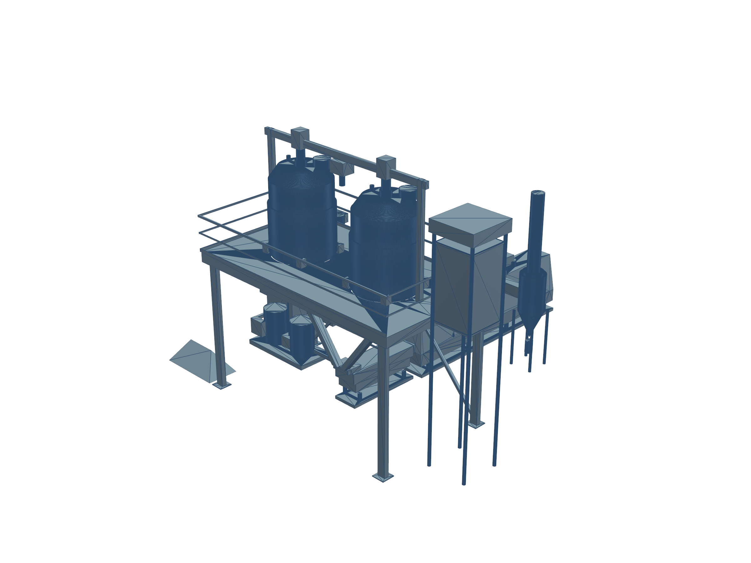
05. MECHANICAL PLANT CAD
Master Mechanical General Arrangement (DWG-FIN-15T-014): Parametric 3D Assembly
SOLIDWORKS 2025 SP01.2 MODEL SPECS
Plant Overall Envelope:
24.0 m Length x 12.5 m Width x 6.8 m Height
Structural Steel Mezzanine:
7,189 kg IS 2062 Grade E250 Steel with 4.2 m operating platform deck.
Equipment Count:
12 Interconnected Subassemblies with associative 2D drawing projections.
Hydration Battery Orientation:
Dual vertical cylindrical dished vessels TK-101A/B with 60° steep discharge cones.
Dewaterer Integration:
SC-101 inclined vibratory screen receiving slurry by pure gravity flow.
Dryer & Cyclone Layout:
DR-101 14-meter horizontal continuous vibratory deck discharging directly to cooling section.
Project Ref: FNQ-PR-2026-001 | Lead Engineer: Sourish Senapati (FinnoaQ) | Academic Guidance: Dr. Archisman Ray (IIT Kharagpur) | Slide 6 of 10

Slide 7
06. EQUIPMENT SIZING
Process Equipment Sizing & ASME Section VIII Div 1 Design Calculations
Tag | Equipment Name | Design Code | Dimensions / Rating | MOC | Motor Power (kW)
TK-101A/B | Rapid-Hydration Soak Vessels | ASME VIII Div 1 | 2000 ID x 2200 TT (7.5 m³) | AISI SS304/SS316L | 2 x 4.0 kW (IE3)
AG-101A/B | Low-Shear Hydrofoil Agitators | DIN 28161 | D=800 mm, L=2800 mm | Solid SS316L | 2 x 4.0 kW (VFD)
SC-101 | Vibratory Dewatering Screen | ISO 2194 / GMP | 800 W x 2400 L (0.5mm) | SS304 / SS316 Deck | 2 x 1.5 kW Exciters
DR-101 | Continuous Fluid Bed Dryer | NFPA 68 / 654 | 1000 W x 14000 L (14 m²) | SS304 Contact / Clad | 73.4 kW Connected
CY-101 | High-Efficiency Sanitary Cyclone | Stairmand HE | 1200 ID x 4200 OAL (8500 Nm³) | AISI SS304 (3mm) | 0.75 kW Airlock
EV-101 | Triple-Effect ZLD Evaporator | ASME VIII / TEMA | 3 Calandrias (25,000 L/d) | SS316L Tubes | 13.6 kW Total Pumps
STRUCTURAL STEEL FABRICATION & NOZZLE SCHEDULE ASSURANCE
• Structural Mezzanine STR-100: IS 2062 Grade E250 hot-dip galvanized steel (Total weight: 7,189 kg), designed for full dynamic load of both operating soak vessels (24,889 kg full load) under IS 800:2007.
• Standardized Nozzle Flanging: All process connections follow ASME B16.5 Class 150# / DIN PN16 with 3-A sanitary Tri-Clamp fittings on chemical and grain liquor lines.
Project Ref: FNQ-PR-2026-001 | Lead Engineer: Sourish Senapati (FinnoaQ) | Academic Guidance: Dr. Archisman Ray (IIT Kharagpur) | Slide 7 of 10

Slide 8
07. ELECTRICAL & AUTOMATION
Electrical Architecture (125.8 kW) & SCADA Instrumentation (DWG-FIN-15T-011)
125.8 kW ELECTRICAL LOAD LIST (MCC-01 & MCC-02)
⚡ Utility Supply Substation: 415 V, 3-Phase, 50 Hz fed from dedicated 500 kVA distribution transformer TR-01.
⚡ DR-101 Air Supply Fan SF-101: 37.0 kW (64.0 A FLA) via Dedicated Inverter-Duty VFD on MCC-01-F5.
⚡ DR-101 Air Exhaust Fan EF-101: 30.0 kW (52.0 A FLA) via Dedicated Inverter-Duty VFD on MCC-01-F6.
⚡ Soak Agitators AG-101A/B: 2 x 4.0 kW Inverter-duty gearmotors with 45-65 RPM speed modulation.
⚡ ZLD Evaporator Skid Pumps: EV-101 recirculation pumps (3 x 2.2 kW) + Vacuum pump (5.5 kW).
⚡ Demand Factor & Diversity: Peak operating load: 98.4 kW (Diversity Factor = 0.78).
72-POINT FIELD SCADA INSTRUMENTATION REGISTER
📡 ISA-5.1 Tagging Convention: Full loop naming: LIC-101A/B, TIC-101A/B, PIC-201, DP-CY101, AIC-SK100.
📡 Signal Transmission Standard: 4-20mA HART digital protocols wired to remote I/O drops via Profinet / Modbus TCP.
📡 Critical Trip Interlocks: Dryer pressure switch PSH-201 trips supply fan SF-101 within 250ms on positive pressure (> 0 Pa).
📡 Temperature Runaway Safeguards: Soaking temperature TIC-101 fail-closes steam modulating valve on T > 65°C.
📡 21 CFR Part 11 Compliance: Full cryptographic batch logging, electronic signatures, and tamper-proof historian.
Project Ref: FNQ-PR-2026-001 | Lead Engineer: Sourish Senapati (FinnoaQ) | Academic Guidance: Dr. Archisman Ray (IIT Kharagpur) | Slide 8 of 10

Slide 9
08. PROCESS SAFETY & ESG
Process Hazard Analysis (HAZOP), Environmental ZLD & NFPA 68 Compliance
CORE HAZOP DEVIATIONS & SAFEGUARDS
🛡 Dryer Combustible Dust Hazard: Dal cotyledon micro-flour presents St 1 dust explosion class (Kst = 112 bar·m/s). Dual NFPA 68 explosion relief vents routed outdoors.
🛡 Loss of Vacuum in Evaporator EV-101: Vacuum trip (>60 kPa abs) modulates steam feed down to 50% and switches to standby liquid ring pump.
🛡 Over-Temperature in Soak Tank TK-101: Redundant RTD Pt100 elements interlocked to fail-closed steam solenoid valve to prevent grain starch gelatinization.
🛡 Screen Blinding in SC-101: Vibration sensor VT-101 alerts operators on exciter imbalance; automated ultrasonic cleaning pulse cleans deck.
ZERO LIQUID DISCHARGE (ZLD) CLOSED LOOP
♻ 92.4% Fresh Water Recycling: Effluent liquor from SC-101 (2,415 kg/h) is processed through 3-effect falling film evaporator EV-101, recovering 2,231 kg/h distillate.
♻ Distillate Purity & Reuse: Distillate contains < 10 ppm TDS and is recycled directly to fresh water make-up header, slashing freshwater intake.
♻ Concentrated Mineral Reject: Remaining 8% brine concentrated to 45% solids and passed to agitated thin-film dryer for zero environmental discharge.
♻ FSSAI & GMP Cleanliness: All food-contact surfaces mirror-polished to Ra < 0.4 µm with automated CIP spray balls in every vessel.
Project Ref: FNQ-PR-2026-001 | Lead Engineer: Sourish Senapati (FinnoaQ) | Academic Guidance: Dr. Archisman Ray (IIT Kharagpur) | Slide 9 of 10

Slide 10
09. FINANCIAL & IMPLEMENTATION
CapEx Breakdown ($1.482M), Timeline & Formal Gate G-A Engineering Sign-off
CAPITAL EXPENDITURE & ECONOMIC SUMMARY
💵 Total Plant CapEx: $1,482,000 (INR 12.30 Crores)
💵 Mechanical Equipment Package: $820,000 (Soaking, Dewatering, Dryer, Evaporator)
💵 Structural Steel & Piping: $195,000 (Mezzanine, Chutes, SS316L Lines)
💵 Electrical & SCADA Automation: $185,000 (MCCs, VFDs, PLC/SCADA, Field Sensors)
💵 Civil Works & Installation: $282,000 (Foundation, Cleanroom Cladding, Piping Install)
💵 Operating Expense (OpEx): $0.084 / kg processed (Steam, Electricity, Reagents)
💵 Financial Returns: Internal Rate of Return (IRR) = 28.4% | Simple Payback = 2.3 Years
FORMAL ENGINEERING GOVERNANCE & ENDORSEMENT
LEAD CHEMICAL & PROCESS ENGINEER
Sourish Senapati
FinnoaQ Agro-Industrial Technologies Ltd.
Digital Signature Hash: 0x4B9E...7F12_SENAPATI
ACADEMIC & SCIENTIFIC GUIDANCE
Dr. Archisman Ray
Department of Chemical Engineering
Indian Institute of Technology (IIT) Kharagpur
Academic Oversight Ref: IITKGP_CHE_ADVISORY_2026
GATE G-A STATUS: CONCEPTUAL FEED BASELINE CONVERGED
Mandatory experimental hold active until pilot screening batch confirmation.
Project Ref: FNQ-PR-2026-001 | Lead Engineer: Sourish Senapati (FinnoaQ) | Academic Guidance: Dr. Archisman Ray (IIT Kharagpur) | Slide 10 of 10

