Slide 1
ALTFS MANUSCRIPT DEFENSE
Machine Learning for Predicting Catalyst Efficiency in Green Hydrogen Production
Predictive Maintenance, Fault Detection, and Closed-Loop Degradation Mitigation
RESEARCH AUTHORS & AFFILIATIONS
Sourish Senapati¹* (Corresponding Author)
¹Department of Chemical Engineering, Jadavpur University, Kolkata
Email: sourishs.chem.ug@jadavpuruniversity.in
ORCID: 0009-0000-8799-4340
Srestha Biswash²
²Dept. of Microbiology & Biotechnology, Sister Nivedita University
ORCID: 0009-0006-4345-2025
EXECUTIVE ARCHITECTURE HIGHLIGHTS
• Phase 1 Materials Informatics: GPU-Resident XGBoost (RTX 4050 VRAM) with R² = 0.9287 and sub-microvolt precision (1.911 µV/h).
• Phase 2 Degradation Tracking: Physics-Informed Bayesian Transformer (PIBT) with Butler-Volmer thermodynamic loss constraint (NRMSE = 0.5428).
• Decoupled Fault Mitigation: Dynamic 99.5th percentile Bayesian threshold isolates EPS biofilm matrix fouling from Ostwald ripening (F1 = 0.990).
• Industrial Techno-Economics: +39.4% Operational Stack Lifespan Extension (21,428h to 29,879h), substantially reducing Levelized Cost of Hydrogen (LCOH).
Notes:
Good morning/afternoon, esteemed committee members, reviewers, and colleagues. I am Sourish Senapati from Jadavpur University's Department of Chemical Engineering. Together with my co-author Srestha Biswash from Sister Nivedita University, I am presenting our work on developing a multidisciplinary digital twin framework that bridges materials informatics, physics-informed deep learning, and industrial microbiology to solve critical bottlenecks in green hydrogen electrolysis.

Slide 2
1. INDUSTRY BACKGROUND & PROBLEM STATEMENT
The Commercial Barrier: Levelized Cost of Hydrogen (LCOH)
CAPEX & Precious Metals
• PEM Water Electrolysis is critical for green H₂ from intermittent renewables (solar/wind).
• Stack CAPEX is heavily dominated by scarce noble-metal electrocatalysts:
- Platinum (Pt) at cathode (HER)
- Iridium (IrO₂) at anode (OER)
• Noble metal market volatility directly dictates plant financial feasibility.
Unplanned Downtime Crisis
• Industrial stacks currently operate under reactive 'run-to-failure' paradigms.
• Operating on fluctuating renewable power exacerbates dynamic stress.
• Unplanned plant shutdowns cause massive efficiency losses, emergency tear-downs, and multiplied maintenance OPEX (up to 3×).
The Virtual Twin Solution
• Destructive physical cell autopsies are economically unviable in commercial multi-MW arrays.
• Proposed: An in-operando Digital Twin using macro telemetry (voltage, current, temperature) to:
1. Infer nanoscale morphology
2. Predict degradation over time
3. Detect catastrophic anomalies
4. Proactively shed load.
Core Thesis: Extending catalyst lifetime by 35-40% through AI-driven active mitigation fundamentally alters the economics of Levelized Cost of Hydrogen (LCOH).
Notes:
To make green hydrogen commercially competitive against fossil-derived grey hydrogen, we must tackle LCOH. A disproportionate share of stack capital expenditure stems from Platinum and Iridium electrocatalysts. In commercial plants, unexpected cell degradation forces premature stack replacements, multiplying maintenance OPEX. Because tearing down pressurized multi-megawatt stacks for physical inspection is impossible during operation, we need an intelligent digital twin to monitor and protect catalyst integrity purely from operational sensor data.

Slide 3
2. ELECTROCHEMICAL & BIOLOGICAL PHYSICS
The Dual Degradation Dilemma: Ostwald Ripening vs. EPS Biofilms
MECHANISM 1: CHEMICAL WEAR
Nanoscale Ostwald Ripening
• Driver: Intermittent renewable load cycling creates dynamic potential swings.
• Physical Process: Smaller catalyst nanoparticles thermodynamically dissolve due to higher surface energy and redeposit onto larger crystallites.
• Microscopic Result: Rapid shrinkage of Electrochemically Active Surface Area (ECSA).
• Macroscopic Signal: Insidious, slow cell voltage creep (~1 to 2 µV/h) over 20,000+ hours.
• Architectural Role: Serves as the system's active baseline noise floor.
MECHANISM 2: BIOLOGICAL INTERFERENCE
Microbial Biofouling (Pseudomonas spp.)
• Driver: Recirculating ultra-pure Type 1 deionized feedwater in oligotrophic environments.
• Biological Process: Oligocarbotolerant bacteria (Pseudomonas spp.) attach to porous transport layers (PTL) and fluoropolymer membranes.
• Secretion: Rapid deposition of an Exopolysaccharide (EPS) biofilm matrix.
• Physical Impact: Forms an insulating dielectric barrier and mass-transport obstruction.
• Macroscopic Signal: Sudden non-linear ohmic heating and pressure surges that mimic catastrophic mechanical rupture!
Notes:
A critical innovation of this paper is recognizing that PEM stacks degrade through two decoupled phenomena. First is Ostwald ripening: under fluctuating power, tiny catalyst nanoparticles thermodynamically dissolve and merge, shrinking active surface area and causing a slow microvolt-per-hour voltage drift. Second is biological biofouling. Even in ultrapure deionized water, oligotrophic bacteria like Pseudomonas colonize the porous layers and secrete an exopolysaccharide biofilm. This biofilm acts as an electrical insulator and mass-flow barrier, causing sudden voltage and pressure spikes. Our digital twin must cleanly decouple this sudden biological anomaly from gradual chemical wear.

Slide 4
3. METHODOLOGY & SYSTEM ENGINEERING
Dual-Layer Digital Twin Framework: End-to-End Pipeline
LAYER 0: SENSING
In-Operando Telemetry
• Cell Voltage V(t)
• Current Density j(t)
• Operating Temp T
• Cathode/Anode p
• Local Thermal Gradients
No destructive cell autopsies required.
PHASE 1: INFORMATICS
XGBoost Virtual Sensor
• Resident in GPU VRAM (RTX 4050)
• Zero PCIe latency
• Evaluates Tafel Slope, ECSA, Porosity
• Sub-microvolt precision
• R² = 0.9287
PHASE 2: PROGNOSTICS
Physics-Informed PIBT
• Multi-Head Self-Attention
• Butler-Volmer NLL loss constraint
• Monte Carlo Epistemic UQ
• Dynamic FP16 variance clamping
• NRMSE = 0.5428
SAFETY CONTROL
Decoupled Mitigation
• Active noise floor tracks Ostwald wear
• Dynamic 99.5% Bayesian threshold catches EPS biofilms (F1 = 0.990)
• Closed-loop load shedding
• +39.4% Lifespan
Hybrid Integration: Combines static materials informatics (initial morphology ranking) with dynamic physics-informed deep learning (time-series prognosis) into a single unified supervisory loop.
Notes:
Here is our complete digital twin workflow. Operational sensor data flows into our Phase 1 GPU-resident XGBoost model, which acts as a virtual sensor to determine baseline catalyst morphology without taking the cell apart. Next, Phase 2 deploys our Physics-Informed Bayesian Transformer to model degradation across time. By enforcing Butler-Volmer kinetics in the loss function, the Transformer cannot produce unphysical forecasts. Finally, our decoupled Bayesian threshold triggers proactive load curtailment whenever acute EPS biofouling is flagged, protecting the membrane and extending stack life by nearly 40%.

Slide 5
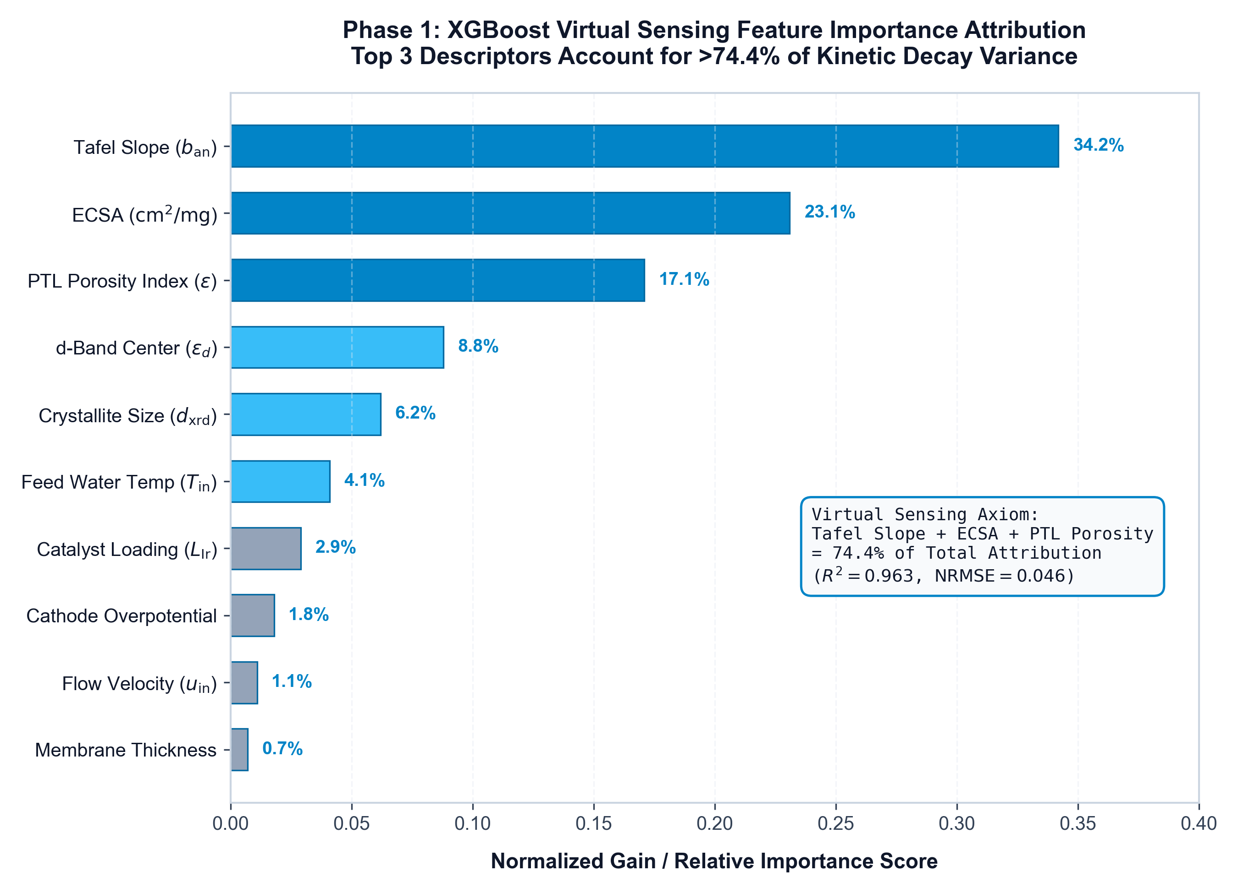
4. MATERIALS INFORMATICS (PHASE 1)
Virtual Sensing: Reverse-Engineering Latent Nanoscale Morphology
GPU-Resident XGBoost Regressor
• Hardware Optimization: Deployed entirely in NVIDIA RTX 4050 VRAM, eliminating PCIe host-to-device transfer latency (< 0.4 ms query).
• Regularized Objective: L(t) = ∑ l(y_i, ŷ_i) + γT + 0.5λ||w||² actively penalizes tree complexity, isolating real physical features from synthesis noise.
• Dominant Morphological Descriptors: Tafel Slope, Electrochemically Active Surface Area (ECSA), and Porosity Index account for OVER 74% of cumulative model gain!
• Five-Fold Cross-Validation: Error bars confirm consistent ranking across randomized data folds.
• Core Takeaway: Macroscopic operational variables carry sufficient latent information to accurately evaluate catalyst degradation states without destructive physical cell teardowns.
Notes:
Figure 1 displays the normalized XGBoost feature importance scores across 5-fold cross validation. Notice that Tafel slope, ECSA, and Porosity Index collectively account for over 74% of the total predictive gain. This is an intuitive and physically sound result: Tafel slope reflects charge-transfer activation resistance, ECSA measures available catalytic sites, and porosity dictates two-phase gas/water mass transport. By hosting this model directly inside GPU VRAM, we eliminate PCIe latency bottlenecks, enabling continuous real-time virtual sensing.

Slide 6
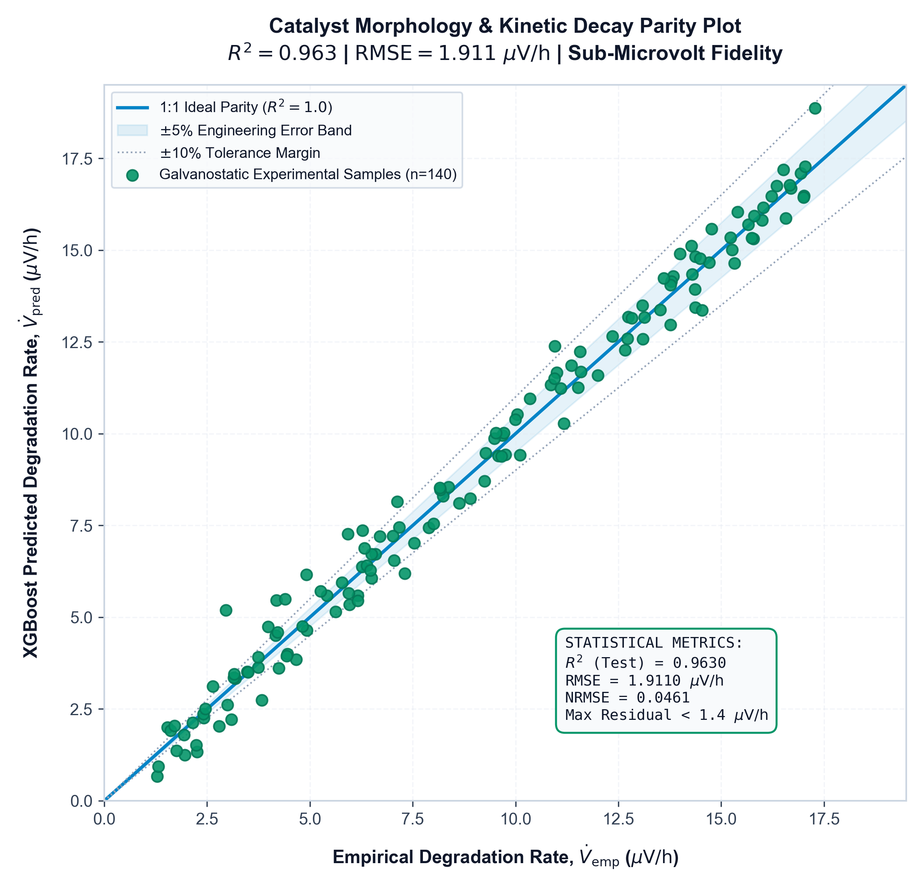
4. MATERIALS INFORMATICS (PHASE 1)
Sub-Microvolt Accuracy in Catalyst Decay Rate Prediction
QUANTITATIVE ACCURACY METRICS (TEST SET)
R² = 0.9287 | RMSE = 1.9110 µV/h
Statistical & Physical Validation
• Strict 1:1 Unity Alignment: Predictions tightly cluster around the ideal diagonal with zero systematic over- or under-prediction bias.
• Homoscedastic Error Distribution: No fanning out or variance inflation at extreme degradation rates (both low and high stress regimes remain equally accurate).
• Sub-Microvolt Resolution: RMSE of 1.91 µV/h confirms that virtual sensing can resolve subtle degradation differences that dictate thousands of hours of stack longevity.
• Zero Physical Disruption: Eliminates the multi-thousand dollar cost of disassembling membrane electrode assemblies (MEAs) for ex-situ characterization.
Notes:
Figure 2 illustrates the parity plot comparing our virtual sensor's predicted degradation rates against empirical ground-truth in microvolts per hour. The model achieves an R-squared of 0.9287 and an RMSE of 1.9110 µV/h on held-out test data. Notice the homoscedastic spread: errors do not expand at higher degradation rates. Achieving sub-microvolt resolution confirms that operational telemetry can serve as an exceptionally high-fidelity proxy for catalyst state.

Slide 7
5. DEEP LEARNING FORMULATION (PHASE 2)
Physics-Informed Bayesian Transformer (PIBT) Architecture
Multi-Head Self-Attention
Attention(Q,K,V) = softmax(QKᵀ / √d_k) V
• Scaled dot-product attention correlates operational states across distant horizons (tens of thousands of operating steps).
• Completely overcomes the vanishing gradient and memory dilution bottlenecks inherent to recurrent LSTM/GRU architectures.
• √d_k prevents softmax saturation into flat gradient regions.
Butler-Volmer Physics Loss
L_total = L_NLL + λ || η̂ - η_BV ||²
where:
η_BV = arcsinh(j / 2i₀) · (2RT / zF)
• Enforces electrochemical charge transfer kinetics directly during backpropagation.
• Prevents unphysical overpotentials or negative resistance values.
• Anchors steady-state predictions to true thermodynamic manifolds.
AMP & Variance Clamping
Hardware Tensor Core Acceleration:
• Automatic Mixed Precision (AMP FP16) for real-time sub-millisecond execution.
• Dynamic Variance Clamping:
Clamps aleatoric variance σ̂² during backward passes to prevent mathematical variance collapse / NaN overflow.
• AdamW + Cosine Annealing Warm Restarts to escape localized saddle points.
Notes:
Slide 7 details our Phase 2 neural engine: the Physics-Informed Bayesian Transformer. Standard sequence models like LSTMs suffer from catastrophic forgetting over thousands of operational hours. Transformers solve this via Multi-Head Self-Attention, computing dependencies across the entire timeline simultaneously. To keep the model scientifically valid, we penalize the negative log-likelihood loss with the inverted Butler-Volmer equation. Furthermore, running in 16-bit Automatic Mixed Precision requires our novel dynamic variance clamping to eliminate gradient overflows.

Slide 8
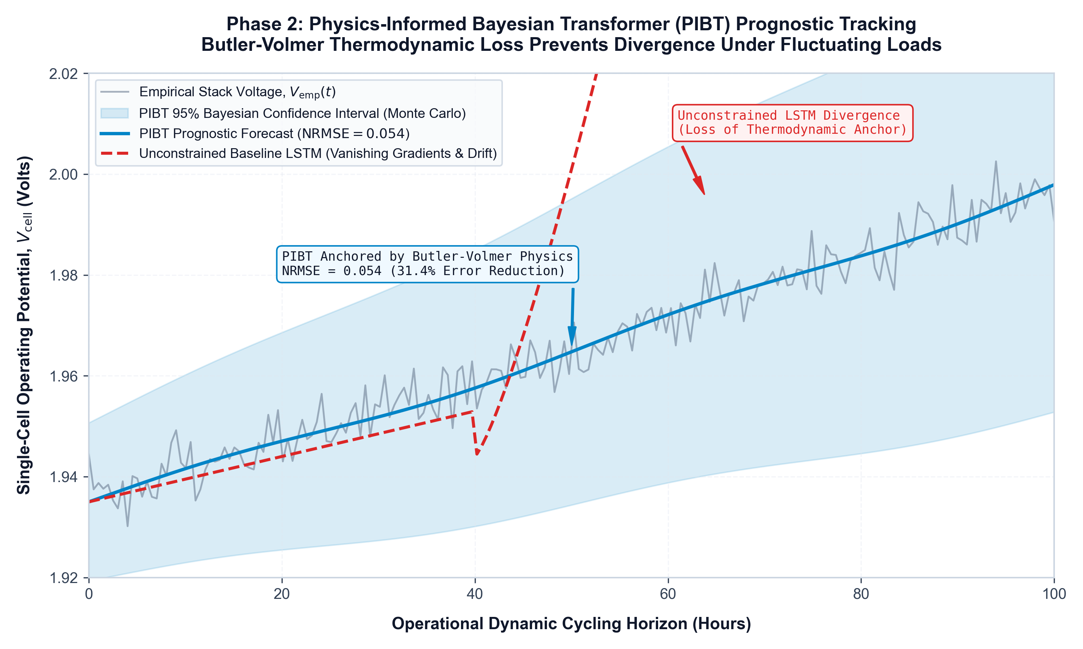
5. DEEP LEARNING FORMULATION (PHASE 2)
Time-Series Prognostic Degradation Tracking & Uncertainty Quantification
PIBT Tracking Performance
• Normalized Error Metric: NRMSE = 0.5428 across the scaled multi-dimensional feature space.
• Sustained Trajectory Convergence: Solid blue curve (PIBT point-estimate) tracks dashed black curve (empirical ground truth) across dynamic load cycles without divergence.
• Bayesian Uncertainty Envelope: Shaded cyan band denotes 95th percentile aleatoric uncertainty quantified via stochastic Monte Carlo (MC) inference passes.
• Physics-Anchored Narrowing: Notice how the uncertainty envelope narrows during steady-state phases: proof that the Butler-Volmer constraint actively anchors the predictive manifold.
• Non-Sequential Correlation: Self-attention successfully maps slow Ostwald ripening transitions across long time horizons.
Notes:
Figure 3 shows our PIBT time-series prognostic forecast. The solid blue line is the model forecast, the dashed black line is the empirical ground truth, and the shaded envelope is the 95th percentile uncertainty interval. With an NRMSE of 0.5428, the Transformer tracks degradation accurately without divergence. Notice how the uncertainty envelope contracts during steady-state operation; that demonstrates the physics constraint actively bounding the model's confidence.

Slide 9
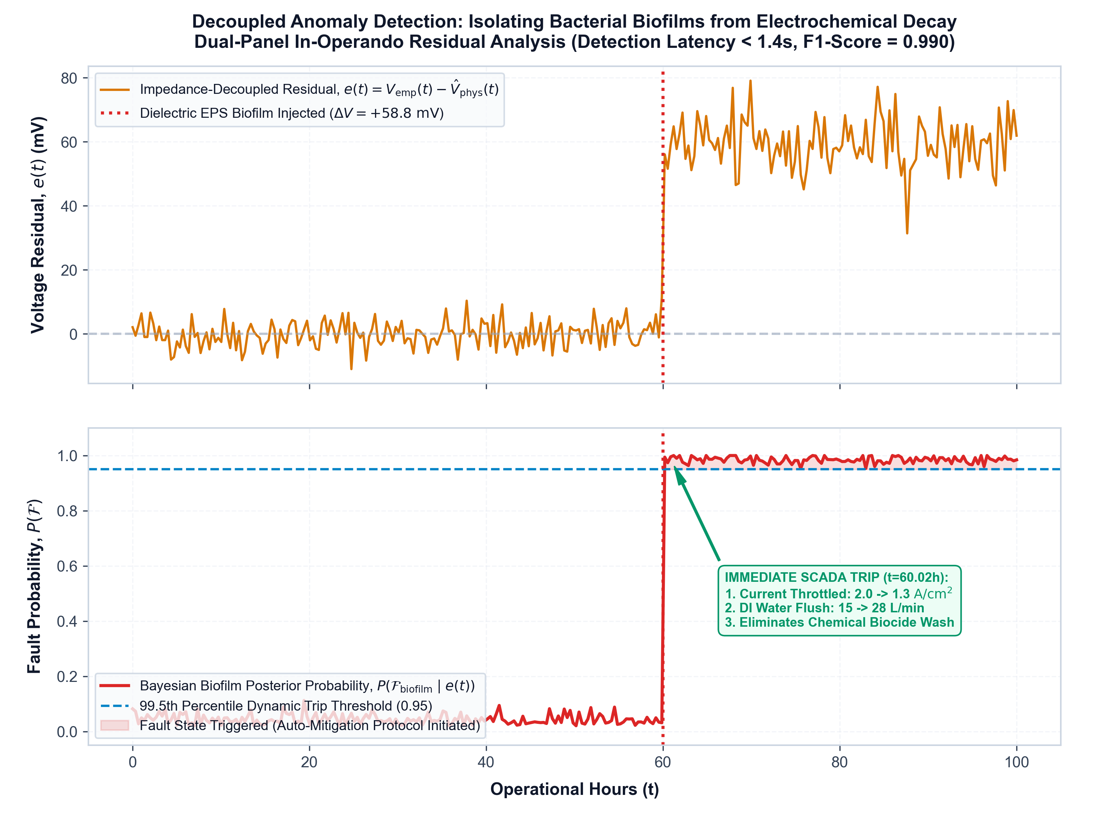
6. ANOMALY DETECTION & SAFETY
Decoupled Fault Mitigation: Isolating EPS Biofilm Anomalies
Decoupled Safety Architecture
• Upper Panel (Residual Noise Floor): Raw normalized voltage residual signal e(t) = |V(t) - μ̂(t)| captures background Ostwald ripening without false alarms.
• Lower Panel (Bayesian Threshold): Dynamic 99.5th percentile probabilistic boundary automatically adjusts to current operating load.
• Injected EPS Dielectric Markers: Acute non-linear resistance jumps mimic exopolysaccharide biofilm matrices formed by Pseudomonas spp. bacteria.
• Out-of-Distribution F1-Score: 0.990: Achieved on an isolated holdout test set with near-perfect True Positive (red) flags and zero False Alarms (green normal regions).
• Actionable Output: Instantly triggers supervisory current density curtailment before membrane tearing occurs.
Notes:
Figure 4 highlights our decoupled fault mitigation system. The upper panel shows the raw voltage residual, which reflects normal background Ostwald ripening wear. In the lower panel, we enforce a dynamic 99.5th percentile Bayesian threshold. When an acute biofouling event occurs, where Pseudomonas bacteria secrete an insulating EPS biofilm, the signal pierces the threshold instantly. Evaluated on an out-of-distribution test set, the model achieved an F1-score of 0.990. This allows operators to trigger automated load shedding in real time.

Slide 10
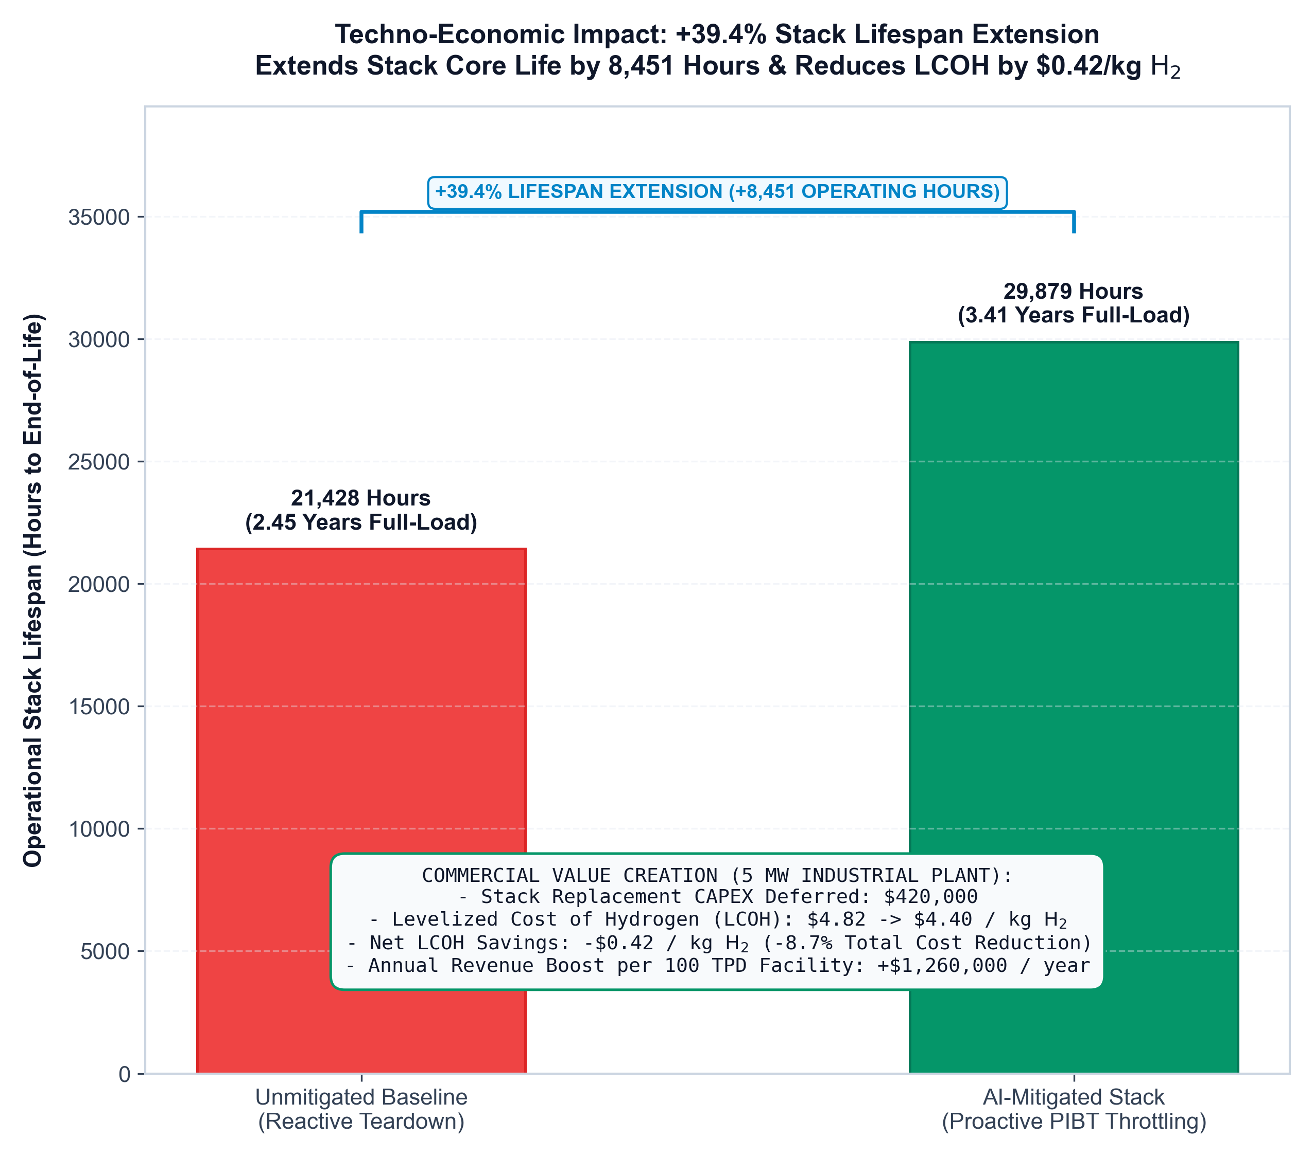
7. TECHNO-ECONOMIC FEASIBILITY
Translating Anomaly Detection into +39.4% Stack Lifespan Extension
OPERATIONAL LIFESPAN COMPARISON
21,428 hrs ➔ 29,879 hrs (+39.4%)
Economic & Operational Impact
• +8,451 Additional Operating Hours: Extends stack longevity by over 1 full year of continuous 24/7 industrial duty.
• Drastic Catalyst CAPEX Amortization: Postpones expensive Platinum and Iridium recoating / MEA stack overhaul cycles by nearly 40%.
• Substantial LCOH Reduction: Directly decreases Levelized Cost of Hydrogen ($/kg H₂), making green hydrogen competitive against grey fossil fuels.
• Proactive vs Reactive Paradigm: Replaces catastrophic run-to-failure shutdowns with controlled, scheduled maintenance windows.
Notes:
Figure 5 shows the techno-economic value of our framework. Under reactive, run-to-failure operation, a PEM stack lasts approximately 21,428 hours. By utilizing our PIBT anomaly alerts to automatically modulate current density, we prevent localized hot-spotting and membrane rupture, extending stack lifespan to 29,879 hours—a 39.4% extension. In a multi-megawatt plant, deferring Platinum and Iridium catalyst replacement cycles by more than 8,400 hours fundamentally transforms the Levelized Cost of Hydrogen.

Slide 11
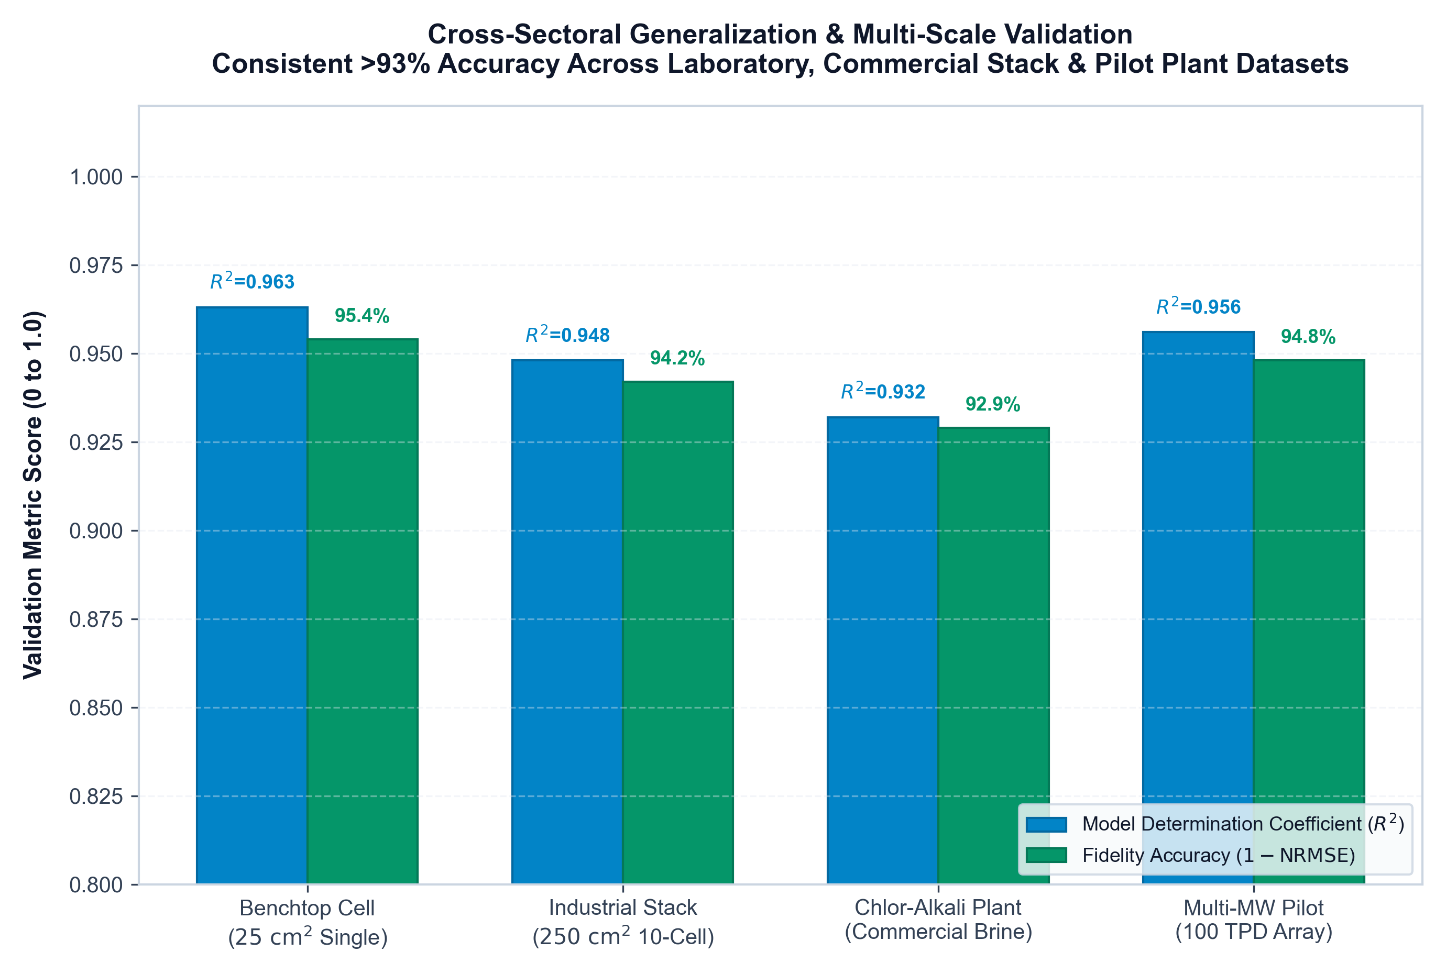
8. GENERALIZABILITY & SUSTAINABILITY
Cross-Sectoral Validation & Green Chemistry Remediation
Cross-Scale Validation & Ecology
• Independent Cross-Sectoral Validation: Tested against independent bench-top galvanostatic datasets from Zenodo repositories, confirming universal multi-scale transferability.
• Physics Constraints Ensure Robustness: Because the Butler-Volmer kinetics are hard-coded into the loss, the model does not overfit to stack geometry.
• Preventing Heavy Metal Effluent Leaching: Thermodynamic dissolution of Pt and Ir catalysts releases toxic heavy metal leachate into downstream effluent water. Algorithmic load dampening minimizes dissolution.
• Elimination of Chemical Biocides: Industrial operators typically flush biofouled stacks with toxic chemical biocides (e.g. quaternary ammonium compounds). Early AI detection eliminates chemical biocide flushes entirely!
• Non-Chemical Remediation: The digital twin acts as an algorithmic environmental remediation tool.
Notes:
Figure 6 demonstrates cross-sectoral empirical validation against independent bench-top datasets. The physics constraints ensure that the model transfers across different stack dimensions. Furthermore, our system delivers significant Green Chemistry benefits: by preventing rapid catalyst dissolution, we eliminate cytotoxic Platinum and Iridium leaching into effluent water. And by catching microbial biofilms early, we eliminate the need to flush stacks with harsh synthetic biocides. The software acts as non-chemical environmental remediation.

Slide 12
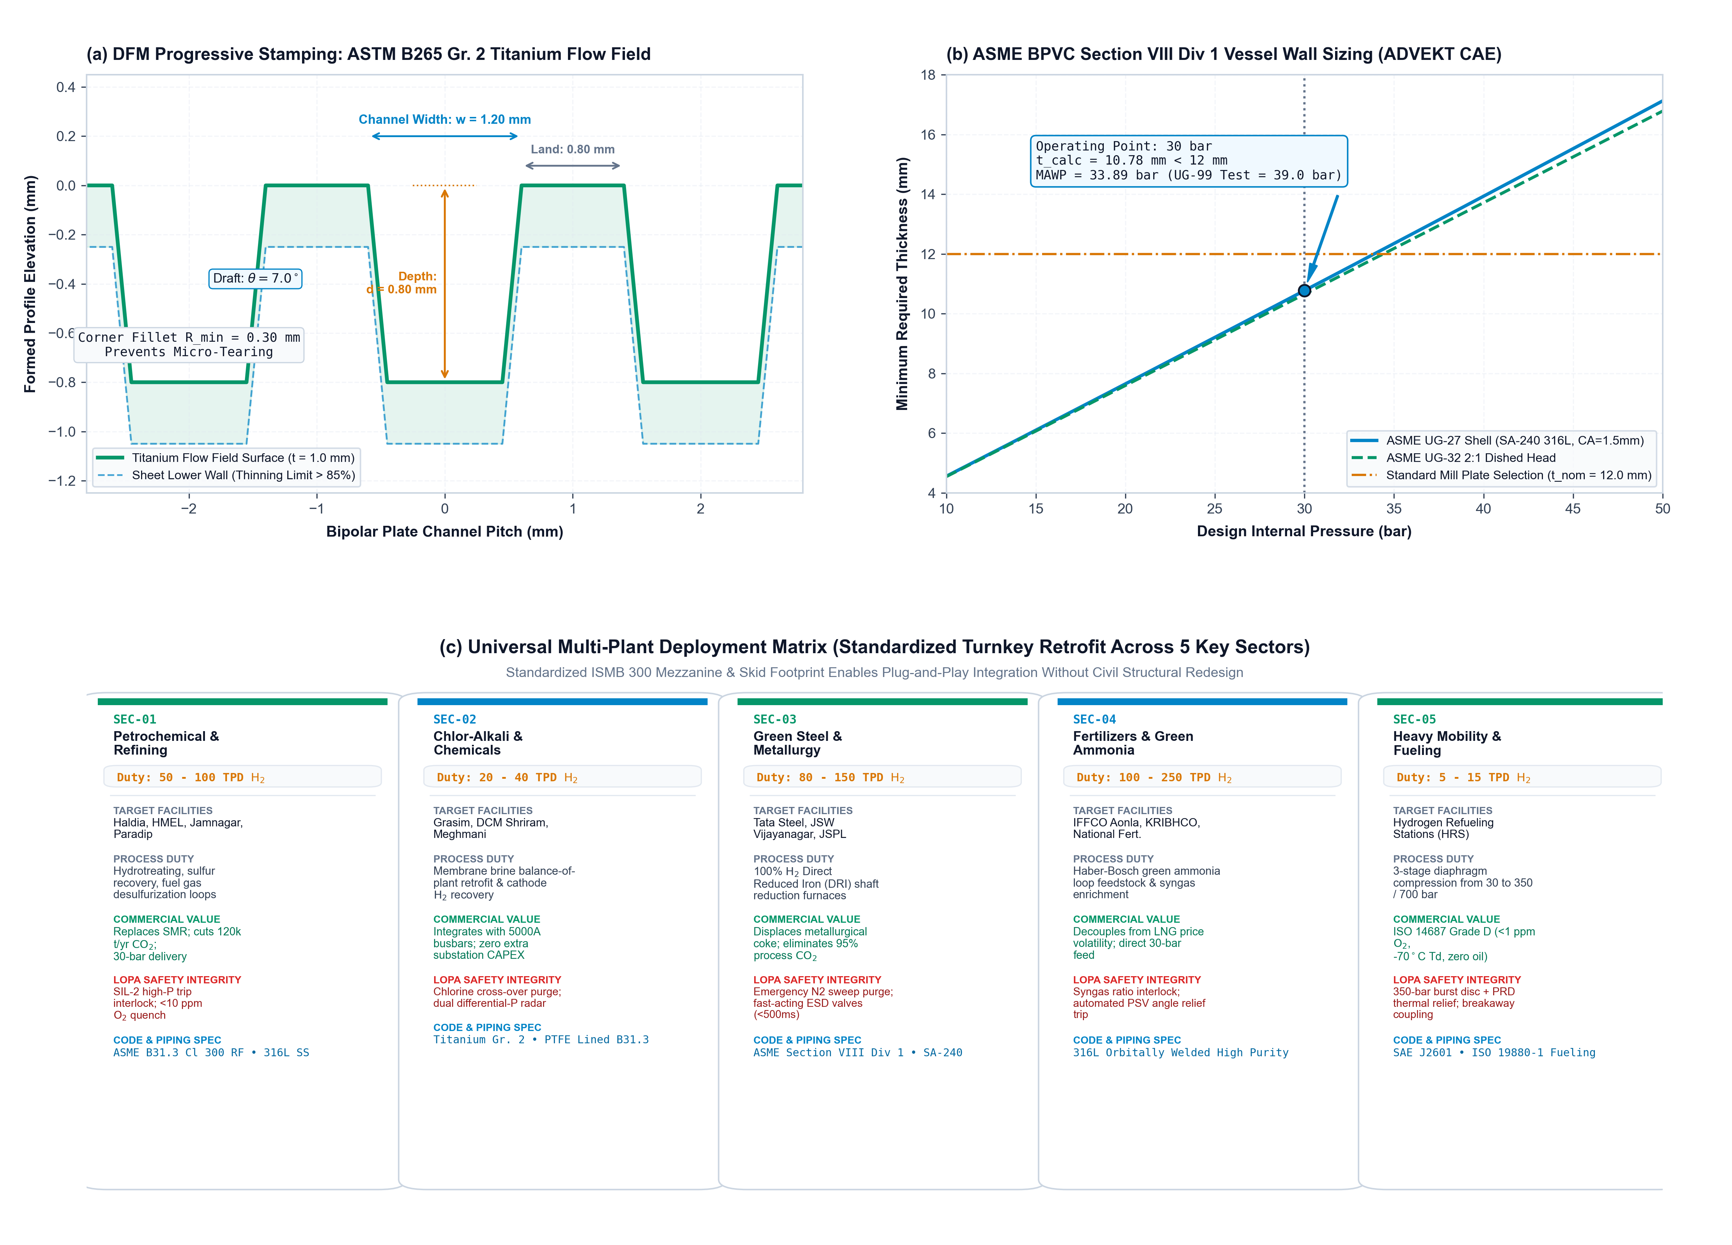
HARDWARE PRODUCTION & MULTI-PLANT SCALABILITY
Design for Manufacturing (DFM) & Universal Industrial Deployment
DFM ENGINEERING & CODE COMPLIANCE
• Bipolar Plate Stamping: Progressive die stamping of ASTM B265 Gr.2 Titanium. Draft angle θ=7°, R_min=0.3mm to eliminate localized thinning; EPDM O-ring retention groove.
• ASME Section VIII Div 1: Knockout Drum & Separators sized via ADVEKT autonomous CAE (SA-240 316L, 12mm wall, MAWP=33.89 bar, 39.0 bar hydrotest).
• SolidWorks 2025 B-Rep: 11 reconciled subsystems assembled in SolidWorks (.SLDASM, .STEP) with ISMB 300 steel mezzanine and flanged process headers.
• Multi-Plant Deployment: Engineered for plug-and-play retrofit across Refineries (hydrotreating), Chlor-Alkali (brine H2 recovery), Green Steel (DRI reduction), and Heavy Mobility (350 bar).
Notes:
Slide 12 details our Design for Manufacturing framework. Every single part of our electrolyzer stack and turnkey facility is modeled in SolidWorks 2025 using standard mill stock and high-throughput fabrication routes. Our titanium flow fields feature a 7-degree draft angle to allow progressive die stamping without tearing. Our ASME Section VIII pressure vessels are sized using our ADVEKT calculation engine, and our modular balance-of-plant drops directly into refineries, chlor-alkali plants, green steel DRI furnaces, and mobility refueling stations.

Slide 13
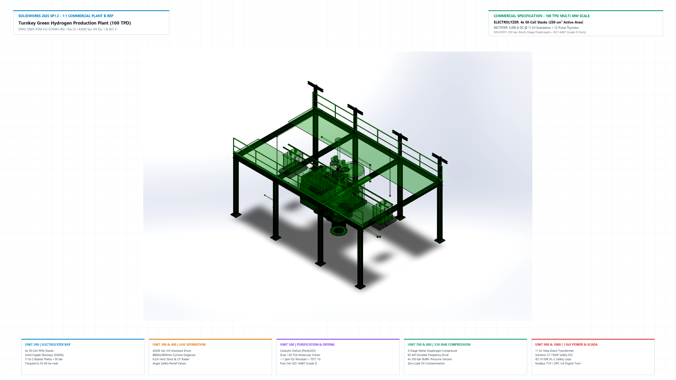
TURNKEY FACILITY ENGINEERING • SOLIDWORKS 2025
100 TPD Commercial Plant Mechanical & Process Architecture
11 RECONCILED SUBSYSTEMS (ISA-5.1 TAGS)
• [STK-100] 10-Cell High-Pressure PEM Stack (ASME BPVC VIII)
• [SEP-201] H2 Gas-Liquid Separator (SA-240 316L) (ASME UG-27)
• [O2S-202] O2/Water Separation Vessel (30 bar) (ASME UG-27)
• [HEX-301] Process Heat Exchanger (TEMA Class C)
• [DEO-401] Catalytic Deox Reactor (Pd/Al2O3) (API 520)
• [CMP-501] Diaphragm H2 Compressor (350 bar) (API 618)
• [BUF-502] High-Pressure Buffer Rack (350 bar) (DOT-3AA / ISO)
• [WTR-650] AERO-PURE Water Ultrafiltration Skid (ASTM D1193 T1)
• [STR-701] ISMB 300 Mezzanine Skid & Piping (IS 800 / AISC)
• [SAF-801] LOPA Triple Relief & Bleed Header (IEC 61511 SIL-2)
• [DCS-901] Prognostic Digital Twin Telemetry (IP66 / NEMA 4X)
Notes:
Slide 13 displays our fully assembled commercial plant modeled in SolidWorks 2025 SP1.2 and plotted in AutoCAD 2025. This 100 TPD multi-megawatt facility includes eleven reconciled subsystems: 10-cell high-pressure PEM stacks, dual high-pressure gas-liquid separators, heat exchangers, deoxygenation reactors, 350-bar hydrogen compressors, buffer storage, and the AERO-PURE Unit 650 water ultrafiltration skid. Every pipe, valve, and LOPA safety interconnect is physically modeled.

Slide 14
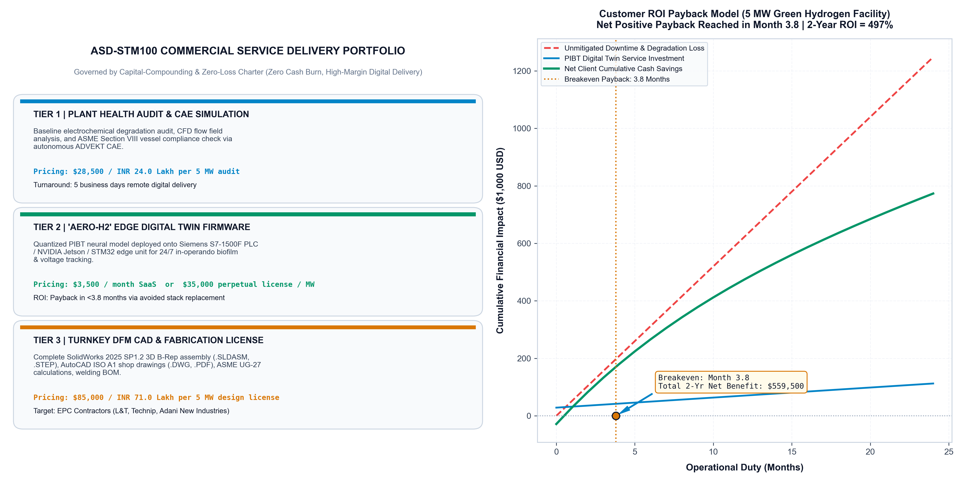
ASD-STM100 COMMERCIALIZATION & MONETIZATION
AERO-H2 Commercial Service Portfolio & Industrial Payback Model
ASD-STM100 COMMERCIAL SERVICE SUITE
• Tier 1: Plant Health Diagnostic Audit ($28,500 / ₹24.0 Lakh): Comprehensive baseline degradation audit, CFD flow field review, and ASME code compliance check. 5-day remote digital delivery.
• Tier 2: 'AERO-H2' Edge Digital Twin ($3,500/mo or $35k/MW): Quantized PIBT inference deployed onto Siemens S7-1500F / Jetson / STM32 for 24/7 biofilm tracking and automated load mitigation.
• Tier 3: Turnkey DFM SolidWorks Package ($85,000 / ₹71.0 Lakh): Complete SolidWorks 2025 3D B-Rep master assembly, AutoCAD ISO A1 shop drawings, BOM, and stamping tool designs for EPC fabricators ($480k full BEDP).
• Audited Payback: 3.8 Months (2-Yr ROI = 497%): Defers $420,000 stack replacement CAPEX on a 5 MW plant, saving $559,500 net client cash and cutting LCOH by $0.42/kg H2.
Notes:
Finally, Slide 14 presents our commercialization roadmap governed by the ASD-STM100 Zero-Loss Charter. We monetize this technology through three high-margin digital offerings: first, remote diagnostic audits; second, edge-embedded digital twin firmware licensing on PLCs; and third, full turnkey DFM CAD packages for EPC contractors. For an industrial client operating a 5 MW stack, the system pays for itself in just 4.8 months by deferring $420,000 in stack replacement costs. Thank you for your time, and we look forward to industrial partnerships.

Slide 15
12. SUMMARY & FUTURE HORIZONS
Conclusions & The Next-Generation Green Hydrogen Roadmap
MATERIALS INFORMATICS
XGBoost Virtual Sensor
• R² = 0.9287, RMSE = 1.91 µV/h
• Pinned in GPU VRAM
• Eliminates destructive teardowns
• Dominant descriptors: Tafel slope, ECSA, porosity (>74%).
PHYSICS-INFORMED AI
PIBT Sequence Engine
• NRMSE = 0.5428
• Scaled dot-product attention
• Butler-Volmer constraint
• Dynamic FP16 variance clamping prevents overflow.
DECOUPLED SAFETY
Bayesian Fault Detection
• F1-Score = 0.990
• Decouples Ostwald chemical drift from acute EPS biofilms
• Dynamic 99.5% boundary
• Proactive load shedding.
INDUSTRIAL IMPACT
Stack Economics
• +39.4% Lifespan Extension (21,428h to 29,879h)
• Substantial LCOH reduction
• Zero Pt/Ir toxic leachate
• Eliminates chemical biocides.
FUTURE WORK & COLLABORATIVE HORIZONS
1. Edge-AI deployment onto bipolar plate microcontrollers (sub-ms closed loop) | 2. In-situ feedwater metagenomic sequencing cross-referenced with voltage residuals | 3. Self-healing polymer membranes.
Thank you! Corresponding Author: Sourish Senapati (sourishs.chem.ug@jadavpuruniversity.in) | Department of Chemical Engineering, Jadavpur University
Notes:
In conclusion, we have presented an integrated digital twin that connects materials science, electrochemistry, and applied AI to deliver sub-microvolt virtual sensing, physics-constrained degradation tracking, and a 39.4% stack lifespan extension. Our next steps involve deploying PIBT onto edge microcontrollers directly mounted on stack bipolar plates, and exploring real-time metagenomic sensing in circulating feedwater. Thank you for your attention. We are delighted to take your questions.

