Slide 1
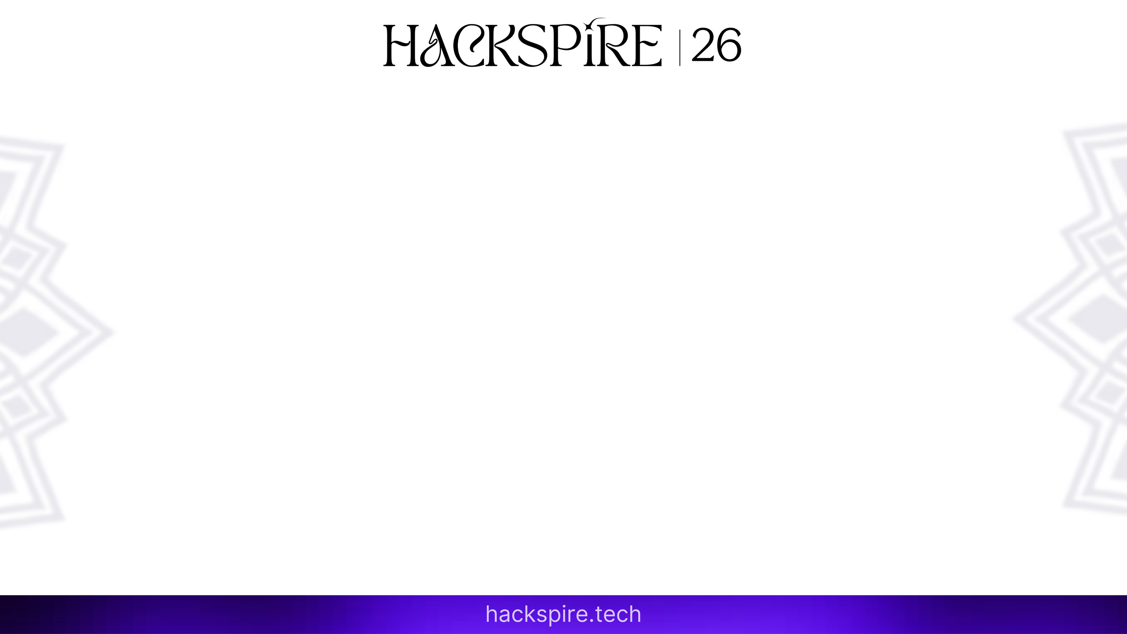

Buffer
Team Name : ThreadRippers
Theme : Smart Automation & Digital Transformation
Problem Statement Title : Workflow Orchestrator with Queuing System
PS Category : Software
1

Slide 2
Buffer – Intelligent Workflow Orchestrator
with Smart Queuing System
Proposed Solution: QR-based virtual queue with digital tokens, live position and predicted waiting time.
Detailed Explanation: Connects counters into one guided flow: Registration → Fee Account → Verification → Approval.
How It Addresses the Problem: Users know when to arrive and which counter to visit instead of standing blindly in long lines.
Innovation & Uniqueness: Orchestrates dependent queues, recalculates ETA and reroutes users during counter/server failures.
2

Slide 3
TECHNICAL APPROACH
Technologies to be Used: React Native, Node.js + Express / Go + Gin, MongoDB/PostgreSQL, Clerk / Postpipe, QR scanner and notifications + More .
Methodology and Process: Create workflow/counters → scan QR → generate token → calculate ETA → staff completes stage → next queue unlocks → analytics update.
3

Slide 4
FEASIBILITY AND VIABILITY
Feasibility Analysis: MVP is practical using role dashboards, real-time token updates and ETA from active counters + average service time.
Potential Challenges & Risks: No-shows, counter downtime, rush-hour prediction errors and staff/user adoption.
Strategies to Overcome: Arrival confirmation, grace period, skip/restore token, pause/resume counters, rerouting and admin override.
4

Slide 5
IMPACT AND BENEFITS
Potential Impact: Reduces physical waiting and overcrowding in colleges, hospitals, banks, government offices and registration centres.
Benefits of the Solution: Saves user-hours, improves transparency, balances counter workload, supports priority users and provides queue analytics.
5

Slide 6
RESEARCH AND REFERENCES
Reference Details: Queueing theory: FCFS, priority queue, service time, throughput and multi-counter load balancing.
Research Work / Links: Workflow management systems, QR token verification, real-time notification systems, Socket.IO/Firebase documentation and public-service queue observations.
Core idea: turn physical waiting into a predictable, guided and digitally orchestrated service flow.
6

