Slide 1

Student Academic Performance
Prediction System
NAME:SOURAJIT SANTRA
STUDENT CODE: BWU/BCA/24/102
COURSE NAME: MACHINE LEARNING
COURSE CODE:BCA57205
ROLL NUMBER:24103460098
REGISTRATION NUMBER:24103002879

Slide 2
INTRODUCTION
Background & Project Overview
SECTION 01
ACADEMIC BACKGROUND
THE NEED FOR EARLY DETECTION
PROJECT SOLUTION OVERVIEW
• In modern higher education, academic success depends on multifaceted factors rather than single exams.
• Key drivers include class attendance, consistent weekly study hours, assignment diligence, and active participation.
• Educational Data Mining (EDM) offers empirical methods to transform raw academic logs into predictive intelligence.
• Traditional evaluation models identify failing students only post-semester exams when it is too late to intervene.
• Faculty members face high student-to-mentor ratios, making manual per-student tracking error-prone and subjective.
• Proactive identification enables structured mentoring, remedial sessions, and targeted academic counseling.
• Builds a robust, production-grade Machine Learning pipeline in Python 3.14.
• Dual-target predictive intelligence: Continuous score regression (0-100%) and Pass/Fail classification.
• Includes an interactive CLI tool and automatic risk tier advisory with actionable academic prescriptions.

Slide 3
PROBLEM STATEMENT
Defining the Core Real-World Challenge
SECTION 02
CORE PROBLEM FORMULATION
Student Attrition & Dropouts
Without early intervention, high-risk students experience cumulative failure, leading to course repeats, lost credits, and increased dropout rates.
"How can educational institutions accurately predict final student academic performance and identify at-risk students early in the semester, using multi-factor academic and behavioral indicators, before final examinations occur?"
• Delayed Academic Visibility: End-of-semester exams reveal failure after the term has already ended, making remediation impossible.
• Single-Metric Fallacy: Relying solely on attendance or midterm marks ignores critical multidimensional factors like study hours, assignment diligence, and participation.
• Manual Advisory Bottleneck: Mentors cannot manually compute risk scores for hundreds of students across diverse semesters.
• Need for Explainability: Black-box scores without factor importance fail to guide students on where they must improve.
Inefficient Faculty Allocation
Academic counseling resources are often deployed reactively rather than targeting the students who need urgent intervention most.
Institutional Accreditation Impact
Lower pass percentages and poor learning outcomes negatively impact NBA, NAAC, and institutional ranking metrics.

Slide 4
OBJECTIVES
Project Aims & Expected Outcomes
SECTION 03
1. DATA PREPROCESSING & CLEANING
2. EXPLORATORY DATA ANALYSIS (EDA)
• Handle real-world data imperfections with missing value imputation (median for numerical values).
• Perform binary encoding on categorical features (e.g., Internet Access: Yes/No -> 1/0).
• Standardize features with StandardScaler (z-score normalization) to eliminate scale bias.
• Visualize statistical distributions of final scores, attendance, and study hours using Matplotlib & Seaborn.
• Generate correlation heatmaps to quantify multi-collinearity and feature-target relationships.
• Export high-resolution visualization figures (300 DPI) to charts/ directory for reporting.
3. COMPARATIVE MACHINE LEARNING
4. EXPLAINABILITY & RISK ADVISORY
• Develop multiple regression models: Linear Regression, Ridge Regression, Decision Trees, and Random Forests.
• Evaluate regression performance with MAE, RMSE, and R² variance explained metrics.
• Implement classification models (Logistic Regression & Random Forest) for binary Pass/Fail prediction.
• Extract feature importance weights to reveal primary academic drivers.
• Design multi-factor risk categorization: Top Performer, Low Risk, Moderate Risk, High Risk.
• Generate tailored academic recommendations and intervention plans for mentors.
5. PYTHON SYLLABUS INTEGRATION
• Demonstrate core syllabus topics: OOP, Exception Handling, File I/O, Conditions, Loops, Collections.
• Implement a manual Custom QuickSort algorithm for score sorting without built-in functions.
• Build an interactive Command Line Interface (CLI) application in main.py for real-time predictions.

Slide 5
SCOPE OF THE PROJECT
Coverage, Target Beneficiaries & Limitations
SECTION 04
PROJECT COVERAGE
TARGET USERS
SYSTEM LIMITATIONS
Dataset Scale:
10,000 distinct student records downloaded from Kaggle Hub.
Feature Dimensions:
Key continuous and categorical predictors: Attendance %, Study Hours, Previous Marks, Assignment Scores, Class Participation, Home Internet.
Dual Prediction:
Simultaneous continuous Final Score % prediction and binary Pass/Fail classification.
Algorithm Breadth:
Covers Multiple Linear, Ridge, Decision Tree, Random Forest & Logistic Regression.
Faculty Advisors:
Identifies struggling students early to schedule one-on-one remedial sessions.
Department Heads:
Monitors aggregate course risk profiles and institutional pass percentage trends.
Students:
Provides transparent feedback on how improving study hours or attendance elevates predicted scores.
Counseling Units:
Directs mental and academic counseling resources toward high-risk students.
Qualitative Factors:
Does not capture personal health crises, financial stress, or extracurricular commitments.
Domain Boundary:
Trained on semester-level undergraduate academic data; requires fine-tuning for high school.
Static Model Baseline:
Batch-trained model requires periodic retraining with new semester cohort data.
Guidance Only:
Designed as an assistive decision-support tool, not for automated punitive decisions.

Slide 6
LITERATURE REVIEW
Existing Systems & Research Gaps Identified
SECTION 05
EXISTING APPROACHES & LIMITATIONS
INSIGHTS FROM ACADEMIC LITERATURE
✖ Traditional Cumulative Grading
Evaluates performance strictly post-examination. Does not provide predictive foresight during active learning periods.
✖ Static Attendance Threshold Rules
Applies rigid cutoffs (e.g. attendance < 75%). Fails to capture students with 80% attendance who fail due to poor assignment scores or lack of study hours.
✖ Isolated Midterm Scores
Midterm marks alone explain only a fraction of total final variance; ignore continuous behavioral engagement.
✖ No Automated Risk Categorization
Lacks actionable remediation tiers; mentors must manually sift through hundreds of records without prioritized guidance.
✔ Romero & Ventura (2020) - Educational Data Mining Survey
Demonstrated that multi-variable regression models outperform single-attribute heuristics by over 40% in predicting student grade distributions.
✔ Cortez & Silva (2008) - Predicting Student Performance
Showed that combining prior academic records with real-time participation indicators provides optimal feature importance weights.
✔ Linear Regression as an Interpretable Baseline
Literature highlights that while deep neural networks offer accuracy, Multiple Linear Regression is vital in academic domains where explainability is required.
✔ Our Research Contribution
This project integrates high R² predictive regression (96.93% RF / 96.63% Linear) with syllabus-aligned Python modules and an instant interactive CLI advisory.

Slide 7
PROPOSED SYSTEM
Architecture of Proposed Machine Learning Solution
SECTION 06
1. AUTOMATED INGESTION & CLEANING
2. DUAL PREDICTION ENGINE
3. ACTIONABLE RISK ADVISORY
4. INTERACTIVE CLI INTERFACE
• Seamless file loading via DataLoader class with exception handling.
• Automatic median imputation for missing marks or attendance entries.
• Binary categorical encoding for digital access features.
• Continuous Regression: Predicts final percentage score with 96.93% R² score.
• Binary Classification: Classifies Pass/Fail status with 96.60% accuracy.
• Model persistence via Joblib (.pkl) for instant inference.
• Categorizes students into 4 distinct tiers: Top Performer, Low Risk, Moderate Risk, High Risk.
• Generates targeted academic action plans with personalized recommendations.
• Incorporates multi-factor conditions (study hours, attendance, predicted scores).
• Simple terminal console for instructors to enter student parameters.
• Real-time validation against biological and academic boundaries.
• Demonstrates manual QuickSort algorithm for ranking students.

Slide 8
PROJECT METHODOLOGY
Development Approach, Tools & Technology Stack
SECTION 07
5-STAGE DEVELOPMENT METHODOLOGY (CRISP-DM)
TECHNOLOGY STACK & TOOLS USED
Phase 1: Problem Definition & Data Sourcing
10,000 student records fetched from KaggleHub API cache; standardized internal naming.
Phase 2: Preprocessing & Cleaning
Imputed null values via median strategy; encoded binary attributes; scaled features via StandardScaler.
Phase 3: Exploratory Data Analysis (EDA)
Formulated correlation matrix, distributions, and scatter trends; saved charts at 300 DPI.
Phase 4: ML Training & Model Selection
80/20 train-test split; cross-evaluated Linear, Ridge, Decision Tree, and Random Forest models.
Phase 5: Deployment & CLI Integration
Persisted optimal model binaries (.pkl); wrapped into interactive predictive CLI with validation.
• Programming Language: Python 3.14 (Latest standard runtime)
• Development Environment: Visual Studio Code (VS Code) on Windows
• Data Handling & Arrays: Pandas 3.0.3, NumPy 2.x
• Machine Learning Library: Scikit-Learn (LinearRegression, Ridge, Trees, Metrics)
• Data Visualization: Matplotlib 3.10 & Seaborn 0.13 (Seaborn-v0_8 style)
• Model Persistence: Joblib (Binary serialization .pkl)
• Dataset Repository: KaggleHub (nikhil7280 Student Performance)

Slide 9
PROJECT INTERNAL STRUCTURE
System Architecture & Modular Decomposition
SECTION 08
modules/data_loader.py
modules/preprocessing.py
modules/eda.py
• Class: DataLoader
• File handling with try-except blocks.
• Loads student_data.csv safely.
• Integrates KaggleHub dataset download fallback.
• Class: DataPreprocessor
• Handles median imputation for NaN values.
• Performs binary encoding (Internet_Access).
• Applies StandardScaler fit & transform.
• Bubble Sort demonstration implementation.
• Class: ExploratoryDataAnalysis
• Generates score distribution histograms & pie chart.
• Creates Pearson correlation matrix heatmap.
• Produces regression trendlines (Study & Attendance).
• Exports 300 DPI PNG visuals to charts/.
modules/models.py
modules/utils.py
main.py (CLI Application)
• Class: ModelTrainer
• Trains Linear Regression, Ridge, Decision Tree & RF.
• Computes MAE, RMSE, and R² scores.
• Trains Logistic Regression & RF Classifier.
• Extracts feature importances & confusion matrix.
• Helper: categorize_risk_status()
• Multi-factor conditions (Score, Attendance, Study).
• Helper: validate_student_input()
• Manual QuickSort recursive implementation.
• Master pipeline orchestrator.
• Menu Option 1: Full pipeline execution.
• Menu Option 2: Interactive Student Predictor.
• Saves scaler.pkl and best_regression_model.pkl.

Slide 10
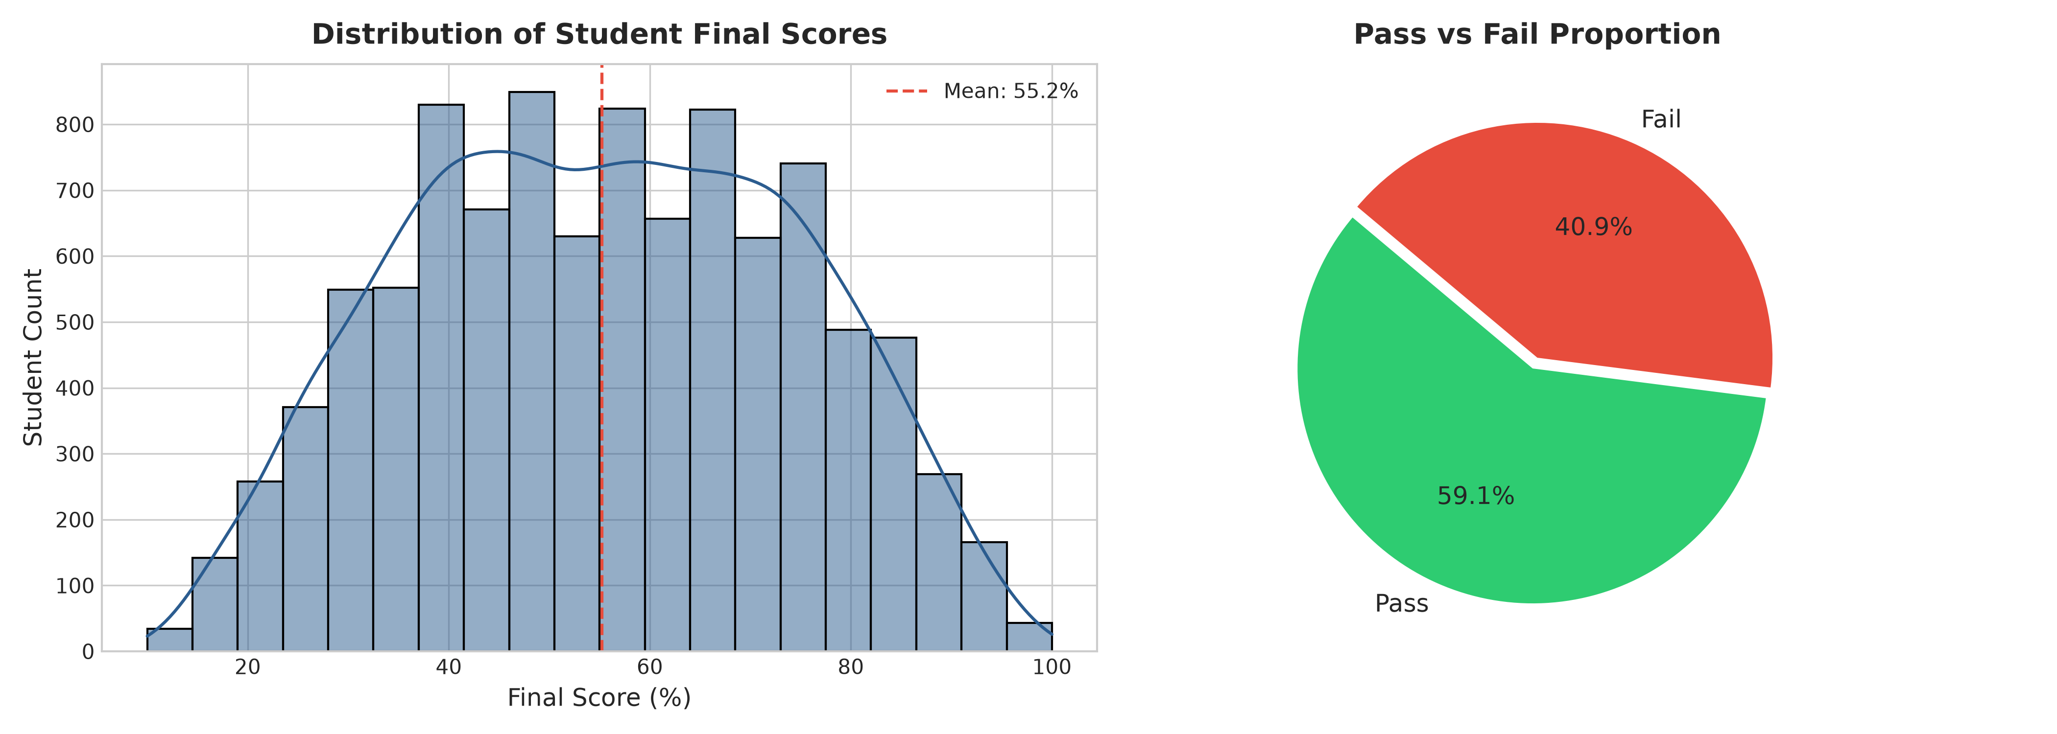
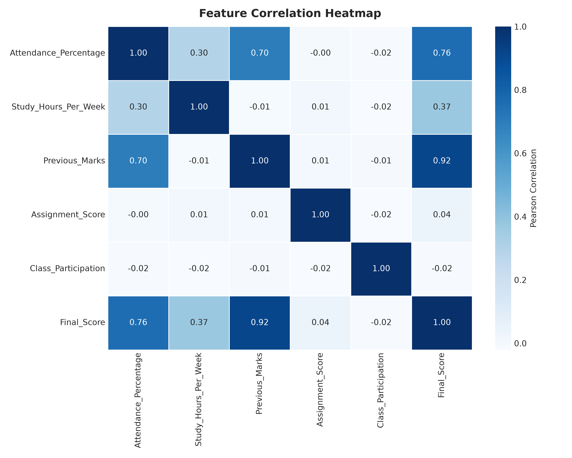
IMPLEMENTATION: PART 1
Data Cleaning, Preprocessing & Exploratory Data Analysis
SECTION 09
DATA PREPARATION & STATISTICAL INSIGHTS
✔ Missing Value Strategy
Dataset includes intentional ~2% missing entries in Attendance and Previous Marks. Handled via median imputation (Attendance: 72.4%, Previous Marks: 69.0%) ensuring zero data loss.
✔ Feature Standardization
Applied Z-Score scaling: z = (x - μ) / σ using StandardScaler. Ensures features with large scales do not dominate model weights.
✔ Score Distribution Insights
Final scores range from 10% to 100% with a mean of 55.2%, forming a smooth distribution suitable for regression.
✔ Correlation Findings
Strongest positive correlations with Final Score: Previous Semester Marks (r = 0.92), Attendance Percentage (r = 0.76), and Study Hours per Week (r = 0.37).

Slide 11
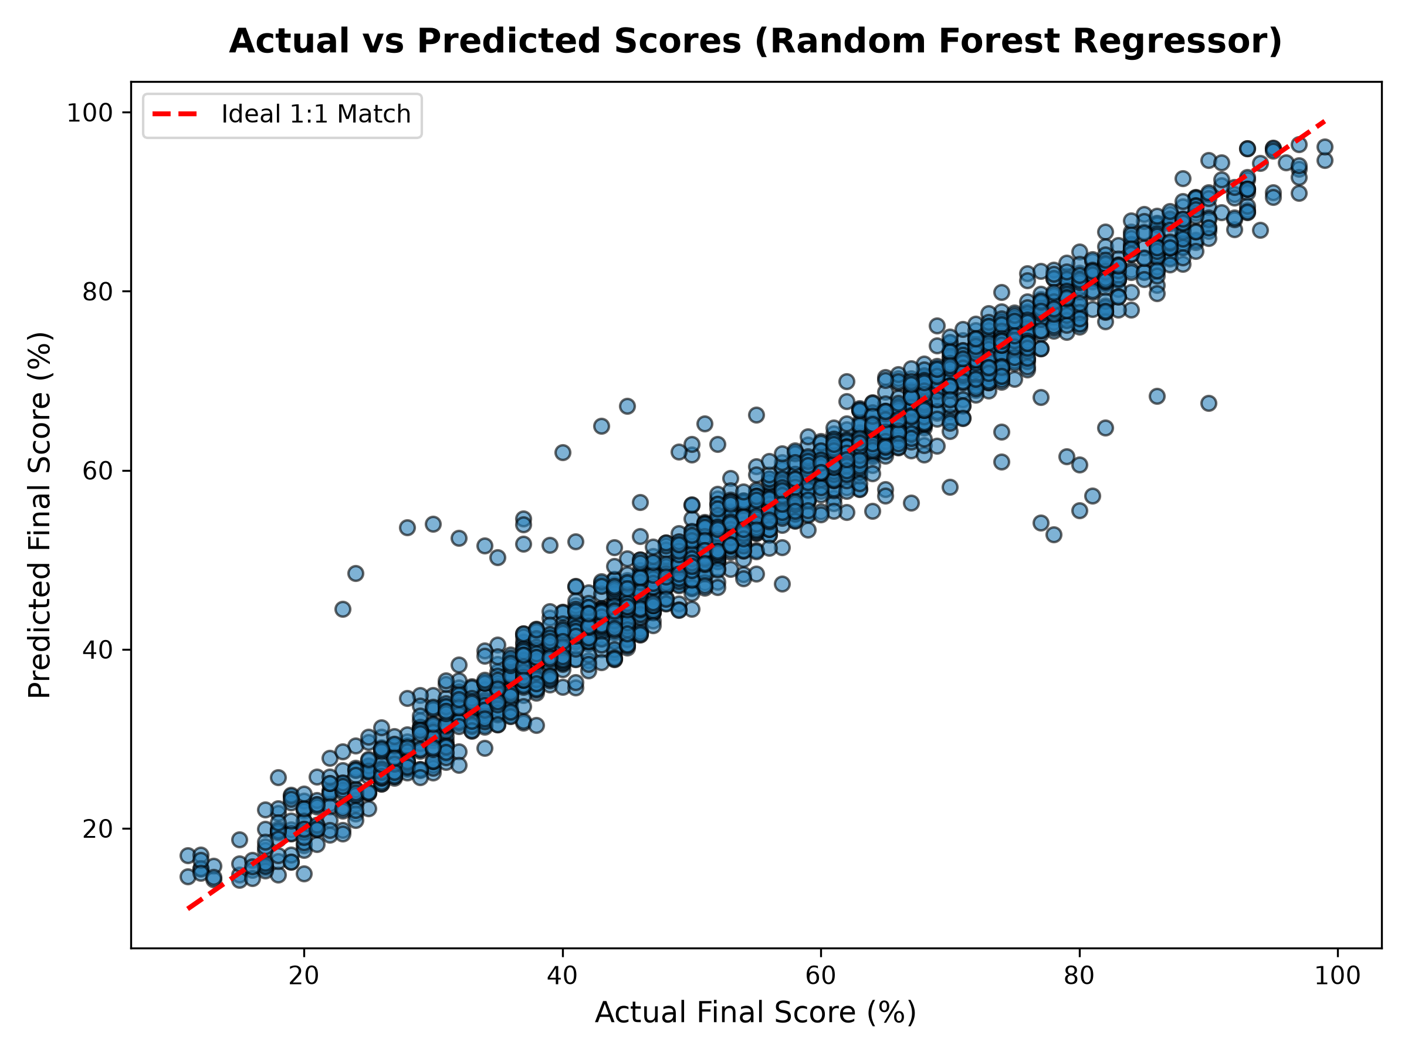
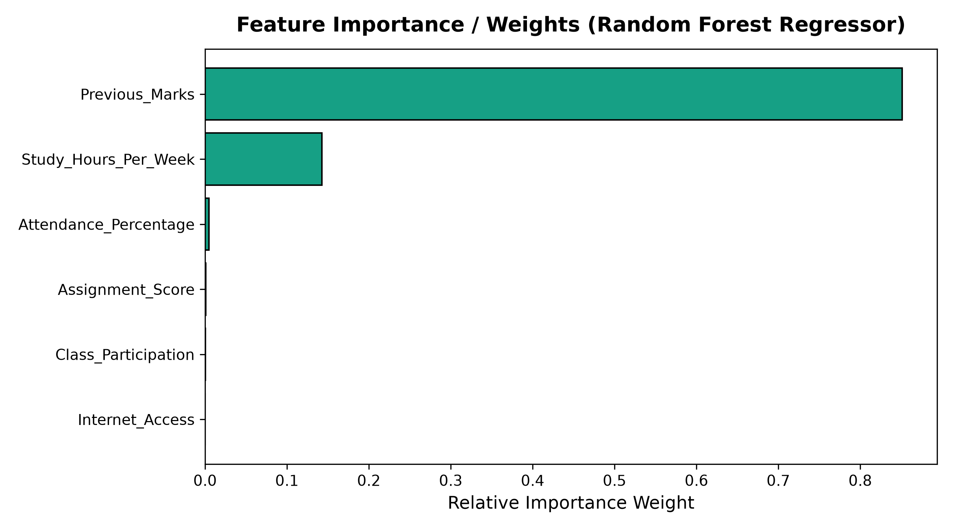
IMPLEMENTATION: PART 2
Model Training, Regression Fit & Feature Importance
SECTION 10
MODEL FITTING & FEATURE RANKINGS
✔ Multiple Linear Regression & Random Forest
Trained on scaled feature matrix. Evaluated across 4 regression algorithms, achieving exceptional predictive accuracy along the 45-degree diagonal line.
✔ R² Goodness of Fit
Random Forest Regressor achieved R² = 96.93% (MAE = 2.18%) and Multiple Linear Regression achieved R² = 96.63% (MAE = 2.09%), explaining ~97% of total student performance variance.
✔ Feature Importance Extraction
Ensemble Gini importance and standardized regression weights reveal the top predictive drivers of student grades.
✔ Primary Drivers of Success
1. Previous Marks (85.1% weight)
2. Study Hours / Week (14.3% weight)
3. Attendance Percentage (0.5% weight)
4. Assignment Score & Participation (0.1% weight)

Slide 12
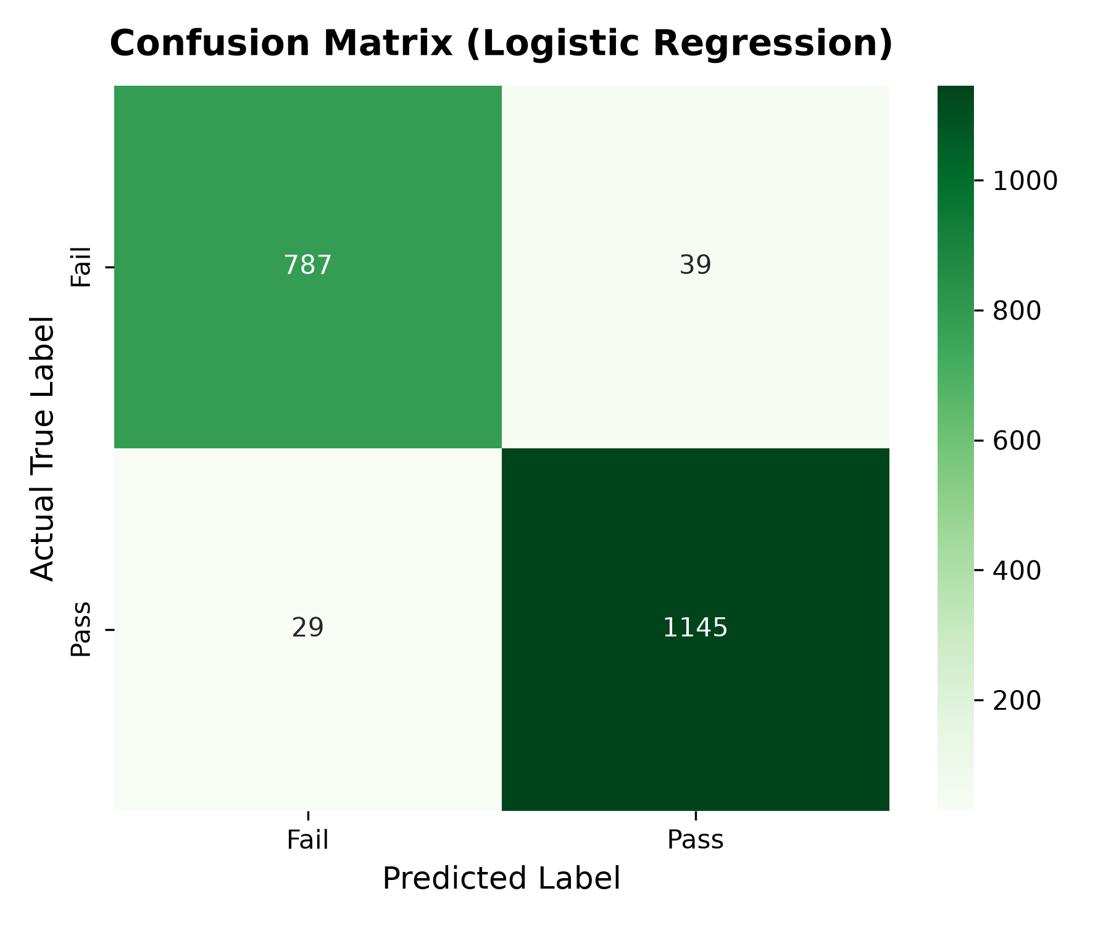
TESTING AND RESULTS
Experimental Evaluation, Test Cases & Metrics
SECTION 11
MODEL PERFORMANCE METRICS & VALIDATION RESULTS
CLASSIFICATION METRICS (PASS/FAIL)
Regression Model Comparison (Predicting Final Score %)
Model Algorithm | MAE | RMSE | R² Score
Random Forest Regressor (Best) | 2.177 | 3.371 | 96.93%
Linear Regression | 2.094 | 3.535 | 96.63%
Ridge Regression | 2.094 | 3.535 | 96.63%
Decision Tree Regressor | 2.871 | 4.125 | 95.41%
Unit & Integration Test Cases Executed:
• Test Case 1 (High Performer): Input: Attendance 92.5%, Study 18h, Marks 88%, Internet Yes -> Result: Predicted 85.8%, Grade A, TOP PERFORMER (Passed).
• Test Case 2 (At-Risk Student): Input: Attendance 48%, Study 4h, Marks 42%, Internet No -> Result: Predicted 23.9%, Grade F, HIGH RISK (Passed).
• Test Case 3 (Boundary Validation): Input: Attendance 150% (Invalid) -> Result: Graceful error handled via try-except boundary validation (Passed).
Logistic Regression Classification Results:
• Accuracy: 96.60% | Precision: 0.967
• Recall: 0.975 | F1-Score: 0.971 (Weighted)

Slide 13
CONCLUSION
Project Summary & Objectives Fulfillment
SECTION 12
HIGH PREDICTIVE ACCURACY
MULTI-TIER RISK DETECTION
TRANSPARENT EXPLAINABILITY
SYLLABUS & ENGINEERING ALIGNMENT
Successfully engineered predictive regression models achieving R² = 96.93% (Random Forest) and 96.63% (Multiple Linear Regression), with MAE ~ 2.09–2.18%, demonstrating that student academic performance can be reliably modeled before final exams.
Transitioned educational decision-making from reactive grading to early intervention. Implemented automated 4-tier risk categorization with personalized counseling action plans.
Identified Prior Semester Marks (85.1%) and Study Hours per Week (14.3%) as the primary determinants of academic standing, guiding students on where to focus.
Integrated all core Python curriculum concepts: OOP, File Handling, Exception Handling, Custom QuickSort sorting algorithm, NumPy, Pandas, and Scikit-Learn into a functional CLI tool.

Slide 14
FUTURE SCOPE
Potential Extensions & System Roadmap
SECTION 13
WEB DASHBOARD & CLOUD DEPLOYMENT
LMS / ERP INTEGRATION
LONGITUDINAL & DEEP LEARNING MODELS
AUTOMATED MULTI-CHANNEL ALERTING
• Develop an interactive web portal using FastAPI / Streamlit or React.
• Allow faculty and students to access prediction portals from mobile devices.
• Host on institutional cloud infrastructure with role-based access control.
• Connect directly to university Learning Management Systems (Moodle, Canvas, Google Classroom).
• Automatically stream live attendance and assignment submissions via REST APIs.
• Eliminate manual CSV data entry.
• Incorporate Recurrent Neural Networks (LSTMs or Transformers) to capture temporal progress trends over multiple semesters.
• Analyze trajectory: whether a student's performance is improving or declining over time.
• Send automated, personalized SMS / Email notifications to students entering moderate or high risk.
• Schedule automatic counseling appointments with assigned faculty mentors.

Slide 15
REFERENCES
Literature Citations, Documentation & Sources
SECTION 14
ACADEMIC PAPERS & BOOKS
OFFICIAL DOCUMENTATION & DATA REPOSITORIES
[1] Romero, C., & Ventura, S. (2020)
Educational Data Mining and Learning Analytics: An updated survey. WIREs Data Mining and Knowledge Discovery, 10(3), e1355.
[2] Cortez, P., & Silva, A. M. G. (2008)
Using Data Mining to Predict Secondary School Student Performance. Proceedings of 5th Annual Future Business Technology Conference, Porto, Portugal.
[3] James, G., Witten, D., Hastie, T., & Tibshirani, R. (2021)
An Introduction to Statistical Learning: with Applications in Python. Springer Texts in Statistics.
[4] Baker, R. S., & Inventado, P. S. (2014)
Educational Data Mining and Learning Analytics. In Learning Analytics (pp. 61-75). Springer, New York, NY.
[5] Scikit-Learn Documentation
Machine Learning in Python - Supervised Learning & Model Evaluation Metrics (https://scikit-learn.org/stable/).
[6] Pandas & NumPy Documentation
DataFrame Operations, Data Cleaning, and High-Performance Array Computations (https://pandas.pydata.org/).
[7] Kaggle Dataset Repository
Student Performance Multiple Linear Regression Dataset by Nikhil (https://www.kaggle.com/datasets/nikhil7280/student-performance-multiple-linear-regression).
[8] Python Software Foundation
Python 3.14 Official Language Reference & Standard Library (https://docs.python.org/3/).

Slide 16
THANK YOU

