Slide 1
Data base management
DMBS
RDBMS
MySQL
Postgre SQL
SQL Server
Sourour ISSAOUI

Slide 2
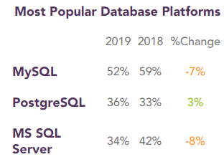
What is RDBM?
DBMS: Database Management System
DBMS (Database Management System) is a system that is used to store and manage data.
A DBMS is a set of programs that is used to store and manipulation data.
Manipulation of data includes the following:
Adding new data
Deleting unwanted data
Changing existing data

Slide 3
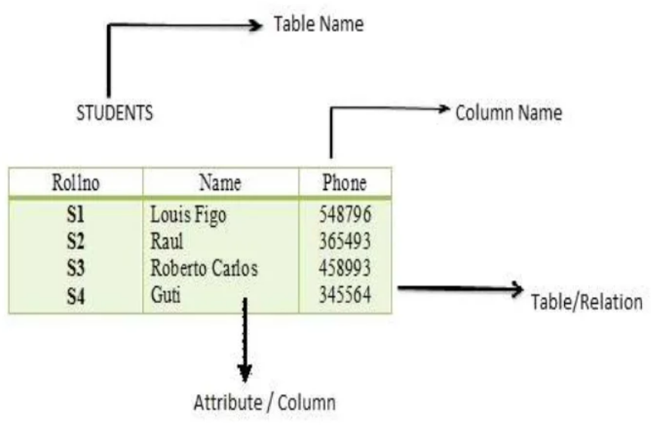
RDBMS(Relational Database Management System)
RDBMS data is structured in database tables, fields and records.
Each RDBMS table consists of database table rows.
Each database table row consists of one or more database table fields.
RDBMS store the data into collection of tables, which might be related by common fields (database table columns).
RDBMS also provide relational operators to manipulate the data stored into the database tables.

Slide 4
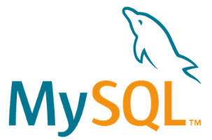
MySQL
MySQL is the most popular RDBMS. It was initially released the 23 May 1995 and written in C/C++. It is currently owned by Oracle Corporation.
It is used by many popular companies: Google, LinkedIn, Amazon, Netflix, Facebook, Twitter, Youtube…
MySQL is open-source and benefits from a very big community.
As a RDBMS it uses a strict schema model (data inputs must strictly respect a certain schema without flexibility as in NoSQL) and relational nature of its data.
As a SQL (structured query language) it uses queries to obtain data via JOINS to join / connect tables together.
Compared to NoSQL, SQL allows to automatically update data redundant in different parts of the databases.

Slide 5
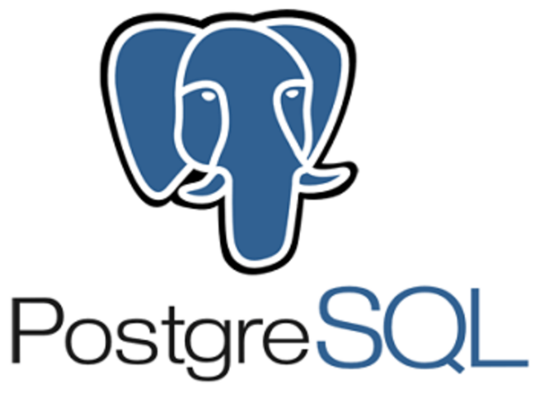
Postgre SQL
Postgre SQL is the second most popular RDBMS. It was initially released the 8 July 1996 and written in C. It is developped and owned by Owned by PostgreSQL Global Development Group.
It is used by many popular companies: Cisco, Apple, Skype…
MySQL is open-source and benefits from a very big community.
As a RDBMS it uses a strict schema model (data inputs must strictly respect a certain schema without flexibility as in NoSQL) and relational nature of its data.
As a SQL (structured query language) it uses queries to obtain data via JOINS to join / connect tables together.
Compared to NoSQL, SQL allows to automatically update data redundant in different parts of the databases.

Slide 6
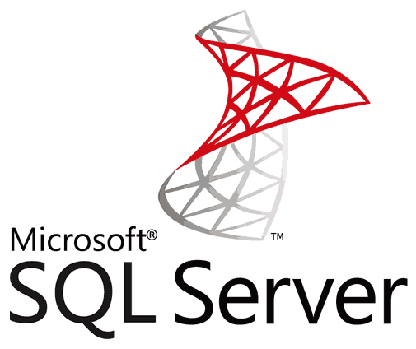
SQL Server
SQL Server is also a RDBMS. It was initially released the 2 April 1989 and written in C,C++ and C#. It was developped and owned by Microsoft.
It is used by many popular companies: EdgeWood College, Palo Alto University, Palo Alto University…
MySQL is a commercial solution (everything is licensed so must be purchased).
As a RDBMS it uses a strict schema model (data inputs must strictly respect a certain schema without flexibility as in NoSQL) and relational nature of its data.
As a SQL (structured query language) it uses queries to obtain data via JOINS to join / connect tables together.
Compared to NoSQL, SQL allows to automatically update data redundant in different parts of the databases.

Slide 7
