Slide 1


Facebook Developers Dhaka Facebook Authentication & Graph API
Tanvir Sourov
CEO, Technolive

Slide 2
Facebook Authentication
Facebook Authentication is the way to get user information from your App using the Facebook Platform. This enables users to directly Register and Login to the App using their Facebook Account. This is currently available for iOS Apps, Android Apps, Facebook Canvas and Websites.

Slide 3
Android Authentication
We will work with Android Authentication.
Go to: https://developers.facebook.com/apps
And click on Add a New App from My Apps (at top right corner).

Slide 4
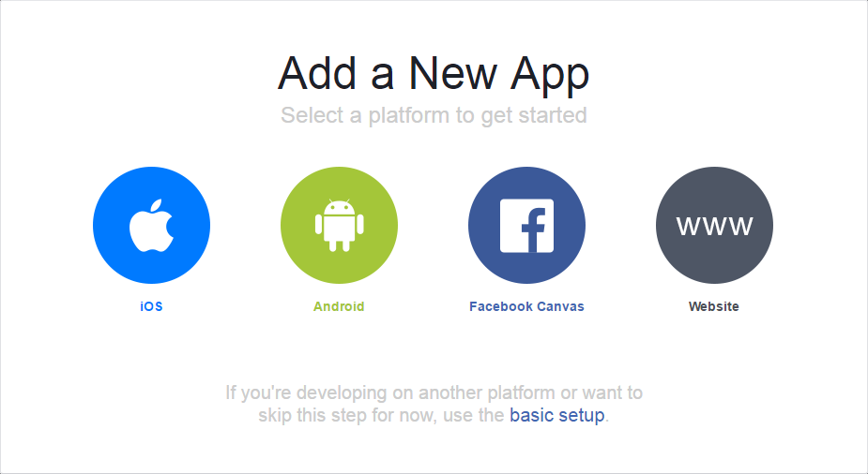
Select Android

Slide 5
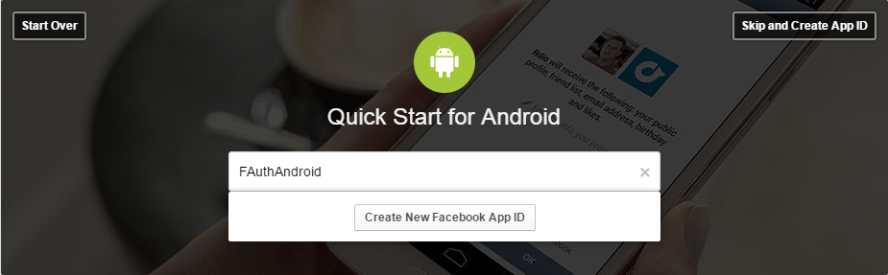
Type Name & Click Create New Facebook App ID

Slide 6
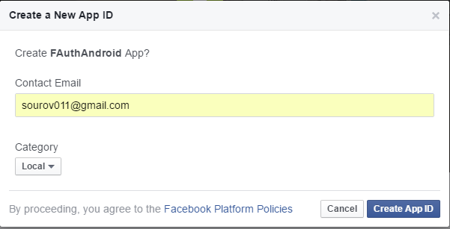
Insert Email, Select Category & Select App ID

Slide 7
Work with build.gradle
Go to your build.gradle file and add the following code before Dependencies:
repositories {
mavenCentral()
}
Inside your dependencies, add this following code for accessing Facebook SDK:
compile 'com.facebook.android:facebook-android-sdk:[4,5)'

Slide 8
Work with string.xml
Go to string.xml file inside res/values/
And paste the following code: <string name="facebook_app_id">YourFacebookAppID</string> You will get the App ID after you create the Facebook App ID (Slide 6)

Slide 9
Work with Mainfest and Permission
Open the AndroidManifest.xml file and add the INTERNET permission before the application tag:
<uses-permission android:name="android.permission.INTERNET"/>
And add the meta-data before the close of application tag:
<meta-data android:name="com.facebook.sdk.ApplicationId" android:value="@string/facebook_app_id"/>

Slide 10
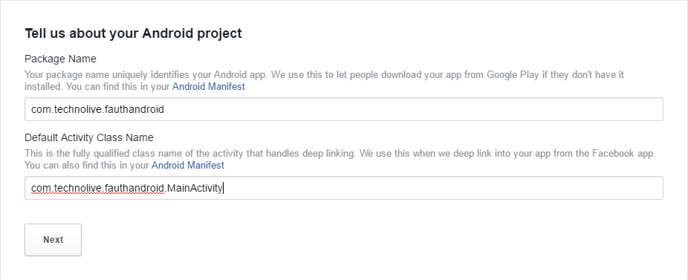
Insert Android Project
Package & Default Activity

Slide 11
Development & Release Key Hashes
Run the following Commands from terminal of Android Studio to Generate the Key Hashes:
Development Key Hash: For Mac:
keytool -exportcert -alias androiddebugkey -keystore ~/.android/debug.keystore | openssl sha1 -binary | openssl base64 For Windows:
keytool -exportcert -alias androiddebugkey -keystore %HOMEPATH%\.android\debug.keystore | openssl sha1 -binary | openssl base64
Release Key Hash: keytool -exportcert -alias YOUR_RELEASE_KEY_ALIAS -keystore YOUR_RELEASE_KEY_PATH | openssl sha1 -binary | openssl base64

Slide 12
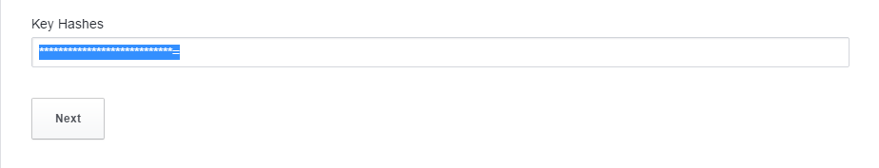
Insert Key Hashes & Press Next

Slide 13
Goto GitHub, Clone the Repository & Get Started
https://github.com/TanvirSourov/FAuthAndroid.git

Slide 14
Thanks!
Questions???
Email me:
tanvir@technolive.co
Connect on Facebook:
fb.com/sourov011

