Slide 1

The CRIME attack

Slide 2
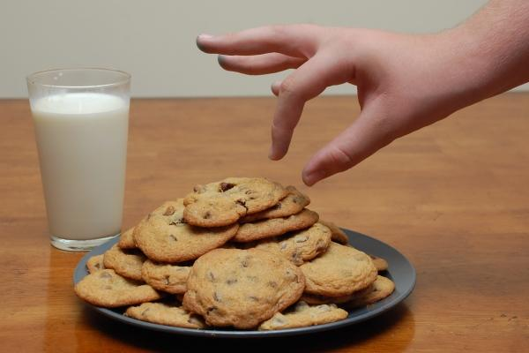

HTTPS:// Secure HTTP
HTTPS provides:
Confidentiality (Encryption),
Integrity (Message Authentication Code),
Authenticity (Certificates)
CRIME decrypts HTTPS traffic to steal cookies and hijack sessions.

Slide 3

How can you become a victim of CRIME?
1st requirement: the attacker can sniff your network traffic.
You share a (W)LAN.
He's hacked your home router.
He's your network admin, ISP or government.

Slide 4
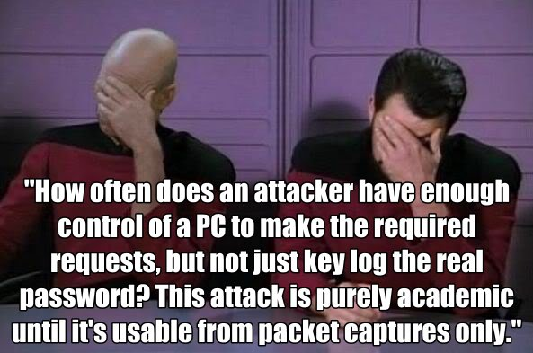
How can you become a victim of CRIME?
2nd requirement: you visit evil.com.
You click on a link.
Or you surf a non-HTTPS site.

Slide 5
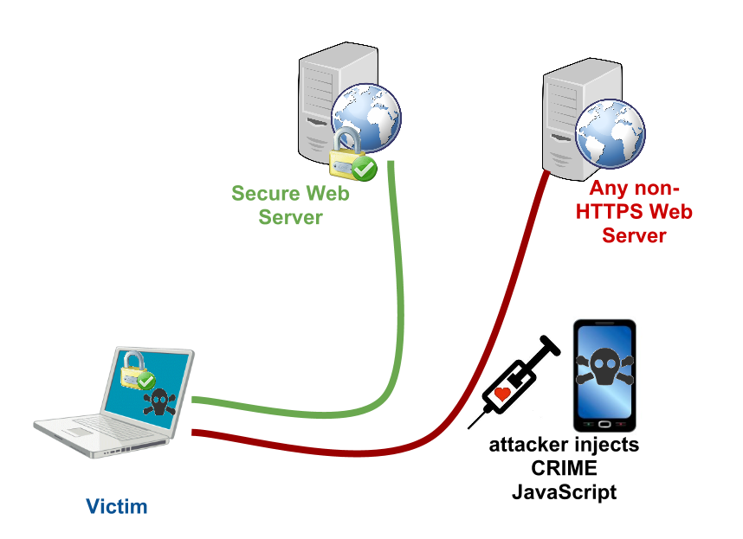
CRIME injection

Slide 6
C in CRIME is compression
Transmit or store the same amount of data in fewer bits.
When you see compression in Internet protocols, it's probably DEFLATE.
zlib and gzip are the two most popular DEFLATE wrappers.

Slide 7
Compression is everywhere
TLS layer compression.
Application layer compression
SPDY header compression,
HTTP response gzip compression,
Not so sure if exploitable: SSH, PPTP, OpenVPN, XMPP, IMAP, SMTP, etc.
We will discuss TLS compression, SPDY and HTTP gzip.

Slide 8
DEFLATE
Lossless compression reducing bits by removing redundancy.
Best way to learn: RFC 1951 and puff.c.
DEFLATE consists of two sub algorithms:
LZ77, and
Huffman coding.

Slide 9
DEFLATE: LZ77
Google is so googley -> Google is so g(-13, 5)y
It scans input, looks for repeated strings and replaces them with back-references to last occurrence as (distance, length).
Most important parameter: window size.
How far does it go back to search for repetition?
Also called dictionary size.

Slide 10

DEFLATE: Huffman coding
Replace common bytes with shorter codes.
Build a table that maps each byte with a unique code.
Dynamic table: built based on the input, codes can be as short as 1 or 2 bits.
Fixed table: specified in the RFC, longer codes (7-9 bits), good for English or short input.

Slide 11
R in CRIME is ratio
How much redundancy the message has.
More redundancy -> better compression ratio -> smaller request length.
len(compress(input + secret))
input is attacker-controlled.
If it has some redundancy with secret, length will be smaller.
Idea: change input and measure length to guess secret.

Slide 12
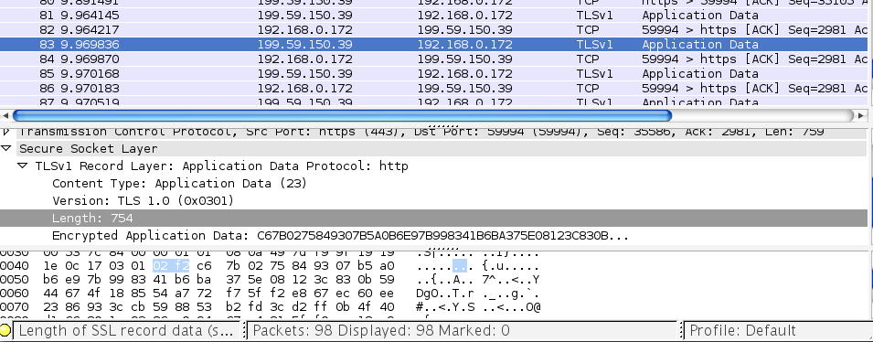
I in CRIME is info-leak
SSL/TLS doesn't hide request/response length.

Slide 13
CRIME algorithm
len(encrypt(compress(input + public + secret)) is leaked
input: URL path
public: known headers
secret: cookie
Algorithm:
Make a guess, ask browser to send a request with path as guess.
Observe length of the request that was sent.
Correct guess is when length is different than usual.
GET /twid=a
Host: twitter.com
User-Agent: Chrome
Cookie: twid=secret
...
GET /twid=s
Host: twitter.com
User-Agent: Chrome
Cookie: twid=secret

Slide 14
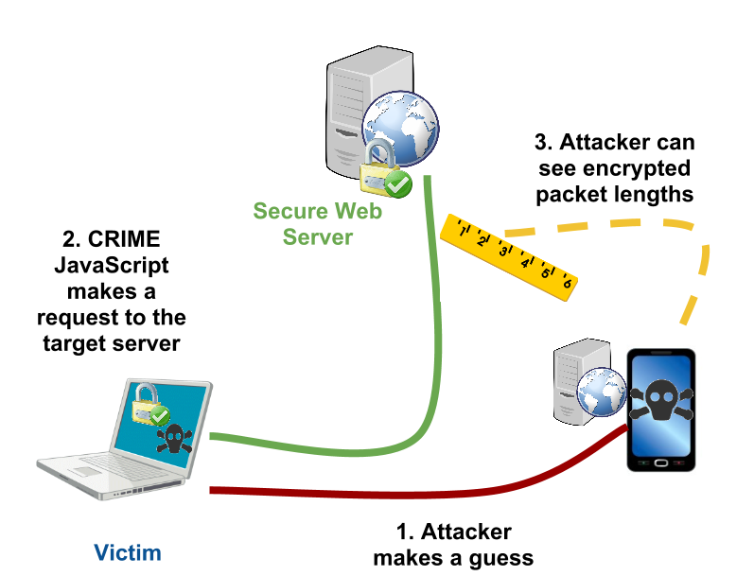
CRIME in a slide

Slide 15
ME in CRIME is mass exploitation
Worked for 45% of browsers: Chrome and Firefox.
Worked for all SPDY servers: Gmail, Twitter, etc.
Worked for 40% of SSL/TLS servers: Dropbox, GitHub, etc.

Slide 16
ME in CRIME is also made easy
JavaScript is optional.
Fast Hollywood-style decryption. The best algorithm requires on average 6 requests to decrypt 1 cookie byte.
Worked for all TLS versions and all ciphersuites (AES and RC4).
Work even if HSTS is active and preloaded.

Slide 17
CRIME is the new BEAST
BEAST opened the path to CRIME
Easy to perform chosen-plaintext attack against HTTPS.
Use URL path to decrypt cookie.
Move data across layer boundary.
What's new?
SSL compressed record length info-leak, instead of CBC mode with chained IVs vulnerability.
New boundaries: compressor window size and TLS record size, instead of block cipher's block size.

Slide 18

So length is leaked
Length is the number of bytes, but DEFLATE outputs bits.
Length of request with a match must have a difference of at least 8 bits.
A 63-bit request looks exactly the same as a 59-bit on the wire.

Slide 19
First attack: Two Tries
Recall window size: if the distance from the current string to the previous occurrence is greater than window size, it won't be replaced.
Window size is essentially a data boundary. Let's move thing across it!
For each guess, send two requests (hence Two Tries)
req1 with the guess inside the window of the cookie.
req2 is a permutation of req1, with the guess outside.

Slide 20
Two Tries: length difference
If guess is incorrect:
guess won't be replaced by a reference to cookie in neither req1 nor req2.
hence, len(req1) == len(req2).
If guess is correct:
guess will be replaced by a reference to cookie in req1.
guess won't be replaced in req2, because it's outside the window.
hence, len(req1) != len(req2).

Slide 21
Two Tries
Oracle:
If len(req1) != len(req2), then the guess is correct;
It's incorrect otherwise.
GET /ABCDEFtwid=s<padding>Cookie: twid=secret
GET /twid=sABCDEF<padding>Cookie: twid=secret

Slide 22
Two Tries
Pros:
Work for TLS compression, SPDY and HTTP gzip as well.
False positive free with a few tricks.
Cons
Require O(W) requests, where W is cookie charset.
May fail when cookie contains repeated strings.
Depend on deep understanding of DEFLATE and zlib's deflate.c to create a 8-bit difference.

Slide 23
SPDY
A new open networking protocol for transporting web content.
Similar to HTTP, with particular goals to reduce web page load latency and improve web security.
SPDY achieves reduced latency through compression, multiplexing, and prioritization.

Slide 24
SPDY
Standardized: selected by IETF as the starting point for HTTP 2.0.
Servers: Google, Twitter, Wordpress, F5 Networks, Cloudflare, Apache httpd, nginx, etc.
Clients: Chrome, Firefox, Opera (beta), etc.

Slide 25
Compression in SPDY
DEFLATE is used to compress headers.
SPDY uses the same compression context for all requests in one direction on a connection.
repeated strings in new requests can be replaced by references to old requests.

Slide 26
CRIME for SPDY
The shared compression context is a two-edged sword
Better compression.
Subsequent compressed headers are so small that zlib decides to use fixed Huffman table.
Recall that fixed Huffman table uses 7-9 bit codes. Hence, it's easier to have a difference of 8 bits.

Slide 27
CRIME for SPDY
Send a request to "reset" the compression context (i.e., prepare the dictionary).
Send another request with a wrong guess to get the base length.
For each guess, send a request. Use the base length to spot possible correct guesses.

Slide 28
CRIME for SPDY
GET /aatwid=a HTTP/1.1\r\n
Host: twitter.com\r\n
User-Agent: Chrome\r\n
Cookie: twid=secret\r\n
GET /bbtwid=b HTTP/1.1\r\n
Host: twitter.com\r\n
User-Agent: Chrome\r\n
Cookie: twid=secret\r\n
(-84, 5)aa(-20, 5)a(-84, 71)
(-84, 5)bb(-20, 5)b(-84, 71)

Slide 29
CRIME for SPDY
GET /rrtwid=r HTTP/1.1\r\n
Host: twitter.com\r\n
User-Agent: Chrome\r\n
Cookie: twid=secret\r\n
GET /sstwid=s HTTP/1.1\r\n
Host: twitter.com\r\n
User-Agent: Chrome\r\n
Cookie: twid=secret\r\n
(-84, 5)rr(-20, 5)r(-84, 71)
(-84, 5)ss(-20, 6)(-84, 71)

Slide 30
CRIME for SPDY
Pros
Still O(W), but with a smaller constant than Two Tries.
Very fast, thanks to SPDY.
Also false positive free.
Cons
Can't send many requests at a time if server sets a maximum limit.
Different browsers have different implementations of SPDY header compression.

Slide 31

CRIME for SPDY
Workaround
Chrome and Firefox have disabled header compression in their SPDY implementations.
SPDY/4 will make CRIME irrelevant (hopefully).

Slide 32
Compression in TLS
Specified in RFC 3749 (DEFLATE) and RFC 3943 (LZS).
Chrome (NSS), OpenSSL, GnuTLS, etc. implement DEFLATE.
If data is larger than maximum record size (16K), it split-then-compress each record independently (in a separate zlib context).

Slide 33
CRIME for TLS Compression: 16K-1
16K is essentially another boundary. BEAST's chosen-boundary attack strikes again!
Make a request so big that it will be split into two records such that:
1st record: GET /<padding>Cookie: twid=s
2nd record: ecret
Simulate the compression of the 1st record for every candidate.
Send the request, obtain the compressed length of its 1st record. Use it to select possible correct bytes.

Slide 34
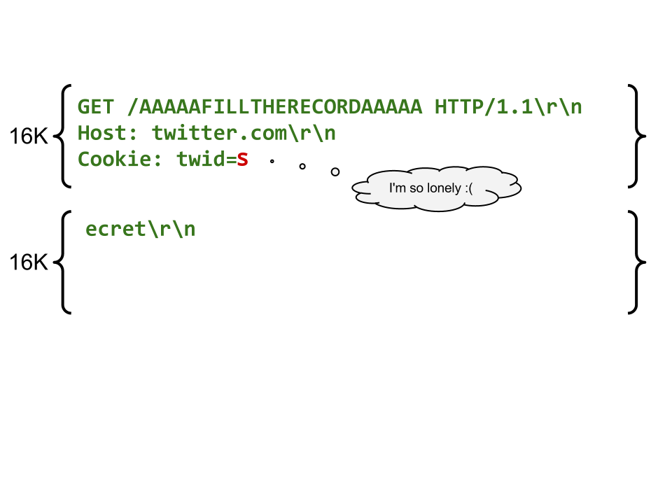
16K-1

Slide 35
16K-1 POC
def next_byte(cookie, known, alphabet=BASE64):
candidates = list(alphabet)
while len(candidates) != 1:
url = random_16K_url(known)
record_lens = query(url)
length = record_lens[0]
record = "GET /%s%s%s" (url, REQ, known)
good = []
for c in candidates:
if len(compress(record + c)) == length:
good.append(c)
candidates = good
return candidates[0]

Slide 36
CRIME for TLS Compression
Pros
Require only O(logW) requests. Can choose between longer offline compression or larger number of online requests.
False positive free.
Compression algorithm independent.
Cons
While server-side deployment is 40%, Chrome was the only browser that supported TLS compression.
zlib versions on victim and attacker should be the same.

Slide 37
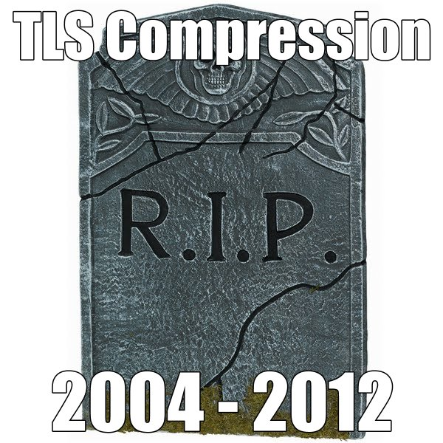
CRIME for TLS Compression
Workaround
Chrome has disabled compression in its ClientHello.

Slide 38
HTTP response gzip compression
The most popular compression on the Internet.
Just a wrapper on top of DEFLATE.
CRIME works like a charm.

Slide 39
CRIME for HTTP gzip
Requirement: server echoes back some client input in the response (e.g., /search?q=crimeN0tF0uddd).
Use the echoed input to extract PII or XSRF token embedded in the response.
Two Tries may work, but we haven't tested it yet.

Slide 40
"We believe"
TLS compression may resurrect in the near future
"Browsers are not the only TLS clients!"
HTTP gzip may be a bigger problem than both SPDY and TLS compression
If you control the network, then a XSRF token is as good as, if not better, a session cookie.
Remember: compression is everywhere.

Slide 41
Thanks
Google, Mozilla, and Dropbox.
Dan Boneh, Agustin Gianni, Kenny Paterson, Marsh Ray, Eduardo Vela and many other friends.
EKOPARTY xD xD xD!!

Slide 42
Related work
John Kelsey, Compression and Information Leakage of Plaintext.
Adam Langley, post to SPDY mailing list.

Slide 43
Questions?
https://twitter.com/julianor or thaidn@gmail.com

