Slide 1
Chronic Kidney Disease Prediction

Slide 2
Introduction
CKD is a condition in which-
Kidneys are damaged
Can’t filter blood
Excess fluid and waste from blood remain in the body
Cause many health problems, such as heart disease and stroke.
01/03/2023 Dept of CSE 02

Slide 3
AI In CKD
AI in Chronic Kidney Disease-
Detect changes in kidney size, structure, and texture
Monitor patient symptoms, lifestyle changes, and other factors.
Used to create personalized treatment plans.
01/03/2023 Dept of CSE 03

Slide 4
Dataset & Data processing
Imported the dataset with about 770 patients’ data.
Import datasets and linear models libraries from sklearn to use dataset as an input.
Then uploaded the dataset.
Split the data into independent (x) dataset (the features) and dependent (y) dataset (the target).
Split the data into 80% training and 20%testing.
01/03/2023 Dept of CSE 04

Slide 5
Aims and Objectives
To improve the accuracy of diagnostic and prognostic models of CKD
To research and develop new AI techniques to improve patient monitoring and management
To use AI for better patient stratification, early detection, and prevention of.
To use AI to facilitate personalized medicine for early detection and management of CKD.
To identify biomarkers and develop imaging-based methods to improve disease prog.
01/03/2023 Dept of CSE 05

Slide 6
Algorithm
Logistic Regression-
Widely used machine learning algorithm in predicting the outcome of chronic kidney disease (CKD)
Produces an equation that assigns a probability of an individual having CKD based on their independent variables.
This probability can then be used to make a prediction.
It is used in CKD diagnostics due to its accuracy, interpretability, and low cost.
01/03/2023 Dept of CSE 06

Slide 7
Model
Sequential Model-
Processes data in a sequential order.
Takes the input data, processes it in a specific order, and then produces the desired output.
Confusion Matrix-
Used to evaluate the performance of a machine learning model.
Displays the predicted outcomes of a model against the actual outcomes of the same data. It is often
Used to measure the accuracy of a model by comparing the predicted and actual results.
01/03/2023 Dept of CSE 07

Slide 8
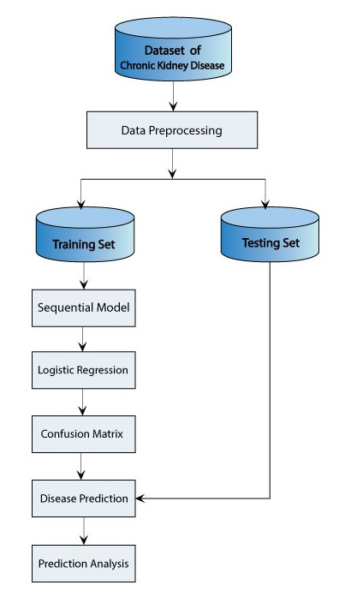
Diagram
01/03/2023 Dept of CSE 08

Slide 9
Conclusion
01/03/2023 Dept of CSE 09

Slide 10
THANKS

