Slide 1
Title: Capstone Project - A recommendation system for coworking spaces in Tunisia (week 2)
Presented by: Aymen Soussi, Data Scientist
Date: 21/02/2019

Slide 2
Motivation
Coworking spaces is a new concept in Tunisia, those places offre to any new start up the chance to meet other start ups in the same place so that they can comminucate with each others and echange experiences between each others when they need.
An other important factor is that those places try to provide start ups with all what they need ( private desktops, meet up room , caffé , drinks and foods.
Research Question:
Can we provide a recommendation system to new start ups so that they can find the best coworking space for them based on the governorate in which they are ?

Slide 3
Dataset details:
We will use Foursquare API to search for venues and make the call to the Foursquare database and in return, We will use K-means clustering to do classification for coworking spaces :
'https://api.foursquare.com/v2/venues/search?client_id={}&client_secret={}&ll={},{}&v={}&query={}&radius={}&limit={}'.format(CLIENT_ID, CLIENT_SECRET, latitude, longitude, VERSION, ***_query, radius, LIMIT)

Slide 4
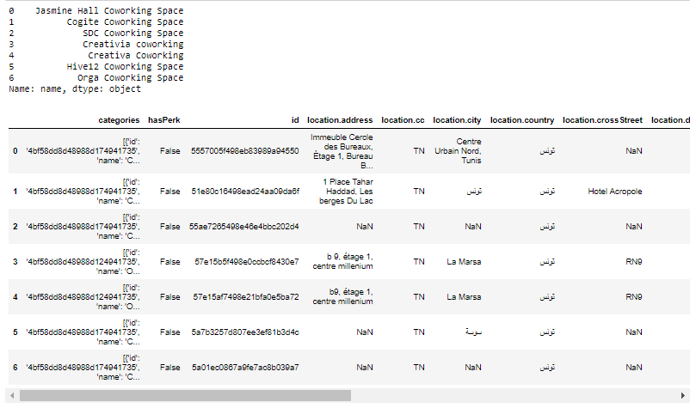
Example of Data:

Slide 5
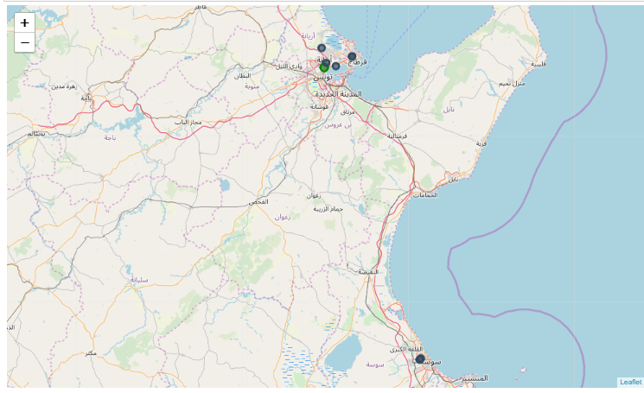
Map of coworinkng spaces in Tunisia based on the data we have (they are marked with blue points)

Slide 6
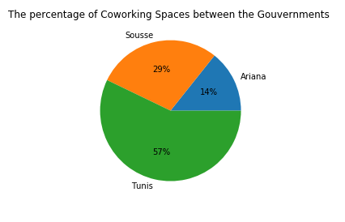
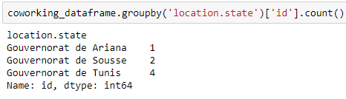
Distribution of data between gouvernements
We have found only 7 coworking spaces distributed by 1 (14%) in Ariana, 2 (29%) in Sousse and 4 (57%) based in Tunis gouvernment .

Slide 7
Conclusion
For those who’s are in Tunis gouvernment they have more chances to get to a coworking space.
The data was very limeted and we need more data so that we can make better anayses about coworking spaces because in origin we have more that 70 coworking spaces based in this country wut we have found only 7 coworking ( less then 10%)

Slide 8
References
Foursquare API for developers: https://developer.foursquare.com/
Matplotlib documentation: https://matplotlib.org/

