Slide 1
CashSnap
Khmer Riel & US Dollar Cash Counting Assistant
AI-Assisted Computer Vision App | Course Assignment Submission

Slide 2
The Problem: Cash Counting is Not Simple Detection
Traditional object detection models struggle in real-world retail (wet markets, corner shops).
Banknotes are rarely clean or isolated; they are folded, wet, dirty, or crinkled.
Banknotes are frequently overlapped or fanned, obscuring denomination evidence.
Naive object detectors will count each visible banknote fragment separately, leading to severe overcounting.
A robust computer vision solution requires two-stage detection + classification combined with fragment fusion.

Slide 3
Challenging Real-World Cases Handled
Overlapped & Fanned Notes: Differentiating overlapping note stacks and thin visible edges.
Hand Occlusions: Identifying denominations even when hands or fingers block details.
Note Condition Randomization: Recognising dirty, wet, crinkled, or low-contrast paper in circulation.
Dual Currency Environment: Supporting mixed US Dollar (USD) and Khmer Riel (KHR) notes simultaneously.
Negative Props: Handling background distractors like empty tables, receipts, or wallets without false counting.
Counterfeit Disclaimer: Explicitly built for cash counting assistance; counterfeit detection is out of scope.

Slide 4
App Features & PRD Blueprint
Camera & Upload: Take photos using phone/webcam or upload saved images (JPEG/PNG).
Image Preview & Retake: Double-check clarity and retake/re-upload if blurry.
Banknote Detection & Denomination Recognition: Fast YOLO bounding box proposals.
Fragment Fusion: AI fuses separate fragment predictions back into physical note counts.
Count & Total calculation: Provides final quantities per denomination and total values by currency.
Confidence & Warnings: Warns users of low-confidence predictions to prompt manual double-checking.

Slide 5
End-to-End User Journey
1. Open CashSnap: Launches in mobile phone browser.
2. Capture/Upload: User takes a cash photo or uploads an existing saved image.
3. Review Preview: User checks the photo on screen and clicks 'Count'.
4. Hugging Face Inference: Image is sent securely to Hugging Face API.
5. Detection & Fusion: System classifies fragments and fuses them into physical note units.
6. Display Totals: App renders bounding boxes, counts per denomination, and final currency totals.

Slide 6
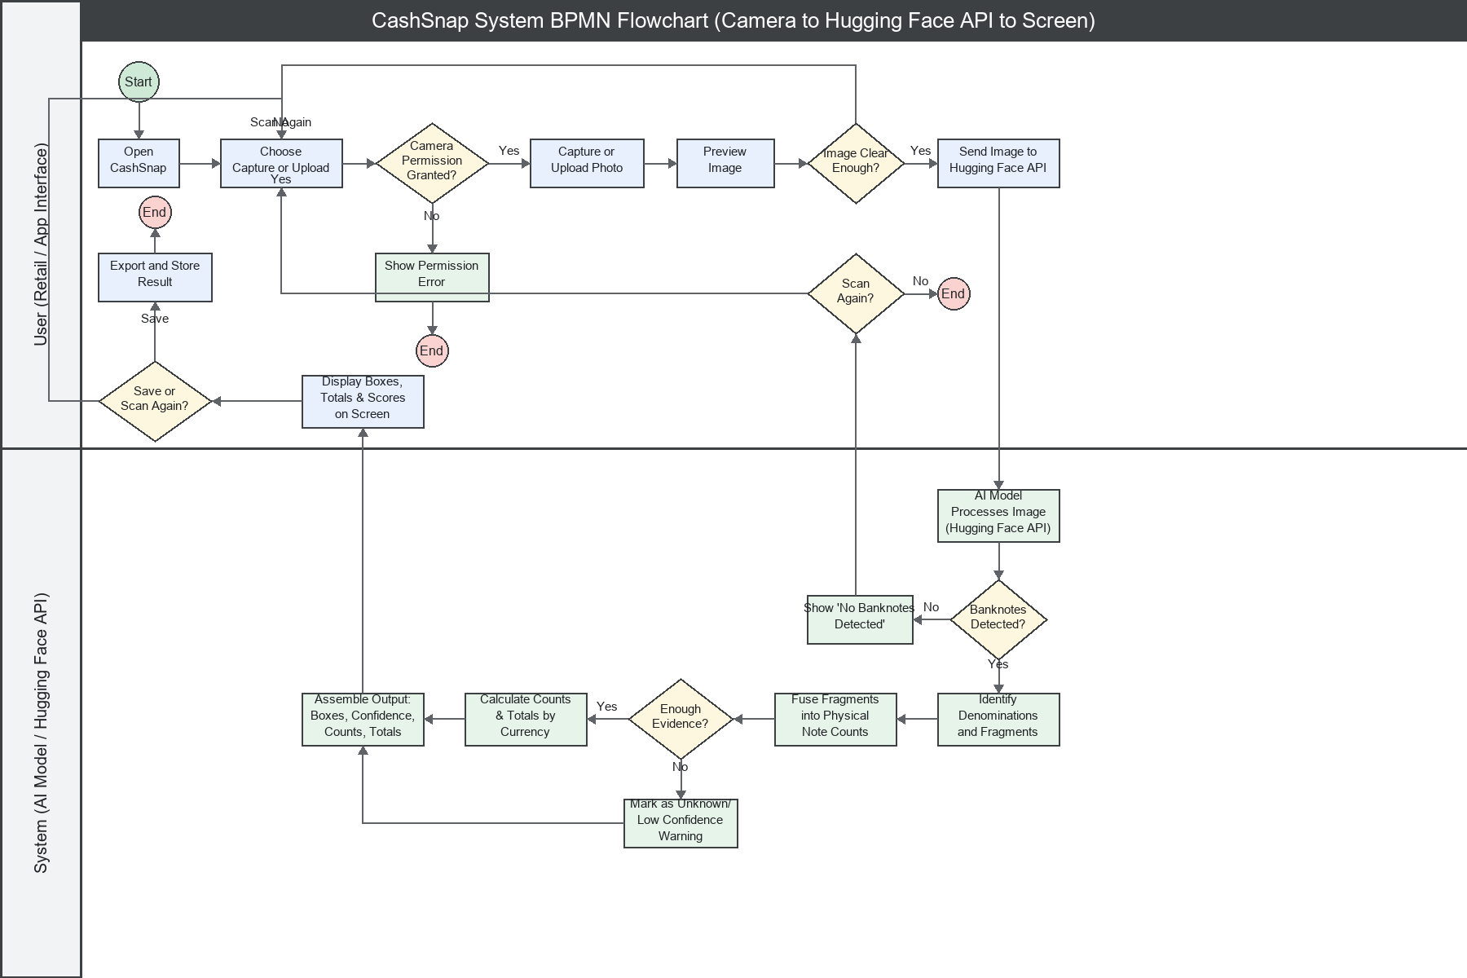
System Flow: BPMN Diagram
Two-Lane Flowchart: maps user interaction vs backend system processing.
Hugging Face Integration: includes camera capture -> API request -> results display.
Fragment Fusion Gate: decides if enough denomination evidence exists to calculate total counts.

Slide 7
Hugging Face API & Inference Pipeline
Preprocessing: Resize and normalize the image to 416x416 resolution.
Detector Stage: Runs YOLOv8-style object detection to propose bounding boxes and potential fragments.
Classification Stage: Crops detection regions and overrides denomination using MobileNetV3 classifier.
Fragment Fusion: Implements IoU matching (0.85 threshold) to fuse multiple fragments into a physical note.
Value Mapping: Aggregates counts and calculates total amounts for USD and KHR currencies.
Offline Demo Mode: Graceful fallback utilizing preloaded test images and mock responses if API is down.

Slide 8
Synthetic Data Engine (WebGL Renderer)
Scaling Unit: Generating massive pre-training data is difficult with physical banknote photos.
WebGL Renderer: Generates synthetic images + pixel-perfect ID masks, bounding boxes, and counts.
Circulation Wear: Models creases, wet patches, crinkles, speckles, and surface dirt.
Lighting Diversity: Incorporates various environments using equirectangular HDRI mapping.
Fragment Labels: Marks connected visible components to guide downstream fusion, rather than guessing hidden note boxes.

Slide 9
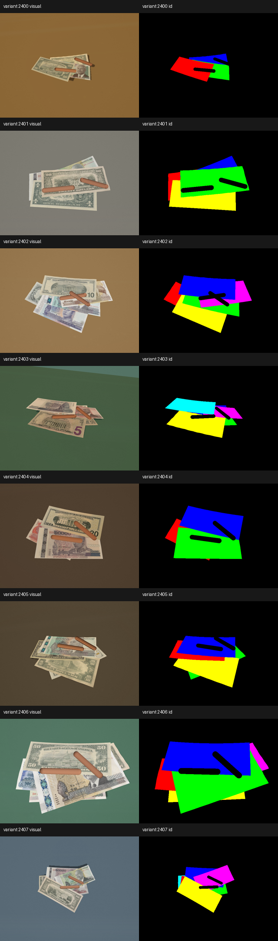
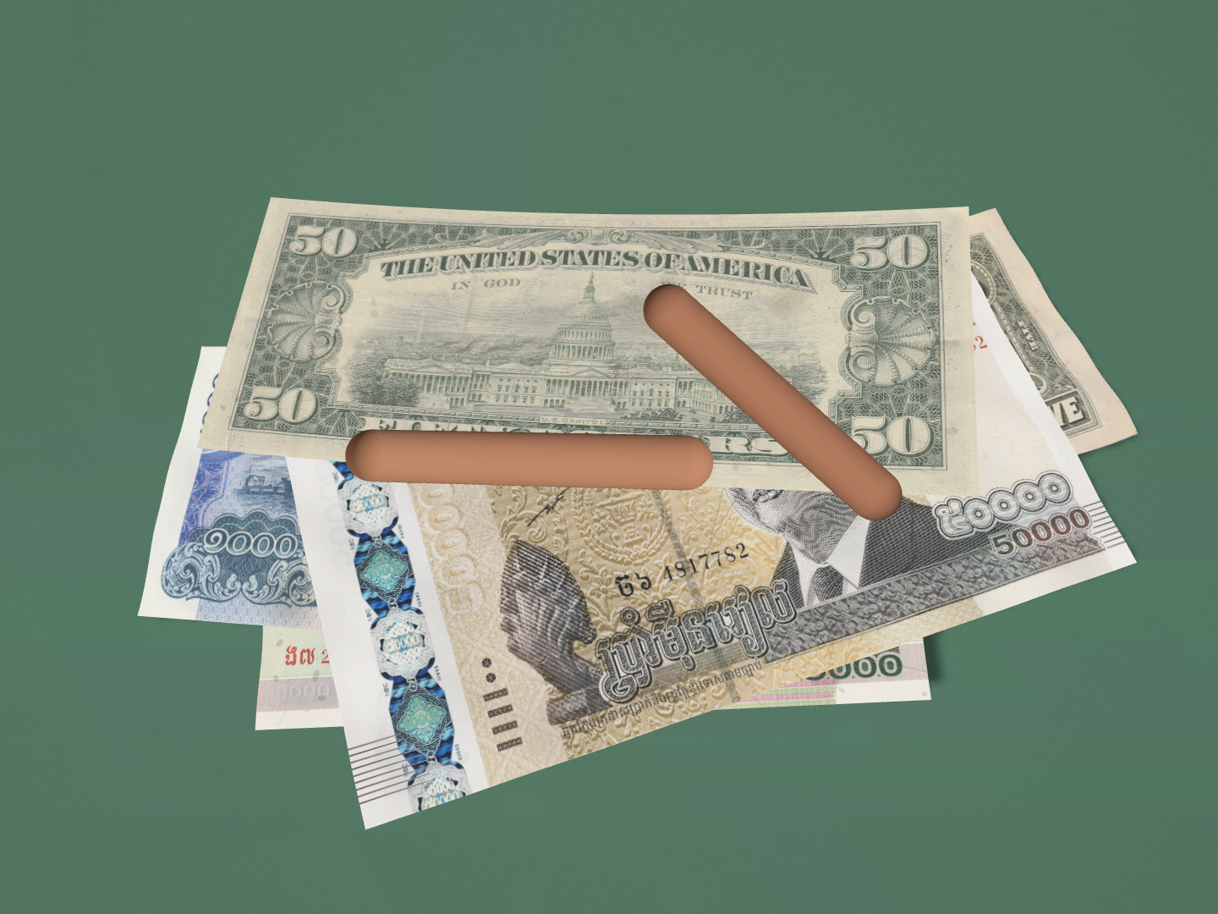
WebGL Synthetic Data Evidence
A: Note condition batches (Speckling & creasing wear randomization).
B: HD variant renderings (Edge quality and texture verification).
C: Poly Haven HDRI reviews (Lighting reflection and surface glossiness QA).

Slide 10
Limitations & Next Steps
Mature clean note detection vs. weak dense overlap and fanned note counting.
Synthetic-to-real transfer validation remains the primary bottleneck.
Need for rights-clean phone-captured fan/overlap stress labels for transfer scoreboards.
Default HDRI reflections require further CC0 register verification.
Warning: The WebGL synthetic rendering is robust, but real-world fan/overlap validation is still the next major proof step.

