Slide 1
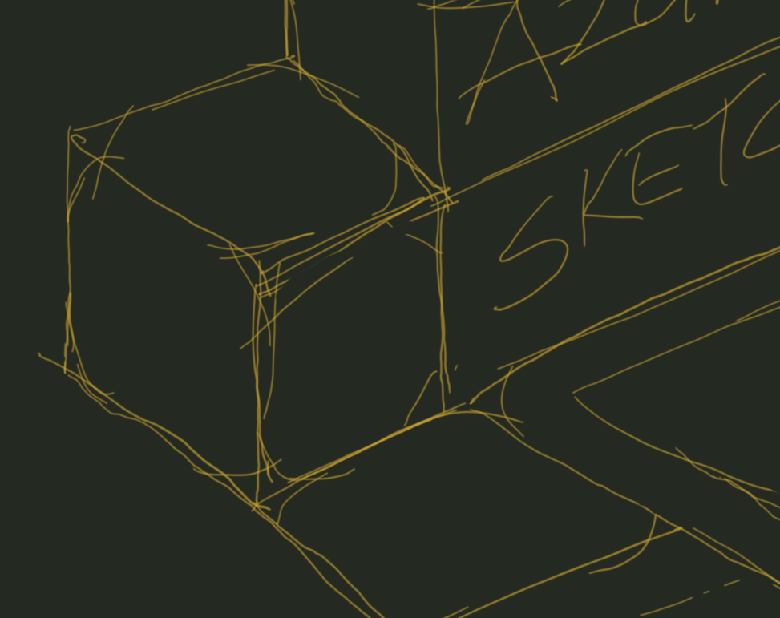


Azure Sketches
Episode 1, “ The 7 Principles.”
Cloud Architecture Series_

Slide 2


7 Principles:
Subscription & Resource Management.
Governance, Identity & Automation.
Network & Routing.
Security & Isolation.
High Availability & Disaster Recovery.
Threat & Performance Intelligence.
Protection & Recovery.
Cloud Architecture Series_

Slide 3


Subscription & Resource Management.
Keep to a minimum.
Design for organizational or operational efficiency.
Design using “gated cost estimates”
Understand subscription limits.
Billing, cost & governance boundary.
Cloud Architecture Series_

Slide 4

Governance, Compliance & Identity.
Governance defines “freedom through guardrails”.
Define governance & regulatory controls upfront.
Use existing & customized blueprints.
Use as a cost control mechanism.
Infrastructure as Code is mandatory.
Identity is the Primary security boundary, not the network.
Cloud Architecture Series_

Slide 5

Network & Routing.
Route by exception only.
Use PaaS services by default.
Never use subnets as separation between workloads.
Use hub/spoke & spoke/spoke peering.
Minimize NSGs (Network Security Groups).
Cloud Architecture Series_

Slide 6




Security & Isolation.
Isolate by exception-based routing.
Centralized egress/ingress to private/public.
Restrict public IPs using policies/blueprints.
Use Azure Virtual WAN and *Azure Security Hubs.
Carve Application vnet into smaller CIDR blocks.
Cloud Architecture Series_

Slide 7
HA & DR.
Workload requirement specific.
Understand the application’s profile for state.
Use PaaS services built-in capabilities.
Keep things simple & automated.
Cloud Architecture Series_

Slide 8
Threat & Performance Intelligence
Combining operational best practice with AI Intelligence.
Incorporate log collection from inception.
Use PaaS services built-in capabilities.
Focus on the results, not the infrastructure to collect it.
Cloud Architecture Series_

Slide 9
Protection & Recovery
Use built-in PaaS services protection capabilities.
Increase recovery points for stateful data.
Protection frequency as workload dictates.
Manage your costs for archival data.
Use hybrid storage technologies off-site data movement.
Cloud Architecture Series_

Slide 10
Lets design!
Cloud Architecture Series_

Slide 11
Share your experiences!
Cloud Architecture Series_

