Slide 1
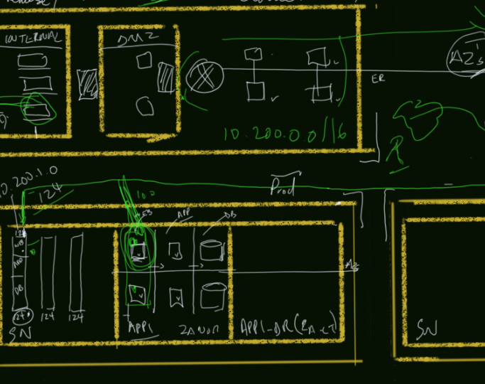

Azure Sketches
Episode 2, “Build & Secure a Global Network”
Cloud Architecture Series for Community

Slide 2
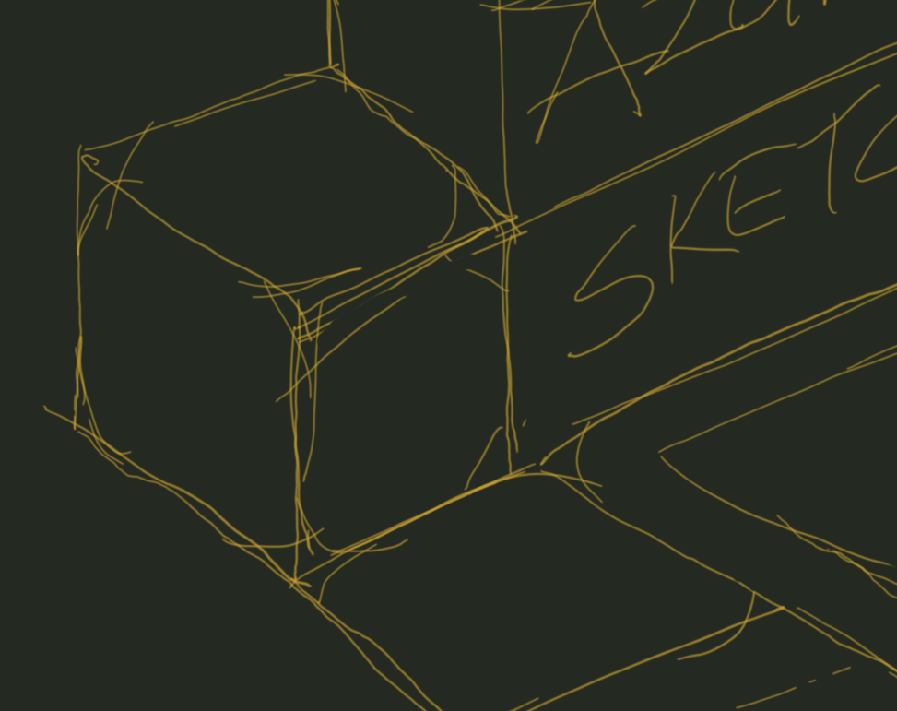


Scenario:
“Build a global, network for applications which is simple to manage and simple to lockdown, use PaaS services where possible”.
Cloud Architecture Series_

Slide 3


Our Building Blocks:
Azure Virtual WAN
Azure Firewall
Azure Secure Hubs
Azure Firewall Manager
Azure Front Door
Cloud Architecture Series_

Slide 4
Azure Virtual WAN
“A single dashboard and control plane for network, routing and security”
Cloud Architecture Series_

Slide 5
Azure Firewall
“A fully stateful firewall as a service built for high availability & scalability”
Cloud Architecture Series_

Slide 6
Azure Firewall Manager
“Simple Central configuration and management of rules for multiple azure firewall instances across Azure regions and subscriptions”
Cloud Architecture Series_

Slide 7
Azure Secure Hubs
“An Azure Virtual WAN hub associated with routing and security policies from the Azure Firewall Manager”
Cloud Architecture Series_

Slide 8
Azure Secure Hubs
“A layer 7 Web application firewall to protect applications against common web based attacks”
Cloud Architecture Series_

Slide 9




Lets design!
Cloud Architecture Series_

Slide 10
Any Questions!
Cloud Architecture Series_

