Slide 1
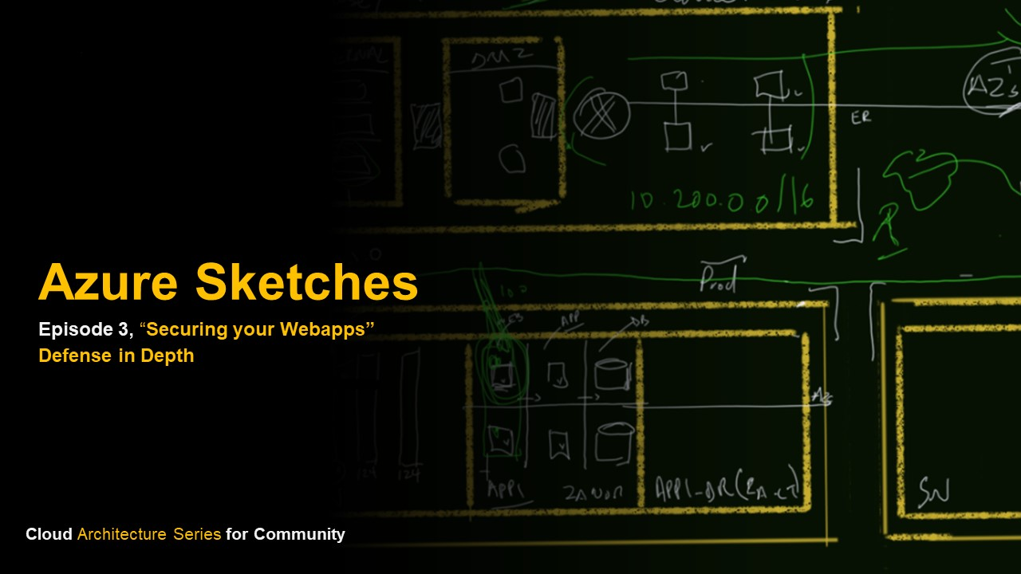
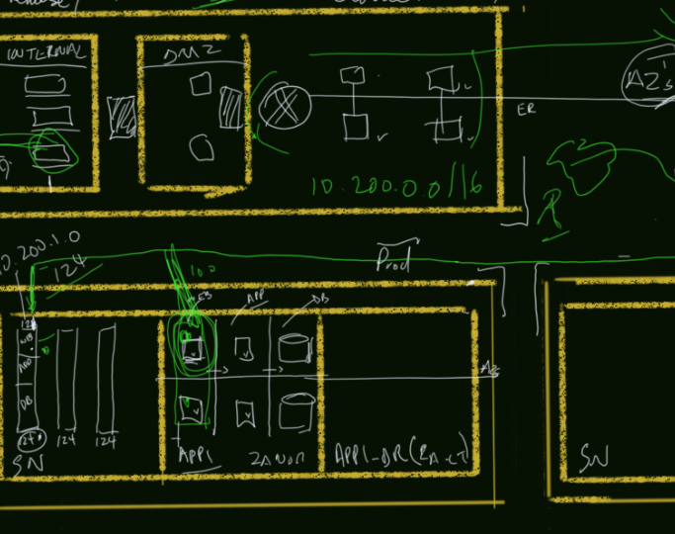
Azure Sketches
Episode 2, “Build & Secure a Global Network”
Cloud Architecture Series for Community

Slide 2
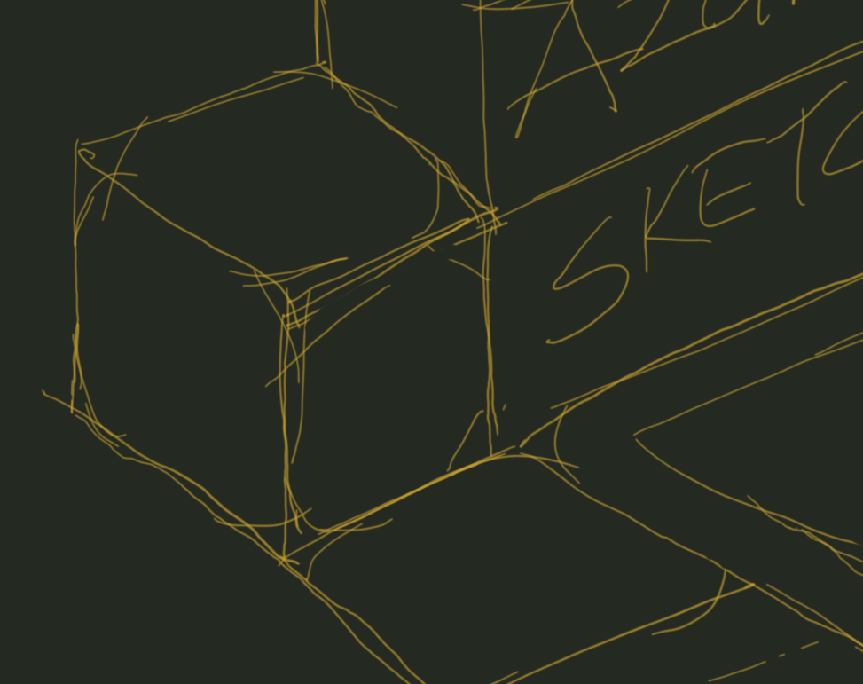
Scenario:
“Build and lockdown a cloud native application across the pipeline and lifecycle”.
Cloud Architecture Series_

Slide 3
Agenda:
"Securing the Platform" - Lawrance (15mins).
"Securing the Code" - Pivendren (15mins).
"Securing the Database" - Ronald (20mins).
Cloud Architecture Series_

Slide 4
The Platform
“All infrastructure components and services to host your application, both stateless and stateful.”
Cloud Architecture Series_

Slide 5
Cloud Native Web Platform:
"Securing the Platform" - Lawrance (15mins).
"Securing the Code" - Pivendren (15mins).
"Securing the Database" - Ronald (20mins).
Cloud Architecture Series_

Slide 6
Azure Firewall
“A fully stateful firewall as a service built for high availability & scalability”
Cloud Architecture Series_

Slide 7
Lets design!
Cloud Architecture Series_

Slide 8
Share your experiences!
Cloud Architecture Series_

Slide 9

Securing the Platform
- Lawrance Reddy
lawrance-reddy-29201126
Cloud Architecture Series_

Slide 10

Securing the Code
- Pivendren Naik
ErrorNaik
Cloud Architecture Series_

Slide 11
Securing the Database
- Ronald Mariah
ronaldmariah
Cloud Architecture Series_

