Slide 1
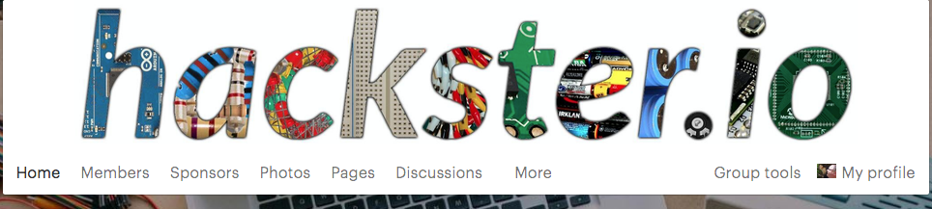
http://www.meetup.com/Hackster-DFW

Slide 2
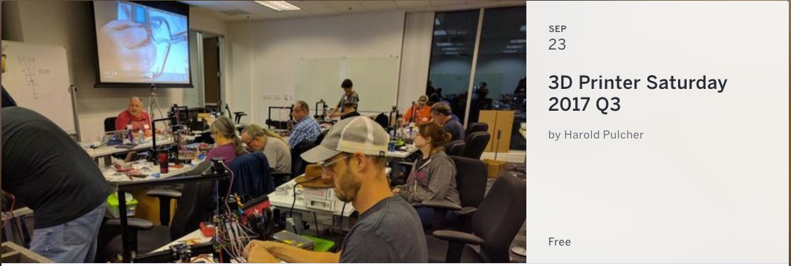
Starts: 9/23/2017 @ 9:00 AM
http://bit.ly/3DPrinterSaturday
http://www.youtube.com/c/HaroldPulcher/live

