Slide 1

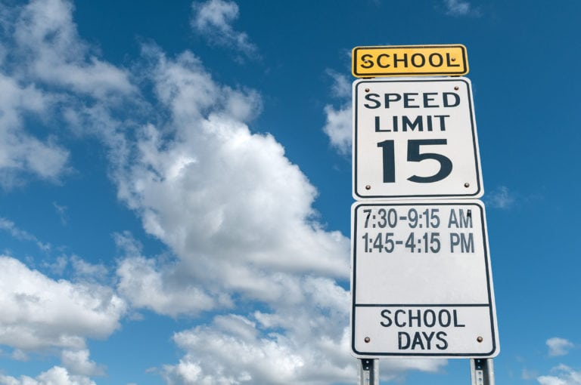
City of Hollywood Speed Zone Camera Enforcement Program Annual Reporting October 22, 2025

Slide 2
Speed Cameras in Hollywood
Timeline of the Speed Camera Program
Summer 2023 | State of Florida passed legislation allowing Speed Camera systems in School Zones
April 2024 | City Commission passed the ordinance to enact School Speed Zone program
May 2024 | City Commission approval of an agreement with Blue Line Solutions to implement a citywide School Speed Zone Program
Summer 2024 | Planning, permitting, and construction of locations Citywide
September 2024 | Locations on local roadways began operating by issuing Warning Notices and Notices of Violations (NOV)
January 2025 | First local City Magistrate Court hearing for NOVs
March 2025 | Began issuing UTCs for NOVs that have not been paid
September 2025 | The first School Zone locations on state and county roads began warning notices
October 2025 | There are currently 18 locations live and implementation continues for State and County roads
Notes:
This is an annual location report, which is also sent to FLHSMV, indicating statistics about each system operating in Hollywood during the reporting period.

Slide 3
Speed Cameras in Hollywood
School Name | Level | Dir | Enforcement Times | S | N | Active | Ser# | Lat | Long
Apollo MS | Middle | East | 9:01am-9:29am, 9:30am-4:00pm, 4:01pm-4:29pm | 15 | 30 | 8/12/2024 | FX1051 | 26.02078 | -80.226
Apollo MS | Middle | West | 9:01am-9:29am, 9:30am-4:00pm, 4:01pm-4:29pm | 15 | 30 | 8/12/2024 | FX1052 | 26.02072 | -80.2213
Attucks MS/Bethune ES | Middle/Elementary | South | 8:26-8:54am, 8:55am-3:25pm, 3:26pm-3:54pm | 15 | 30 | 8/12/2024 | FX1061 | 26.04241 | -80.1632
Beachside Montessori | K-8 | North | 8:46am-9:14am, 9:15am-3:45pm, 3:46pm-4:14pm | 15 | 30 | 4/16/2025 | FX1140 | 26.01634 | -80.1546
Beachside Montessori | K-8 | South | 8:46am-9:14am, 9:15am-3:45pm, 3:46pm-4:14pm | 15 | 30 | 4/16/2025 | FX1141 | 26.01733 | -80.1546
Ben Gamla Charter | Elementary | East | 7:31am-7:59am, 8:00am-2:00pm,2:01pm-2:29pm | 15 | 25 | 8/27/2024 | FX1085 | 26.01073 | -80.1614
Boulevard Heights | Elementary | North | 7:31am-7:59am, 8:00am-2:00pm,2:01pm-2:29pm | 15 | 30 | 5/27/2025 | FX1103 | 26.0171 | -80.232
Boulevard Heights | Elementary | South | 7:31am-7:59am, 8:00am-2:00pm,2:01pm-2:29pm | 15 | 30 | 5/27/2025 | FX1105 | 26.01815 | -80.2322
Chaminade - Madonna College Prep | High | North | 7:31am-7:59am, 8:00am-1:40pm, 8:00am-2:10pm, 8:00am-3:00pm, 1:41pm-2:09pm | 15 | 30 | 5/2/2025 | FX1109 | 26.01417 | -80.2322
Chaminade - Madonna College Prep | High | South | 7:31am-7:59am, 8:00am-1:40pm, 8:00am-3:00pm, 1:41am-2:09pm, 3:01pm-3:29pm | 15 | 30 | 5/2/2025 | FX1110 | 26.01642 | -80.195
Championship Academy | Elementary | East | 7:31am-7:59am, 8:00am-2:00pm,2:01pm-2:29pm | 15 | 30 | 8/12/2024 | FX1071 | 26.00058 | -80.1888
Championship Academy | Elementary | West | 7:31am-7:59am, 8:00am-2:00pm,2:01pm-2:29pm | 15 | 30 | 8/12/2024 | FX1081 | 26.00139 | -80.1893
Colbert ES | Elementary | North | 7:16am-7:44am, 7:45am-1:45pm, 1:46pm-2:14pm | 15 | 30 | 8/12/2024 | FX1062 | 26.00224 | -80.1569
Colbert ES | Elementary | South | 7:16am-7:44am, 7:45am-1:45pm, 1:46pm-2:14pm | 15 | 30 | 8/12/2024 | FX1067 | 26.00224 | -80.1569
Driftwood ES | Elementary | South | 7:31am-7:59am, 8:00am-2:00pm,2:01pm-2:29pm | 15 | 30 | 8/12/2024 | FX1131L | 26.03492 | -80.2267
Driftwood ES | Elementary | South | 7:31am-7:59am, 8:00am-2:00pm,2:01pm-2:29pm | 15 | 30 | 8/12/2024 | FX1131R | 26.03492 | -80.2267
Notes:
This is an annual location report, which is also sent to FLHSMV, indicating statistics about each system operating in Hollywood during the reporting period.

Slide 4
Speed Cameras in Hollywood
School Name | Level | Dir | Enforcement Times | S | N | Active | Ser# | Lat | Long
Driftwood MS | Middle | North | 9:01am-9:29am, 9:30am-4:00pm, 4:01pm-4:29pm | 15 | 30 | 5/5/2025 | FX1129 | 26.03342 | -80.2296
Driftwood MS | Middle | South | 9:01am-9:29am, 9:30am-4:00pm, 4:01pm-4:29pm | 15 | 30 | 5/5/2025 | FX1130 | 26.03593 | -80.2298
Hollywood Hills ES | Elementary | East | 7:31am-7:59am, 8:00am-2:00pm,2:01pm-2:29pm | 15 | 30 | 8/12/2024 | FX1112 | 26.02531 | -80.1816
Hollywood Hills ES | Elementary | West | 7:31am-7:59am, 8:00am-2:00pm,2:01pm-2:29pm | 15 | 30 | 8/12/2024 | FX1123 | 26.02564 | -80.1781
Hollywood Park ES | Elementary | East | 7:41am-8:09am, 8:10am-2:10pm,2:11pm-2:39pm | 15 | 30 | 1/7/2025 | FX1068 | 26.01708 | -80.2262
Hollywood Park ES | Elementary | West | 7:41am-8:09am, 8:10am-2:10pm,2:11pm-2:39pm | 15 | 30 | 1/7/2025 | FX1098 | 26.01722 | -80.2251
Little Flower Catholic School | PreK-8 | North | 7:50am-2:45pm | 15 | 30 | 5/29/2025 | FX1132 | 26.01561 | -80.1452
Little Flower Catholic School | PreK-8 | South | 7:50am-2:45pm | 15 | 30 | 5/29/2025 | FX1133 | 26.01685 | -80.1452
Nativity ES | Elementary | East | 7:21am-7:49am, 7:50am-2:50pm,2:51pm-3:19pm | 15 | 30 | 4/16/2025 | FX1134 | 26.01795 | -80.197
Nativity ES | Elementary | West | 7:21am-7:49am, 7:50am-2:50pm,2:51pm-3:19pm | 15 | 30 | 4/16/2025 | FX1135 | 26.01798 | -80.1959
Orange Brook ES | Elementary | East | 7:31am-7:59am, 8:00am-2:00pm,2:01pm-2:29pm | 15 | 30 | 8/12/2025 | FX1099 | 26.00292 | -80.1886
Orange Brook ES | Elementary | West | 7:31am-7:59am, 8:00am-2:00pm,2:01pm-2:29pm | 15 | 30 | 8/12/2025 | FX1124 | 26.00292 | -80.1881
Sheridan Hills ES | Elementary | East | 7:31am-7:59am, 8:00am-2:00pm,2:01pm-2:29pm | 15 | 30 | 2/6/2025 | FX1108 | 26.03058 | -80.1946
Sheridan Hills ES | Elementary | West | 7:31am-7:59am, 8:00am-2:00pm,2:01pm-2:29pm | 15 | 30 | 2/6/2025 | FX1122 | 26.03061 | -80.1936
Sunshine ES / Paragon Academy | Elementary | North | 7:31am-7:59am, 8:00am-3:00pm,3:01pm-3:29pm | 15 | 30 | 5/29/2025 | FX1125 | 26.01483 | -80.1634
Sunshine ES / Paragon Academy | Elementary | South | 7:31am-7:59am, 8:00am-3:00pm,3:01pm-3:29pm | 15 | 30 | 5/29/2025 | FX1127 | 26.01604 | -80.1634
West Hollywood ES | Elementary | North | 7:41am-8:09am, 8:10am-2:10pm,2:11pm-2:39pm | 15 | 30 | 2/6/2025 | FX1107 | 26.01097 | -80.2156
West Hollywood ES | Elementary | South | 7:41am-8:09am, 8:10am-2:10pm,2:11pm-2:39pm | 15 | 30 | 2/6/2025 | FX1111 | 26.01355 | -80.2158
Notes:
This is an annual location report, which is also sent to FLHSMV, indicating statistics about each system operating in Hollywood during the reporting period.

Slide 5
Annual Statistics
For the Period 7/1/2024 – 6/30/2025
Item | Amount
Total Notices of Violation (NOVs) issued | 28,030
Total NOVs Contested in city Magistrate Court | 85
Upheld | 82
Dismissed | 3
Scheduled | 45
NOV’s Paid | 16,520
NOV’s issued as Uniform Traffic Citations (UTCs) | 2,374
Notes:
NOVs issued during the time period listed are based on the date of the violation. NOVs contested and the results of the hearings are based on the magistrate hearing dates withing the reporting period. UTCs issued are based on the issuance date of the UTC.

Slide 6
Violation Fee Breakdown
Florida Statute defines maximum violation amount and required contributions
$100 citation
$20 to the State of Florida
$12 to School District
$5 to School Crossing Guard Program
$3 to the Florida Department of Law Enforcement
$60 to the City (minus vendor costs)

Slide 7
Fiscal Impact
For the Period 7/1/2024 – 6/30/2025
Item | Amount
Violations Paid | 16,520
Collected Funds | $1,738,518.60
Disbursed Funds
Dept of Revenue – General | $330,400.00
Dept of Revenue –FDLE | $49,560.00
Broward County School Board | $198,240.00
Vendor Services and Fees | $504,136.40
The remaining funds collected through this program are being expended on the operational costs of running the program as well as investments in modernizing Police technology Citywide.
Notes:
Net of $656,245.20
Covers cost of employees associated with program
Covers cost of school crossing guard contract

Slide 8
Remarkable Results in Hollywood
Statistical analysis of the Speed Camera program shows an:
89% | 36%
REDUCTION | REDUCTION
in vehicles speeding 10+ mph over the speed limit through our school zones. | in traffic accidents in school zones with speed cameras up and running in 2025
Notes:
This represents data aggregation comparing pre-installation speed studies, to 6 months into the program’s operation, at the first 14 schools with systems installed.

Slide 9
City of Hollywood Speed Zone Camera Enforcement Program Annual Reporting October 22, 2025

