Slide 1










Session de formation 2023

Slide 2

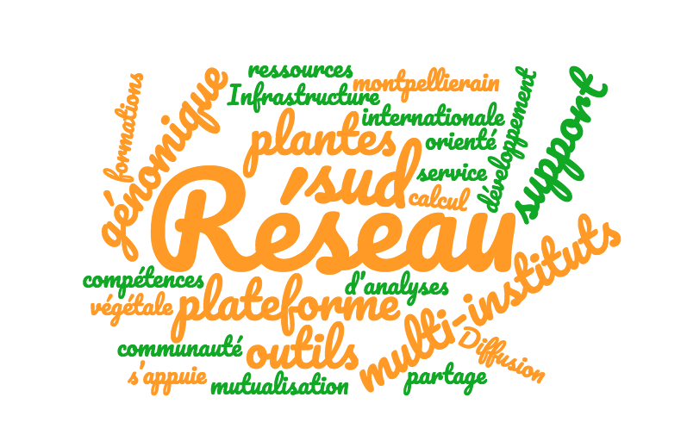
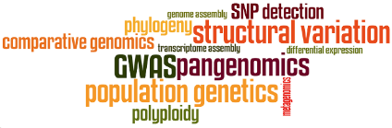

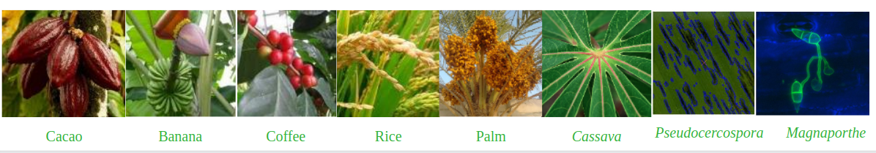
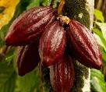
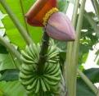
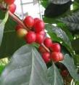
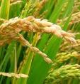
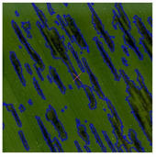
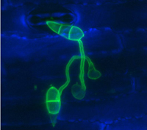
bioinformatics platform dedicated to the genetics and genomics of tropical and Mediterranean plants and their pathogens
Mutualisation
www.southgreen.fr
Cacao
Banana
Coffee
Rice
Palm
Cassava
Pseudocercospora
Magnaporthe

Slide 3








4 institutes
3 research units
25+
Storage and computing resources
Tools
Trainings
400+

Slide 4



Storage and computing resources
Meso@LR au CINES
1090 threads :
35 standard nodes
2 bigmem nodes
1 GPU node
500 To of replicated storage
CINES
1130 threads:
30 standard node
1 supermem node
1 GPU node
150 To on 3 NAS + 210 To scratch
400+
600+ tools
Resources mutualised at Meso@LR through the
Mudis4Ls project (purchase/storage/data)

Slide 5


Collaborative development of tools
Genomics
Pangenomic
Gene families
web applications (16)
Comparative
Phylogeny
Assemblies
visualisation (8)
Annotation
Data mining
+20 tools
Diversity exploration
genotype manipulation
workflows(5)
mosaic manipulation
Metagenomic
packages (4)
https://github.com/SouthGreenPlatform/

Slide 6


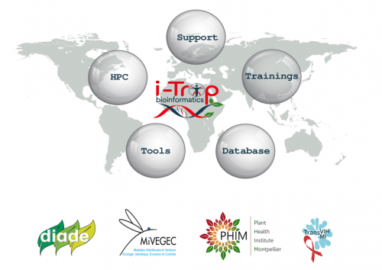





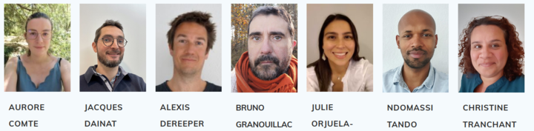

https://bioinfo.ird.fr/
bioinfo@ird.fr
@ItropBioinfo

Slide 7

Florian Charriat
Antoni Exbrayat
Guilhem Sempere
Bruno Granouillac
Jacques Dainat
Nicolas Fernandez
Thomas Denecker
And more collaborators !

Slide 8
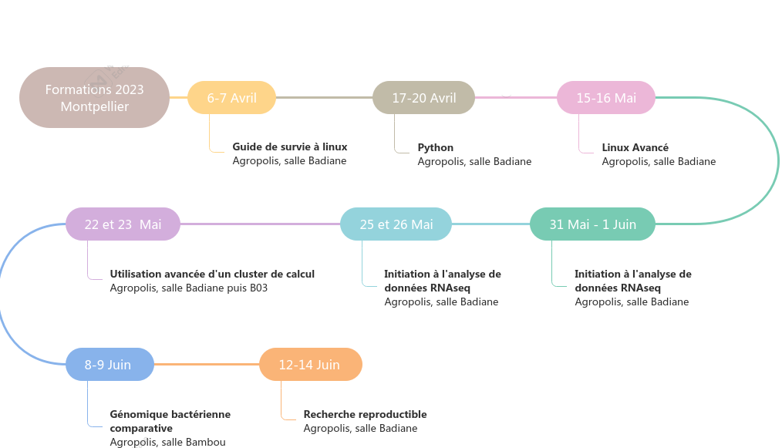

Notes:
date nanopore changé

