Slide 1



PACkages and environments management with
Marcel Martin
https://nbisweden.github.io/workshop-conda/
Jacques Dainat Ph.D.

Slide 2
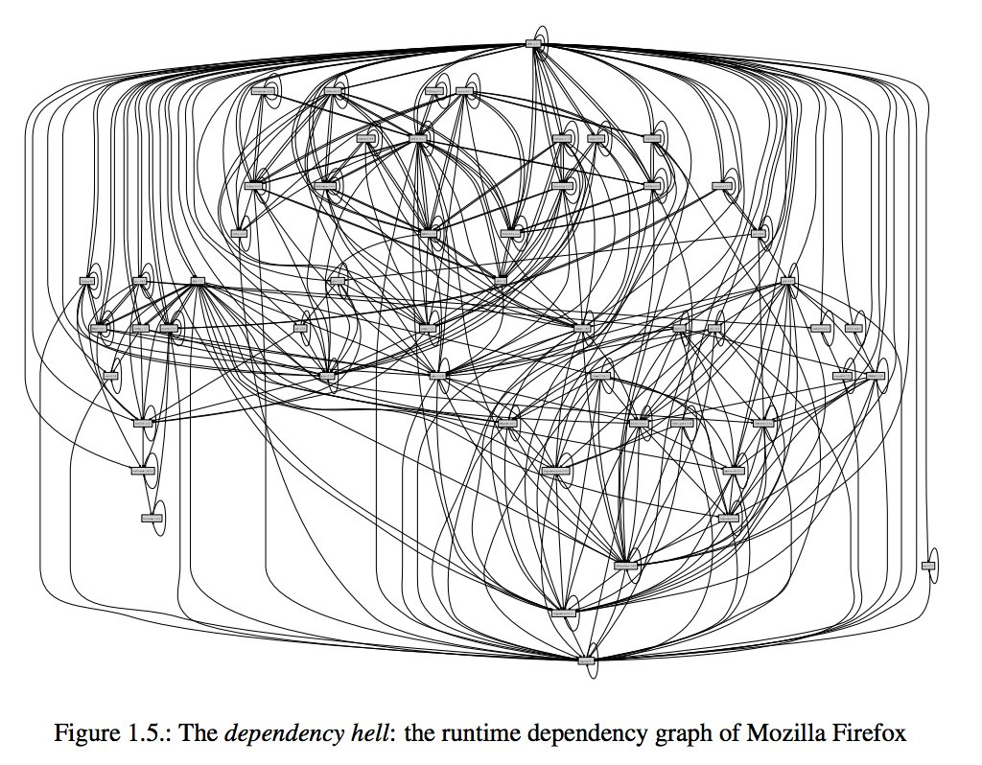
REPRODUCTIBILITY CRISIS
Dependencies hell (scripts, tools, DB, ref etc)
The purely functional software deployment model / Eelco Dolstra - [S.l.] : [s.n.], 2006 - Tekst. - Proefschrift Universiteit Utrecht
Notes:
Figure 1.5 shows the dependency graph of Mozilla Firefox, a popular web browser3. Each node is a component that must be present. This gives an intuition as to the magnitude of the problem.

Slide 3




Dependencies hell
Computer
(OS) update
new tool installation
depA_v2
depA_v3
ToolA
depA_v1
ToolB
libA_v1
libA_v2
libA_v1
depB_v1
depB_v1
depB_v2
libB_v1
NOW
Tools A and/or B may provide different results or stop to work
A new Tools C cannot be installed due to compilation requirements competing with another tool

Slide 4


Conda dependency manager
Each environment will have its own dependencies
depA_v1
depA_v1
depA_v2
depB_v1
depB_v1
depB_v1
Conda strength: - tool precompiled
- isolated environments with defined dep/software versions
Drawback: - conda environment can be heavy

Slide 5
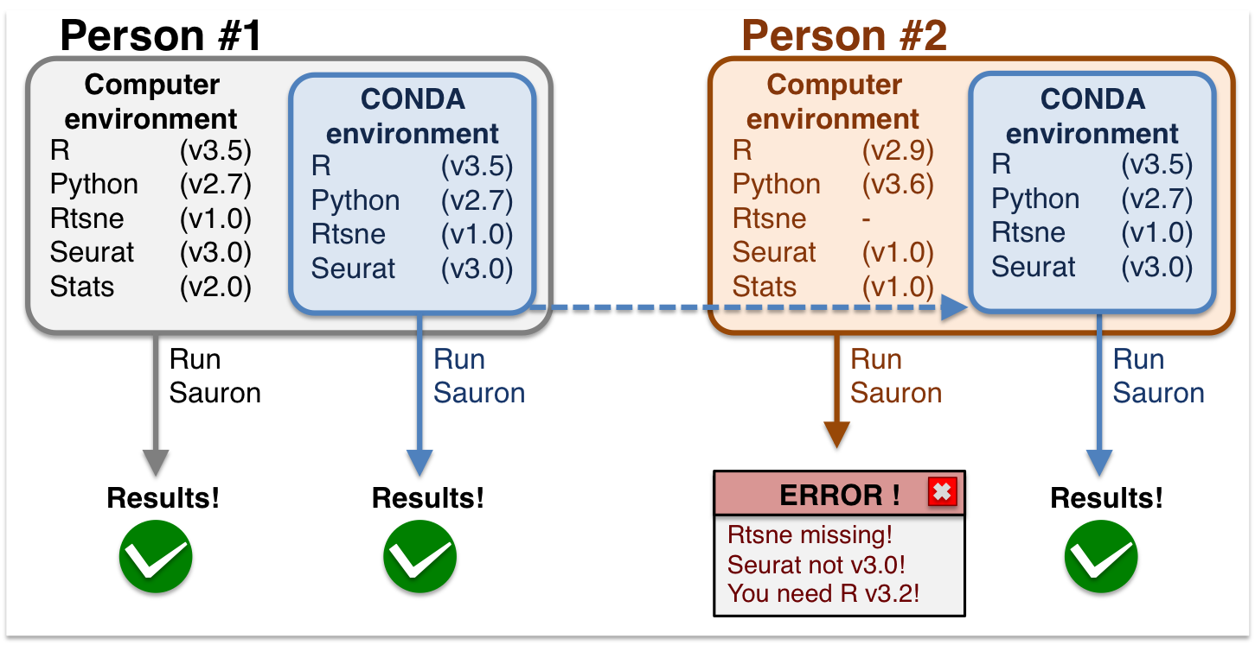
Conda dependency manager
https://nbisweden.github.io/excelerate-scRNAseq/conda_instructions.html

Slide 6
Conda: a package, dependency, and environment manager
Like apt, brew, pip, yum, etc., but with focus on data science
Supports Linux, macOS, Windows
Packages come pre-compiled
On Linux, they work on most distributions
Packages are hosted centrally at anaconda.org
Users can contribute their own packages via channels (think YouTube)
Most important for us :
The defaults channel (11 270 packages)
The conda-forge channel (21 455 packages)
The Bioconda channel ( 9894+ packages)
Both are community-driven
Notes:
https://repo.anaconda.com/pkgs/
Main 3026 ; free 832; r 7176; msys2 236
Main = anaconda

Slide 7
CONDA terms
Conda: The package manager
conda: The command-line program
Anaconda, Inc: The company (previously Continuum Analytics, Inc)
Anaconda: A distribution of many data-science packages managed by conda
miniconda: A much smaller distribution that only contains conda
Mamba: A faster, drop-in replacement for conda
Bioconda: A bioinformatics-focused channel for Conda packages
conda-forge: A community-driven channel for everything else
Notes:
Different channels can have the same package, so conda must handle these channel collisions
https://conda-forge.org/docs/_downloads/f55f7fa98f0dc3f3d3684e98163614e0/czi-eoss-5-loi-infra.pdf
https://conda.io/projects/conda/en/latest/user-guide/tasks/manage-channels.html
https://conda-forge.org/docs/user/introduction.html
https://repo.anaconda.com/pkgs/ => defaults channels = r 7176 +main (=anaconda) 3025 + free 832 + mro-archive 236 => 11000+

Slide 8
Using Conda on your laptop
Download Miniconda and install it:
Set up the Bioconda channel:
$ curl -sO https://repo.anaconda.com/miniconda/Miniconda3-latest-Linux-x86_64.sh
$ bash Miniconda3-latest-Linux-x86_64.sh
Welcome to Miniconda3 ...
[...]
conda config --add channels defaults
conda config --add channels bioconda
conda config --add channels conda-forge
conda config --set channel_priority strict

Slide 9
Conda limit
Conda is sometimes slow
Conda installs a package and all required dependencies, observing constraints on the version.
Example:
A workflow needs tools x and y.
x requires snakemake
Recent snakemake versions require python>=3.7
Tool y requires python<=3.6
→ The dependency resolver needs to find an older snakemake version still compatible with Python 3.6.
Solving which package versions satisfy all requirements is an NP-complete problem
For channels with many packages (conda-forge) and/or packages with many dependencies, dependency resolution can take hours.
Notes:
le problème est NP-complet, ce qui signifie que l'on ne connaît pas de méthode générale pour construire une solution optimale, à part l'examen systématique de toutes les solutions envisageables.

Slide 10

Mamba to the rescue
Mamba is a replacement for conda with a much faster dependency resolver
Same command-line interface as conda (in most cases)
Install it (from conda-forge):
conda install –n base mamba

Slide 11
Conda environments

Slide 12
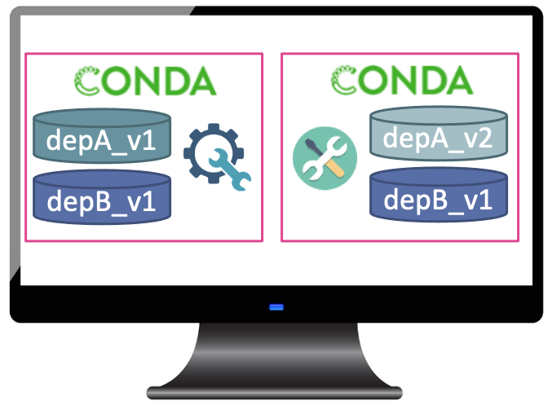
Conda environment basics
Anything installed by Conda is put into a Conda environment.
A single environment contains a consistent set of packages (compatible with each other)
Different environments are independent of each other
The default environment is called base
It contains Conda itself and its dependencies such as Python
The base environment is the only one that cannot easily be deleted and re-created, so keep it clean
Best to use it only for Conda-related tools (mamba, conda-build etc.)
For anything else, create a new environment

Slide 13
Working with environments
Example: Create an environment named mapping and install Samtools and Bowtie2 into it:
To use the software you must activate the environment:
To install a package into an existing environment:
To install into the currently active environment:
You can use =, >=, <= to constrain package versions
Find packages by searching anaconda.org or with conda search
conda create –n mapping samtools bowtie2
$ conda activate mapping
$ samtools --version
samtools 1.15.1
conda install -n mapping bwa=0.7.17
conda install bwa=0.7.17

Slide 14

Treat Conda environments as ephemeral
To test a new tool, install it into a fresh Conda environment. Then delete the environment to uninstall.
To find out when the bug you’re seeing in a tool was introduced, install older versions into a temporary environment.
If your project’s environment got messed up, just delete it and start over.
Environments are just directories within your Conda installation directory
~/miniconda/envs/mapping or similar
Activating an environment adds its bin/ directory to your $PATH
conda env remove -n mapping

Slide 15
Persisting and sharing environments
Environment files specify how to create an environment.
Example environment.yaml:
To create the environment, run:
The YAML file can be written manually or be generated from an existing environment:
--no-builds is recommended in the Bioconda FAQ
name: bwa
channels:
- conda-forge
- bioconda
- defaults
dependencies:
- bwa=0.7.17
mamba env create -f environment.yaml # Note: "env create", not "create"
conda env export --no-builds [--from-history] > environment.yaml
Notes:
The --no-builds argument completely removes the build number from the output, avoiding future errors when trying to rebuild the environment, and allowing the conda solver to identify the packages that can co-exist in the same environment.

Slide 16
Categories of environment files
Environment files can be abstract or concrete (or in between).
Abstract dependencies: List only pysam and Conda will pick a suitable version for it and its dependencies.
Good at development time and when you develop something that needs to be installable alongside other tools.
Not reproducible. If a dependency is updated, your tool or workflow may produce different results.
Concrete dependencies: List pysam=0.19.1 and all dependencies and their versions.
This is what conda env export creates.
Reproducible.
Very unflexible. Installing another tool into the environment likely leads to conflicts.
Probably platform-specific. You need one concrete environment.yaml for each platform you support.

Slide 17
Abstract or concrete?
For some projects, using both abstract and concrete makes sense:
The abstract dependencies define what your software depends on
The concrete dependencies (one file for each platform) are used for your tests (CI)
The concrete environments are generated from the abstract one.

Slide 18
More ways to create reproducible environment specifications
$ conda list --export
# This file may be used to create an environment using:
# $ conda create --name <env> --file <this file>
# platform: linux-64
...
bwidget=1.9.14=ha770c72_1
bzip2=1.0.8=h7f98852_4
...
$ conda list --explicit
...
@EXPLICIT
...
https://conda.anaconda.org/conda-forge/linux-64/bwidget-1.9.14-ha770c72_1.tar.bz2
https://conda.anaconda.org/conda-forge/noarch/bzip2-1.0.8-h7f98852_4.tar.bz2
...
--explicit includes channels!
Exactly reproduces environments (on one platform)
It is very fast because Conda no longer resolves dependencies
Recreating the environment can fail when files are removed from anaconda.org

Slide 19
A last word
Conda is designed to make your life as a bioinformatician easier!
Conda works well with workflow managers!

