Slide 1



Making reproducible workflows with
---
Jacques Dainat Ph.D.

Slide 2
Why Workflows Management System (WMS)?
To automate series of bioinformatic processing steps.
To standardize analysis for large projects or core facilities (repetitive task)
Optimise computation (parallelization, times, …)
Simplify deployment of complex pipelines
Improve reproducibility

Slide 3
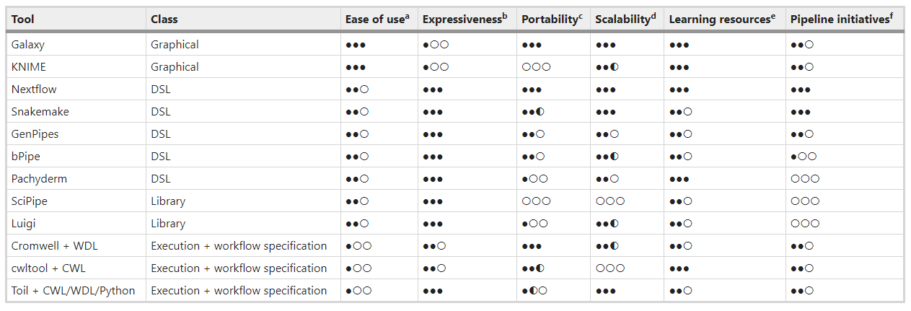
What Workflows Management System
There are over 150 workflow managers currently in use and under development
https://github.com/pditommaso/awesome-pipeline
https://github.com/common-workflow-language/common-workflow-language/wiki/Existing-Workflow-systems
Overview of workflow managers for bioinformatics
https://doi-org.insb.bib.cnrs.fr/10.1038/s41592-021-01254-9

Slide 4
Differences between Snakemake and Nextflow
 | Snakemake | Nextflow
Language | Python | Groovy
Data | Everything is a file | Can use both files and values
Execution | Working directory | Each job in its own directory
Philosophy | « Pull » | « Push »
Dry-runs | Yes | No
Track code changes | No | Yes
Question: But, which one is the best?
Answer: Both– it’s mostly up to personal preference

Slide 5
Nextflow features
Generalisable
Portable
Scalable
Platform-agnostic
Based on Groovy and Java
Large active community in e.g. nf-core

Slide 6
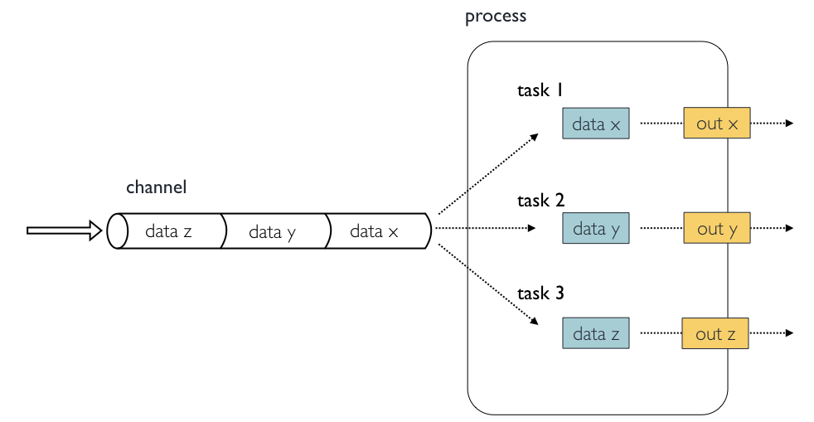
Concepts and nomenclature
Channels contain data, e.g. input files
Processes run some kind of code, e.g. a script or a command-line program
Tasks are instances of a process, one per process input

Slide 7
Anatomy of a process
process GET_SRA_BY_ACCESSION {
input:
val(sample)
output:
path("${sample}.fastq.gz")
script:
"""
fastq-dump ${sample} > ${sample}.fastq.gz
"""
}

Slide 8
Anatomy of a process
process GET_SRA_BY_ACCESSION {
input:
val(sample)
output:
tuple val(sample), path("${sample}.fastq.gz")
script:
"""
fastq-dump ${sample} > ${sample}.fastq.gz
"""
}

Slide 9
Anatomy of a process
process GET_SRA_BY_ACCESSION {
cpus 2
memory '8 GB'
input:
val(sample)
output:
tuple val(sample), path("${sample}.fastq.gz")
script:
"""
fastq-dump ${sample} > ${sample}.fastq.gz
"""
}

Slide 10
Anatomy of a process
process GET_SRA_BY_ACCESSION {
cpus 2
memory '8 GB’
conda 'sra-tools=2.11.0'
container 'ncbi/sra-tools:2.11.0'
input:
val(sample)
output:
tuple val(sample), path("${sample}.fastq.gz")
script:
"""
fastq-dump ${sample} > ${sample}.fastq.gz
"""
}

Slide 11
Anatomy of a process
process GET_SRA_BY_ACCESSION {
cpus 2
memory '8 GB’
conda 'sra-tools=2.11.0'
container 'ncbi/sra-tools:2.11.0'
input:
val(sample)
output:
tuple val(sample), path("${sample}.fastq.gz")
script:
"""
fastq-dump ${sample} –X {params.depth} > ${sample}.fastq.gz
"""
}

Slide 12
Anatomy of a workflow
workflow {
// Define SRA input data channel
ch_sra_ids = Channel.fromList ( ["SRR935090", "SRR935091"] )
// Define the workflow
GET_SRA_BY_ACCESSION ( ch_sra_ids )
}

Slide 13
Anatomy of a workflow
workflow {
// Define SRA input data channel
ch_sra_ids = Channel.fromList ( ["SRR935090", "SRR935091"] )
// Define the workflow
GET_SRA_BY_ACCESSION ( ch_sra_ids )
RUN_FASTQC ( GET_SRA_BY_ACCESSION.out )
}

Slide 14
Anatomy of a workflow
workflow {
// Define SRA input data channel
ch_sra_ids = Channel.fromList ( ["SRR935090", "SRR935091"] )
// Define the workflow
GET_SRA_BY_ACCESSION ( ch_sra_ids )
RUN_FASTQC ( GET_SRA_BY_ACCESSION.out )
RUN_MULTIQC ( RUN_FASTQC.out.collect() )
}

Slide 15
Executing Nextflow
# Execute a workflow
$ nextflow run main.nf
# Re-run using cached results
$ nextflow run main.nf -resume
# Executing with a specific configuration file
$ nextflow run main.nf –c nextflow.config
# Supply a custom parameter
$ nextflow run main.nf –-my_param "my value"
# Use Docker or Singularity
$ nextflow run main.nf –with-docker
$ nextflow run main.nf –with-singularity
# Use a pre-defined configuration profile
$ nextflow run main.nf –profile my_cluster_profile

Slide 16

Start of 2018 / NGI Stockholm
A community effort to collect a curated set of analysis pipelines built using Nextflow.

Slide 17
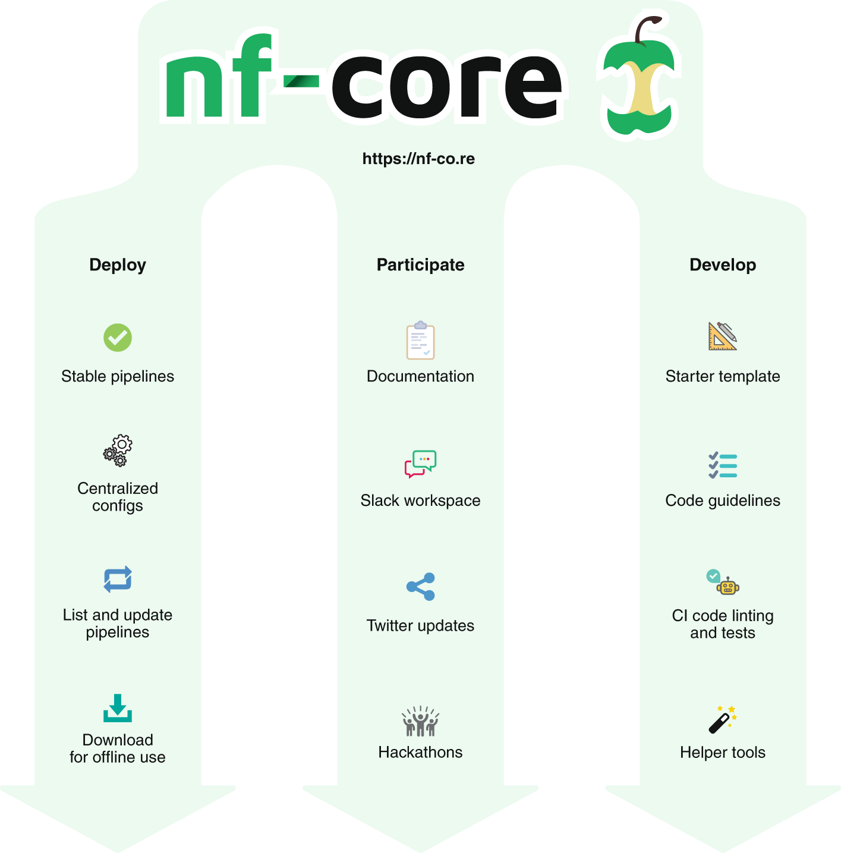

Slide 18
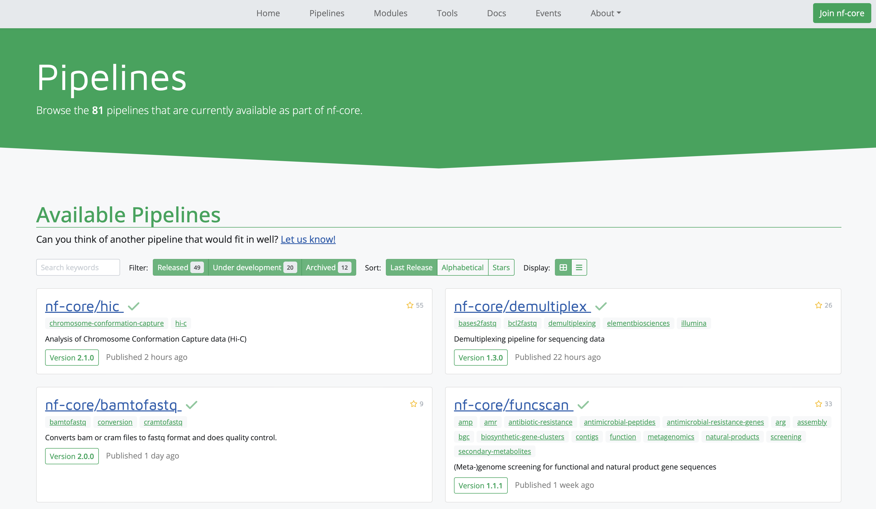

Slide 19
