Slide 1





Making reproducible workflows with
---
Jacques Dainat Ph.D.

Slide 2
Differences between Snakemake and Nextflow
 | Snakemake | Nextflow
Language | Python | Groovy
Data | Everything is a file | Can use both files and values
Execution | Working directory | Each job in its own directory
Philosophy | « Pull » | « Push »
Dry-runs | Yes | No
Track code changes | No | Yes
Question: But, which one is the best?
Answer: Both– it’s mostly up to personal preference

Slide 3
Nextflow features
Generalisable
Portable
Scalable
Platform-agnostic
Based on Groovy and Java
Large active community in e.g. nf-core

Slide 4
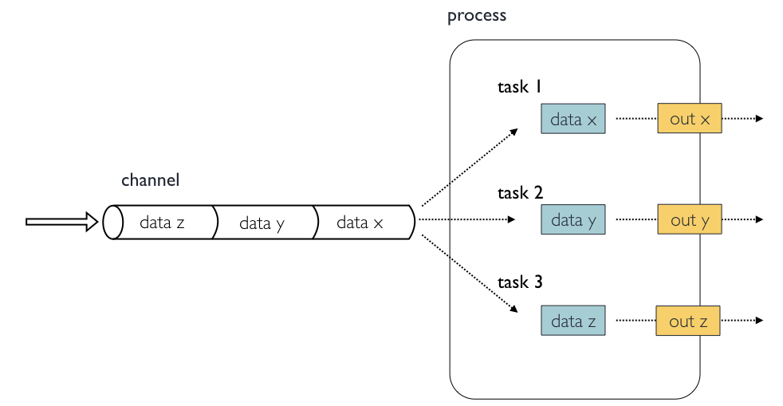
Concepts and nomenclature
Channels contain data, e.g. input files
Processes run some kind of code, e.g. a script or a command-line program
Tasks are instances of a process, one per process input

Slide 5
Anatomy of a process
process GET_SRA_BY_ACCESSION {
input:
val(sample)
output:
path("${sample}.fastq.gz")
script:
"""
fastq-dump ${sample} > ${sample}.fastq.gz
"""
}

Slide 6
Anatomy of a process
process GET_SRA_BY_ACCESSION {
input:
val(sample)
output:
tuple val(sample), path("${sample}.fastq.gz")
script:
"""
fastq-dump ${sample} > ${sample}.fastq.gz
"""
}

Slide 7
Anatomy of a process
process GET_SRA_BY_ACCESSION {
cpus 2
memory '8 GB'
input:
val(sample)
output:
tuple val(sample), path("${sample}.fastq.gz")
script:
"""
fastq-dump ${sample} > ${sample}.fastq.gz
"""
}

Slide 8
Anatomy of a process
process GET_SRA_BY_ACCESSION {
cpus 2
memory '8 GB’
conda 'sra-tools=2.11.0'
container 'ncbi/sra-tools:2.11.0'
input:
val(sample)
output:
tuple val(sample), path("${sample}.fastq.gz")
script:
"""
fastq-dump ${sample} > ${sample}.fastq.gz
"""
}

Slide 9
Anatomy of a process
process GET_SRA_BY_ACCESSION {
cpus 2
memory '8 GB’
conda 'sra-tools=2.11.0'
container 'ncbi/sra-tools:2.11.0'
input:
val(sample)
output:
tuple val(sample), path("${sample}.fastq.gz")
script:
"""
fastq-dump ${sample} –X {params.depth} > ${sample}.fastq.gz
"""
}

Slide 10
Anatomy of a workflow
workflow {
// Define SRA input data channel
ch_sra_ids = Channel.fromList ( ["SRR935090", "SRR935091"] )
// Define the workflow
GET_SRA_BY_ACCESSION ( ch_sra_ids )
}

Slide 11
Anatomy of a workflow
workflow {
// Define SRA input data channel
ch_sra_ids = Channel.fromList ( ["SRR935090", "SRR935091"] )
// Define the workflow
GET_SRA_BY_ACCESSION ( ch_sra_ids )
RUN_FASTQC ( GET_SRA_BY_ACCESSION.out )
}

Slide 12
Anatomy of a workflow
workflow {
// Define SRA input data channel
ch_sra_ids = Channel.fromList ( ["SRR935090", "SRR935091"] )
// Define the workflow
GET_SRA_BY_ACCESSION ( ch_sra_ids )
RUN_FASTQC ( GET_SRA_BY_ACCESSION.out )
RUN_MULTIQC ( RUN_FASTQC.out.collect() )
}

Slide 13
Executing Nextflow
# Execute a workflow
$ nextflow run main.nf
# Re-run using cached results
$ nextflow run main.nf -resume
# Executing with a specific configuration file
$ nextflow run main.nf –c nextflow.config
# Supply a custom parameter
$ nextflow run main.nf –-my_param "my value"
# Use Docker or Singularity
$ nextflow run main.nf –with-docker
$ nextflow run main.nf –with-singularity
# Use a pre-defined configuration profile
$ nextflow run main.nf –profile my_cluster_profile

Slide 14

Start of 2018 / NGI Stockholm
A community effort to collect a curated set of analysis pipelines built using Nextflow.

Slide 15
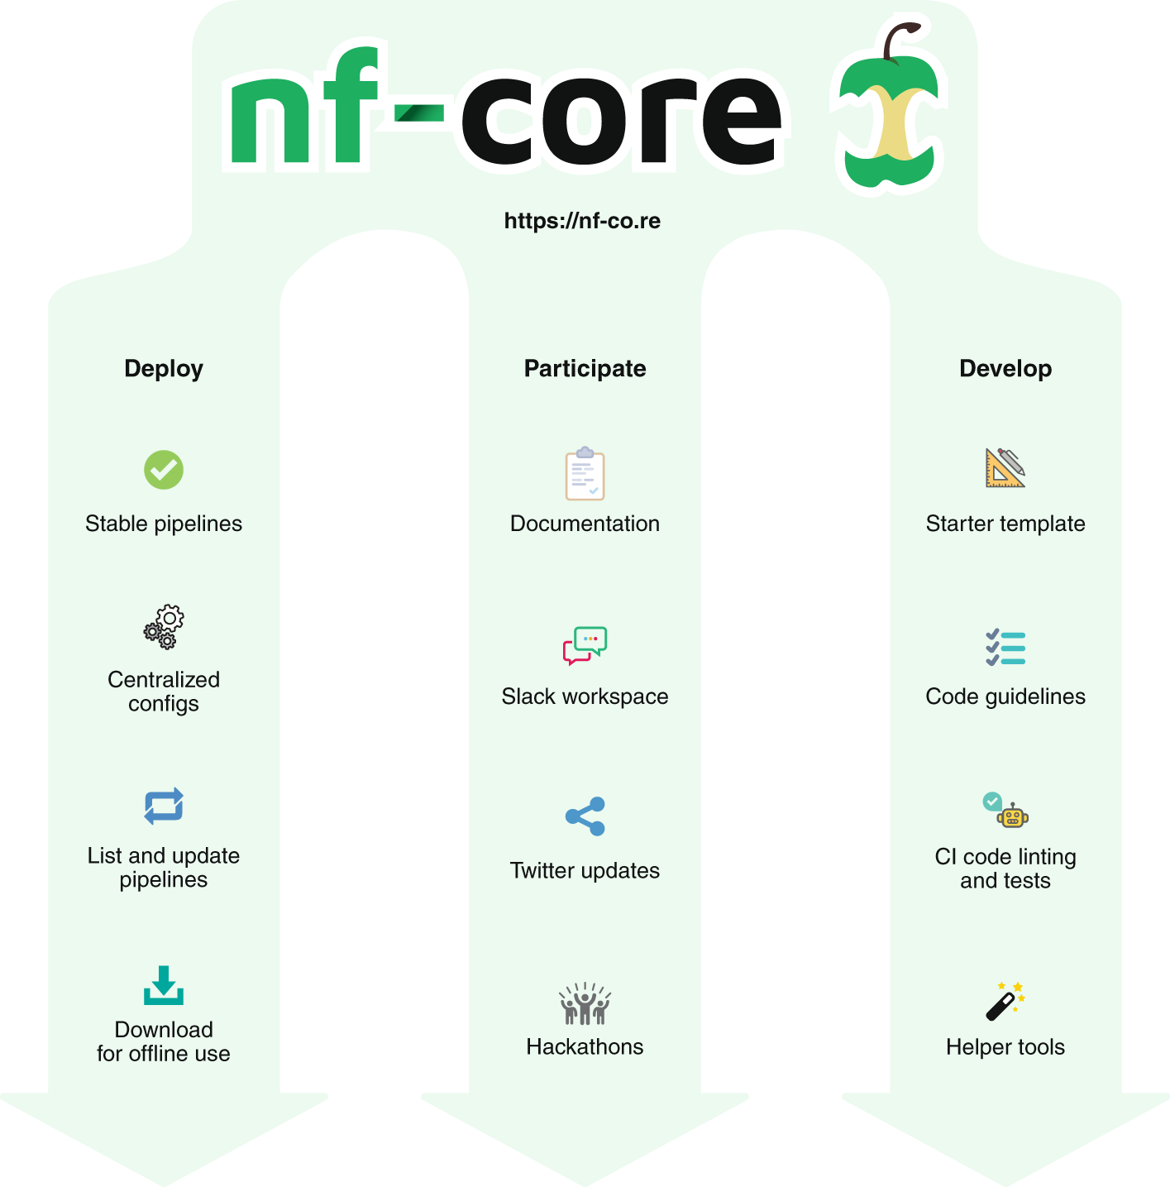

Slide 16
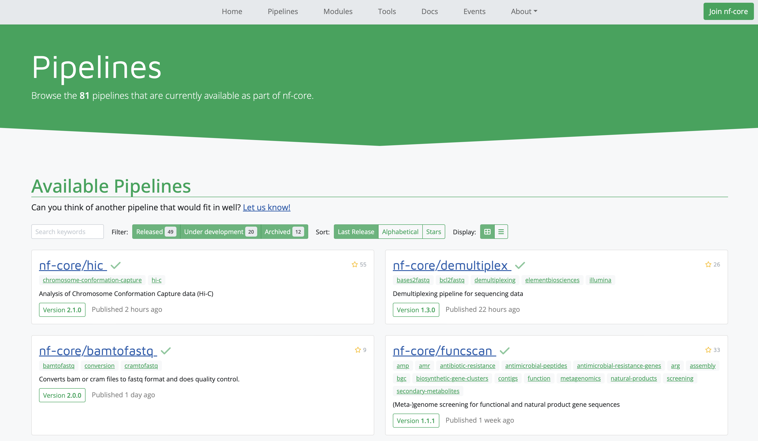

Slide 17
