Slide 1




Managing you data
Jacques Dainat Ph.D.

Slide 2
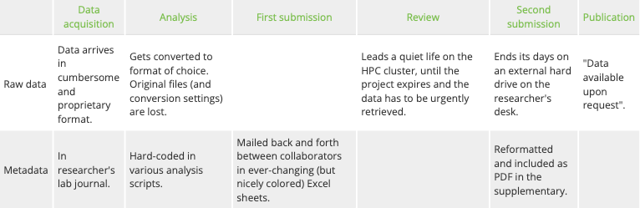
Data (mis)management in practice

Slide 3
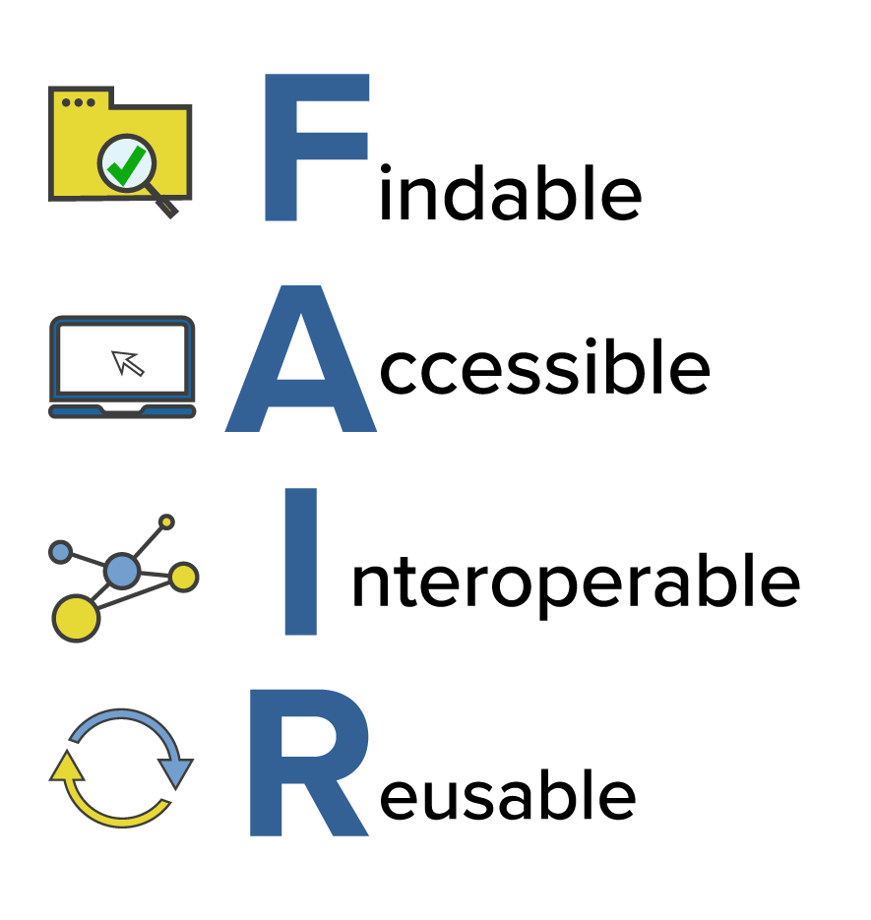
FAIR data
Strive to make your data FAIR (for both machines and humans):
Wilkinson, Mark et al. “The FAIR Guiding Principles for scientific data management and stewardship”. Scientific Data (2016)

Slide 4
Data management plan
Check requirements of funding agency and field of research.
Determine required storage space for short and long term.
Provide helpful metadata.
Consider legal/ethical restrictions if working with sensitive data.
Find suitable data repositories.
Strive towards uploading data to its final destination already at the beginning of a project.
ANR Data management plan requirements
https://anr.fr/fileadmin/documents/2019/ANR__Modele_de_DMP_francais_DMPOPIDoR_2019_07_24_mis_en_page_2.pdf

Slide 5
Data sharing
Why Open Access?
Publicly funded research should be unrestricted.
Published results should be verifiable by others.
Enables other to build upon previous work.

Slide 6
Organizing your projects

Slide 7
Organizing your projects
Which sample file represents the latest version?
$ ls -l data/ -rw-r--r-- user staff samples.mat -rw-r--r-- user staff samplesFinal.mat -rw-r--r-- user staff samplesFinalV2.mat -rw-r--r-- user staff samplesUSE_THIS_ONE.mat
-rw-r--r-- user staff samplesV2.mat

Slide 8
Organizing your projects
The project directory
The first step towards working reproducibly: Get organized!
Divide your work into distinct projects.
Keep all files needed to go from raw data to final results in a dedicated directory.
Use relevant subdirectories.

Slide 9
Organizing your projects
There are many ways to organize a project
One example here: https://github.com/NBISweden/project_template
code/ code needed to go from input files to final results data/ raw and primary data (never edit!) doc/ documentation of the study intermediate/ output files from intermediate analysis steps
logs/ logs from the different analysis steps notebooks/ notebooks that document your day-to-day work results/ output from workflows and analyses scratch/ temporary files that can ve safely deleted or lost config.yml configuration of the project workflow Dockerfile recipe to create a project container environment.yml project dependencies list used to create software environment README.md project description and instructions Snakefile workflow file used by snakemake

Slide 10
There are many ways to organize a project
Another example: https://github.com/snakemake-workflows/snakemake-workflow-template
config/
workflow/
Snakefile
LICENSE
README.md

Slide 11
Organizing your projects
Helpful tools
syntax highlighting, autocomplete, git integration etc
Atom
RStudio
PyCharm
VSCode

Slide 12
Questions?

