Slide 1
Version Control with Git
Research Software Group
http://rsg.southampton.ac.uk
1
Notes:
Take a brief look at
what version control is,
when you might find it useful

Slide 2
What is Version Control?
AKA revision control, source control
Tracks changes to files
Any file can be tracked
Text (source code etc.) works best
            diff / merge etc.
2
Notes:
Version control - aka source / rev.control - tracks changes to files
At simplest - a better way to back up your files – you never throw anything away.
But also, Helps avoid this situation ->

Slide 3

Why Use Version Control? #1
A more efficient backup
Reproducibility
3
Notes:
We’ve all been in this situation before! It's crazy to have lots of similar versions of the same document.
Some apps deal with this a little better - MS Word Track Changes. BUT research isn’t just Word docs.
With VC, you can label each significant change that you make and store this history with the file
at any point in the future, you can retrieve the right versions of your documents, scripts or code.
So 1yr after publishing a paper, you can instantly find the exact combination of scripts and data that you used to assemble it.
VC makes reproducibility simpler.

Slide 4

Why Use Version Control? #2
Teamwork
4
Notes:
Recognise these guys?
As well as keeping a rev history, VC tools help multiple authors work together on same file.
Every large software project uses VC
Keeps track of who changed what, and when. And who to blame when things to go wrong.

Slide 5
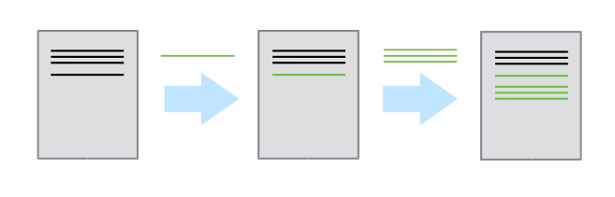
Version Control Tracks Changes
          Changes are tracked sequentially
5
Notes:
Let's take a high level view of how VC systems work.
As mentioned, they track CHANGES to files
Like a tape that you can rewind, and play back changes to get back to get to most recent version

Slide 6
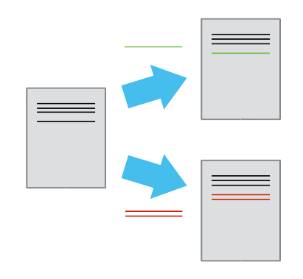
Version Control Tracks Changes
          Different versions can be saved
6
Notes:
Once you think of changes as separate from the document itself, you can then think about “playing back” different sets of changes onto the base document and getting different versions of the document.
For example, two users can make independent sets of changes based on the same document.

Slide 7
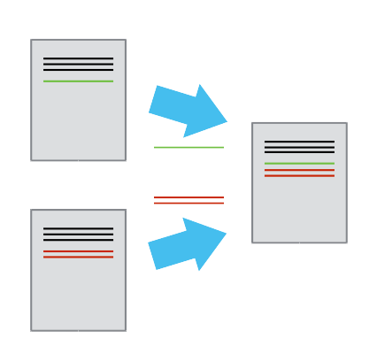
Version Control Tracks Changes
          Multiple versions can be merged
7
Notes:
If there aren't conflicts, you can even try to play two sets of changes onto the same base document.
A process call **merging**.

Slide 8
Version Control Alternatives
Subversion (svn) - Centralised
Mercurial (hg) - Distributed
Git (git) – Distributed
N.B. GitHub != git
8
Notes:
Let's have a brief look at the most popular VC systems
If you're a greybeard like me you might have a soft spot for Subversion.
svn been around since about 2000. Dev to replace CVS. Allowed mv /ren with provenance.
hg and git arose from the need to find a new VC for the Linux Kernel, after BitKeeper → Non free
Svn has sinlge central master repository hg and git are dist VCSs. Eash devs codebase is a complete repo. Can use offline, no 1 point of fail.
Git written by Linus. Made pop in part by github, repo hosting + project man tools. Git != github

Slide 9

Monsters...
9

Slide 10
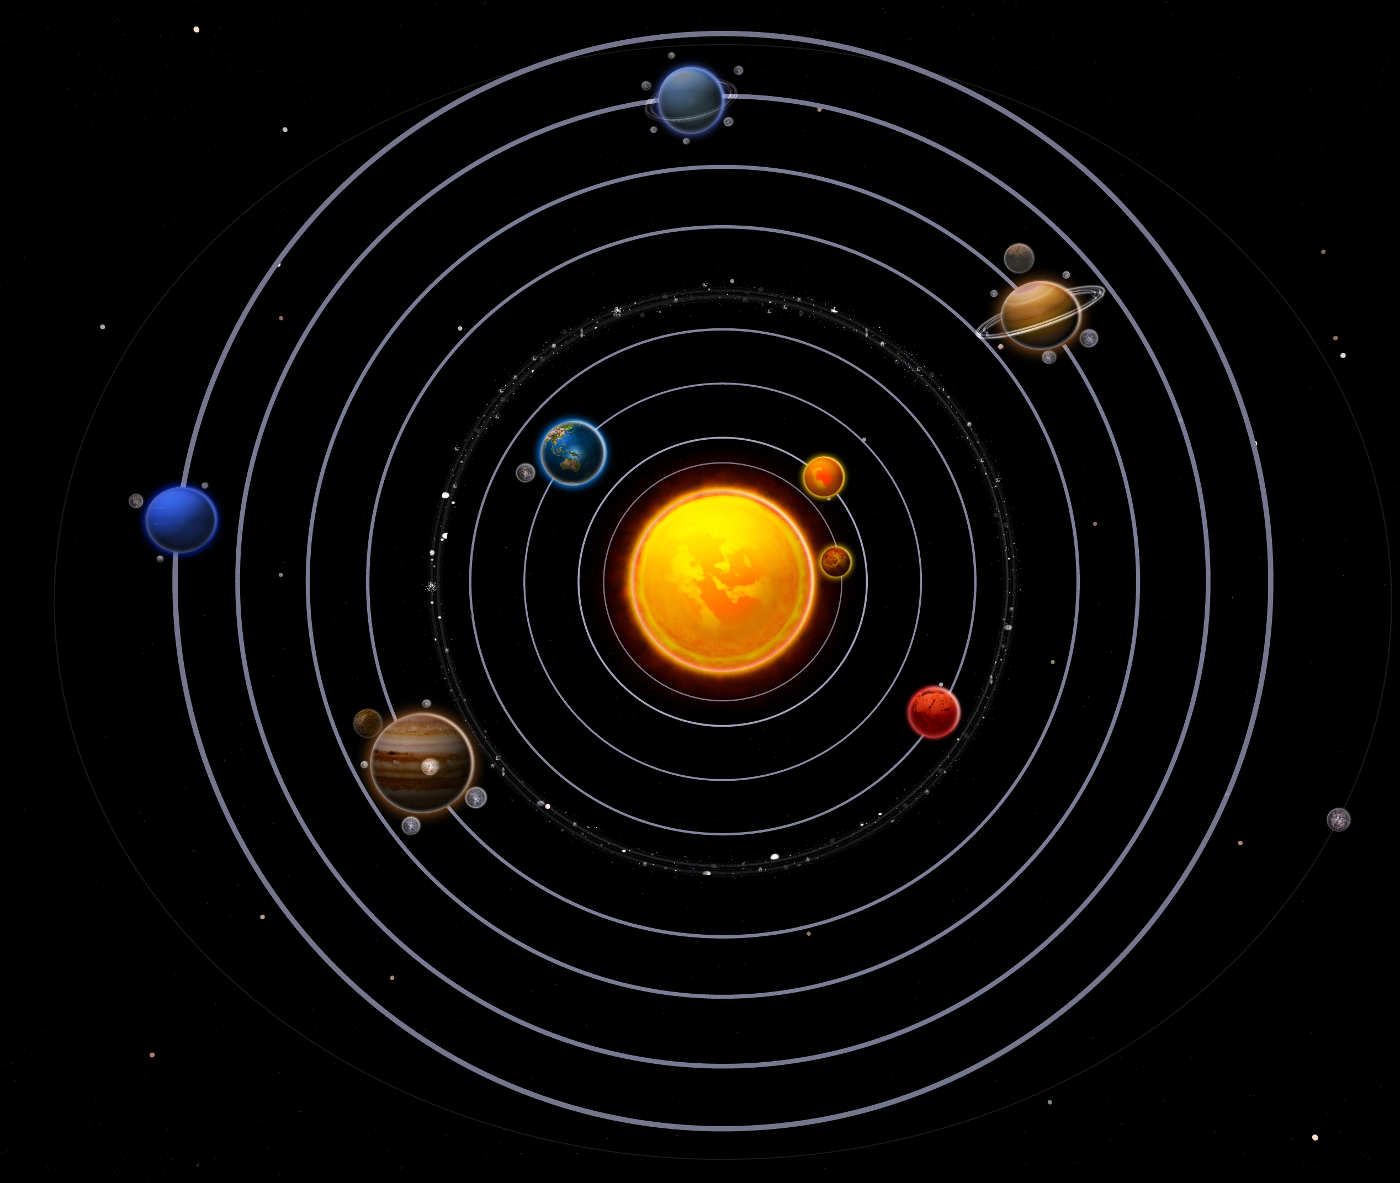
...in space
(?!)
10

Slide 11
Local Configuration
git config
11

Slide 12
Creating a Repository
git init
git status
12

Slide 13
Tracking Changes to Files
git add
git commit
13

Slide 14
Git – add and commit
Workspace
Staging
Area
Local Repo
add
commit
Visible File System
Git Repository
17

Slide 15
Exploring History #1
git log
git diff
15

Slide 16
Git – diff #1
Workspace
Staging
Area
Local Repo
diff
diff --staged
Visible File System
Git Repository
17

Slide 17
Git – diff #2
Workspace
Staging
Area
Local Repo
diff sl33v51a
sl33v51a
f22b25e
g31a45d
HEAD ~2
HEAD ~1
diff HEAD
HEAD
Visible File System
Git Repository
17

Slide 18
Restoring Files
git checkout
15

Slide 19
Git - restoration
Workspace
Staging
Area
Local Repo
f22b25e
sl33v51a
checkout f22b25e
f22b25e
g31a45d
HEAD ~2
g31a45d
checkout HEAD
HEAD ~1
HEAD
Visible File System
Git Repository
17

Slide 20
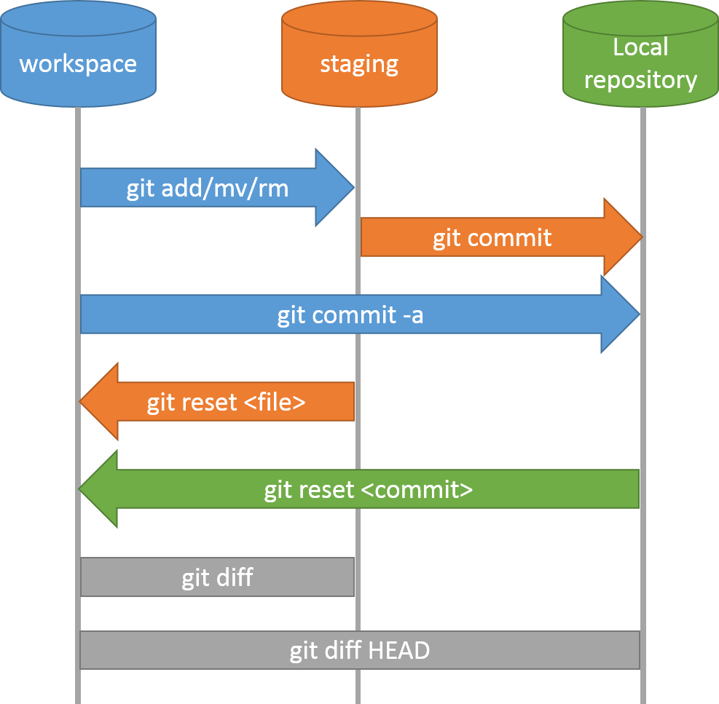
Git Workflow – Local Repo.
17

Slide 21
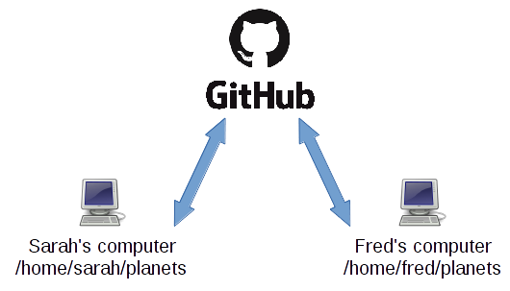
Collaboration
A
B
17

Slide 22
Collaboration
Let's collaborate via remote repo
Working in pairs:
Developer A / Developer B
18

Slide 23
Collaboration:
Remote Repositories #1
Developer A
  Sign in https://github.com/
  Create repository
  git remote add
  git push
  Add Developer B as a collaborator

Slide 24
Collaboration:
Remote Repositories #2
Developer B
  Clean up
  git clone
  git add
  git commit
  git push

Slide 25
Collaboration:
Conflicts
Cold and dry, but everything is my favourite colour
The two moons may be a problem for Wolfman
But the Mummy will appreciate the lack of humidity
Cold and dry, but every
The two moons may be a
But the Mummy will appr
Developer A added this
Cold and dry, but every
The two moons may be a
But the Mummy will appr
This was added by Dev B
?

Slide 26
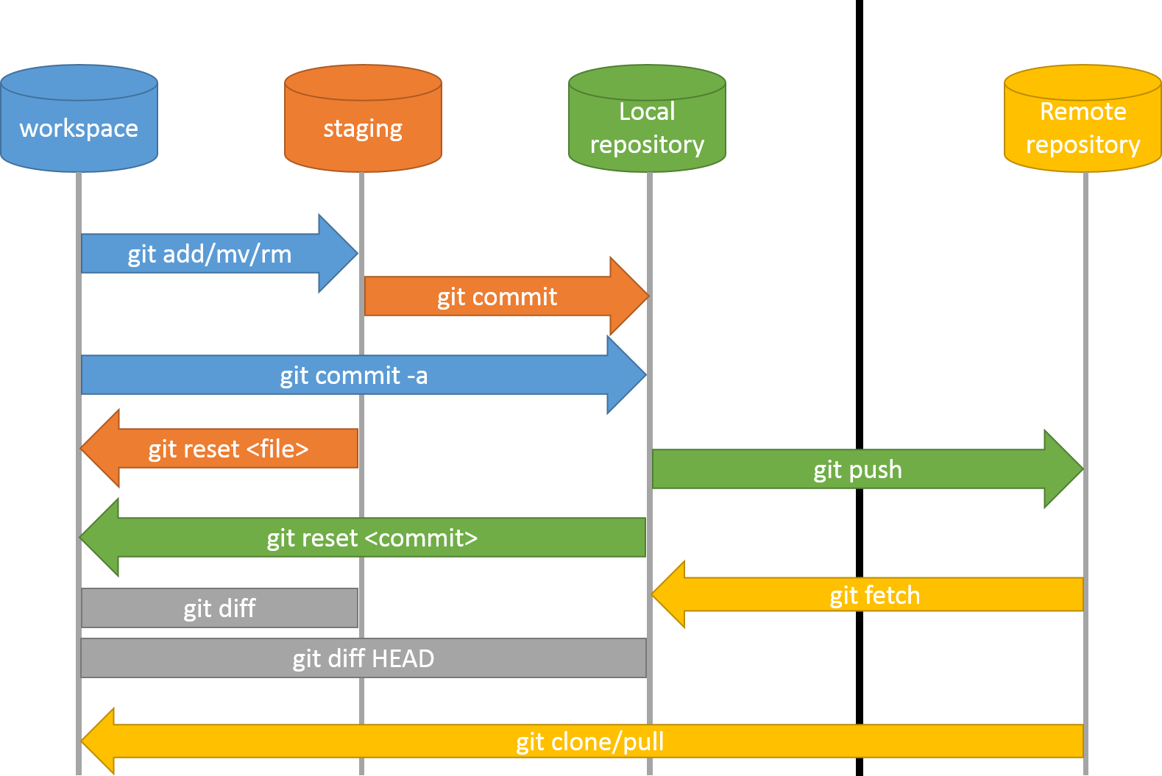
Git Workflow – Remote Repo.
21

Slide 27
What next?
Merging conflicts
Branching
https://software-carpentry.org
22

